Slide 1




BUSINESS INTELLIGENCE & DATA ANALYTICS REPORT
Customer Data Analysis Project
Using SQL & Power BI
Analyzed 1,000 customer retail transactions using SQL and Power BI to build interactive dashboards, uncover actionable business insights, and deliver strategic recommendations.
Database
SQL
Power BI
PREPARED BY
Baliji Mohan
Data Analyst
July 2026

Slide 2




SECTION 01
Executive Summary
This project analyzes 1,000 customer retail transactions across ten shopping malls using SQL and Power BI. The analysis identifies customer demographics, purchasing behavior, payment preferences, product performance, and shopping mall trends, transforming raw data into actionable business insights.
1,000
Total Customers
Customers aged 50+ contribute the highest share of transactions and revenue
2.37M
Female customers account for 62% of all transactions and generate the highest overall revenue.
Total Revenue
Clothing leads every category in both quantity and revenue
~3,000
Cash is the most preferred payment method, representing 42% of all transactions.
Units Sold
Mall of Istanbul consistently ranks as the highest-performing shopping mall across key business metrics.
8
Product Categories
CUSTOMER DATA ANALYSIS | SQL & POWER BI
02 / 15

Slide 3


SECTION 02
Project Overview
This project transformed raw customer retail transaction data into actionable business intelligence through three stages: database preparation, SQL analysis, and interactive Power BI dashboard development.
01
02
03
Database Preparation
SQL Analysis
Power BI Delivery
Imported, structured, and validated customer transaction data within a relational database for analysis.
Performed data cleaning, validation, and SQL analysis to answer 11 key business questions and generate actionable insights.
Built two interactive Power BI dashboards using Power Query and DAX to visualize business performance and customer insights.
Executive Overview Dashboard
Business Insights Dashboard
High-level performance summary for senior stakeholders
Deep-dive exploration for analysts and category managers
CUSTOMER DATA ANALYSIS | SQL & POWER BI
03 / 15

Slide 4





SECTION 03
Business Objectives
The analysis was designed around seven key business objectives, each addressing an important business decision.
Gender Analysis
Age Segmentation
Category Targeting
Payment Strategy
Analyze customer transactions, quantity sold, and revenue contribution by gender.
Identify the highest-value customer age groups for targeted marketing and business growth.
Identify high-performing product categories across customer segments to improve promotions and inventory planning.
Analyze customer payment preferences to optimize payment options and improve the checkout experience.
Location Analysis
Core KPI Tracking
Self-Service Delivery
Analyze customer transactions, revenue, and sales performance across shopping mall locations.
Monitor key performance indicators including revenue, average order value, quantity sold, and unit price.
Interactive dashboards for non-technical stakeholders
CUSTOMER DATA ANALYSIS | SQL & POWER BI
04 / 15

Slide 5
SECTION 04
Dataset Overview
invoice_no
customer_id
Unique transaction identifier
Unique customer identifier
gender
age
Customer Data Analysis
Female / Male
Customer age (years)
MySQL database • Single Table: Customer
category
quantity
1,000
Transaction Records
Product category purchased
Units purchased
10
Source Columns
price
payment_method
Unit price
Cash / Credit / Debit
2
Calculated Fields
invoice_date
shopping_mall
12
Total Analysis Fields
Transaction date
Shopping mall location
revenue*
age_group*
Imported into MySQL, cleaned and validated using SQL, then prepared for visualization in Power BI.
Derived as Quantity × Price
Teen, 20 - 30, 30 – 40, 40 – 50, 50+
* engineered in SQL during data preparation
CUSTOMER DATA ANALYSIS | SQL & POWER BI
05 / 15

Slide 6











SECTION 05
Data Analysis Workflow
A structured analytics workflow transforms raw CSV data into actionable business insights and interactive Power BI dashboards.
1
2
3
4
5
6
CSV Dataset
Import to MySQL
Data Validation
Data Cleaning
Derived Fields
Business Analysis with SQL
7
8
9
10
11
12
Power Query
Power BI Data Model
DAX Measures
Executive Dashboard
Insights Dashboard
Recommendations
CUSTOMER DATA ANALYSIS | SQL & POWER BI
06 / 15

Slide 7




SECTION 06
SQL Analysis Methodology
01
02
03
04
Primary Analytical Tool
Data Validation
Aggregate Functions
Grouping & Ranking
SQL served as the primary analytical tool for data exploration, transformation, and business analysis.
SQL queries validated data quality by checking for missing values, duplicate records, and data consistency.
COUNT(), SUM(), AVG(), and ROUND() were used to calculate key business metrics and summarize transaction data.
GROUP BY and ORDER BY were used to summarize, compare, and sort business performance.
05
06
07
08
CASE Segmentation
Revenue Calculation
Question-Driven Queries
Business Interpretation
A CASE expression categorized customers into age groups.
Revenue was derived using the SQL expression Quantity × Price to support sales and revenue analysis.
Each query was scoped to answer one business question.
SQL results were translated into actionable business insights and recommendations.
CUSTOMER DATA ANALYSIS | SQL & POWER BI
07 / 15

Slide 8

SECTION 07
SQL Business Analysis & Key Findings
SQL analysis answered 11 key business questions, providing the foundation for the Power BI dashboards and business recommendations.
Revenue by Gender
Revenue by Age Group
Female
1,408,881 (62%)
50+
901.4K
Male
955,487 (38%)
20–30
497.2K
41–50
485.7K
Female customers completed 620 transactions and purchased 1,853 units, compared to 380 transactions and 1,128 units purchased by male customers.
31–40
409.0K
Clothing
Cash
Mall of Istanbul
Highest-performing product category by revenue and quantity sold.
Most preferred payment method, accounting for 42% of all transactions.
Highest-performing shopping mall with total revenue of 528,002.
CUSTOMER DATA ANALYSIS | SQL & POWER BI
08 / 15

Slide 9
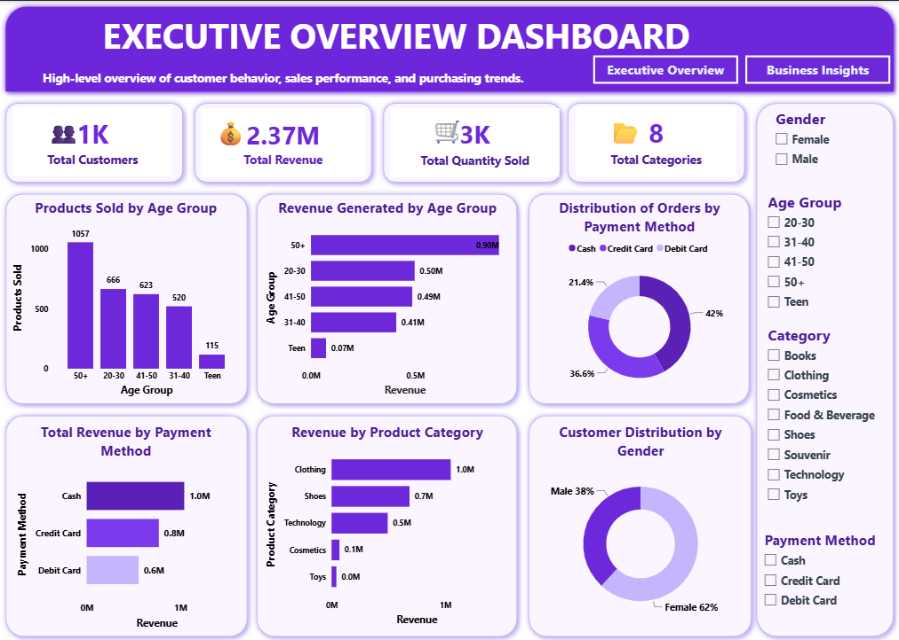
SECTION 08
Power BI Dashboard — Executive Overview
Executive Overview Dashboard
Key Features
Interactive slicers for Gender, Age Group, Category, and Payment Method.
KPI cards summarizing Total Customers, Revenue, Quantity Sold, and Product Categories.
Customer demographic analysis by Age Group and Gender.
Revenue analysis across Age Groups, Product Categories, and Payment Methods.
Executive-level dashboard for quick business performance monitoring.
Visualizes customer behavior and purchasing patterns through interactive charts and KPI visuals.
Supports executive decision-making by highlighting key sales and customer performance metrices.
1,000
2.37M
Interactive slicers: Gender · Age Group · Category · Shopping Mall · Payment Method
CUSTOMER DATA ANALYSIS | SQL & POWER BI
09 / 15

Slide 10
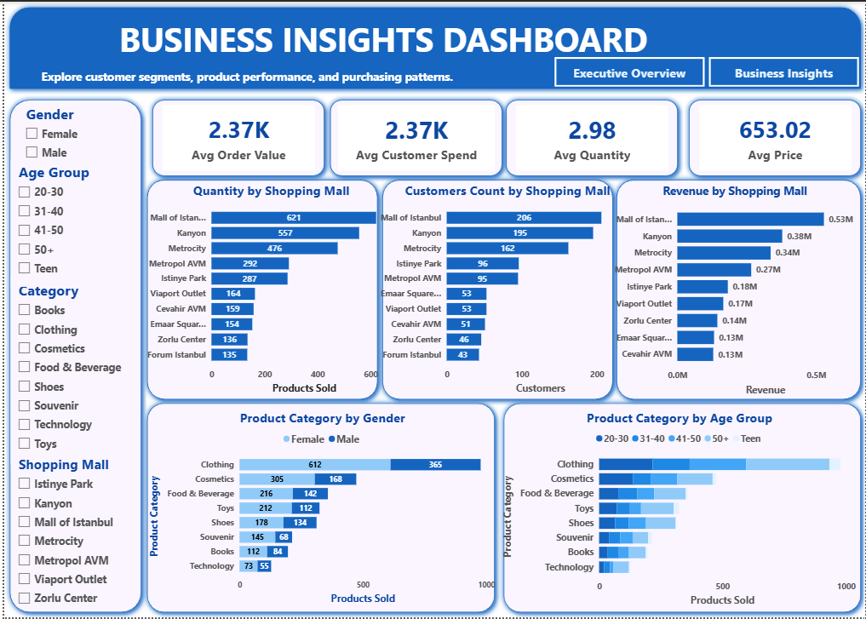
SECTION 09
Power BI Dashboard — Business Insights
Key Features
Interactive slicers for Gender, Age Group, Category, and Shopping Mall analysis.
KPI cards summarizing Average Order Value, Average Customer Spend, Average Quantity, and Average Unit Price.
Shopping mall performance analysis using Revenue, Customer Count, and Quantity Sold.
Product category comparison by Gender and Age Group.
Identifies top-performing shopping malls based on business metrics.
Supports business decisions through detailed customer and product insights.
Interactive visualizations for exploring purchasing behavior and shopping trends.
CUSTOMER DATA ANALYSIS | SQL & POWER BI
10 / 15

Slide 11



SECTION 10
KPI Summary
Eight key performance indicators (KPIs) summarize overall business performance and customer purchasing behavior across both dashboards.
1K
2.37M
3K
8
Total Customers
Total Revenue
Total Quantity Sold
Total Categories
2.37K
2.37K
2.98
653.02
Avg. Order Value
Avg. Customer Spend
Avg. Quantity per Transaction
Avg. Unit Price
CUSTOMER DATA ANALYSIS | SQL & POWER BI
11 / 15

Slide 12
SECTION 11
Business Insights
Customer Demographics
Product Performance
Female customers account for 62% of total customers and consistently outspend male customers. The 50+ segment leads in transactions, units, and revenue.
Clothing is the top revenue driver across all segments. Shoes and Technology are the next strongest revenue-generating categories.
Payment Behavior
Shopping Mall Performance
Cash leads at 42% of transactions and the highest revenue share, ahead of Credit Card (36.6%) and Debit Card (21.4%).
Mall of Istanbul leads in revenue, customer count, and quantity sold, followed by Kanyon, Metrocity, Metropol AVM, and Istinye Park.
CUSTOMER DATA ANALYSIS | SQL & POWER BI
12 / 15

Slide 13




SECTION 12
Business Recommendations
01
02
03
04
05
Customer Engagement
Product Sales
Marketing Strategy
Mall Performance
Payment Experience
Prioritize loyalty programs for female customers and the 50+age segments; build targeted campaigns to grow Teen engagement.
Prioritize inventory for Clothing, Shoes & Technology; increase promotional campaigns for lower-performing categories like Books & Toys.
Focus investment on female customers and the 50+ segment; run category-specific campaigns around Clothing.
adopt best practices from Mall of Istanbul, Kanyon, and Metrocity at lower-performing locations.
Maintain efficient cash handling while incentivizing digital payment adoption via cashback & rewards.
CUSTOMER DATA ANALYSIS | SQL & POWER BI
13 / 15

Slide 14



SECTION 13
Conclusion & Future Scope
FUTURE SCOPE
Business Conclusion
Seasonal Trend Analysis
Use invoice_date to reveal monthly & seasonal demand patterns.
Revenue and engagement are concentrated in identifiable, addressable patterns. Female shoppers and customers aged 50+ drive a disproportionate share of transaction volume and revenue.
Repeat-Purchase Analysis
Distinguish one-time buyers from repeat customers.
Clothing is the leading revenue-generating category, followed by Shoes and Technology. Cash remains the dominant payment method, while Mall of Istanbul delivers the strongest overall performance across all locations.
Expanded Dataset
Grow beyond 1,000 records for stronger segment confidence.
Profitability Modeling
Add COGS to shift from revenue to margin-based analysis.
SQL analysis and Power BI dashboards together support data-driven decisions across segmentation, product, marketing, and location strategy.
Automated Refresh
Pipe source data into MySQL & Power BI without manual re-import.
CUSTOMER DATA ANALYSIS | SQL & POWER BI
14 / 15

Slide 15




THANK YOU
Questions & Discussion
Customer Data Analysis Project Using SQL & Power BI
Baliji Mohan • Data Analyst
balijimohan364@gmail.com
linkedin.com/in/mohan-baliji-083b90254
github.com/balijimohan
Tools: MySQL · SQL · Power BI · Power Query · DAX

