Slide 1
DATA ANALYTICS PORTFOLIO PROJECT
JOB MARKET
ANALYSIS
An End-to-End SQL & Power BI Project on the U.S. Data & Analytics Job Market
Prepared By: Baliji Mohan
Data Source: Glassdoor Jobs Dataset
Tools: MySQL Workbench • Power BI Desktop
2,000
318
35
$107K
57
JOB LISTINGS
COMPANIES
STATES
AVG. SALARY
INDUSTRIES

Slide 2

SECTION 01
Project Overview
Built using a real Glassdoor job-postings dataset to analyze the U.S. data & analytics job market across multiple industries.
Performed SQL-based data cleaning, validation, and business analysis before developing four interactive Power BI dashboards.
Transformed 2,000 job-posting records into actionable insights for job seekers, employers, and workforce planners.
Analyzed hiring demand, salary trends, in-demand skills, and top hiring companies to uncover key job market insights.
PROJECT AT A GLANCE
2,000
318
JOB LISTINGS
COMPANIES
35
$107K
STATES
AVG. SALARY (K)
220
57
UNIQUE JOB TITLES
INDUSTRIES
392
3.77
PYTHON POSTINGS
AVG. COMPANY RATING
Built with MySQL Workbench (SQL) & Power BI Desktop (DAX).
An end-to-end analytics project transforming raw job data into actionable business insights.
JOB MARKET ANALYSIS • DATA ANALYST PORTFOLIO
2

Slide 3




SECTION 02
Objectives
1. Clean & Validate the Dataset
Remove duplicates and standardize placeholder / missing values in the raw Glassdoor job-postings data.
2. Explore Core Business Questions
Use SQL to explore ten business questions covering geography, compensation, industry, company, and skills.
3. Design a Flexible Data Model
Build a Power BI model with derived fields — state, seniority, skill flags — for cross-filterable analysis.
4. Generate Actionable Business Recommendations
Turn analytical findings into actionable recommendations for job seekers, employers, and workforce planners.
Established clear analytical goals to guide data cleaning, exploration, and business reporting.
JOB MARKET ANALYSIS • DATA ANALYST PORTFOLIO
3

Slide 4






SECTION 03
Dataset Description
Real-world Glassdoor job-posting dataset with 2,000 records and 41 analytical attributes after preprocessing (42 original columns).
Job Details
Location
Company Profile
Compensation
Skill Flags (Binary)
Job Title, Salary, Seniority Level, Degree, and Job Category
Job Location, State Information and Company Headquarters
Company Name, Rating, Size, Ownership Type, Industry, Revenue, and Competitor Details
Minimum, Maximum & Average Salary(K), Hourly Pay, and Employer-Provided Salary
Python, Spark, AWS, Excel, SQL, SAS, Keras, PyTorch, TensorFlow, Hadoop, Tableau, Power BI, and more.
DATA QUALITY NOTES
Replaced placeholder values (-1) with NULL during SQL data cleaning.
Extracted state information from composite location fields for regional analysis.
Converted binary skill columns into an analysis – friendly format for SQL and Power BI.
A well-prepared dataset forms the foundation for reliable analysis and decision-making.
JOB MARKET ANALYSIS • DATA ANALYST PORTFOLIO
4

Slide 5






SECTION 04
Technology Stack
End-to-end analytics technology stack for transforming raw data into interactive business insights.
MySQL Workbench
SQL Querying & Analysis
Power BI Desktop
Used MySQL Workbench for data cleaning, validation, business queries, joins, aggregations, and analytical reporting.
Database creation, duplicate detection, NULL validation, placeholder cleanup, business-question analysis.
Developed interactive dashboards using data modeling, DAX measures, and advanced visualizations.
Power Query (M)
DAX
Glassdoor CSV Dataset
Cleaned, transformed, and reshaped data for analysis using Power Query.
Created DAX measures and KPIs for salary analysis, job counts, percentages, and business metrics.
Primary raw data source used throughout the SQL and Power BI analytics pipeline.
A modern analytics stack enabled efficient data processing, visualization, and reporting.
JOB MARKET ANALYSIS • DATA ANALYST PORTFOLIO
5

Slide 6


SECTION 05
Methodology
A structured three-stage workflow transformed raw job-posting data into reliable business insights and interactive dashboards.
1. Data Cleaning
2. SQL Analysis
3. Power BI Modeling
Duplicate check on ID field
Null audit on core fields
Placeholder (-1) cleanup via UPDATE
Post-update validation
10 business-oriented SQL queries
Maps to core analytical questions
GROUP BY, AVG, SUM, SUBSTRING_INDEX
Consistency check vs. dashboards
Derived columns: state, company age
Skill unpivoting (16 binary cols)
DAX measures & KPIs
Synced slicers across 4 pages
A structured workflow ensured data accuracy, consistency, and meaningful business insights.
JOB MARKET ANALYSIS • DATA ANALYST PORTFOLIO
6

Slide 7
SECTION 06
SQL Analysis
Business-oriented SQL queries were developed to answer key questions about hiring trends, salaries, companies, industries, and skills.
Business Question | SQL Techniques Used
Which states have the highest number of job openings? | String Functions, GROUP BY
What are the average min/max salaries by state? | Aggregates, ROUND, GROUP BY
Which industries post the most data-related jobs? | COUNT, Filtering, GROUP BY
Which companies have the most job openings? | COUNT, GROUP BY, LIMIT
Which job titles appear most frequently? | COUNT, GROUP BY, LIMIT
Which skills are required most often, by job title? | SUM (binary flags), GROUP BY
How does average salary relate to required education? | AVG, COUNT, GROUP BY
Top States by Job Openings
SAMPLE QUERY
SELECT
SUBSTRING_INDEX(Location,',',-1) AS State,
COUNT(*) AS Total_Jobs
FROM Job_Market_Analysis_Clean
GROUP BY State
ORDER BY Total_Jobs DESC
LIMIT 10;
Complete SQL scripts are available in Appendix A of the project report.
SQL transformed raw data into valuable insights by answering key business questions.
JOB MARKET ANALYSIS • DATA ANALYST PORTFOLIO
7

Slide 8

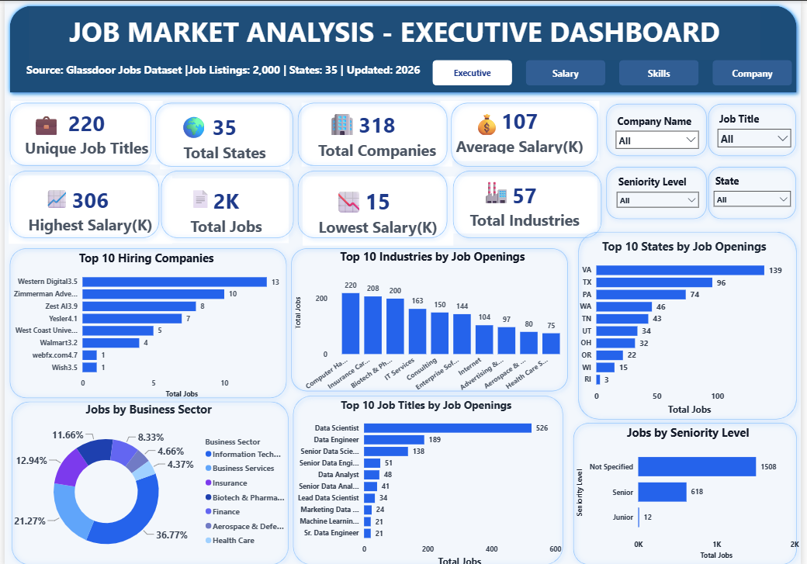
SECTION 07
Executive Dashboard
EXECUTIVE INSIGHTS
Data Scientist dominates with (526) postings — more than double Data Engineer (189).
Virginia leads all states with (139) openings, followed by Texas (96) and Pennsylvania (74).
Computer Hardware, Insurance Carriers, and Biotech/Pharma emerged as the leading hiring industries for data professionals.
Hiring demand is concentrated across specific job roles, industries, and geographic regions, indicating clear market hotspots for data professionals.
Western Digital is the top individual employer with (13) open roles.
TOP 5 STATES BY JOB OPENINGS
State | Total Jobs
Virginia | 139
Texas | 96
Pennsylvania | 74
Washington | 46
Tennessee | 43
Interactive Executive Dashboard built in Power BI with dynamic slicers for Industry, State, Company, and Job Title.
JOB MARKET ANALYSIS • DATA ANALYST PORTFOLIO
8

Slide 9
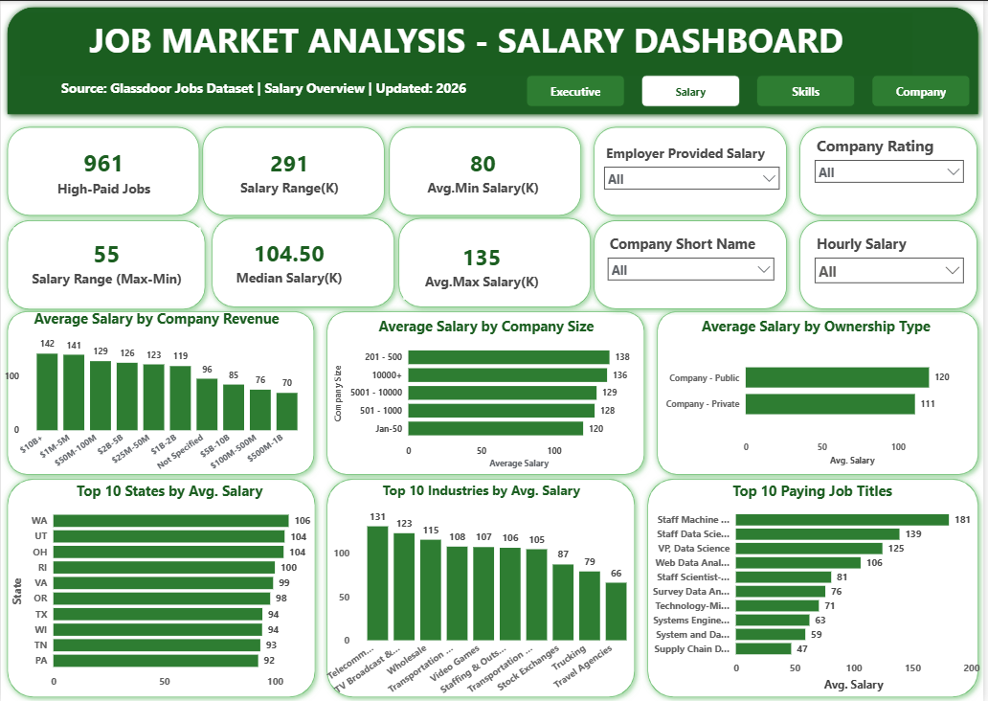
SECTION 08
Salary Dashboard
KEY INSIGHTS
The median salary is $104.5K across 961 high-paying roles, with average salaries ranging from ($80K–$135K).
Washington ($106K), Utah ($104K), and Ohio ($104K) recorded the highest average salaries among the analyzed states.
Telecommunications ($131K) and TV Broadcasting & Cable ($123K) are the highest-paying industries.
Mid-sized companies (201–500 employees) show a measurable pay premium.
Staff Machine Learning Engineer is the highest-paid title at $181K average.
TOP 5 HIGHEST-PAYING TITLES
Job Title | Average Salary
Staff ML Engineer | $181K
Staff Data Scientist | $139K
VP, Data Science | $125K
Web Data Analyst | $106K
Staff Scientist | $81K
Interactive Salary Dashboard built in Power BI with dynamic slicers for Industry, State, Company, and Job Title.
JOB MARKET ANALYSIS • DATA ANALYST PORTFOLIO
9

Slide 10
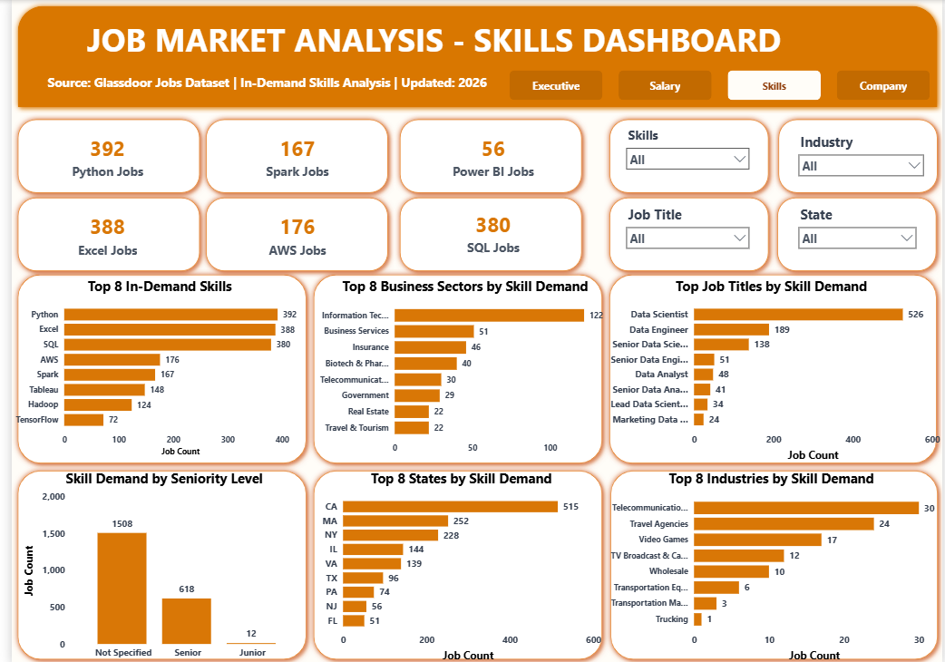
SECTION 09
Skills Dashboard
KEY INSIGHTS
Python (392), Excel (388), and SQL (380) are the three most in-demand skills across job postings.
AWS (176) and Spark (167) highlight strong demand for cloud and big data technologies.
TensorFlow (72) and Power BI (56) indicate demand for specialized machine learning and business intelligence skills.
California (515), Massachusetts (252) & New York (228) are the leading skill-demand states.
Information Technology recorded the highest skill demand with 122 skill-tagged postings.
TOP 5 IN-DEMAND SKILLS
Skill | Postings
Python | 392
Excel | 388
SQL | 380
AWS | 176
Spark | 167
Interactive Skills Dashboard built in Power BI with dynamic slicers for Skills, Industry, Job Title, and State.
JOB MARKET ANALYSIS • DATA ANALYST PORTFOLIO
10

Slide 11
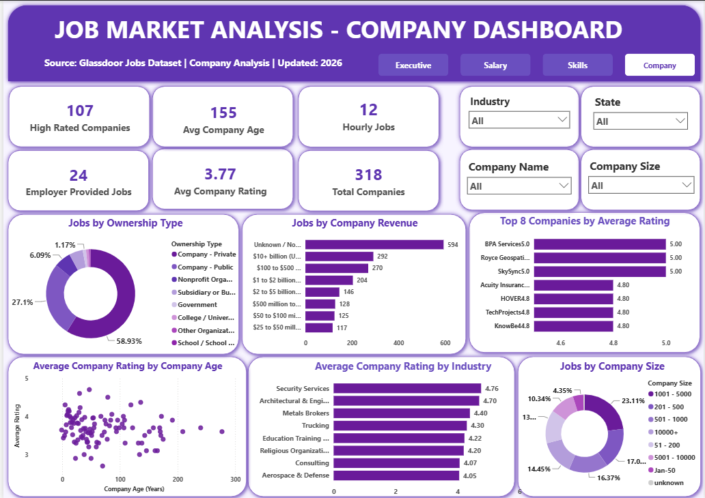
SECTION 10
Company Dashboard
KEY INSIGHTS
The dataset includes 318 hiring companies, with 107 highly rated organizations and an average Glassdoor rating of 3.77/5.
Privately held companies account for 58.9% of job postings, compared with 27.1% from publicly traded companies.
Companies with undisclosed revenue contribute the largest share of postings (594 jobs).
Mid-to-large companies (1,001–5,000 employees) post the most jobs (23.1%).
BPA Services, Royce Geospatial & SkySync each hold a perfect 5.0 rating.
TOP 5 COMPANIES BY RATING
Company | Rating
BPA Services | 5.0
Royce Geospatial | 5.0
SkySync | 5.0
Acuity Insurance | 4.8
HOVER | 4.8
Interactive Company Dashboard built in Power BI with dynamic slicers for Industry, State, Company, and Company Size.
JOB MARKET ANALYSIS • DATA ANALYST PORTFOLIO
11

Slide 12
SECTION 11
Key Business Insights
Six cross-cutting insights bring together the SQL findings and all four Power BI dashboards.
Roles
Geography
Compensation
Data Scientist is the most in-demand role with 526 postings (approximately 25% of all job listings).
Virginia, Texas, and Pennsylvania recorded the highest job volume, while California, Massachusetts, and New York showed the strongest demand for technical skills.
The median salary is $104.5K, with Telecommunications and states such as Washington and Utah offering the highest average salaries.
Skills
Company Profile
Seniority
Python, Excel, and SQL are the three most requested skills, each appearing in approximately one-fifth of job postings.
Private companies account for most job postings, while public companies offer approximately 8% higher average salaries.
Senior-level opportunities are more common than junior roles, while many postings remain open across experience levels.
Overall, the analysis reveals strong demand for data professionals, with clear opportunities driven by technical skills, competitive salaries, and region-specific hiring trends.
JOB MARKET ANALYSIS • DATA ANALYST PORTFOLIO
12

Slide 13



SECTION 12
Business Recommendations
Strategic recommendations based on insights from SQL analysis and Power BI dashboards.
For Job Seekers
For Employers
For Workforce Planners
Prioritize Python, SQL, and Excel, as they appear in the largest share of job postings across industries and experience levels.
Focus your job search on Virginia, Texas, and Pennsylvania for higher job availability, or California, Massachusetts, and New York for stronger technical-skill demand.
Target Telecommunications, TV Broadcasting & Cable, and mid-sized (201–500 employees) or public companies for higher salary opportunities.
Clarify seniority levels in postings to improve applicant matching and attract entry-level talent.
Benchmark salary offerings against public companies and mid-sized organizations to remain competitive.
Improve transparency by disclosing company revenue and size, as nearly one-third of postings fall into the "Unknown Revenue" category.
Expand training programs in cloud (AWS) and big data (Spark) technologies to meet growing employer demand.
Promote structured junior and entry-level hiring initiatives to strengthen the future data talent pipeline.
These recommendations help job seekers, employers, and workforce planners align with current trends in the U.S. data analytics job market.
JOB MARKET ANALYSIS • DATA ANALYST PORTFOLIO
13

Slide 14

SECTION 13
Project Challenges & Outcomes
CHALLENGES FACED
PROJECT OUTCOMES
Placeholder Values — Resolved invalid (-1) values in Rating, Founded, Industry, and Sector using SQL UPDATE statements.
Location Parsing — Used SQL string functions and Power Query transformations to extract state-level geography.
Skill Transformation — Unpivoted sixteen binary skill columns into a unified Skills Dashboard.
Incomplete Data — Treated missing seniority and revenue information as documented project limitations.
Dashboard Design — Balanced four dashboard perspectives while avoiding duplicate visuals.
Data Validation — Cross-verified SQL results with Power BI measures and dashboard visualizations.
Clean Dataset — Validated MySQL database with duplicates, nulls & placeholders resolved and documented.
SQL Query Library — Ten reusable SQL queries answering the project's core business questions.
Interactive Dashboard — Four-page, cross-filterable Power BI suite covering 2,000 job listings.
Project Documentation — Full methodology, dashboard explanations, insights, and recommendations.
Business Report — Produced a professional project report covering methodology, SQL analysis, Power BI dashboards, insights, and recommendations.
This project demonstrates my ability to transform raw data into actionable business insights using SQL and Power BI.
JOB MARKET ANALYSIS • DATA ANALYST PORTFOLIO
14

Slide 15

CONCLUSION
From raw CSV to a cleaned relational database to a polished, interactive Power BI dashboard suite — this project demonstrates a complete, real-world analytics workflow.
Data Scientist remains the flagship title; SQL and Excel are among the most requested technical skills.
Compensation is influenced more by ownership structure and industry than by company size alone.
Pairing SQL's precision with Power BI's interactive storytelling turns a static dataset into a living, explorable tool.
Validating SQL outputs against dashboard visuals ensured consistency, accuracy, and reliable reporting throughout.
Strengthened practical expertise in SQL, Power BI, DAX, data modeling, dashboard design, and business storytelling.
SKILLS DEMONSTRATED
SQL & Data Cleaning
SQL Query Optimization
Power BI & DAX
Data Modeling
Dashboard Design
Business Analysis
Data Validation
Data Storytelling
Technical Documentation
This end-to-end project showcases my ability to transform raw data into meaningful business insights using SQL, Power BI, and data analytics.

