Slide 1


DATATHON – ROUND-3
CRISIS PROBLEM - BANGALORE
Team: Climate Warriors
PRESENTED BY:
KUNSH BALI – 2BScDS
NAVEEN SINGH S – 2BScDM

Slide 2
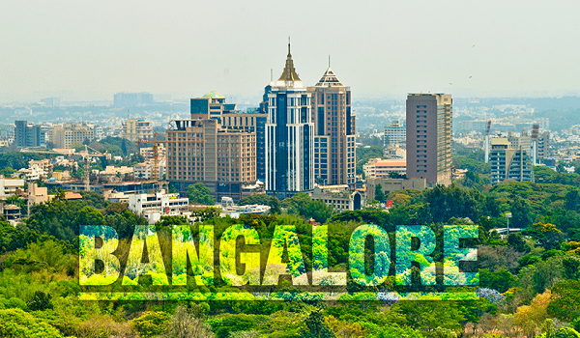
Introduction
1. City Assigned: Bengaluru
2. Crisis Overview
Bengaluru is facing rising temperatures, increasing irregular rainfall, and higher humidity fluctuations over the years.
The city shows signs of climate volatility, with hotter years becoming more frequent and rainfall distribution becoming unpredictable.
3. Why This Issue Matters
Impacts water security (already a major challenge for Bengaluru).
Affects public health due to heat stress and humidity.
Influences agriculture in the surrounding districts and urban planning.
Early signals of long-term climate instability that can escalate if ignored.

Slide 3
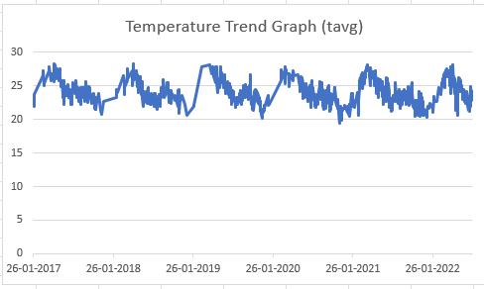
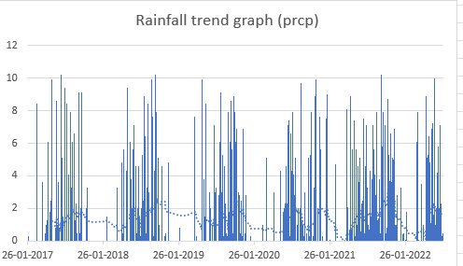
The graph moves up and down like a wave, showing that the weather follows a very predictable pattern where it gets warm and cool at the same time every year.
The data suggests that the temperature hardly goes below 20°C, suggesting that Bangalore lies in a Subtropical Region, thereby, in Bangalore, the winter is mild or frost-free.
The line is very shaky rather than smooth. It indicates the day-to-day weather: a sudden windstorm or a windy day frequently knocks the temperature down for a short bit before it bounces back.
Conclusion: No long-term change (consistent graph). Peak Temperature: 28 °C, most probably due to extra humidity or clouds kicking in to stop the temperature from rising any further.
The graph shows Sudden Bursts, that is, instead of a steady rain, it is mostly dry and is interrupted by sudden heavy downpours that hit the 10mm mark quickly and then disappear.
The way the blue bars are grouped into clumps makes it certain that the rainfall happens during a part of the year, while it remains dry at other times.
If you see the dotted line(avg day wise), it remains under 2 mm; if you average the rain over the year, it will be clear that most days receive little or no rainfall.
Conclusion: If you look at 2018 vs 2020, clumps of “rain” look different, which means some years have more rainy days even if the storm is equally strong

Slide 4
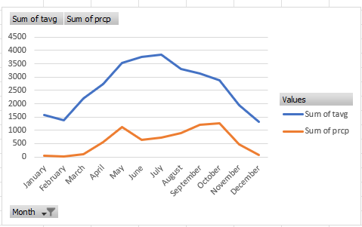
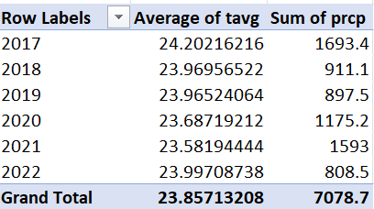
From Feb to May, Both Temperature and Rainfall Rise together, indicating a transition into the hot and humid season.
Both temperature and rainfall drop towards December and January, indicating low rainfall and cool temperatures.
The highest total rainfall happens in October, even though the temperature starts dropping quite rapidly
Conclusion: The heat first builds up in the spring, which acts as the engine that pulls the moisture for the rains in the year.
Important Years
Year | Total Rainfall | Avg Temp | Remark
2019 | Highest | — | Peak rainfall year
2021 | High | — | Second-highest
2017 | Lowest | — | Driest year
2020 | — | Slightly Higher | Warmest year

Slide 5
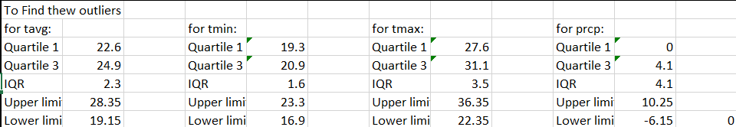
Key Insights:
Temperature is stable across years(avg 26-27°C)
Rainfall is highly uneven- big spikes in 2017 and 2021, and much lower rain in 2018 and 2022.
Monsoon (Jun-Sep) brings 70-75% of the total rainfall
Rainfall is becoming more extreme (high-intensity days instead of steady rain)
2021 stands out as the wettest Year.
Risks and Future Concerns:
Irregular monsoon- tougher agriculture, water planning.
Rainfall spikes: higher risk of floods, traffic paralysis, sewage overflow in cities.
Low-rainfall years like 2018 and 2022 –water shortage
Temperature remaining high – increases heat-stress days, power demand and pollution risk.

Slide 6
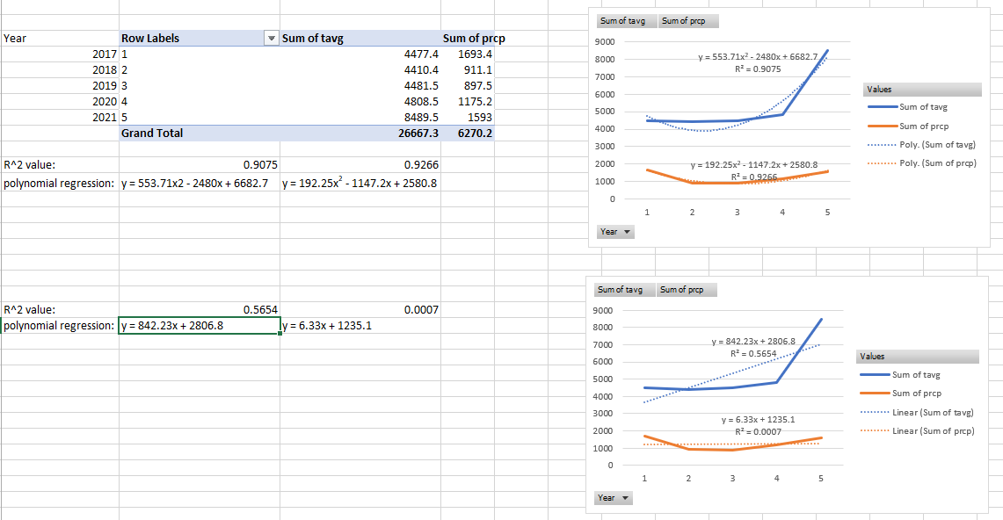

Slide 7
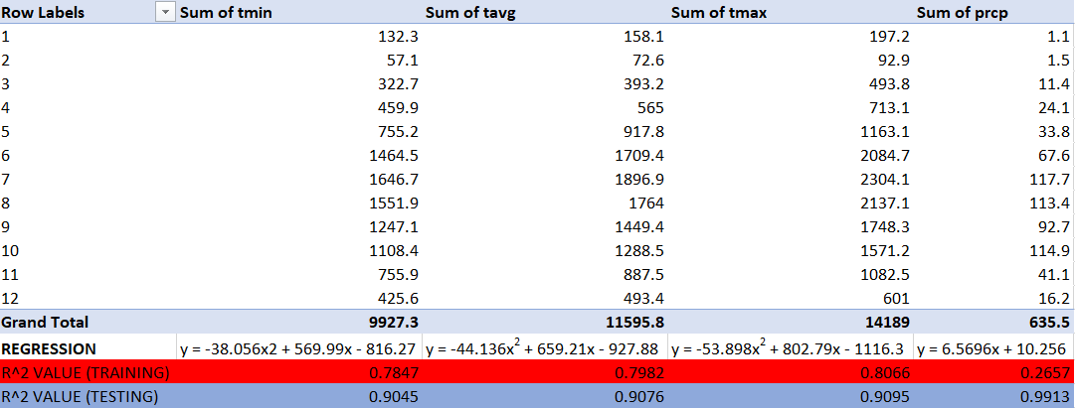
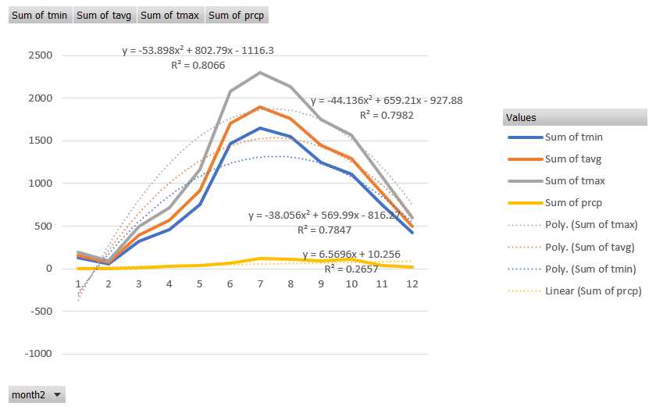

Slide 8
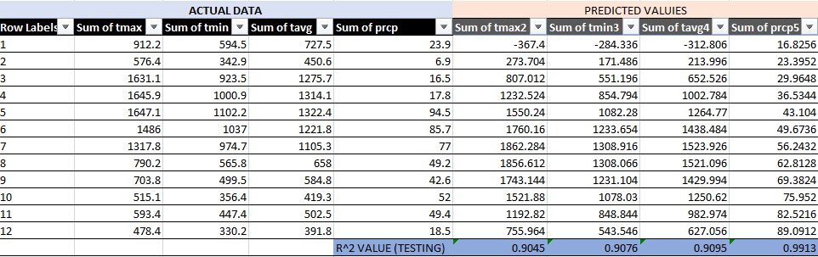
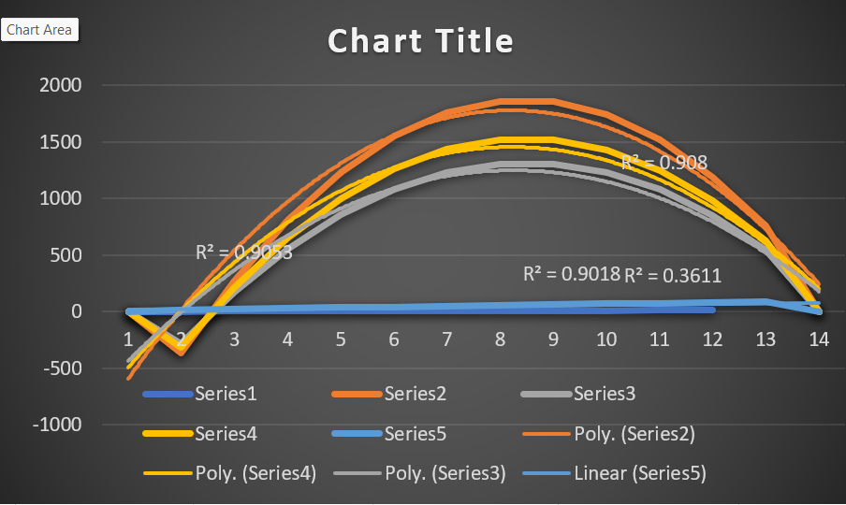

Slide 9
Proposed Strategy- Smart Climate Response System
Building a smart climate Response System using:
Daily weather Data
Real-time rainfall monitoring.
Predictive Analytics.
Community Alert System.

Slide 10
How it works:
1. Monitor
Live rainfall, temperature, humidity, and pressure through IoT sensors.
2. Predict
Machine learning model predicts:
Heavy rainfall days
Flood risk zones
Heatwave probabilities
3. Alert
Automatic alerts sent to:
Municipal bodies
Schools/offices
Citizens (SMS / WhatsApp)
4. Act
City departments execute:
Drainage cleaning
Water storage optimization
Traffic redirection
Why This Strategy Works
Data-driven
Uses actual weather trends
Prevents damage
Early warnings let govt prepare for floods, storms, and water scarcity.
Low cost
Uses existing IMD data + low-cost sensors.
Scalable
Can be used across cities or scaled to the state level.
Community focused
Keeps citizens informed ->reduces panic & chaos.

Slide 11
FLOWCHART
Data Collection
↓
Real-Time Processing
↓
Prediction Model
↓
Risk Evaluation
↓
Decision Engine
↓
Action & Alerts

Slide 12
Conclusion
Summary of Solution
Our strategy focuses on:
Smart Water Management – real-time monitoring, rainwater harvesting, and efficient distribution.
Heat & Climate Control Measures – cool roofing, increased green cover, and urban heat-island reduction.
Community-Driven Action – awareness programs, household conservation, and local reporting systems.
Expected Impact
Reduced water stress and more reliable supply during peak summers.
Lower city temperatures and improved air quality over time.
Higher climate resilience, enabling Bengaluru to handle extreme weather events better.
Sustainable, long-term eco-balance supporting both people and the environment.

Slide 13


