Slide 1
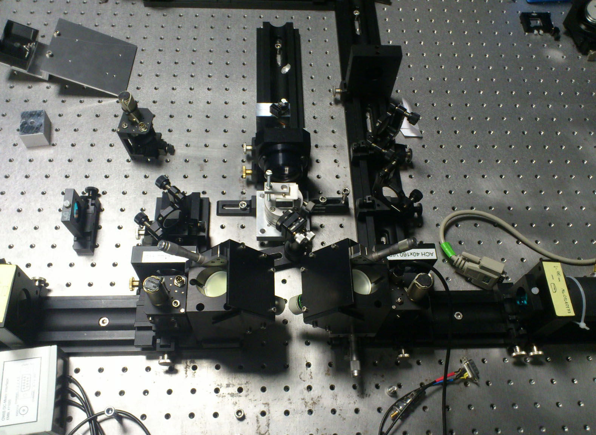
scanning mirror
scan lens
tube lens
beam splitter
flipping mirror
illumination objective
imaging
objective
emission filter

Slide 2
SM
SL
BS
TL
TL
TL
TL
FM
FM
O1
O2
EF

