Slide 1
IoT-Enabled Home Security and Intrusion Detection System with Motion Sensors and Instant Alert Notifications
An IoT-based security solution designed to continuously monitor residential premises, detect suspicious activities and unauthorized intrusion attempts, and deliver instant alert notifications — enabling homeowners to respond quickly and monitor their homes remotely.
Continuous Monitoring
Intrusion Detection
24/7 surveillance of residential premises using smart sensors
Identifies unauthorized movement and suspicious activity in real time
Instant Alerts
Remote Monitoring
Immediate notifications delivered to homeowners upon threat detection
Access security information from anywhere via mobile app or web dashboard
BALLA MOHAN MURALI
323129520033

Slide 2

Problem Statement
Home security has become increasingly important as thefts and unauthorized intrusions continue to pose serious risks to residential safety. Existing approaches fall short in several critical ways.
Limitations of Conventional Systems
What Homeowners Actually Need
Rely on manual monitoring or standalone alarm systems
Provide limited real-time security information
Delayed responses reduce the effectiveness of security measures
No centralized visibility across entry points
Intelligent systems that monitor continuously without human intervention
Automatic detection of suspicious activities as they occur
Instant notifications that enable rapid response
Improved overall safety and peace of mind
Delayed responses in conventional systems can critically reduce the effectiveness of security measures — making real-time intelligence essential.

Slide 3
Proposed Solution
The IoT-Enabled Home Security and Intrusion Detection System addresses these gaps by combining motion sensors and IoT technologies into a unified, intelligent security platform for residential premises.
IoT-Powered Sensor Network
Centralized Monitoring Platform
Motion sensors and door/window sensors work together to continuously detect unauthorized movement and intrusion attempts across all monitored areas.
A secure, user-friendly interface consolidates all sensor data and security events into a single dashboard accessible from any device.
Instant Alert Notifications
Remote Home Monitoring
When suspicious activity is detected, the system immediately sends alerts to homeowners — eliminating the need for continuous manual observation.
Homeowners can monitor their premises from anywhere in the world through a mobile application or web dashboard, ensuring security is always within reach.

Slide 4
Objectives
The system is designed around ten core objectives that together deliver comprehensive, intelligent, and responsive home security.
01
02
03
Continuously monitor residential premises
Detect unauthorized movement and intrusion attempts
Monitor doors and windows for suspicious activity
04
05
Provide real-time security information
Generate instant alert notifications
01
02
Enable remote monitoring via mobile apps or web dashboards
Maintain intrusion history and activity records
03
04
Improve user safety and response time
Support smart home automation

Slide 5

Sensors and System Components
Five major components work in concert to deliver continuous, reliable security monitoring across all residential entry points and monitored zones.
PIR Motion Sensors
Door & Window Sensors
IoT Communication Modules
Detect movement within monitored areas and identify possible unauthorized activity in real time.
Monitor the opening or activity of doors and windows to help identify possible intrusion attempts at entry points.
Transmit sensor data to the central monitoring system reliably and in real time.
Cloud Connectivity
Mobile App / Web Dashboard
Supports centralized access to all security information from any location at any time.
Provides security alerts, sensor status, and remote monitoring capabilities to homeowners.
These components form an integrated ecosystem — each layer depends on the others to ensure no security event goes undetected or unreported.

Slide 6
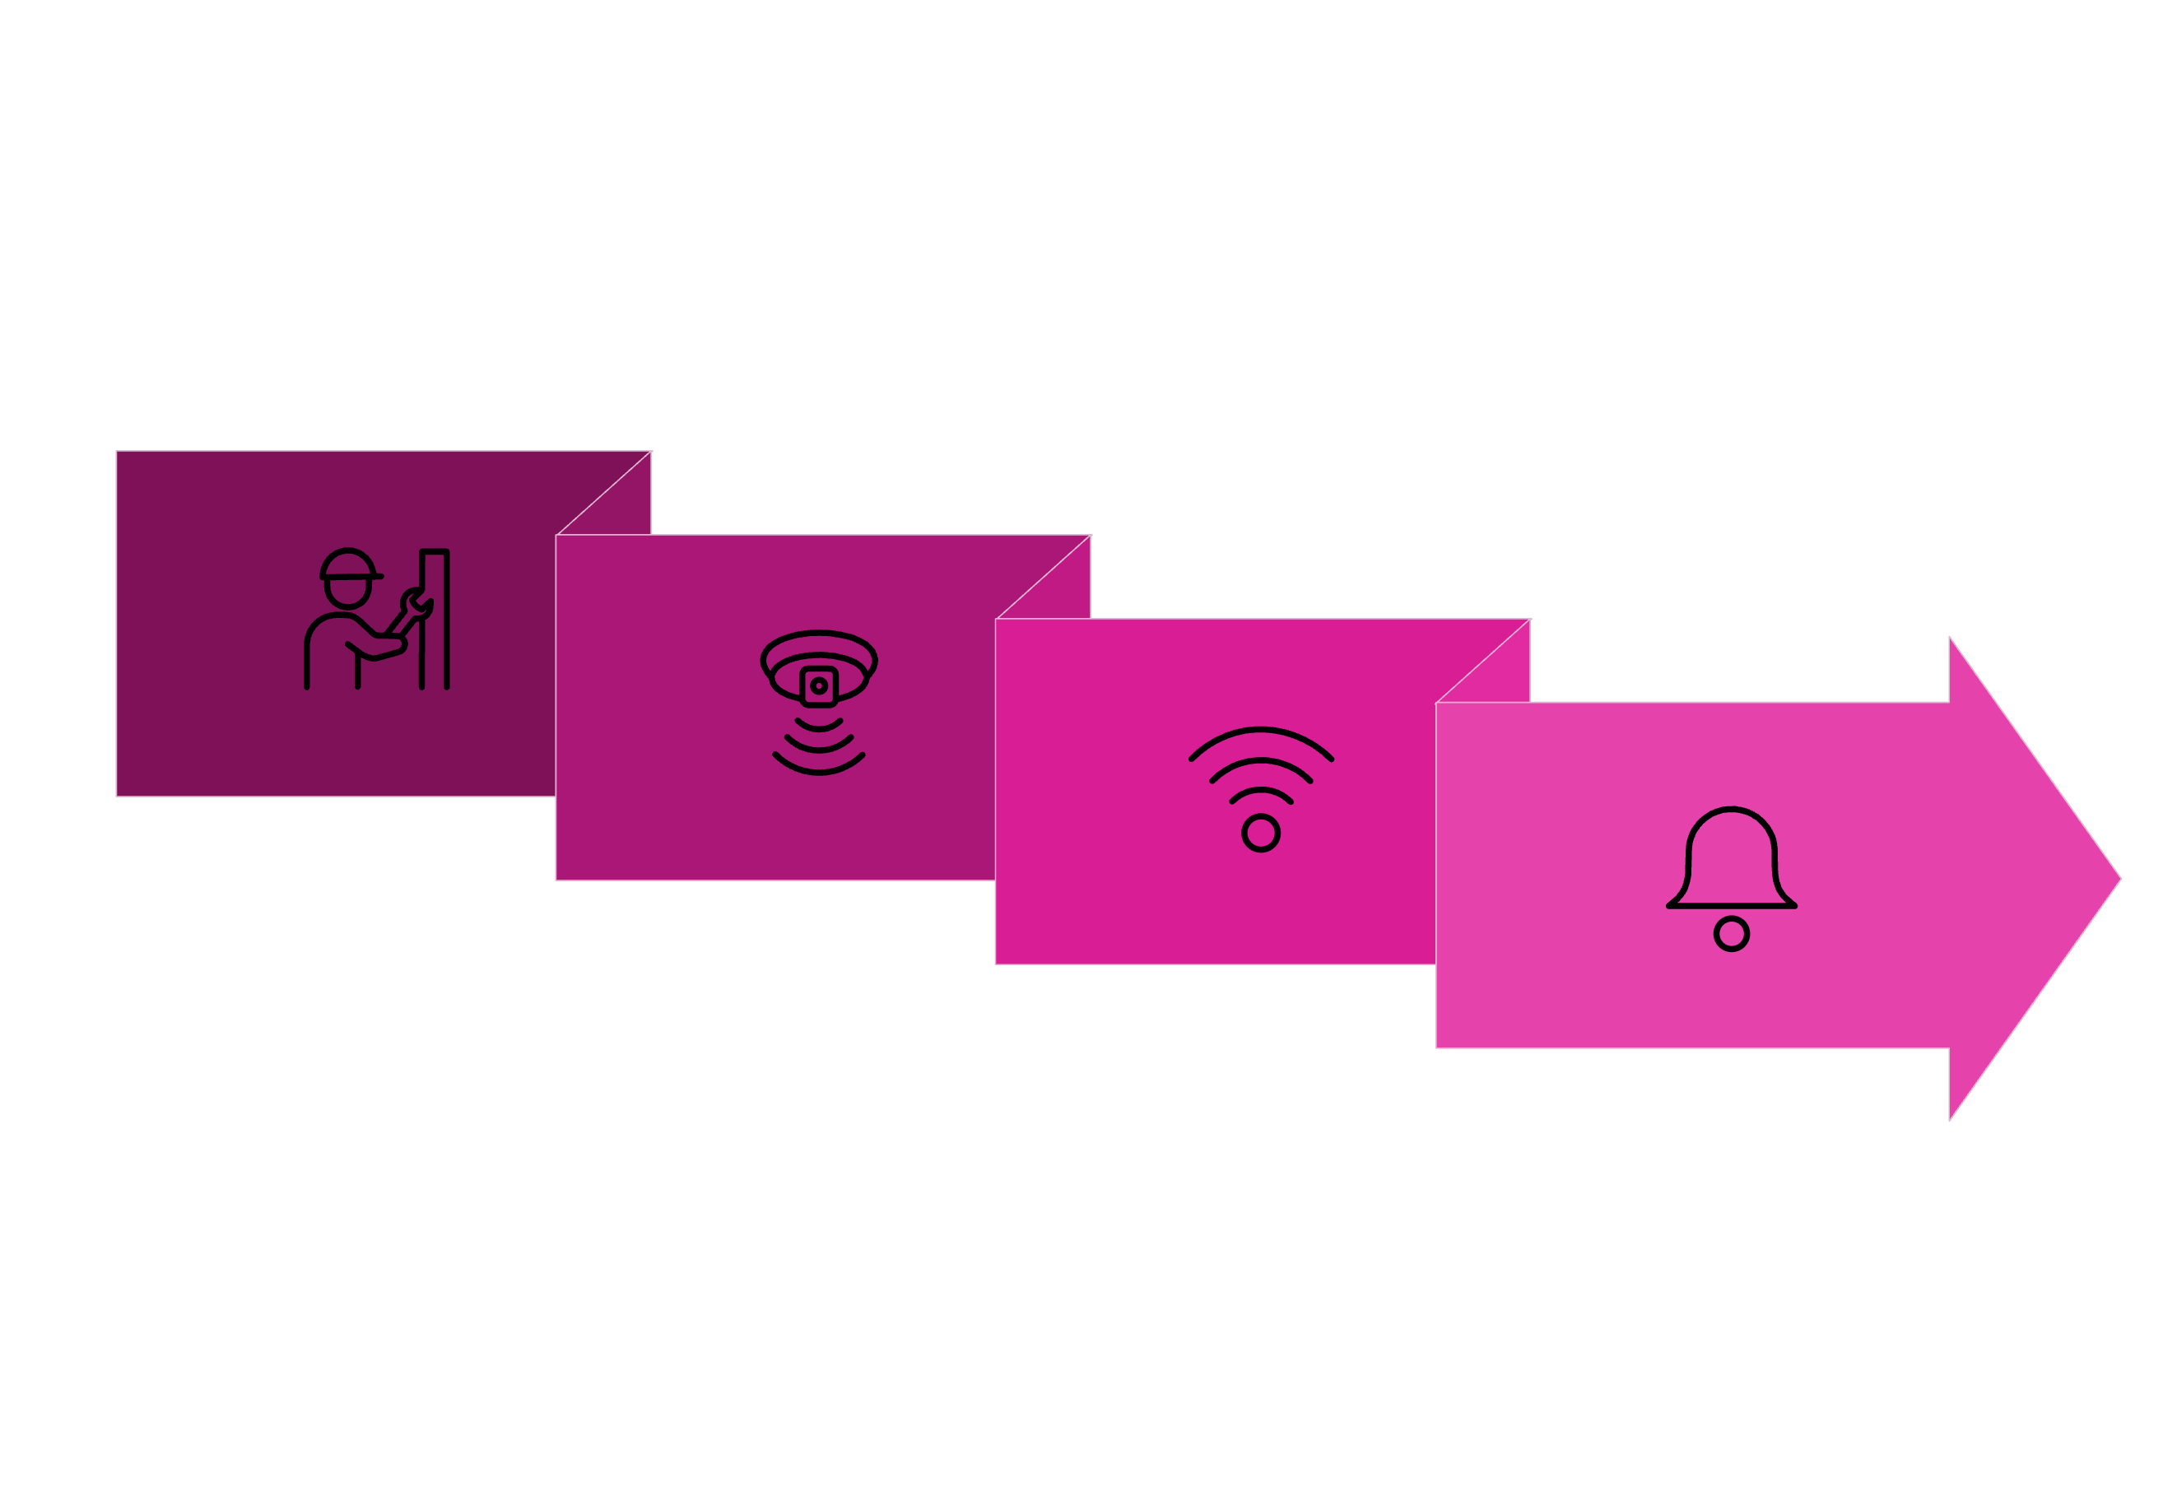
System Working Process
The system follows a structured 10-step operational workflow — from sensor installation through to event recording — ensuring every security event is detected, communicated, and logged.
Detect Movement
Alert & Log
Install Sensors
Transmit Data
1
Installation & Sensing
2
Detection & Transmission
Security sensors are installed at important locations. PIR motion sensors and door/window sensors continuously monitor all designated areas and entry points.
Sensors detect suspicious movement or intrusion attempts. Sensor data is immediately transmitted using IoT communication modules to the central system for processing.
3
Alert & Response
4
Recording & Logging
An instant alert is generated and delivered to the homeowner via mobile app or web dashboard. The homeowner reviews the information remotely and responds quickly.
All intrusion events and system activity are recorded for future monitoring, analysis, and continuous security management.

Slide 7
Real-Time Monitoring and Alerts
The system's monitoring and notification capabilities ensure homeowners are always informed — without needing to continuously observe their property manually.
What the System Monitors
What the System Reports
Real-Time Sensor Monitoring
Motion Detection Information
Instant Intrusion Alerts
Real-Time Security Notifications
Continuous status tracking of all connected sensors across the premises.
Logs and displays all detected movement events with timestamps.
Immediate push notifications triggered by any detected suspicious activity.
Ongoing updates delivered to the homeowner's mobile app or dashboard.
Door & Window Activity
Sensor Status
Intrusion History
System Activity Logs
Displays the operational health and connectivity of each sensor.
A complete log of all past intrusion events for review and analysis.
Detailed records of all system operations and sensor interactions.
Tracks all open/close events at monitored entry points.

Slide 8
Dashboard and Remote Monitoring
The centralized monitoring dashboard brings all security information into one accessible interface, enabling homeowners to stay informed and in control from anywhere.
Current Sensor Status
Intrusion History
Live view of all connected sensors and their operational state across the premises.
Complete record of all past intrusion events, accessible for review at any time.
Real-Time Alerts
System Activity Logs
Instant display of active security notifications as they are triggered by the system.
Detailed logs of all system operations, sensor events, and user interactions.
Advantages of Remote Monitoring
Monitor from Anywhere
Rapid Threat Identification
Homeowners can review security conditions remotely at any time, regardless of their physical location.
Suspicious activity can be identified quickly through real-time alerts and live sensor data.
Timely Response
Reduced Manual Dependency
Users can respond to security threats promptly, reducing the window of vulnerability.
Eliminates the need for continuous manual observation, freeing homeowners from constant vigilance.

Slide 9

Benefits and Applications
Key Benefits
Suitable Applications
Enhances intrusion detection accuracy and coverage
Improves real-time monitoring across all entry points
Provides instant security notifications to homeowners
Improves overall user safety and awareness
Enables remote home monitoring from any location
Reduces dependence on manual monitoring
Supports quick response to suspicious activity
Provides historical security information for ongoing management
Homes
Apartments
Offices
Warehouses
Small Businesses
The system is designed to be secure and scalable — adaptable to a wide range of premises sizes and security requirements.

Slide 10
Conclusion
The IoT-Enabled Home Security and Intrusion Detection System represents a modern, intelligent approach to residential security — combining continuous sensor monitoring, cloud connectivity, and instant alert notifications into a single cohesive platform.
Continuous Sensor Coverage
Centralized & Remote Access
PIR motion sensors and door/window sensors continuously monitor all important areas, ensuring no intrusion attempt goes undetected.
IoT communication and cloud connectivity enable centralized monitoring and remote access through mobile applications and web dashboards.
Instant Intelligent Alerts
Historical Records & Smart Automation
Suspicious activity triggers immediate alert notifications, empowering homeowners to respond quickly without manual observation.
Intrusion history and activity logs support continuous security management, while smart home automation integration extends the system's capabilities.
"IoT-enabled real-time monitoring and instant alerts provide intelligent, responsive, and reliable security for modern homes."

