Slide 1
Project Presentation of Industry Oriented Hands on Experience (22CS422)
On
Civis - Smart Civic Issue Reporting Platform
Supervised By :- Mrs. Swati Goel
Presented By :-
Student Name | Student Id
Varun Bali | 2211981456
Abhinav Sharma | 2211985001
Harsh Yadav | 2211981465
Vansh Rana | 2211981454
Department of Computer Science and Engineering,
Chitkara University, Punjab

Slide 2
Index
Topic Name | Page Number ( Current Page is 2 )
Index | 2
Introduction | 3
Problem Statement | 4
Objective | 5
Core Features | 6,7
Tech Stack | 8
Methodology & Facilities | 9
Civis Flow Diagram | 10
Use-Case Diagram | 11
Class Diagram | 12
Conclusion | 13

Slide 3
Introduction
• In many cities, civic issues like potholes, garbage overflow and water leakage are common.
• The existing complaint system is slow and mostly manual.
• Citizens often do not get updates about their complaints.
• There is no centralized platform to manage and track all complaints efficiently.

Slide 4
Problem Statement
The current system for reporting civic issues in cities is not very efficient. People often face problems like potholes, garbage overflow, water leakage, and broken streetlights, but there is no easy and proper way to report them. Most of the time, complaints are made through phone calls or manual methods, which are slow and unorganized.
There is also no clear way for citizens to track the status of their complaints, which creates frustration and lack of trust in the system. In many cases, duplicate or false complaints are also submitted because there is no proper verification process. On the other hand, authorities find it difficult to manage and prioritize complaints due to the lack of a structured system. This leads to delays and inefficient handling of civic issues.
Key Challenges :
No Centralized Platform: There is no single platform where users can easily report and manage complaints.
Lack of Tracking: Users cannot see the progress of their complaints.
Duplicate Complaints: Same issues are reported multiple times.
Poor Communication: There is a gap between citizens and authorities.
Inefficient Management: Authorities struggle to handle and prioritize complaints.

Slide 5
Objective
To overcome the problems in the current civic issue reporting system, the main objective of this project is to develop a simple and user-friendly digital platform. The system will allow citizens to easily report issues such as potholes, garbage, and water leakage along with proper details and location. It will also provide a way for users to track the status of their complaints in real time.
The platform will help authorities manage complaints in a more organized way by providing a centralized dashboard where they can view, assign, and update issues. To improve reliability, the system will include basic validation to reduce duplicate or false complaints. In addition, the platform aims to improve communication between citizens and authorities by keeping all updates transparent and accessible. Overall, the goal is to make the complaint process faster, more efficient, and easy to use for everyone.

Slide 6
Core Features
To build an efficient and easy-to-use civic issue reporting system, the platform includes several important features. These features help users report issues quickly and allow authorities to manage them in a better and organized way. The system focuses on simplicity, transparency, and faster resolution of problems.
Users can register and log in securely to submit complaints with proper details such as description, category, and location. The platform also allows users to track their complaints, so they always know the current status. On the admin side, a dashboard is provided to manage complaints, assign tasks, and update progress. Overall, the system improves communication and makes the entire process more reliable and efficient.

Slide 7
Core Features
Key Features of Our Platform:
User Registration & Login: Users can create accounts and securely access the platform.
Complaint Submission: Users can report issues by adding details like description, category, and location.
Complaint Tracking: Users can check the status of their complaints in real time.
Admin Dashboard: Authorities can view, manage, and update complaints in an organized way.
Status Updates & History: All updates are recorded, so the process remains transparent.
Basic Validation: The system helps reduce duplicate or false complaints.

Slide 8
Tech Stack
Frontend: React.js, Typescript, Vite
Backend: Spring Boot (Java)
Database: PostgreSQL
Authentication: JWT (JSON Web Token)
Security: Spring Security
API Communication: Rest APIs

Slide 9
Methodology & Facilities
Phases of Development: The project is developed in multiple stages including planning, UI/UX design, backend development, frontend integration, and final testing and deployment.
Technology & Software: The system is built using React.js for frontend and Spring Boot for backend, with PostgreSQL as the database. Development tools include VS Code, Postman, and GitHub for version control.
Hardware Requirements: The project requires a basic system with at least 8GB RAM, a stable internet connection, and a local server setup for backend testing.

Slide 10
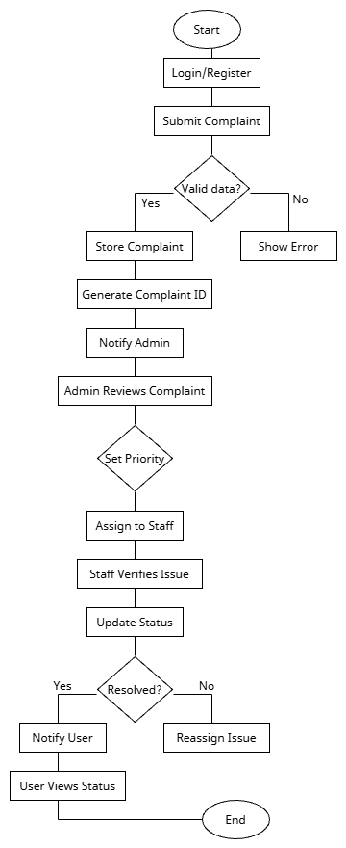
Civis Flow

Slide 11
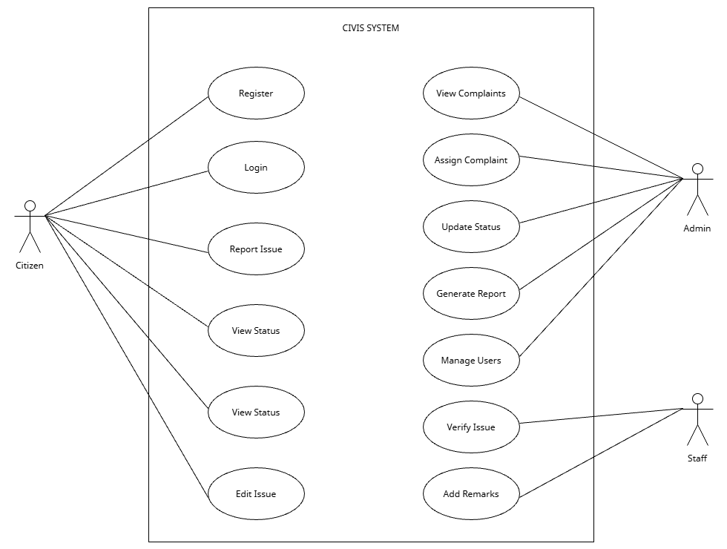
USE-CASE

Slide 12
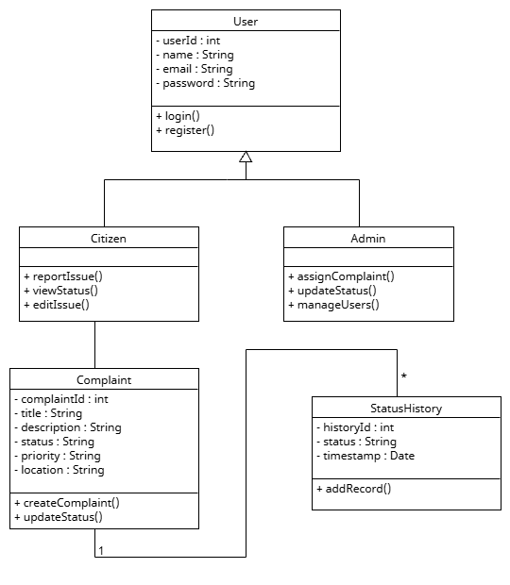
Class Diagram

Slide 13
Conclusion
CIVIS is a simple and useful platform for reporting civic issues. It helps users easily submit complaints and check their status, while authorities can manage and resolve them in an organized way.
The system improves transparency and communication, making the complaint process faster and more efficient. Overall, it helps in better handling of civic issues and improves user experience.

Slide 14
Thank You

