Slide 1
OPERATING SYSTEMS
Basics & Types of
Operating System
From firmware boot to kernel services,
process isolation and modern OS architectures
Applications
System Calls
Kernel
Hardware
Lecture 1–2 • Conceptual diagrams • Engineering graduate level

Slide 2
Lecture roadmap
OVERVIEW
A guided path from the role of an OS to its boot process and architectural choices.
01
02
03
OS as resource manager
Boot sequence
OS responsibilities
Definition, abstraction and isolation
UEFI, Secure Boot, initramfs and PID 1
Core services and resource management
04
05
06
Privilege boundary
Kernel architectures
Traditional → modern
User space, kernel space and system calls
Monolithic vs. microkernel
How OS designs adapt to cloud-native systems
BASICS & TYPES OF OPERATING SYSTEM • LECTURE 1–2
02

Slide 3
What is an operating system?
FOUNDATIONS
The OS provides controlled abstractions between applications and physical resources.
An OS is a system-software layer that:
Modern system-design lens
• Manages hardware resources such as CPU, memory, storage and devices.
• Provides standard abstractions and services for applications.
• Enforces protection and isolation between processes.
• Coordinates access to shared resources while maintaining system stability.
RESOURCE MANAGER
ISOLATION PROVIDER
SERVICE PLATFORM
Apps do not need to manage hardware directly.
BASICS & TYPES OF OPERATING SYSTEM • LECTURE 1–2
03

Slide 4
Core functions of an operating system
FOUNDATIONS
These functions work together to provide a stable and efficient execution environment.
Process management
Memory management
File-system management
Create, schedule, synchronize and terminate processes.
Allocate RAM, maintain virtual memory and protect address spaces.
Organize files, directories, permissions and persistent storage.
Device & I/O management
Security & protection
Networking
Coordinate drivers, interrupts, buffering and device access.
Authenticate users and enforce access controls and isolation.
Provide sockets, protocol stacks and communication services.
BASICS & TYPES OF OPERATING SYSTEM • LECTURE 1–2
04

Slide 5
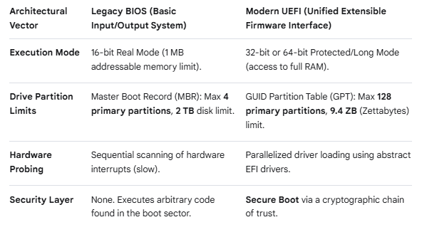
Booting Sequence
The firmware layer bridges raw physical hardware with the execution of the operating system kernel.

Slide 6
Booting sequence: from power-on to user space
BOOT PROCESS
Firmware prepares the platform; the bootloader loads the kernel; the kernel initializes user space.
1
2
3
4
5
6
Power on
UEFI / Secure Boot
Bootloader
Kernel init
Pivot root
PID 1
CPU reset vector
Platform checks & trust chain
Selects kernel + initramfs
Memory, scheduler, drivers
Switch to real root filesystem
systemd / init starts services
Firmware → Bootloader → Linux kernel → Real root filesystem → Services
The exact firmware stages and Secure Boot behavior depend on platform configuration.
BASICS & TYPES OF OPERATING SYSTEM • LECTURE 1–2
05

Slide 7
Kernel initialization and pivot_root
BOOT PROCESS
Early userspace bridges the kernel to the production root filesystem.
01
02
03
Kernel initializes
Mount initramfs
Early userspace runs
Sets up core memory management, scheduling and hardware subsystems.
Creates a temporary root environment in RAM.
Loads storage / network drivers and handles decryption where required.
04
05
Real root becomes available
pivot_root / switch root
The production filesystem can now be mounted.
The system changes its root filesystem and transitions away from initramfs.
The exact handoff command and cleanup behavior depend on the initramfs implementation.
BASICS & TYPES OF OPERATING SYSTEM • LECTURE 1–2
09

Slide 8
User-space initialization: systemd and PID 1
BOOT PROCESS
After the real root is ready, the kernel starts the first user-space process.
Orphan adoption
Zombie reaping
PID 1
Adopts orphaned descendants when their parent exits.
Collects child exit status through wait-family system calls.
init / systemd
Ancestor of user processes
Service manager
System startup coordinator
Service startup
Socket activation
Starts and supervises services according to dependencies.
Can start selected services when their sockets receive activity.
Precision note: PID 1 has special signal semantics; it is not simply immune to all signals.
BASICS & TYPES OF OPERATING SYSTEM • LECTURE 1–2
10

Slide 9
User space vs. kernel space
PROTECTION
Privilege boundaries restrict what application code can do directly.
Privilege boundary (simplified)
Kernel space
Privileged code can manage hardware, page tables, scheduling and device drivers.
USER SPACE • Ring 3
Apps • shells • user processes
User space
Applications have restricted access and normally request services through system calls.
KERNEL SPACE • Ring 0
Scheduler • memory • drivers
Why the boundary matters
A fault in an ordinary application is more containable than a fault in privileged kernel code.
Ring terminology is CPU-architecture dependent; Ring 0 / Ring 3 is a common x86 simplification.
BASICS & TYPES OF OPERATING SYSTEM • LECTURE 1–2
11

Slide 10
System calls: the controlled entry into the kernel
SYSCALLS
Example: an application requests a file read or sends data through a socket.
1
2
3
4
5
Request
Trap instruction
Dispatch
Execute
Return
Application calls read() / write()
CPU enters the syscall handler
Kernel identifies the syscall number
Kernel validates arguments and performs work
Result / error is returned to user space
Privilege transition ≠ always a process switch
Registers & execution state
A syscall changes execution privilege; scheduling may or may not switch processes.
Architecture-specific entry code saves the state needed to resume user execution.
BASICS & TYPES OF OPERATING SYSTEM • LECTURE 1–2
12

Slide 11
Kernel architecture paradigms
ARCHITECTURE
Where operating-system services run affects performance, isolation and maintainability.
Monolithic kernel
Microkernel
Most core services run in kernel space.
Only minimal mechanisms remain in kernel space.
Scheduler
VFS
IPC
Scheduler
Basic memory
Drivers
File systems
Protocols
Network
Drivers
Strength: fast in-kernel communication.
Trade-off: a faulty driver can compromise the kernel.
Strength: stronger fault isolation.
Trade-off: IPC can add communication overhead.
Examples in the source material: Linux / FreeBSD (monolithic family); seL4 / QNX / Zircon (microkernel family).
BASICS & TYPES OF OPERATING SYSTEM • LECTURE 1–2
13

Slide 12
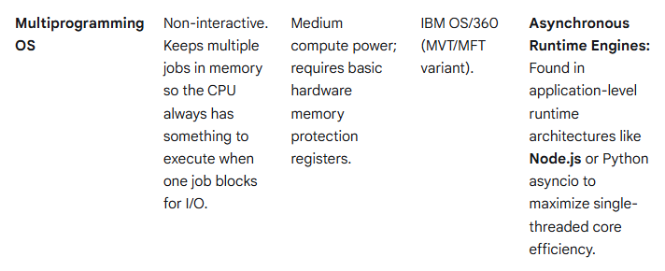
Types of OS (Traditional Vs Modern Adaptation)

Slide 13
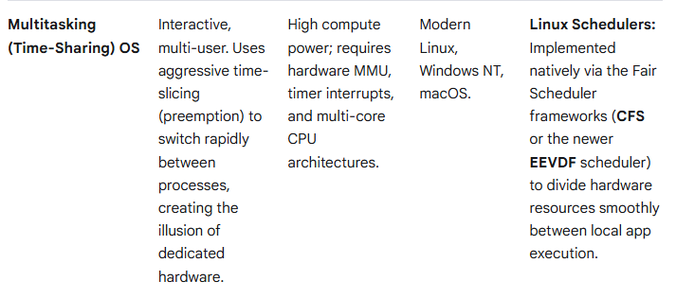
Types of OS (Traditional Vs Modern Adaptation)

Slide 14
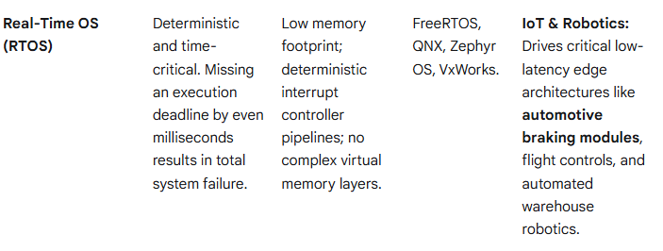
Types of OS (Traditional Vs Modern Adaptation)

Slide 15
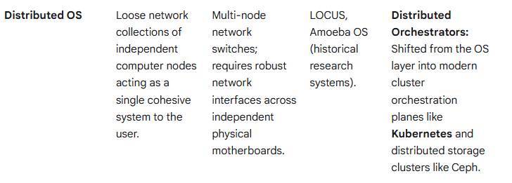
Types of OS (Traditional Vs Modern Adaptation)

Slide 16
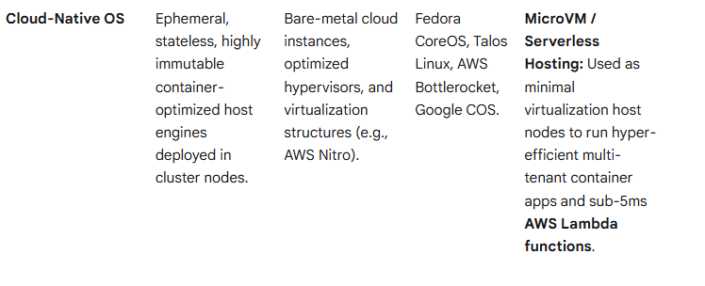
Types of OS (Traditional Vs Modern Adaptation)

Slide 17
Types of OS: traditional foundations to modern adaptation
OS LANDSCAPE
The OS role stays familiar, but deployment constraints and operational models evolve.
Traditional general-purpose OS
Container-optimized OS
MicroVM / serverless hosting
• Broad device and application support
• Interactive administration and package tools
• Flexible for desktops and servers
• General-purpose service footprint
• Minimal, purpose-built host environment
• Often immutable or read-only root design
• Managed declaratively for cluster nodes
• Examples: Fedora CoreOS, Talos Linux, Bottlerocket
• Lightweight virtual-machine boundary
• Hypervisor-based tenant separation
• Designed for fast provisioning and density
• Example: Firecracker-backed serverless infrastructure
Modern adaptation: immutable hosts + containers + stronger isolation where the threat model requires it.
BASICS & TYPES OF OPERATING SYSTEM • LECTURE 1–2
14

Slide 18
Key takeaways
OS role
Manage resources, abstract hardware and isolate applications.
Boot chain
Firmware → bootloader → kernel → root filesystem → PID 1.
initramfs
Enables early userspace to prepare storage before mounting the real root.
Privilege boundary
System calls provide controlled access to privileged kernel services.
Architecture choice
Kernel structure trades communication speed against fault isolation.
Modern deployments
Minimal host OS designs and microVMs address cloud operational and isolation needs.
Think like a system designer: understand the boundary, the resource, and the failure mode.
BASICS & TYPES OF OPERATING SYSTEM • LECTURE 1–2
15

