Slide 1
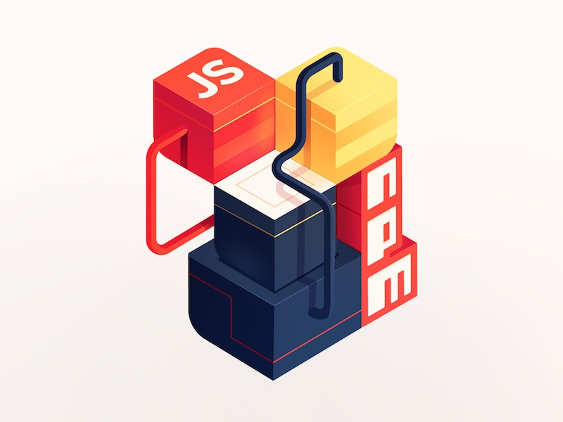
Notes:
Package version manager

Slide 2
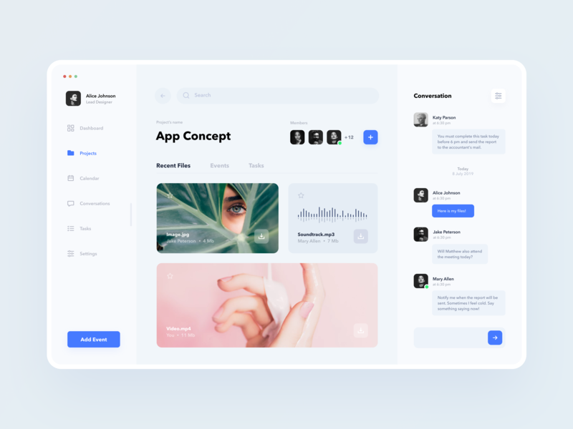
Another good template

Slide 3
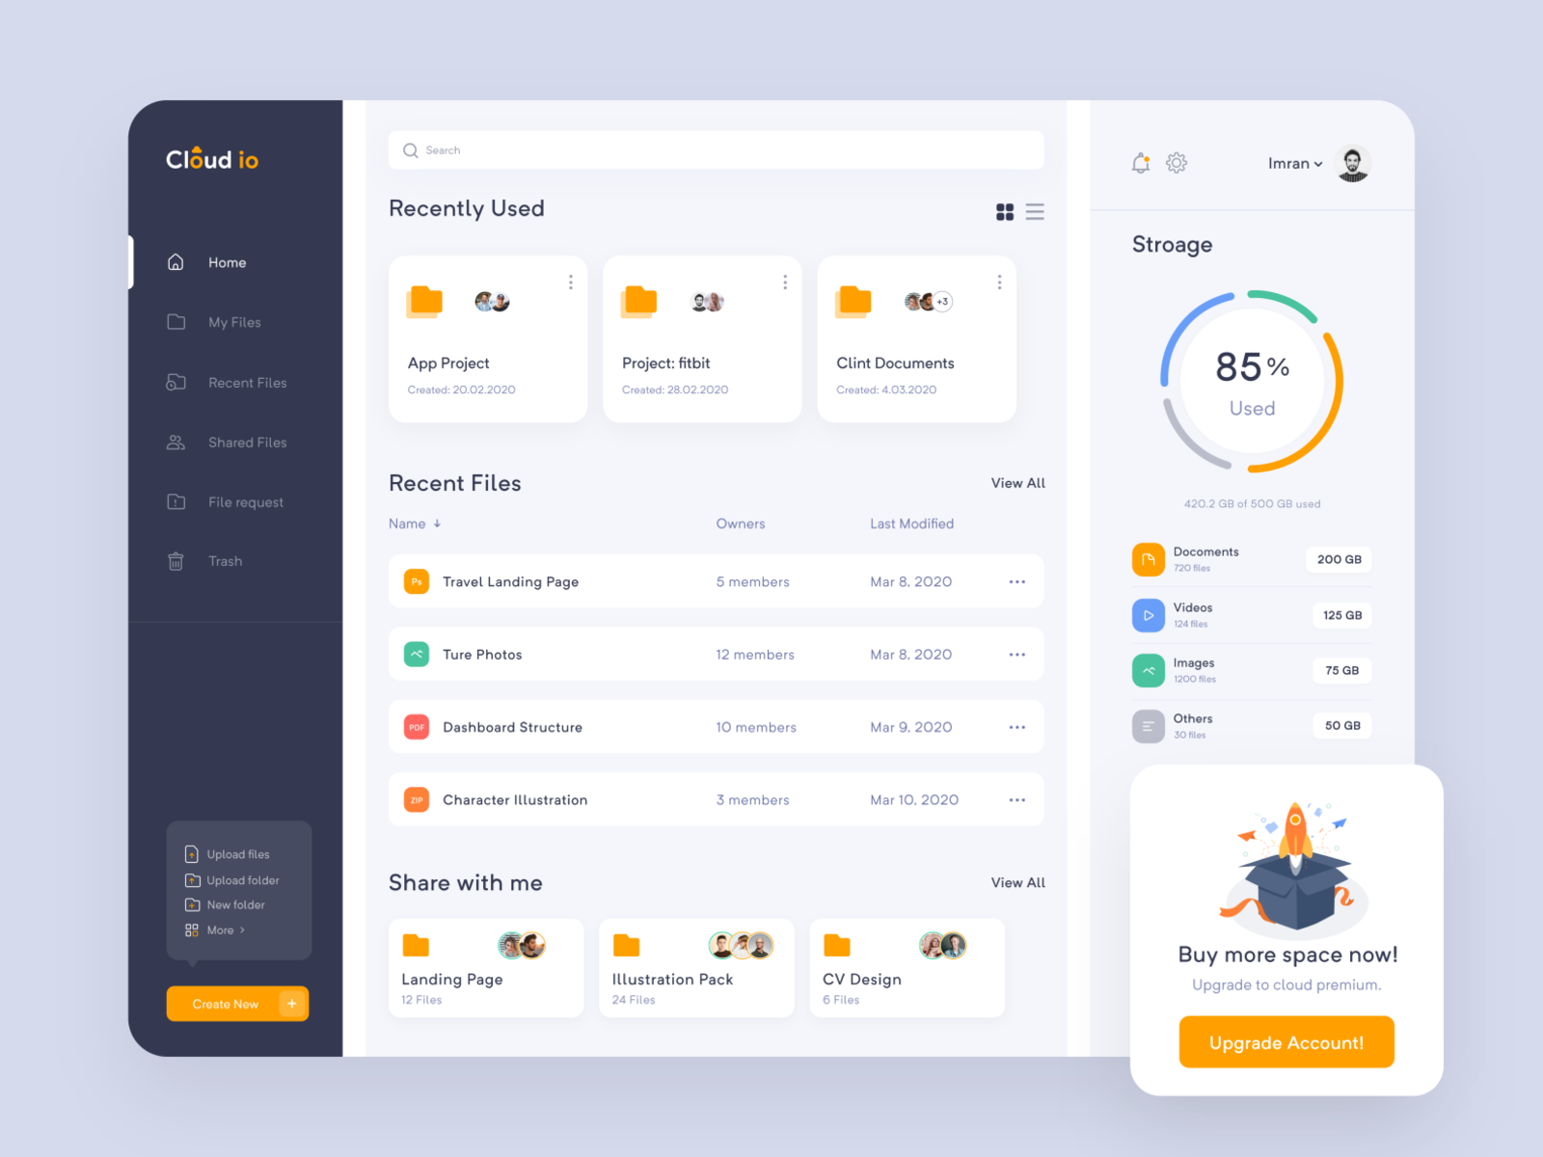
Show Healthy/Out of date dependencies dist using npm audit
Author Name from package.json file
Tabs: All/Update(8)
List out of date dependencies with show all
List all dependencies here with Columns*
Notes:
*columns: common icon for package, version number, update button(enabled if update available. Prominent button if npm audit asks to update)

Slide 4
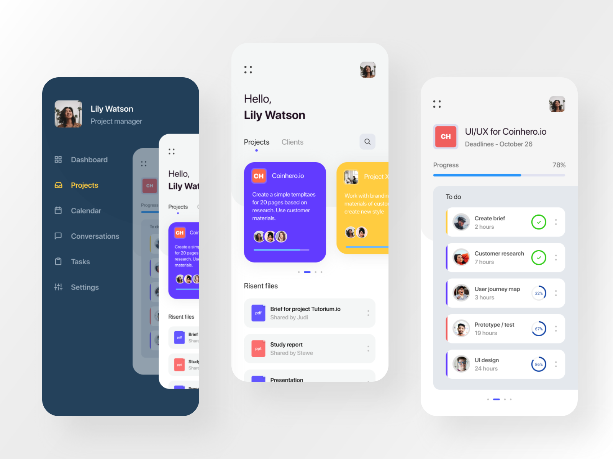
Package description from package.json
Author name from package.json
Show progress while
updating the selected
dependencies like we
see in PlayStore
Packages List
packages list
that are getting
updated with same
template except the
individual progress we’ll
show an infinite loader
as displayed on slide 6

Slide 5
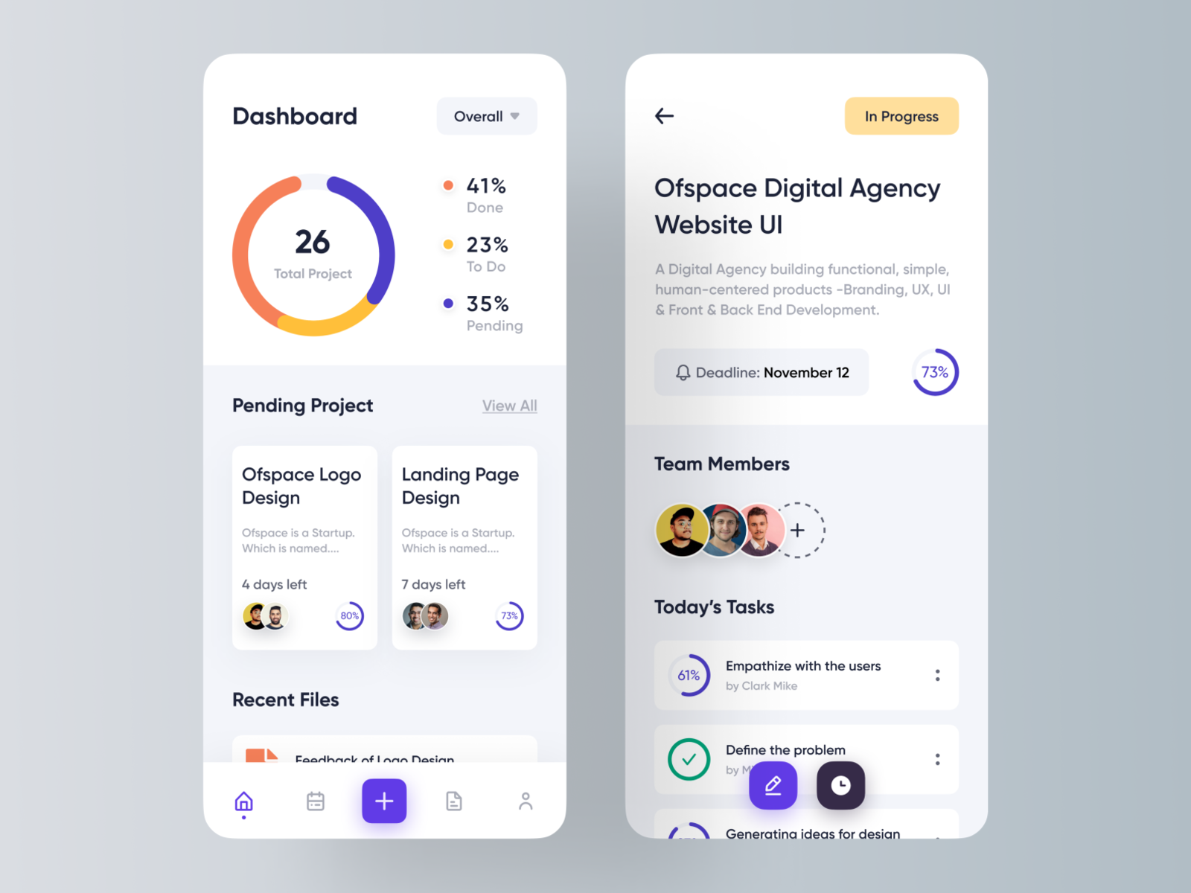
Same insight as desktop page

Slide 6
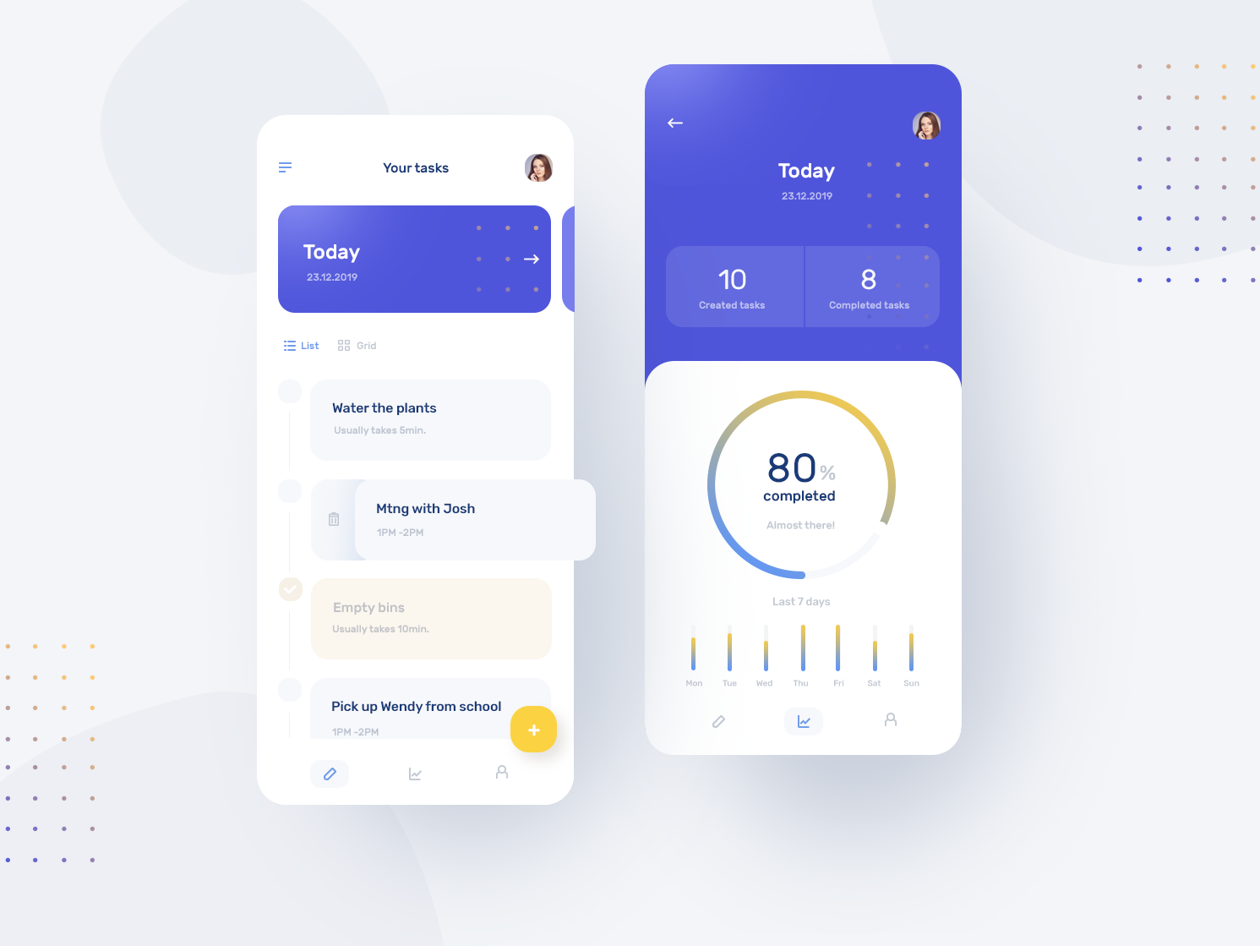
This could also be the landing page
with minimalistic approach.
Only show insights at first, then take
user to full list of packages and update
flow.
remove bars and add Updates button with
notification bubble as number
of packages to be updated

Slide 7
