Slide 1

Conformal Risk Control for
Safety-Critical Wildfire
Evacuation Mapping
A Comparative Study of Tabular, Spatial, and Graph-Based Models
Baljinnyam Dayan
Imperial College London | ELEC70122 | March 2026

Slide 2

Why This Matters
False Negatives Kill
92.8%
Evacuation perimeters are built pixel by pixel — each missed fire pixel is a gap in the safety boundary. Standard models miss 48–93% of fires at conventional thresholds.
of fires missed by LightGBM
at standard threshold (p ≥ 0.5)
Shadow Evacuations
61.0%
48.5%
Over-broad perimeters cause residents outside the official zone to self-evacuate, congesting roads and trapping those in genuine danger (Zhao et al., 2022).
missed by U-Net
missed by ResGNN
No model is safe at p ≥ 0.5. We need distribution-free guarantees.

Slide 3

The Research Gap
Wildfire ML
Conformal Prediction
The Missing Link
Extensive work on spread prediction (CNNs, GNNs, U-Nets). All evaluate on accuracy metrics: F1, IoU, AUROC.
CRC provides distribution-free safety guarantees. Applied to medical imaging, autonomous driving, NLP.
CRC covers medical imaging and autonomous driving, but wildfire spread — where false negatives are deadliest — lacks distribution-free guarantees.
First application of conformal risk control to wildfire spread prediction

Slide 4


Related Work
Wildfire ML
Conformal Methods
Jain & Coogan (2020) — Review
Radke et al. (2019) — FireCast
Huot et al. (2022) — NDWS dataset
All use accuracy metrics only
Vovk et al. (2005) — Foundations
Romano et al. (2020) — Adaptive sets
Angelopoulos et al. (2022) — CRC
Not applied to geospatial/disaster
Calibration & UQ
Safety-Critical ML
Guo et al. (2017) — Miscalibration
Platt (1999) — Platt scaling
No finite-sample guarantees
Heuristic uncertainty only
Amodei et al. (2016) — AI safety
FN cost ≫ FP cost in evacuation
Formal guarantees needed, not just empirical perf.
Wildfire: no guarantees until now

Slide 5



Our Approach
NDWS
Dataset
3 Model
Families
CRC
Calibration
Safe
Decisions
18,545 samples
64×64 patches
12 channels
LightGBM
Tiny U-Net
ResGNN-UNet
FNR ≤ 0.05
Distribution-free
Finite-sample
95%+ coverage
Tight zones
3-way triage
Key Design Decisions
Deterministic splits (seed 42, 70/15/15) — calibration set never used in training
Same data + splits across all models — fair architectural comparison
CRC applied uniformly post-hoc — model-agnostic safety wrapper

Slide 6

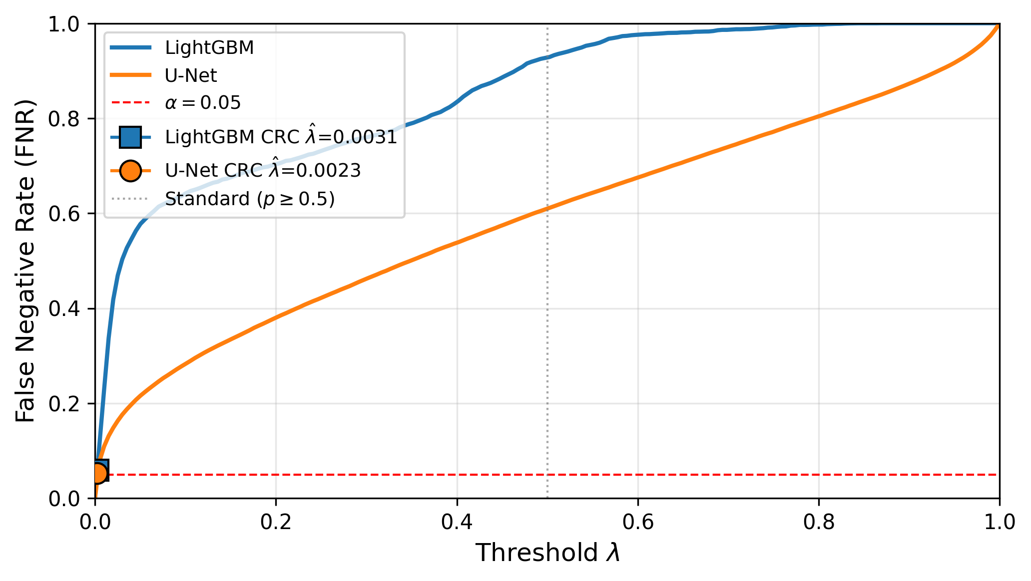
How CRC Works
The Intuition
The Guarantee
1
Collect predicted probabilities on held-out calibration set
E[FNR(λ̂)] ≤ α = 0.05
Holds regardless of model quality, calibration, or architecture
2
Sort the probabilities of true fire pixels
3
Pick the α-quantile as threshold λ̂ (the "safety cutoff")
Key Insight
4
Apply λ̂ unchanged to test data → guaranteed FNR ≤ α
CRC decouples safety from efficiency.
Model quality → evacuation zone size
CRC → fire coverage guarantee
FNR vs. threshold: U-Net stays safe over a much wider range

Slide 7

Three Model Families
LightGBM
Tiny U-Net
ResGNN-UNet
Tabular Baseline
Spatial CNN
Graph + CNN Hybrid
Pixel-level features (12 channels)
Each pixel treated independently
5% pixel subsampling for memory
Binary cross-entropy objective
470K parameters
2 encoder + 2 decoder blocks
Skip connections, 1×1 conv head
AdamW + cosine annealing, 50 epochs
229K parameters
CNN encoder → GAT bottleneck → decoder
3 GATConv layers, 4 heads each
Early-stopped at epoch 12/25
AUROC 0.854
AUROC 0.969
AUROC 0.951
Increasing complexity: pixel-independent → local spatial → graph propagation

Slide 8
Three-Way CRC Extension
SAFE
MONITOR
EVACUATE
p̂ < λ_min
λ_min ≤ p̂ < λ_max
p̂ ≥ λ_max
No action needed
Human review
Immediate evacuation
Cost Parameters
c_fn = 5 (missed fire cost) vs c_fp = 1 (false alarm cost)
Asymmetric: missing fire risks lives; over-alerting causes logistics issues
Shift interval ρ ∈ [0.9, 1.1] for mild prevalence variation
Routes uncertain pixels to human review instead of forcing binary automated decisions

Slide 9
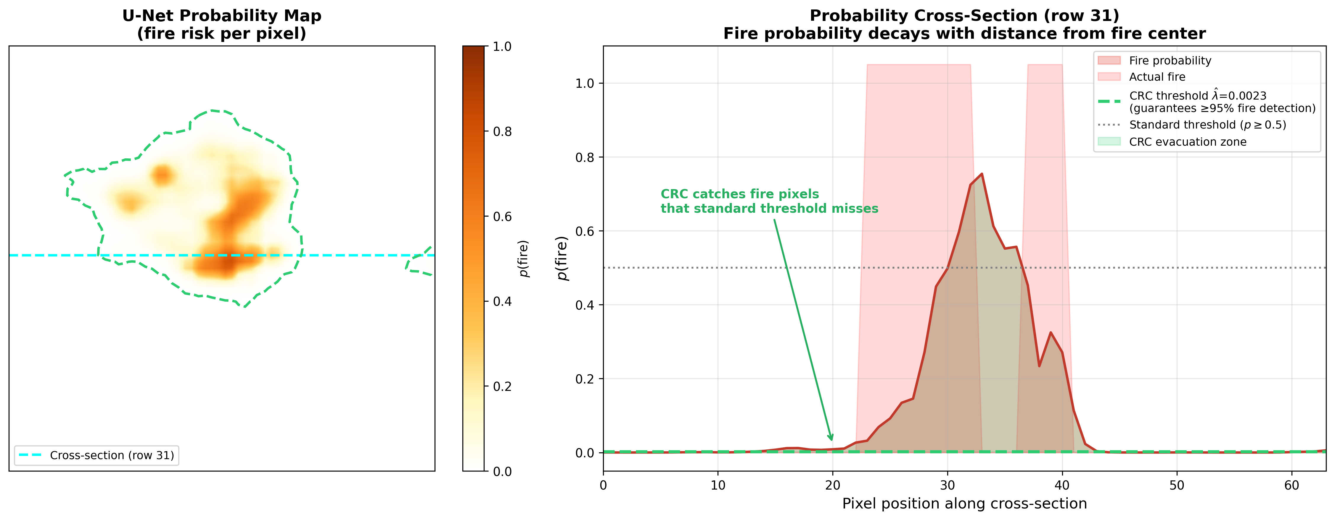
Why Standard Thresholds Fail
Probability cross-section through a U-Net prediction. Standard threshold (p ≥ 0.5, gray) misses most of the fire region. CRC threshold (λ̂ = 0.002, green) captures it entirely.

Slide 10
Results: CRC Delivers Safety
Method | Params | λ̂ | Coverage ↑ | FNR ↓ | Set Size ↓ | AUROC ↑
LGBM (p≥0.5) | — | .500 | 7.2% | .928 | 0.1% | .854
LGBM + CRC | — | .003 | 94.1% | .059 | 62.6% | .854
U-Net (p≥0.5) | 470K | .500 | 39.0% | .610 | 0.7% | .969
U-Net + CRC | 470K | .002 | 94.7% | .053 | 14.9% | .969
ResGNN (p≥0.5) | 229K | .500 | 51.5% | .485 | — | .951
4.2×
smaller evacuation zones
U-Net vs LightGBM
under same safety guarantee
95%+
fire coverage achieved
by both models with CRC
regardless of architecture

Slide 11
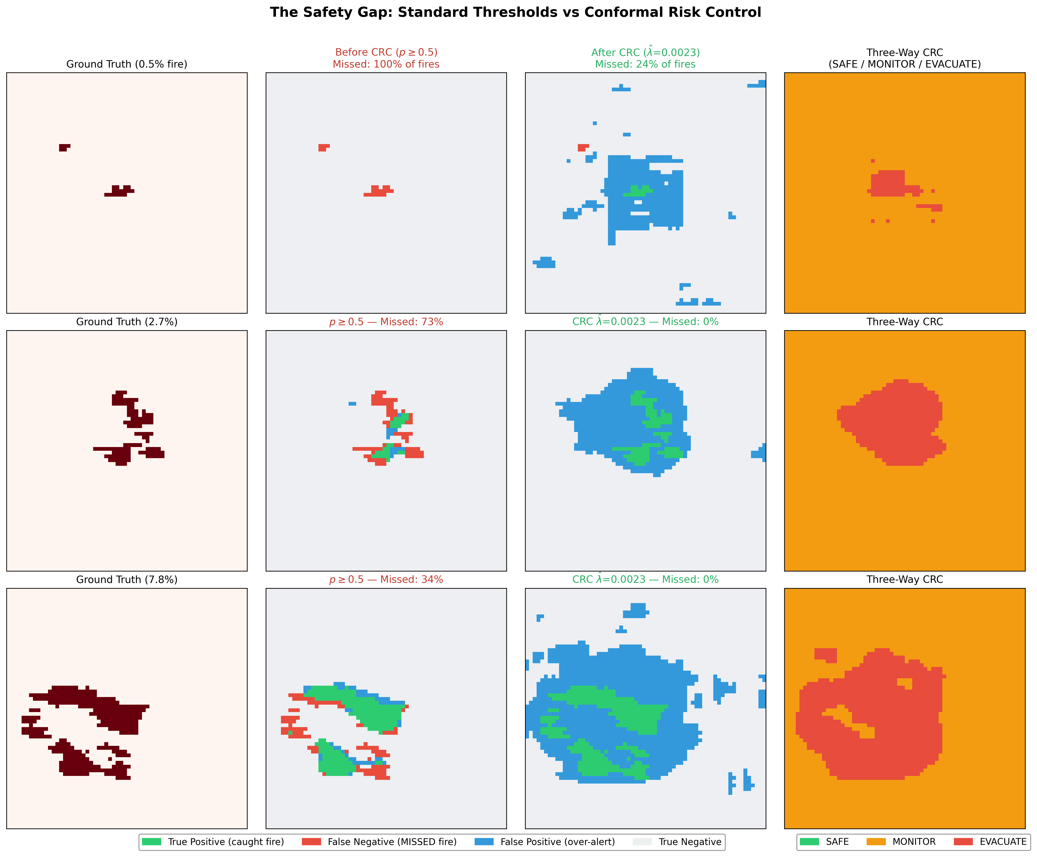
Before vs. After CRC
Three test samples (0.5%, 2.7%, 7.8% fire prevalence). Red = missed fire. Green = correctly detected. Three-way zones show SAFE/MONITOR/EVACUATE routing.
Standard threshold: 34–100% fires missed → CRC: 0–2% fires missed

Slide 12
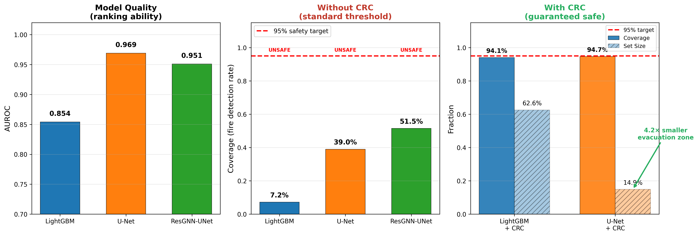
The Central Finding
Model architecture determines evacuation efficiency. CRC determines safety.
Complexity ≠ better separation: ResGNN-UNet (229K, graph attention) achieves lower AUROC than Tiny U-Net (470K, standard conv) on 64×64 patches.

Slide 13
Three-Way Zone Analysis
Model | SAFE | MONITOR | EVACUATE
LightGBM | 0.0% | 95.96% | 4.04%
U-Net | 0.0% | 94.90% | 5.10%
The SAFE Zone Collapses
With ~5% fire prevalence:
B_pw = max(5 × 0.05, 1 × 0.95) = 0.95
Dominated by majority-class term c_fp · π₀. The shift correction exceeds the CRC threshold, pushing λ_min below zero. All non-evacuated pixels routed to human review.
Fundamental limitation of prevalence-weighted bounds in rare-event regimes (π₀ ≫ π₁)

Slide 14
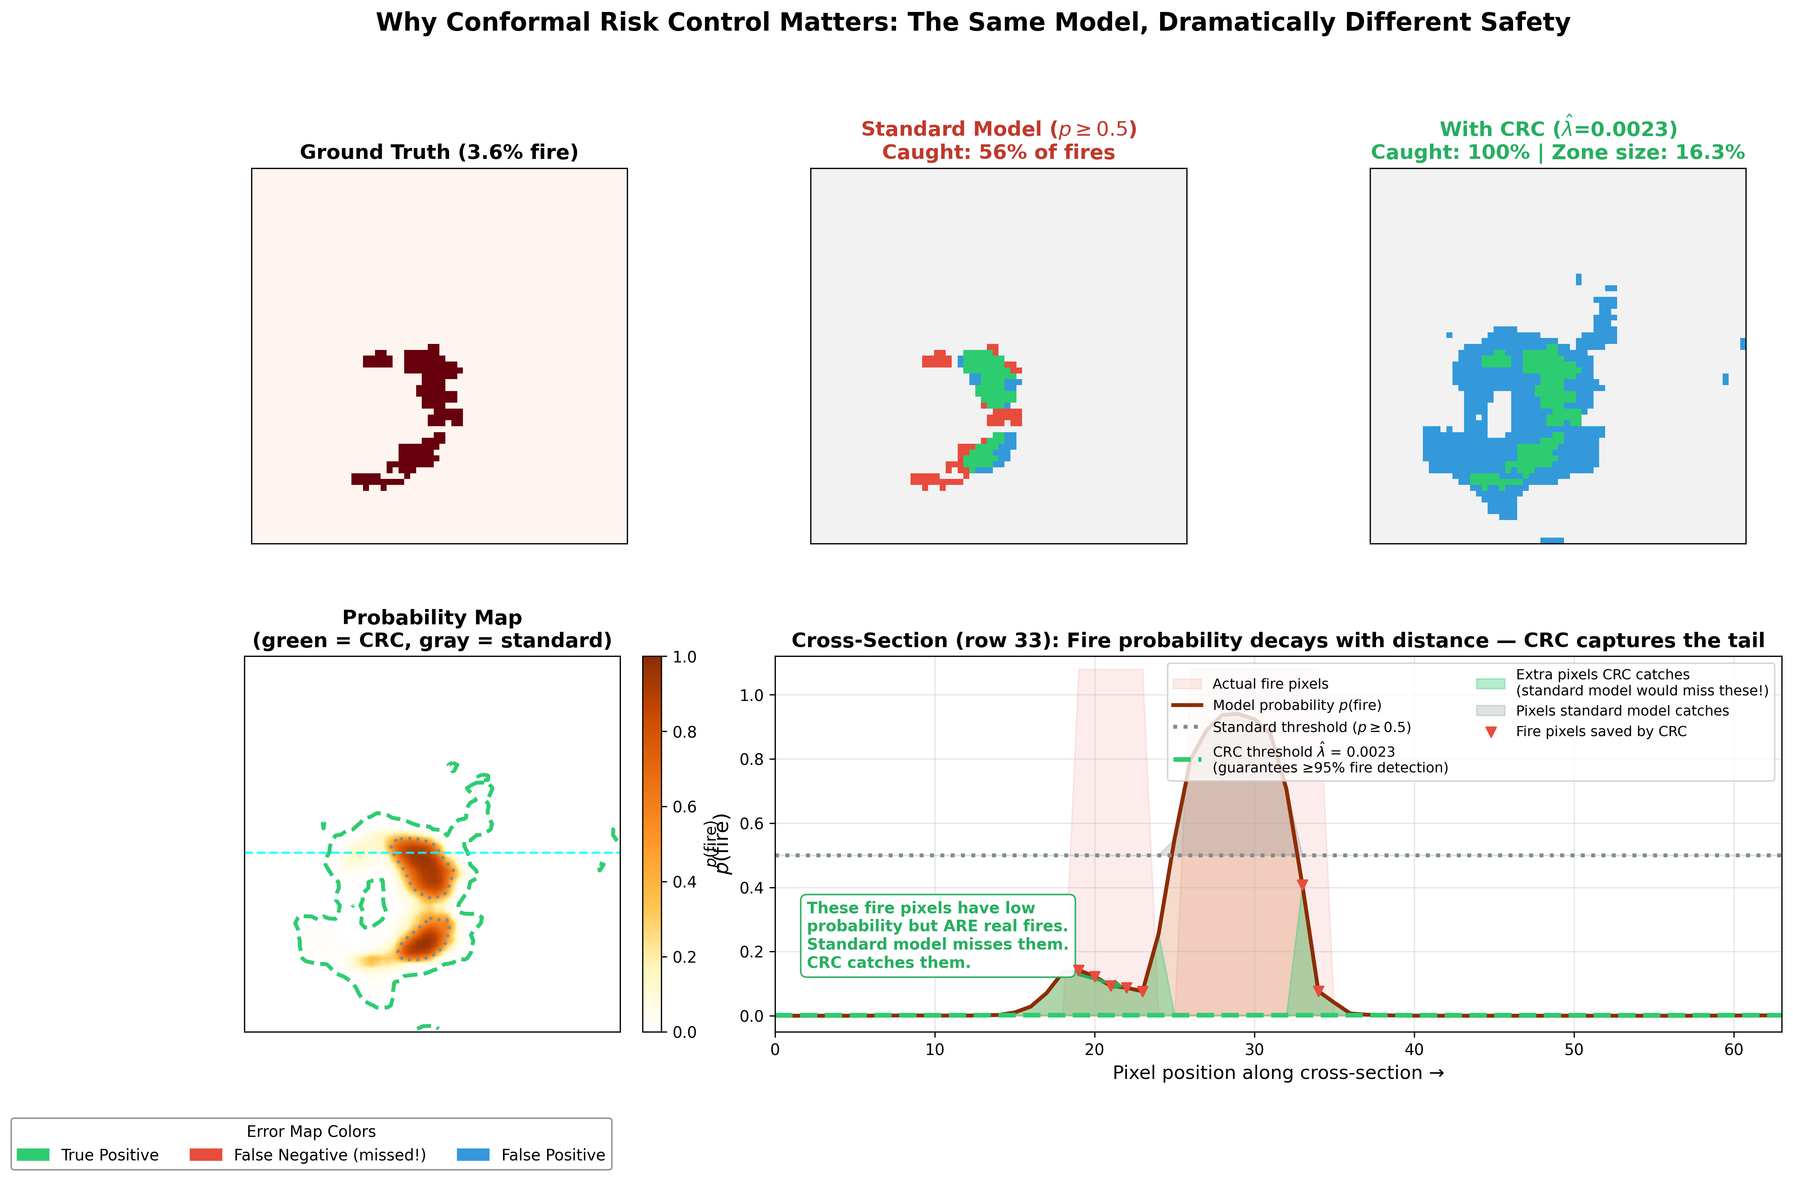
CRC Deep Dive: Same Model, Different Thresholds
Standard thresholding (p ≥ 0.5) catches 56% of fires. CRC (λ̂ = 0.002) catches 100%. Green shading marks pixels saved by CRC.

Slide 15
Conclusion
No model is safe without CRC
1
Standard thresholding captures only 7–52% of fires across all architectures.
CRC guarantees safety regardless of model
2
Both calibrated models achieve ≥94% coverage on held-out test data.
Model quality determines efficiency, not safety
3
Tiny U-Net achieves 4.2× tighter evacuation zones than LightGBM under identical CRC guarantee.
Complexity without separation is waste
4
Graph-augmented ResGNN-UNet underperforms standard U-Net in AUROC despite more complex architecture.
A simple model + CRC provides stronger safety AND tighter zones than a complex model evaluated on F1 alone.

Slide 16


Future Work
Class-Conditional CRC
Image-Level CRC
Calibrate each zone boundary independently (FNR-CRC for λ_max, FPR-CRC for λ_min) to resolve SAFE zone collapse under imbalance.
Move from pixel-pooled to per-image FNR losses. Restores theoretical exchangeability, produces operationally meaningful per-image guarantees.
AUROC–Efficiency Formalization
Temporal & Geographic Shift
Derive closed-form relationship between model discrimination and evacuation cost. Answer: what AUROC for a target zone size?
Validate CRC robustness under seasonal/climate shift using temporally stratified splits and multi-region datasets.

Slide 17

Thank You
Questions?
Baljinnyam Dayan
baljinnyam.dayan25@imperial.ac.uk
github.com/baljinnyamday/wildfire-evacuation-crc

