Slide 1

Conformal Risk Control for
Safety-Critical Wildfire
Evacuation Mapping
A Comparative Study of Tabular, Spatial, and Graph-Based Models
Baljinnyam Dayan
Imperial College London | ELEC70122 | March 2026

Slide 2


Why This Matters
False Negatives Kill
92.8%
A fire pixel classified as safe means people stay in a burning zone. Standard ML models miss 48–93% of fires at conventional thresholds.
of fires missed by LightGBM
at standard threshold (p ≥ 0.5)
Shadow Evacuations
61.0%
48.5%
Over-broad perimeters cause residents outside the official zone to self-evacuate, congesting roads and trapping those in genuine danger (Zhao et al., 2022).
missed by U-Net
missed by ResGNN
No model is safe at p ≥ 0.5. We need distribution-free guarantees.

Slide 3

The Research Gap
Wildfire ML
Conformal Prediction
The Missing Link
Extensive work on spread prediction (CNNs, GNNs, U-Nets). All evaluate on accuracy metrics: F1, IoU, AUROC.
CRC provides distribution-free safety guarantees. Applied to medical imaging, autonomous driving, NLP.
The domain where false negatives are most dangerous has no formal safety guarantees.
First application of conformal risk control to wildfire spread prediction

Slide 4
Related Work
Wildfire ML
Conformal Methods
Jain & Coogan (2020) — Review
Radke et al. (2019) — FireCast
Huot et al. (2022) — NDWS dataset
All use accuracy metrics only
Vovk et al. (2005) — Foundations
Romano et al. (2020) — Adaptive sets
Angelopoulos et al. (2022) — CRC
Not applied to geospatial/disaster
Calibration & UQ
Safety-Critical ML
Guo et al. (2017) — Miscalibration
Platt (1999) — Platt scaling
No finite-sample guarantees
Heuristic uncertainty only
Amodei et al. (2016) — AI safety
FN cost ≫ FP cost in evacuation
Formal guarantees needed, not just empirical perf.
Wildfire: no guarantees until now

Slide 5

Our Approach
NDWS
Dataset
3 Model
Families
CRC
Calibration
Safe
Decisions
18,545 samples
64×64 patches
12 channels
LightGBM
Tiny U-Net
ResGNN-UNet
FNR ≤ 0.05
Distribution-free
Finite-sample
95%+ coverage
Tight zones
3-way triage
Key Design Decisions
Deterministic splits (seed 42, 70/15/15) — calibration set never used in training
Same data + splits across all models — fair architectural comparison
CRC applied uniformly post-hoc — model-agnostic safety wrapper

Slide 6

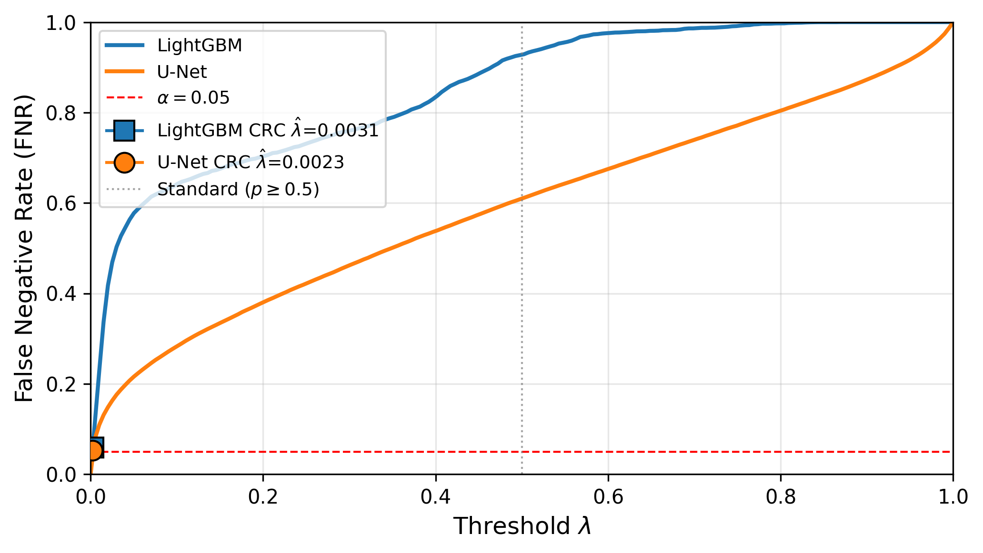
How CRC Works
The Intuition
The Guarantee
1
Collect predicted probabilities on held-out calibration set
E[FNR(λ̂)] ≤ α = 0.05
Holds regardless of model quality, calibration, or architecture
2
Sort the probabilities of true fire pixels
3
Pick the α-quantile as threshold λ̂ (the "safety cutoff") and Apply λ̂ unchanged to test data → guaranteed FNR ≤ α
Key Insight
4
CRC decouples safety from efficiency.
Model quality → evacuation zone size
CRC → fire coverage guarantee
FNR vs. threshold: U-Net stays safe over a much wider range

Slide 7
Three Model Families
AUROC 0.854
AUROC 0.969
AUROC 0.951
LightGBM
Tiny U-Net
ResGNN-UNet
Tabular Baseline
Spatial CNN
Graph + CNN Hybrid
Pixel-level features (12 channels)
Each pixel treated independently
5% pixel subsampling for memory
Binary cross-entropy objective
470K parameters
2 encoder + 2 decoder blocks
Skip connections, 1×1 conv head
AdamW + cosine annealing, 50 epochs
229K parameters
CNN encoder → GAT bottleneck → decoder
3 GATConv layers, 4 heads each
Early-stopped at epoch 12/25
Increasing complexity: pixel-independent → local spatial → graph propagation

Slide 8
Three-Way CRC Extension
SAFE
MONITOR
EVACUATE
p̂ < λ_min
λ_min ≤ p̂ < λ_max
p̂ ≥ λ_max
No action needed
Human review
Immediate evacuation
Cost Parameters
c_fn = 5 (missed fire cost) vs c_fp = 1 (false alarm cost)
Asymmetric: missing fire risks lives; over-alerting causes logistics issues
Shift interval ρ ∈ [0.9, 1.1] for mild prevalence variation
Routes uncertain pixels to human review instead of forcing binary automated decisions

Slide 9
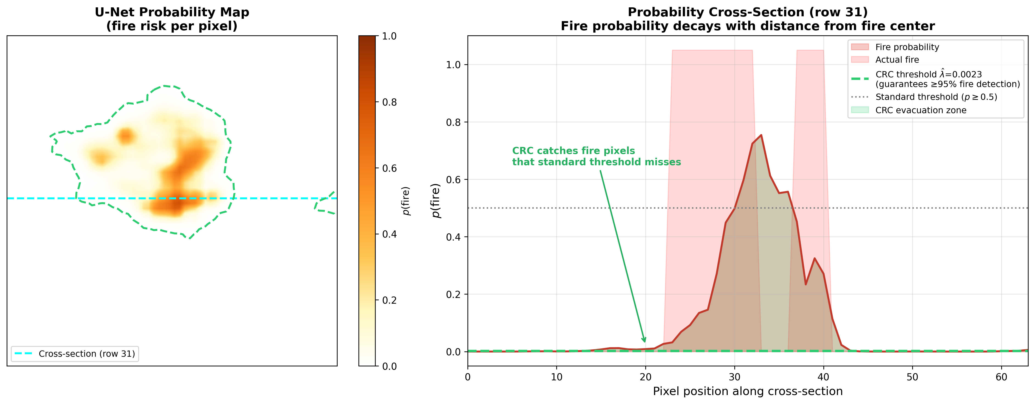
Why Standard Thresholds Fail
Probability cross-section through a U-Net prediction. Standard threshold (p ≥ 0.5, gray) misses most of the fire region. CRC threshold (λ̂ = 0.002, green) captures it entirely.

Slide 10
Results: CRC Delivers Safety
Method | Params | λ̂ | Coverage ↑ | FNR ↓ | Set Size ↓ | AUROC ↑
LGBM (p≥0.5) | — | .500 | 7.2% | .928 | 0.1% | .854
LGBM + CRC | — | .003 | 94.1% | .059 | 62.6% | .854
U-Net (p≥0.5) | 470K | .500 | 39.0% | .610 | 0.7% | .969
U-Net + CRC | 470K | .002 | 94.7% | .053 | 14.9% | .969
ResGNN (p≥0.5) | 229K | .500 | 51.5% | .485 | — | .951
4.2×
smaller evacuation zones
U-Net vs LightGBM
under same safety guarantee
95%+
fire coverage achieved
by both models with CRC
regardless of architecture

Slide 11
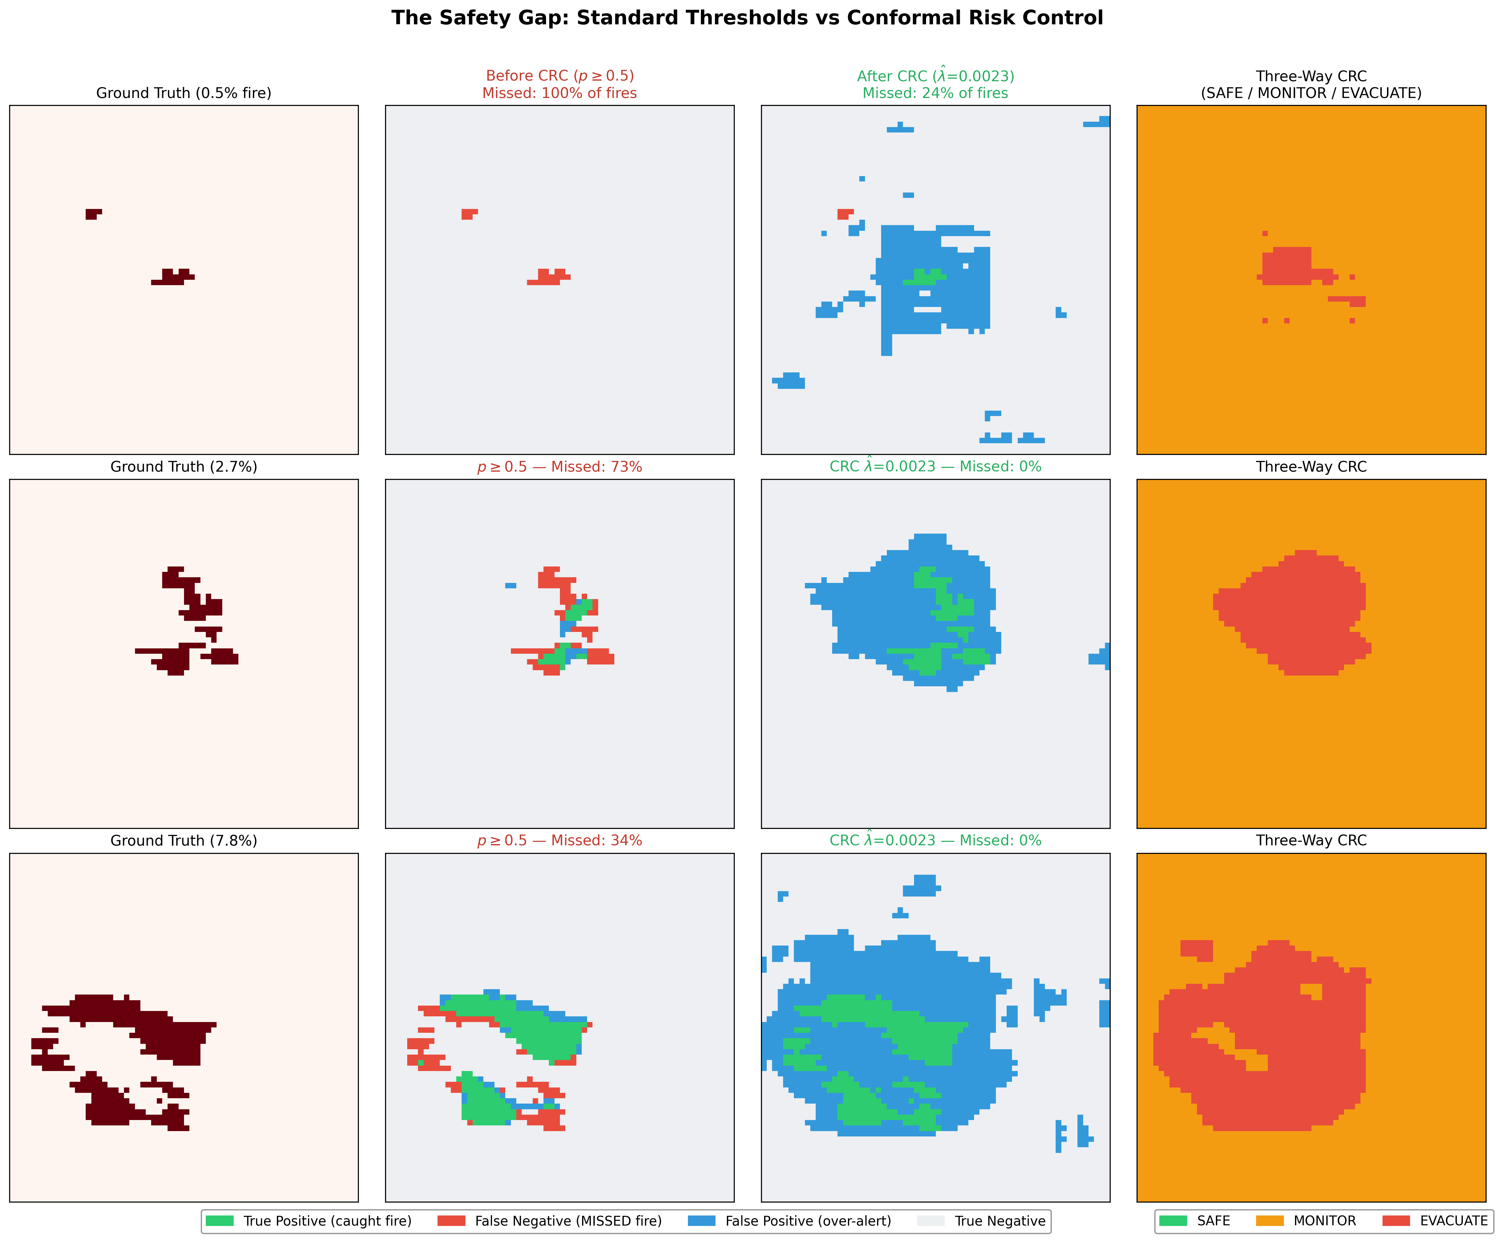
Before vs. After CRC
Standard threshold: 34–100% fires missed → CRC: 0–2% fires missed

Slide 12
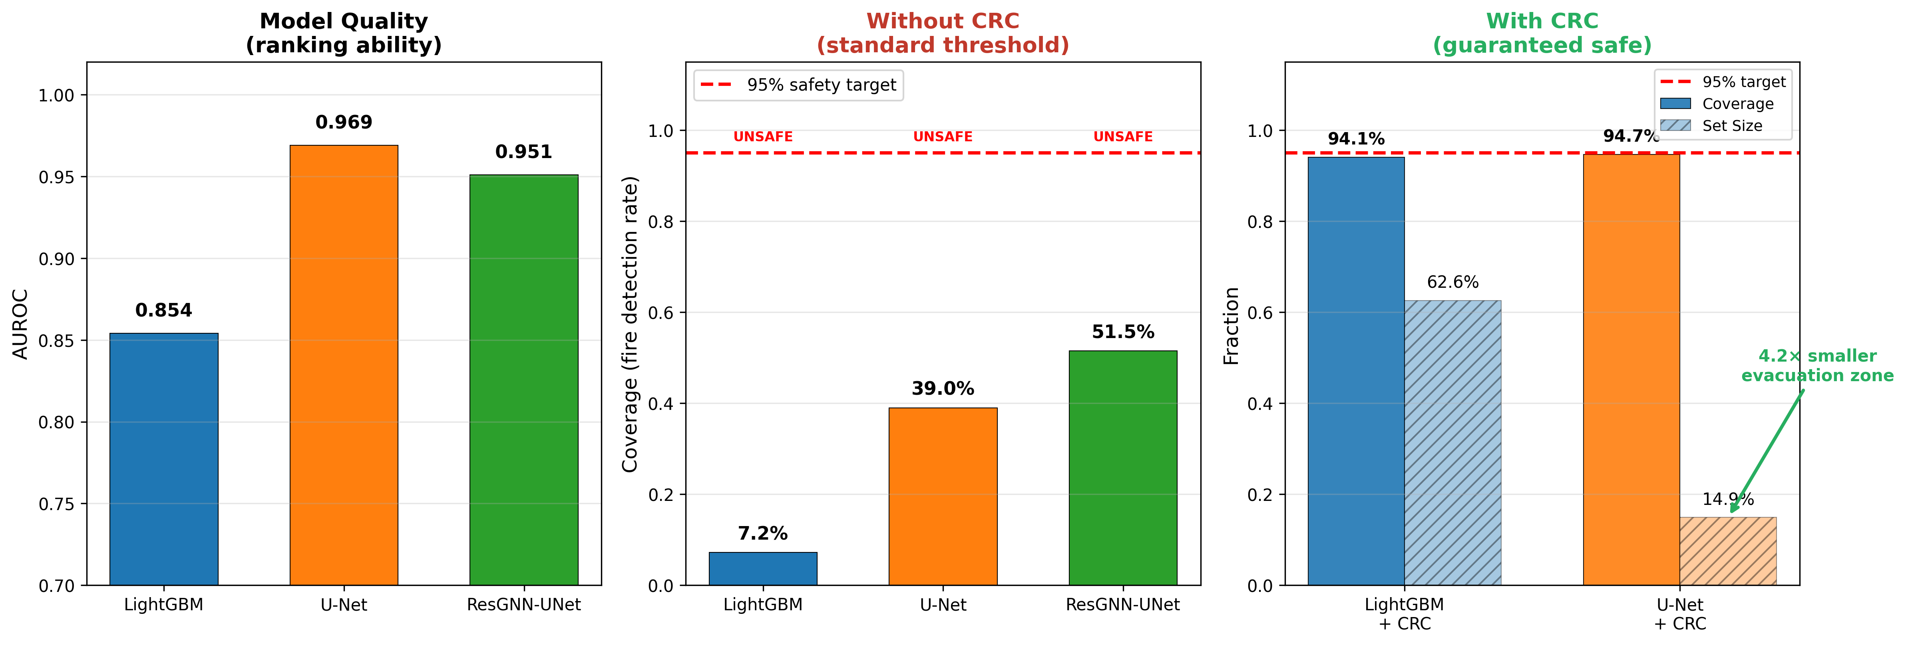
The Central Finding
Model architecture determines evacuation efficiency. CRC determines safety.
Complexity ≠ better separation: ResGNN-UNet (229K, graph attention) achieves lower AUROC than Tiny U-Net (470K, standard conv) on 64×64 patches.

Slide 13
Three-Way Zone Analysis
Model | SAFE | MONITOR | EVACUATE
LightGBM | 0.0% | 95.96% | 4.04%
U-Net | 0.0% | 94.90% | 5.10%
The SAFE Zone Collapses
With ~5% fire prevalence:
B_pw = max(5 × 0.05, 1 × 0.95) = 0.95
Dominated by majority-class term c_fp · π₀. The shift correction exceeds the CRC threshold, pushing λ_min below zero. All non-evacuated pixels routed to human review.
Fundamental limitation of prevalence-weighted bounds in rare-event regimes (π₀ ≫ π₁)

Slide 14
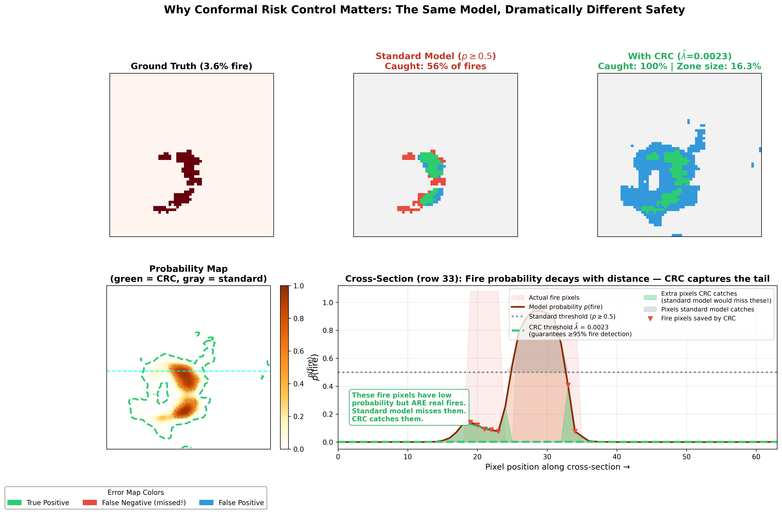
CRC Deep Dive: Same Model, Different Thresholds
Standard thresholding (p ≥ 0.5) catches 56% of fires. CRC (λ̂ = 0.002) catches 100%. Green shading marks pixels saved by CRC.

Slide 15
Conclusion
No model is safe without CRC
1
Standard thresholding captures only 7–52% of fires across all architectures.
CRC guarantees safety regardless of model
2
Both calibrated models achieve ≥94% coverage on held-out test data.
Model quality determines efficiency, not safety
3
Tiny U-Net achieves 4.2× tighter evacuation zones than LightGBM under identical CRC guarantee.
Complexity without separation is waste
4
Graph-augmented ResGNN-UNet underperforms standard U-Net in AUROC despite more complex architecture.
A simple model + CRC provides stronger safety AND tighter zones than a complex model evaluated on F1 alone.

Slide 16



Future Work
Class-Conditional CRC
Image-Level CRC
Calibrate each zone boundary independently (FNR-CRC for λ_max, FPR-CRC for λ_min) to resolve SAFE zone collapse under imbalance.
Move from pixel-pooled to per-image FNR losses. Restores theoretical exchangeability, produces operationally meaningful per-image guarantees.
AUROC–Efficiency Formalization
Temporal & Geographic Shift
Derive closed-form relationship between model discrimination and evacuation cost. Answer: what AUROC for a target zone size?
Validate CRC robustness under seasonal/climate shift using temporally stratified splits and multi-region datasets.

Slide 17

Thank You
Questions?
Baljinnyam Dayan
baljinnyam.dayan25@imperial.ac.uk
github.com/baljinnyamday/wildfire-evacuation-crc

