Slide 1
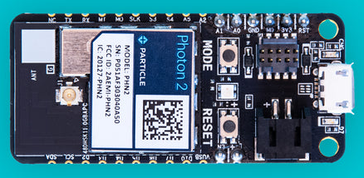
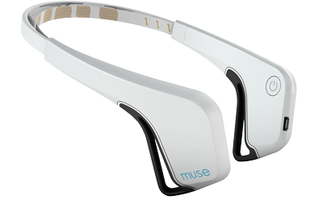
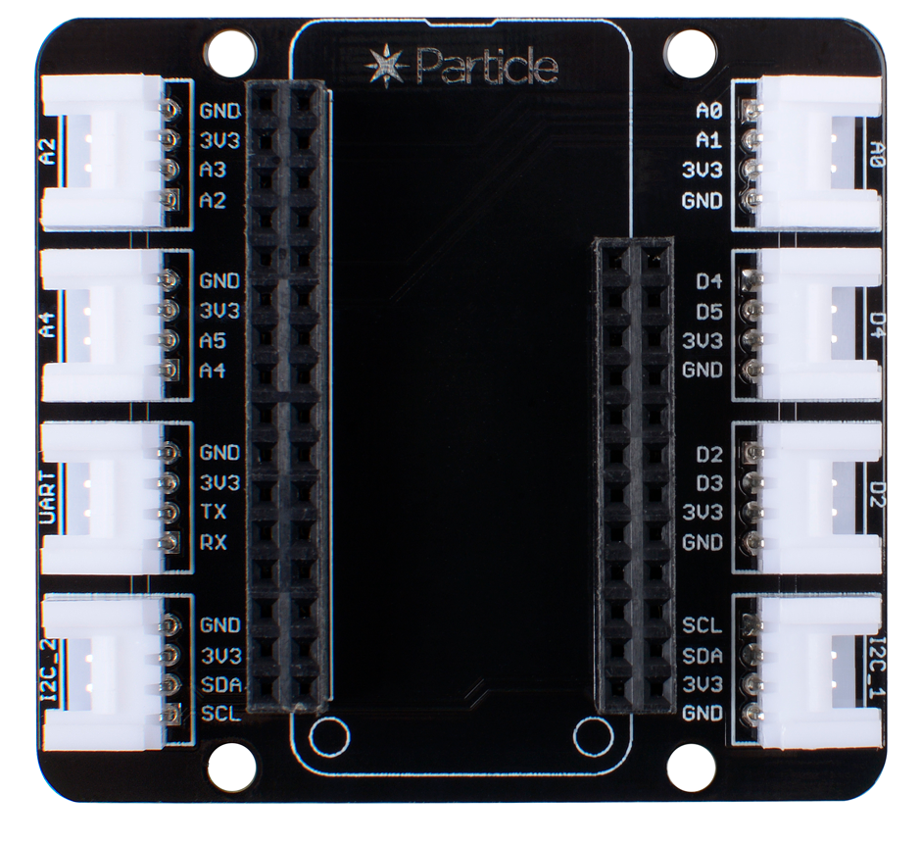
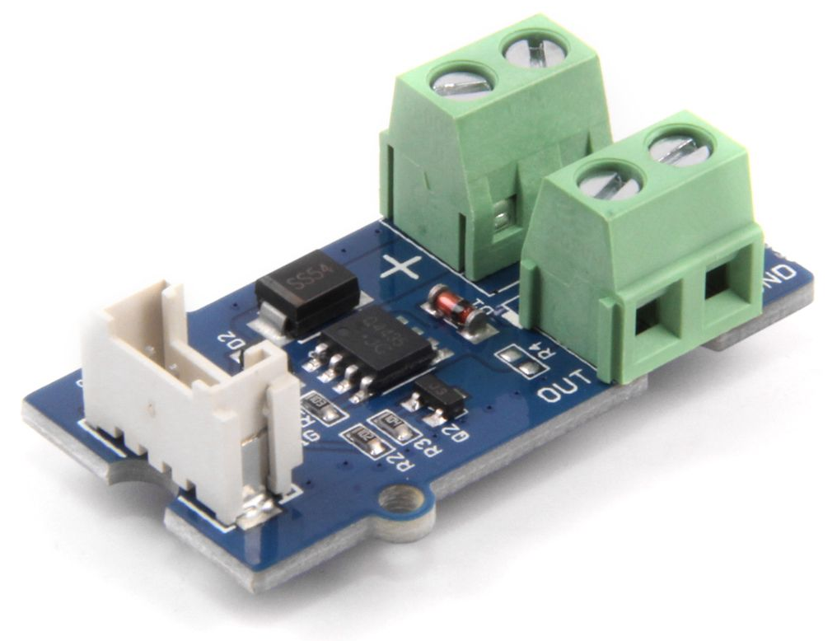
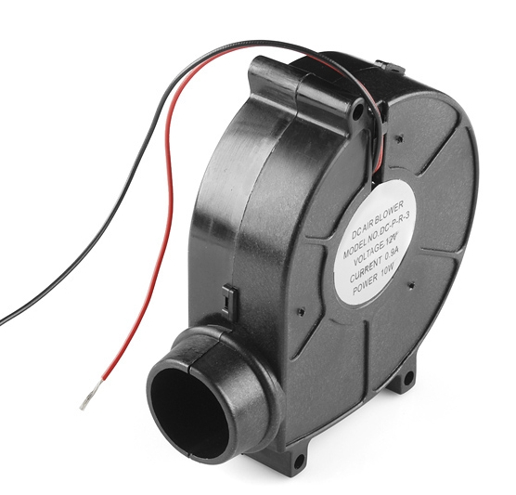
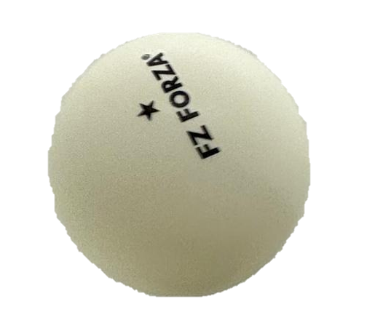
Muse EEG headset (https://neurotechx.github.io/neurotechedu/headsets.html)
Particle Photon 2 (https://store.particle.io/products/photon-2)
Grove Shield for Particle (https://www.seeedstudio.com/Grove-Shield-for-Particle-Mesh-p-4080.html)
Grove MOSFET for Arduino (https://www.seeedstudio.com/Grove-MOSFET.html)
12V Blower fan (https://www.sparkfun.com/blower-squirrel-cage-12v.html)
Generic ping pong ball (own picture)

