Slide 1
Olympics

Slide 2
Audience and Hypotheses
My audience are people who want to know why some factors contribute to athletes winning medals.
Hypotheses
Older age athletes win less than younger age athletes.
Developed countries win more than undeveloped countries
The location of the Olympics does not influence the chance of winning a medal.

Slide 3
Questions
1)Older age athletes win less than younger age athletes?
What is the prime age for athletes?
Athlete age and year.
2) Developed vs undeveloped countries
A)Developed vs undeveloped countries in top 10 sports
3) Regions that compete in a Olympic that is located in their region has better chance of winning a medal?
A) which cities follow this trend and which one don’t?

Slide 4
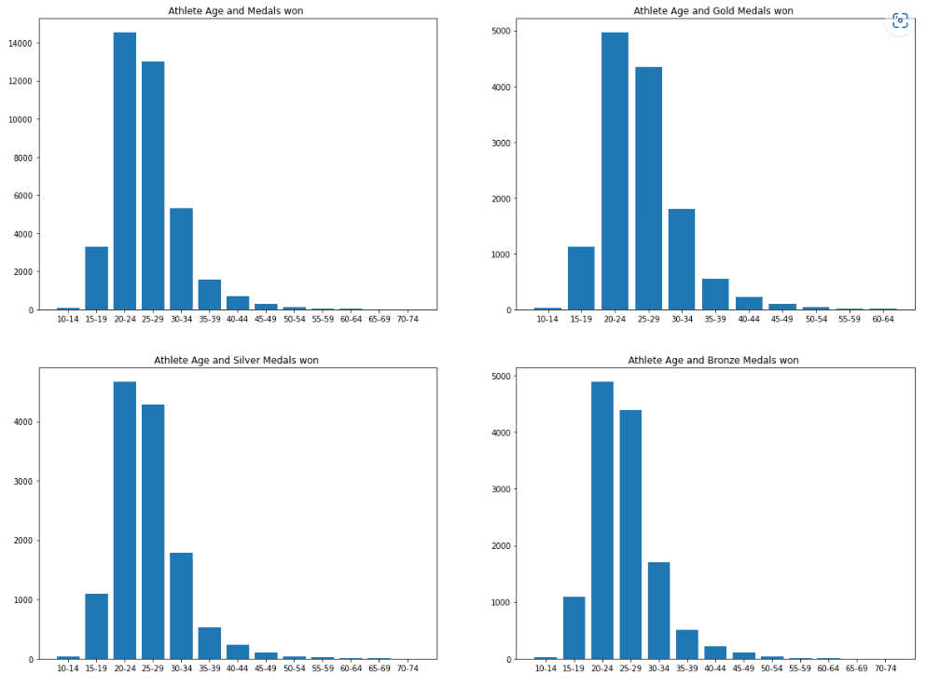
Older age athletes win less than younger age athletes?

Slide 5
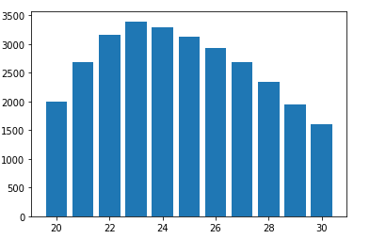
Older age athletes win less than younger age athletes?
From the previous slide we can see that the distribution for winning medals for bronze, silver, and gold are the same.
Age 20 to 30 have the most medals. From the graph below we can see that from age 20 to 23 there is positive relationship between winning medals and age. However, from age 24 to 30 there is a negative relationship

Slide 6
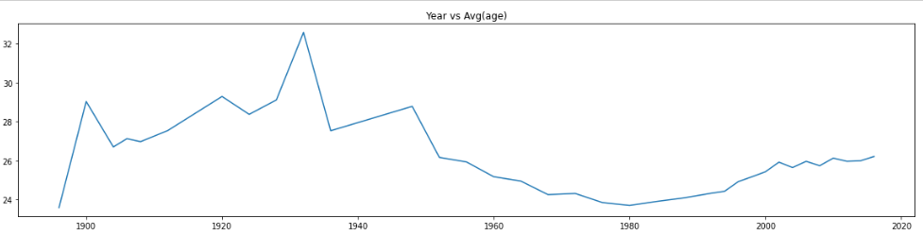
1)Older age athletes win less than younger age athletes?
Has age changed over time?
From this graph the average age has decreased from year 1960 to 2000. From 2000 to 2020 there is slight increase.

Slide 7

Develop countries vs undeveloped countries
Developed countries have more medals won vs undeveloped countries. CMedals = number Medals won. Developed countries have 4 times the medals than undeveloped countries. Moreover, I used a statistical test that takes into account the number of athletes from undeveloped and developed countries, as a result there was a statistical difference that developed countries win more.

Slide 8
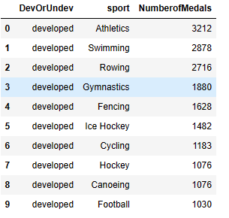
Developed vs undeveloped countries in top 10 sports based on number of medals won
All top 10 sports with the medals won is obtained by developed countries.

Slide 9
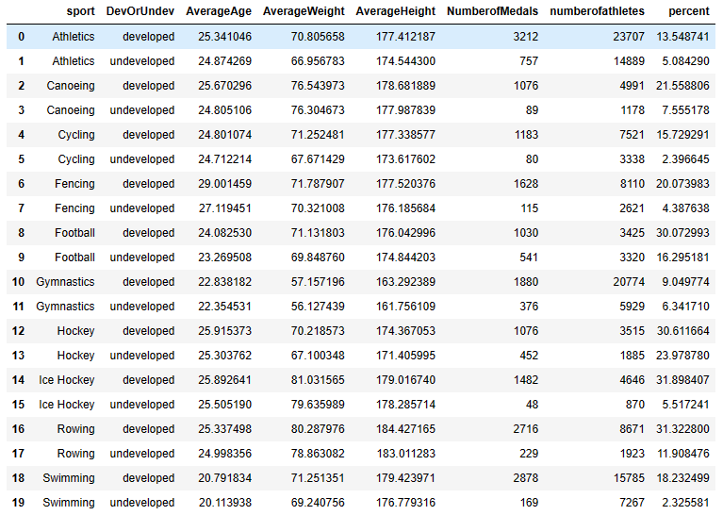
Developed vs undeveloped countries in top 10 sports based on number of medals won
There seems to be some factors why developed countries tend to do better then undeveloped countries.
We can see that developed countries
tend to have higher weight and height.
Also, when taking into account
the number of athletes and medals
won undeveloped countries are still
Behind developed countries.

Slide 10

Regions that compete in a Olympic that is located in their region has better chance of winning a medal?
Regions that compete in the Olympics that is located in their region
Has better chance of winning a medal.

Slide 11
which cities don’t follow this trend?
Mexico and Brazil do not follow this trend.
When Brazil competed in an Olympic that was in their region the average of age of their Athletes were older compare to Olympics that were outside of their region. Moreover, the average weight and height were lower of Brazilian Athletes that competed in a Olympics in their region. This can be said about Mexican Athletes as well.

Slide 12
recommendation
Countries should spend more resources on athletes that are less than 31 years old because there is a significant drop off in winning a medal and age. Moreover, they should use those resources on younger athletes from age 20-29 because they have higher chance on winning medals.
Undeveloped countries should try to encourage young people to play more sports, as a result have more young talent joining the Olympics which increases their chance of winning a medal.

