Slide 1
Copyright
While anybody use other work for their profits , its called copyright .This includes various types of expressions like :- movies, books, music and works of art .

Slide 2
Famous dispute
One of the most famous dispute in music industries I heard that was between ‘katy parry’ and ‘Marcus gray (the rapper flame)’ . Their songs Dark horse and joyful noise respectively are same to listen in music tones and they use musical elements on commonplace. Gray’s music team report the plagiarism case in court against the katy parry song dark horse and as well as demand for 2.8million dollar and won the case in 2016 but after long time again parry appealed this case again in a federal district court in 2020 .
Now judge take their decision in parry side and ruled that gray was attempting to claim improper monopoly and over conventional musical building blocks . As a respect parry got their 2.8 million dollar back .

Slide 3
Conclusion of this dispute and opinion
No matter what was think by gray’s music team that time about music of that song , but they were unable to connivence the judge about their plagiarism case.
In my opinion , solve to this type problems are difficult and like these type of cases create hate between the artists ,which will ruin their career and money also . There are lots of examples who lost their money in case of copyright :- Dua Lipa, BTS, Bryan kahn and etc .

Slide 4
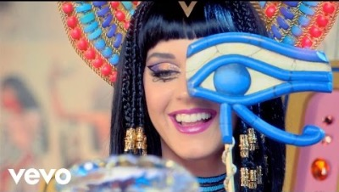
Dark horses by Katy parry

Slide 5

Joyful noise by Flame

