Slide 1

IN HOUSE PROJECT
ON
HAND
Supervised by:
Mr. Sujit Tripathy
Faculty in school of IST & ETC
Presented by:
Pradyumna Kumar Mirdha
Nabin Kumar Sahu
Balkishan Padihar
Contact: balkishanpadihar@gmail.com

Slide 2
CONTENT
Introduction
Objective
Methodology
Tools required
Flow chart
Advantage & application
Limitation
Conclusion
Reference

Slide 3
INTRODUCTION
A WLAN is created by using the concept of socket programming. Socket programming is a way of connecting two nodes on a network to communicate with each other.

Slide 4
OBJECTIVE
To exchange inform between two devices and to operate one device with another device.

Slide 5
METHODOLOGY
The socket is created using
<stdio.h>,<winsock2.h> , <windows.h> , <ws2tcpip.h> header files
Function
String
If-else statement

Slide 6
TOOLS REQUIRED
A personal computer/laptop (having windows operating system)
A personal computer / smartphone
Visual studio
Termux application

Slide 7
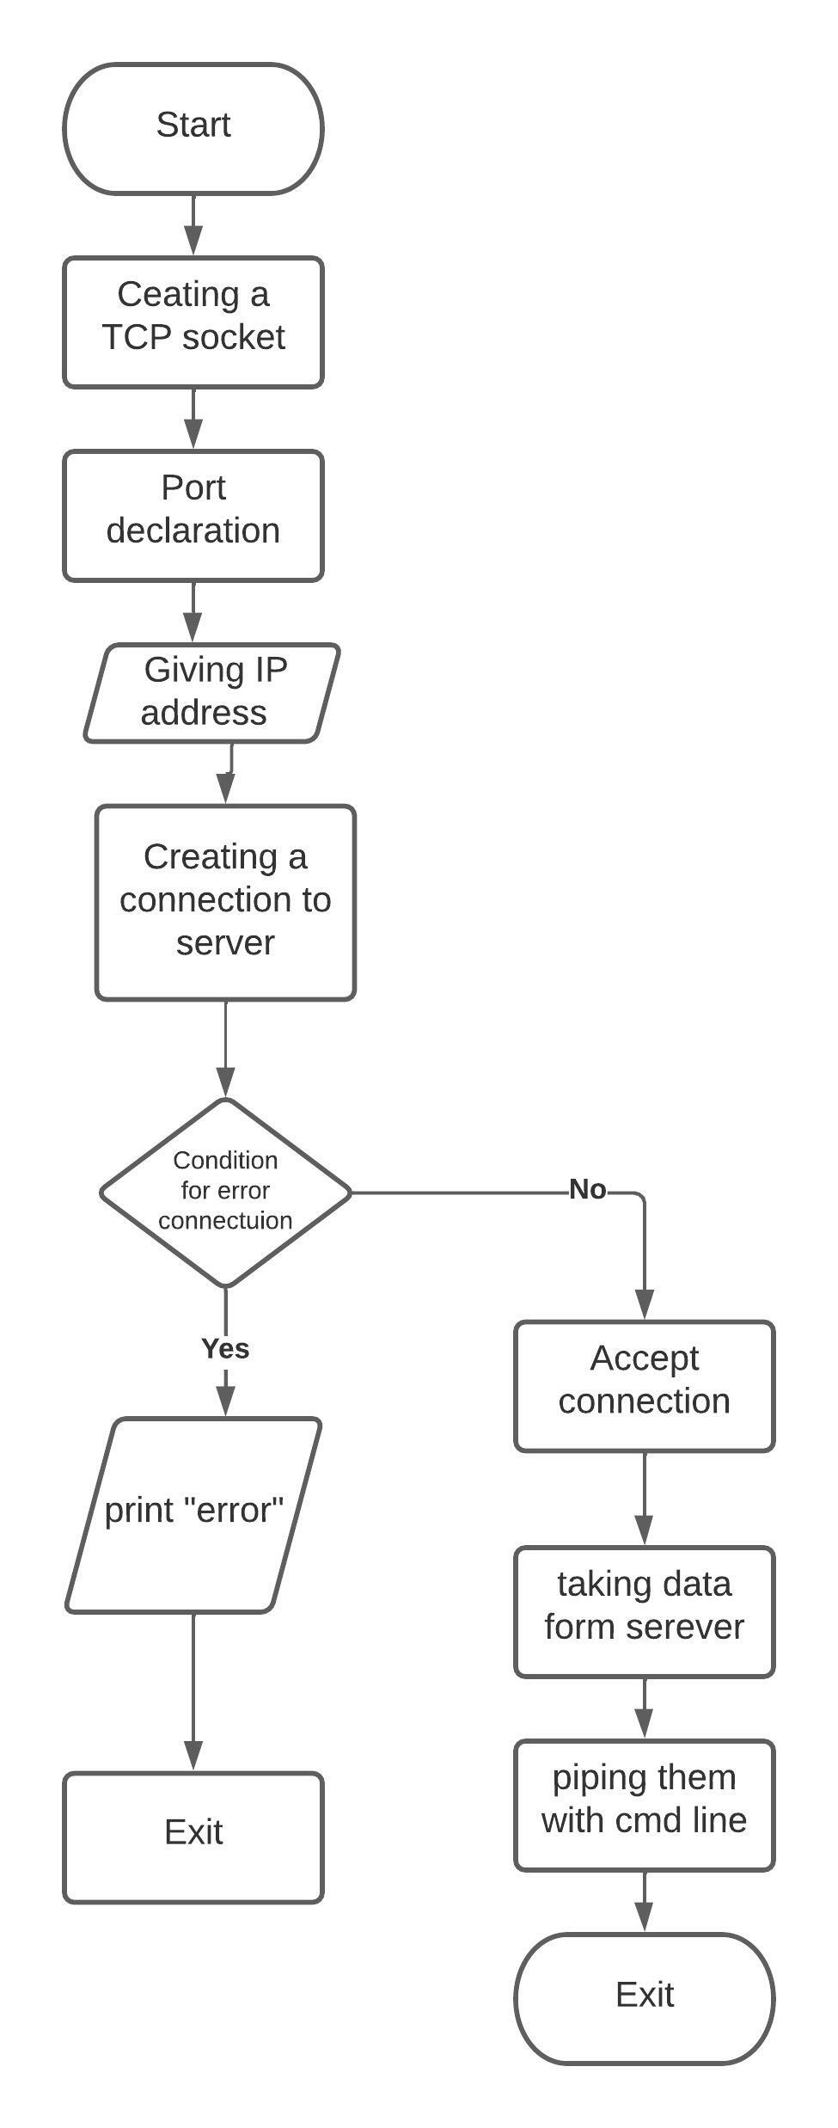

Slide 8
Advantage & application
Flexible access to files and data over a network
Enhances the security
Sharing resources.
Centralized software management

Slide 9
Limitation
Only windows operated devices can be a client.
It can only be operated in LAN
Multiple client can not be connected to same server port

Slide 10
Conclusion
Network programming makes use of socket for interprocess communication between hosts where sockets act as the endpoint of the interprocess communication.

Slide 11
Reference
https://pubs.opengroup.org/onlinepubs/009695399/basedefs/netinet/in.h.html
https://docs.microsoft.com/en-us/windows/win32/api/ws2def/ns-ws2def-sockaddr_in
https://stackoverflow.com/questions/39314086/what-does-it-mean-to-bind-a-socket-to-any-address-other-than-localhost
https://docs.microsoft.com/en-us/windows/win32/api/winsock/ns-winsock-wsadata

Slide 12
ANY QUERIES?

Slide 13
THANK YOU

