Slide 1


Prototype Overview
Prototype Features Demonstrated
◆ 3D warehouse hub and module selection screen
◆ Interactive 360° practical activity (hazard spotting)
◆ Timed quiz and decision-based challenge
◆ Score feedback, retake and completion certificate
The prototype focuses on validating interaction concepts, not full system deployment.

Slide 2
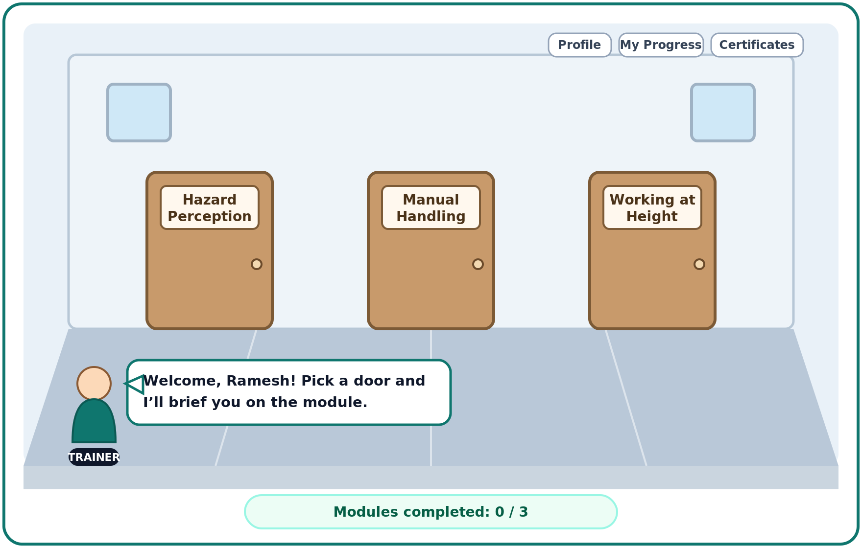
Live Prototype Demonstration
Demonstration Steps
◆ Launch the Zero Incident Safety Training Simulator
◆ Sign in as an employee (demo account, auto-filled)
◆ Enter the walkable 3D warehouse training hub
◆ Open a module door and complete the 360° practical activity
◆ Answer the timed quiz and decision prompts
◆ View score, retake route and completion certificate
◆ This demonstrates the system's usability and engagement potential
3D training hub - demo.html (interactive)
Demo file: demo.html - double-click to open in any browser (no server, no internet needed).
Live system: npm start, then open http://localhost:3000 (demo account: ramesh.s / Welcome!2026)

