Slide 1
InsideHR
Admin Training
The full picture, end to end.
An iORA-style HR system for Singapore + Malaysia

Slide 2
Welcome — Admin role
The full picture of what InsideHR lets you do as the system owner.

Slide 3
InsideHR · Admin Training
3
Logging in
Every staff member uses the same login screen.
STEP-BY-STEP
1
Open the InsideHR URL in your browser.
2
Enter the email + temporary password issued to you.
3
On first login you'll be forced to change your password (8+ characters).
4
After that, the password lives only in your head — Admin can reset but never see it.
WHAT YOU CAN DO
Forgot password? Click the link, and you'll get a reset email via Resend.
The system enforces secure session cookies that expire after a period of inactivity.
On first sign-in for the demo: jin@company.com / changeme123

Slide 4
Dashboard & People
Day-to-day overview and the employee directory.

Slide 5
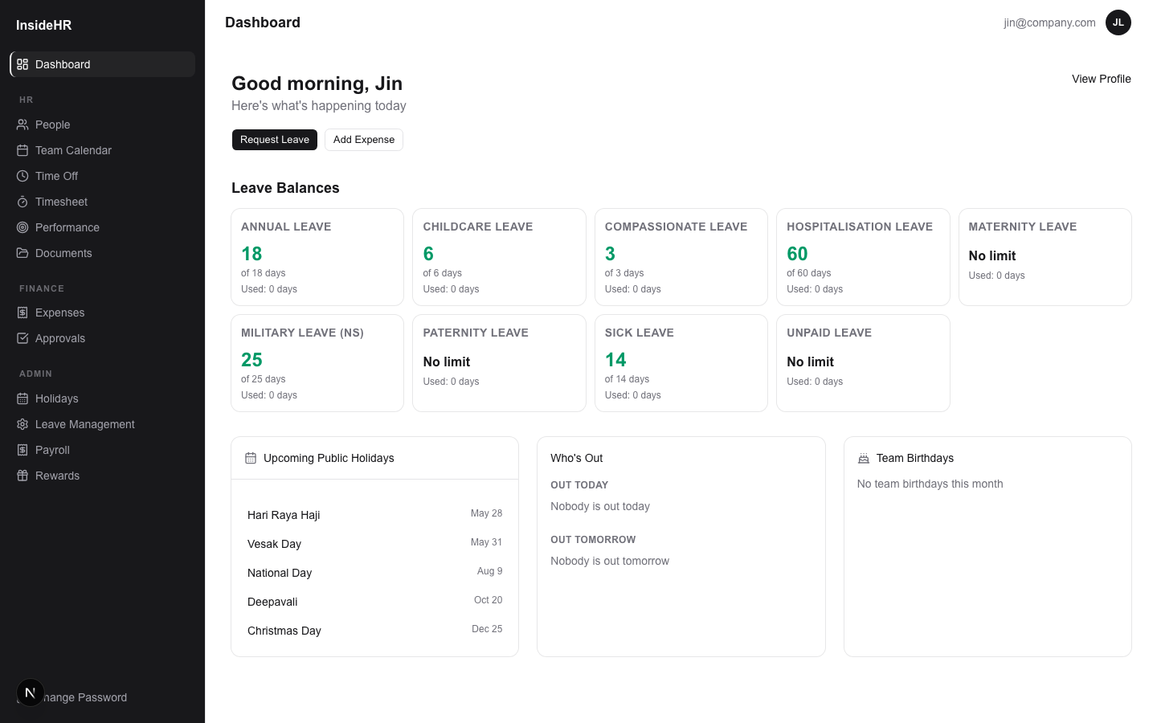
InsideHR · Admin Training
5
The admin dashboard
At-a-glance summary of what needs your attention.
WHAT YOU CAN DO
Top: approval-count widget — pending leave + expense + reviews across the company.
Birthday widget for the next 14 days.
Country holiday card — defaults to your country's holidays for the current year.
From here you can navigate to any module via the sidebar.

Slide 6
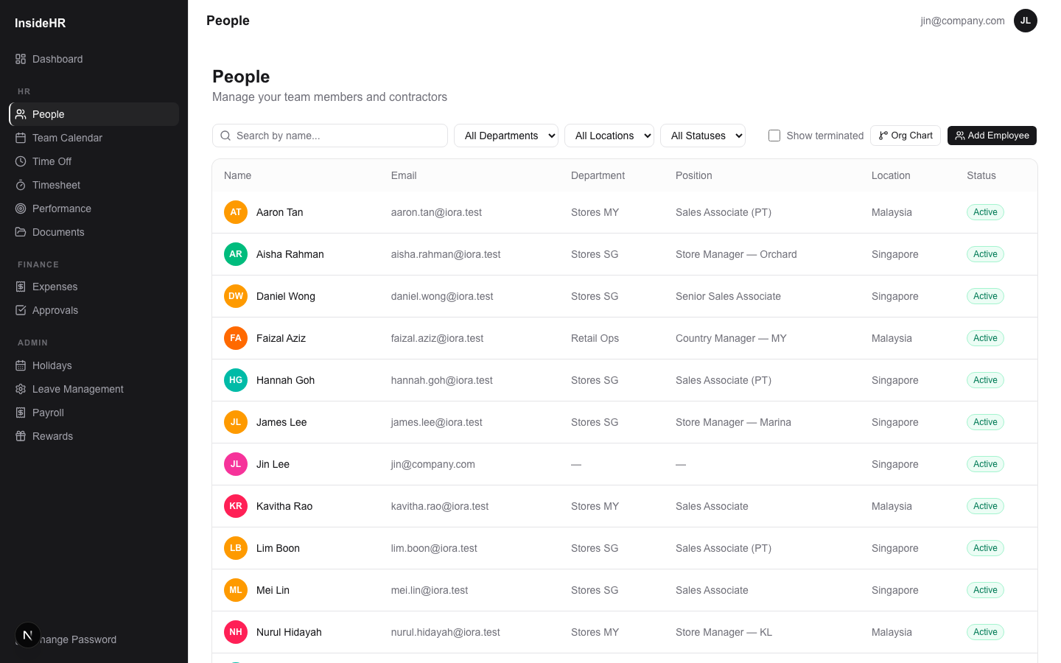
InsideHR · Admin Training
6
People — directory
One row per active employee, with quick filter + search.
WHAT YOU CAN DO
Filter by country (SG / MY), role, department, status.
Coloured avatar + role pill makes status visible.
Click any row → detailed employee profile with documents, leave, reviews, audit trail.

Slide 7
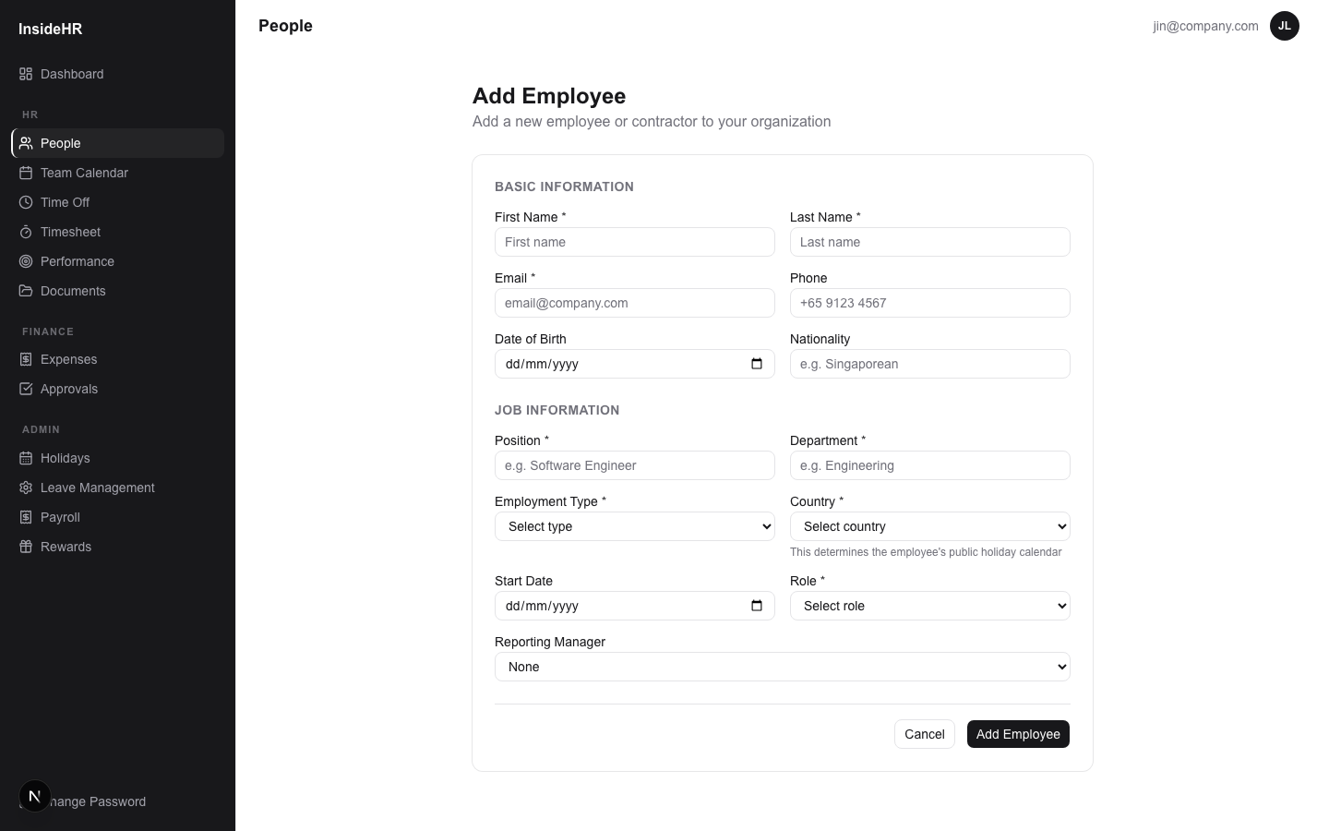
InsideHR · Admin Training
7
People — add new employee
The form that creates a user record.
STEP-BY-STEP
1
Click "+ New employee" on the People list.
2
Fill out basics (name, email, country), then the job info section.
3
Set Employment Type — EMPLOYEE / CONTRACTOR / PART_TIME. Part-time enables timesheets + payroll fields.
4
Pick a reporting manager — drives review assignment, leave approval, and expense approval.
5
Save → the system issues a temporary password and the user gets an invite email.
PART_TIME = sets hourlyRate + normalDailyHours required for payroll math.

Slide 8
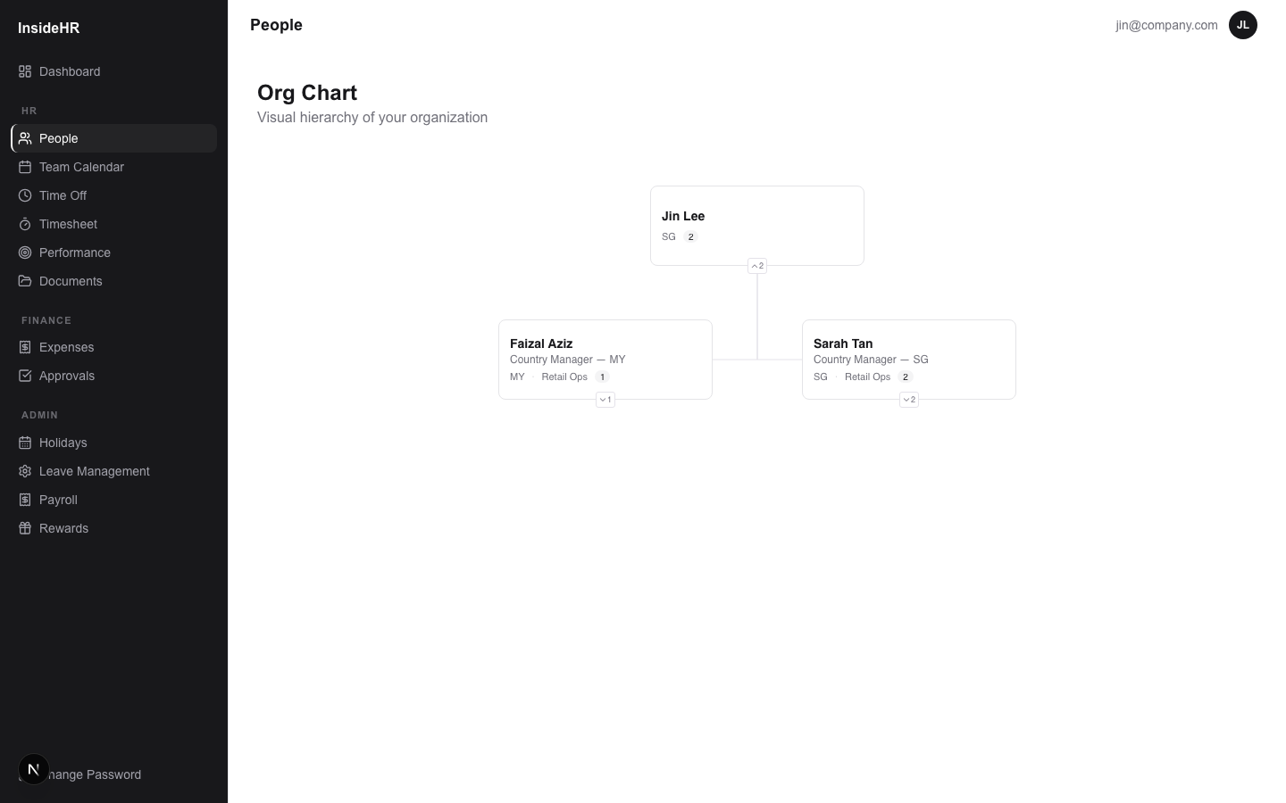
InsideHR · Admin Training
8
Org chart
The reporting hierarchy as a navigable tree.
WHAT YOU CAN DO
Auto-built from each employee's reportingManagerId.
Click a node to focus on that branch.
Useful for sanity-checking the management graph before running a perf review cycle.

Slide 9
Leave & Holidays
Time off policy, balances, public holidays.

Slide 10
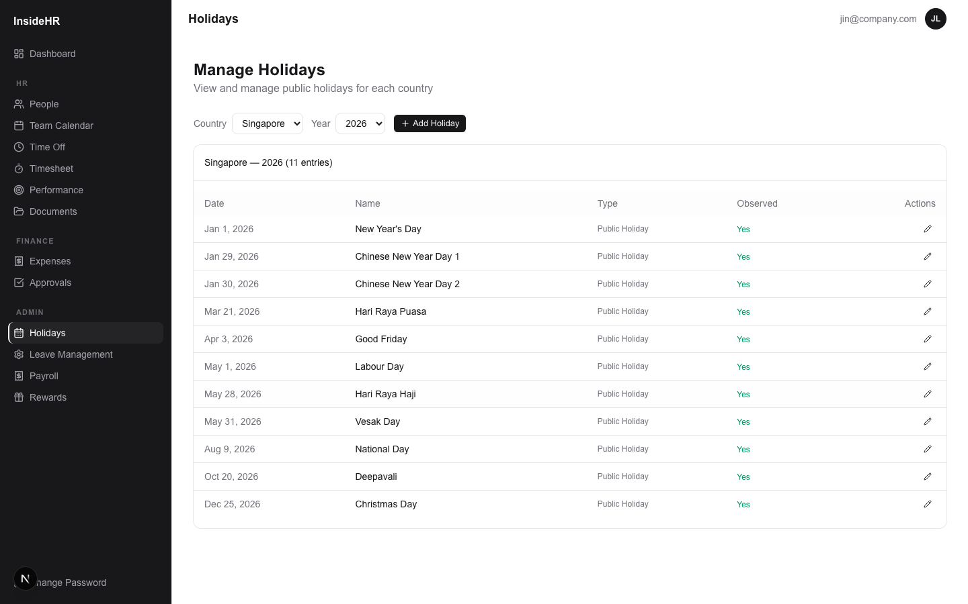
InsideHR · Admin Training
10
Holidays — SG & MY
Public holiday calendar per country.
WHAT YOU CAN DO
Seeded with 2026 federal holidays for both countries.
Add / edit / mark observed status per country.
Drives auto-detection in the part-time timesheet (logging hours on a holiday = 2× pay).

Slide 11
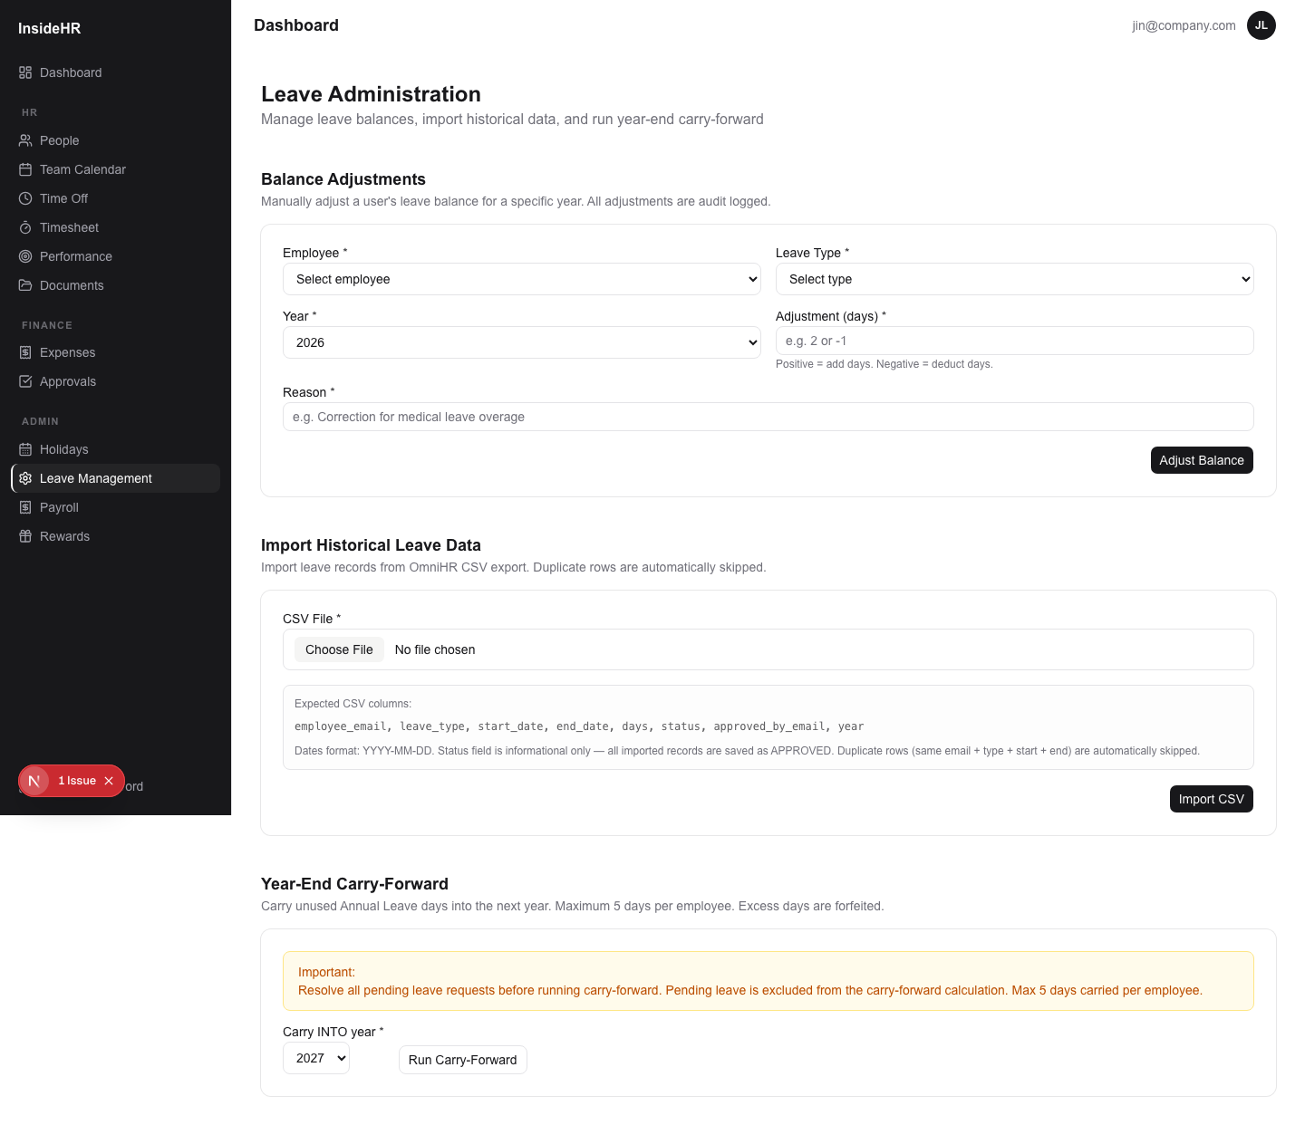
InsideHR · Admin Training
11
Admin Leave Management
Operations admin: bulk balance adjust, CSV import, year-end carry forward.
WHAT YOU CAN DO
Balance adjust — give an employee +N days for a leave type, audit-logged.
CSV import — bulk-load historical leave from your previous system.
Carry-forward — at year-end, roll unused balance into the new year (caps configurable).

Slide 12
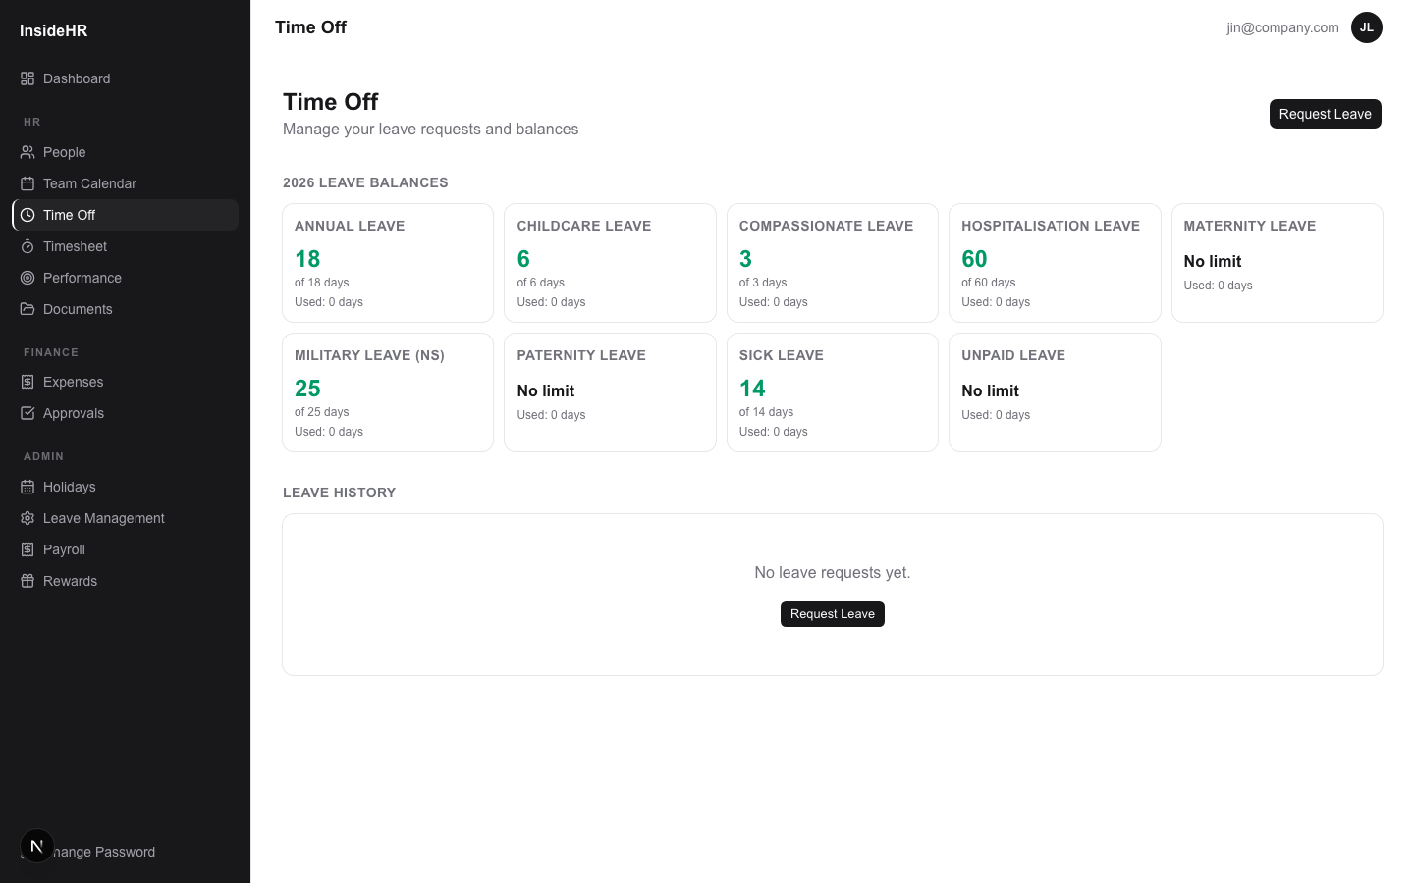
InsideHR · Admin Training
12
Time Off — view from admin
Admin can see and act on any employee's leave.
WHAT YOU CAN DO
Filter by status, leave type, person, or date range.
Admin override: approve / reject any request (audit-logged).

Slide 13
Documents & Expenses
Files and reimbursable spend.

Slide 14
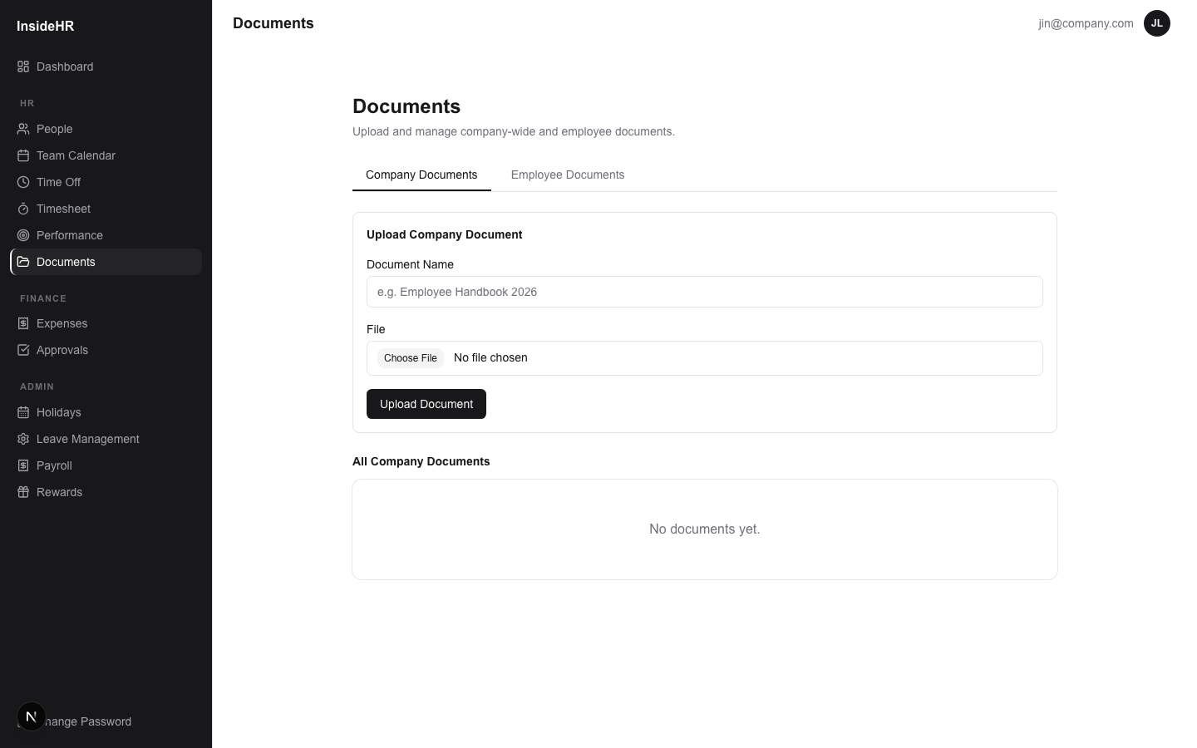
InsideHR · Admin Training
14
Documents
Company-wide files + per-employee documents.
WHAT YOU CAN DO
Company tab: HR uploads handbook, policies, holiday calendar PDFs — visible to everyone.
Employee tab: per-employee folders — only visible to that employee + their manager + admin.
Files live in Google Drive; the app issues short-lived download URLs.

Slide 15
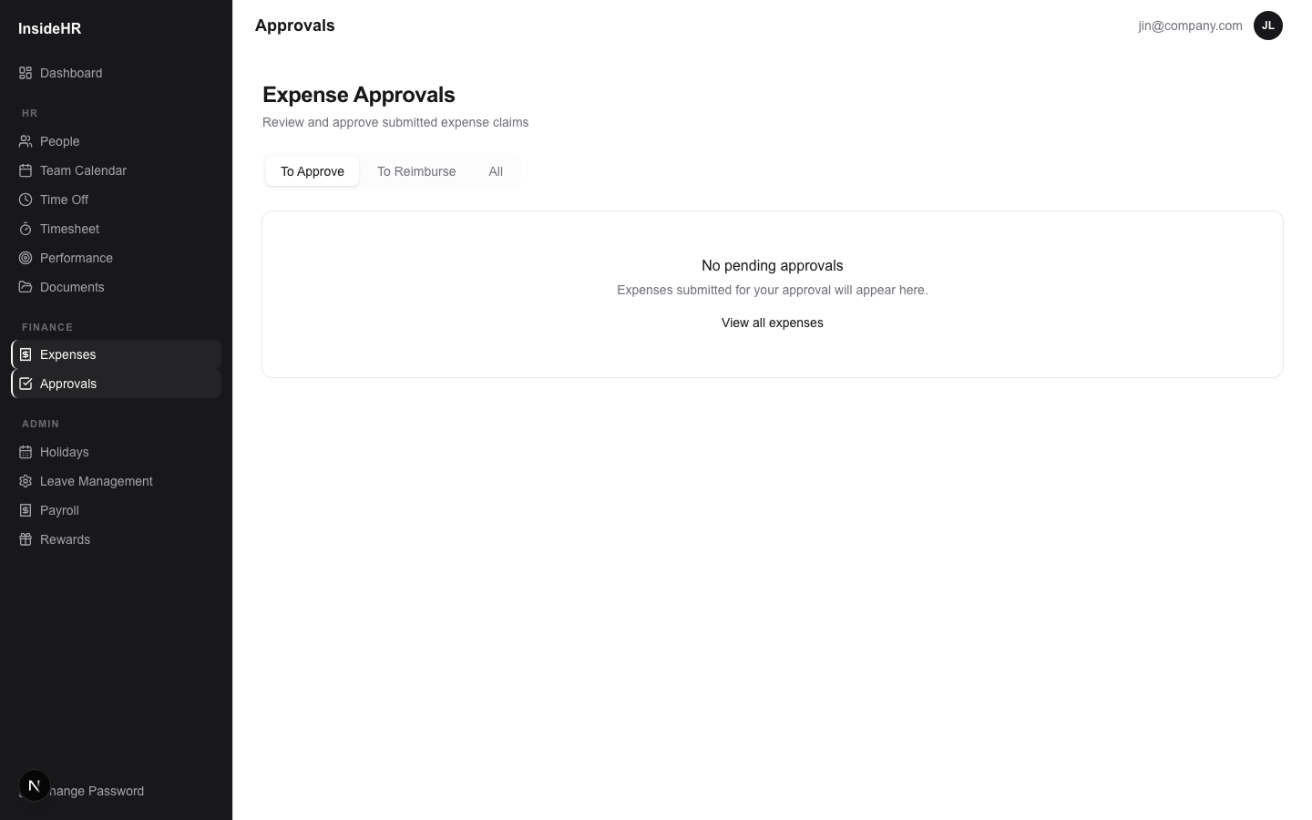
InsideHR · Admin Training
15
Expenses — admin reimbursement queue
Approved expenses awaiting reimbursement.
WHAT YOU CAN DO
Bulk-select rows, then mark as reimbursed — sets reimbursedAt + reimbursedById, audit-logged.
Export Excel: per-employee summary + line items for finance handoff.
Receipts are linked Google Drive URLs.

Slide 16
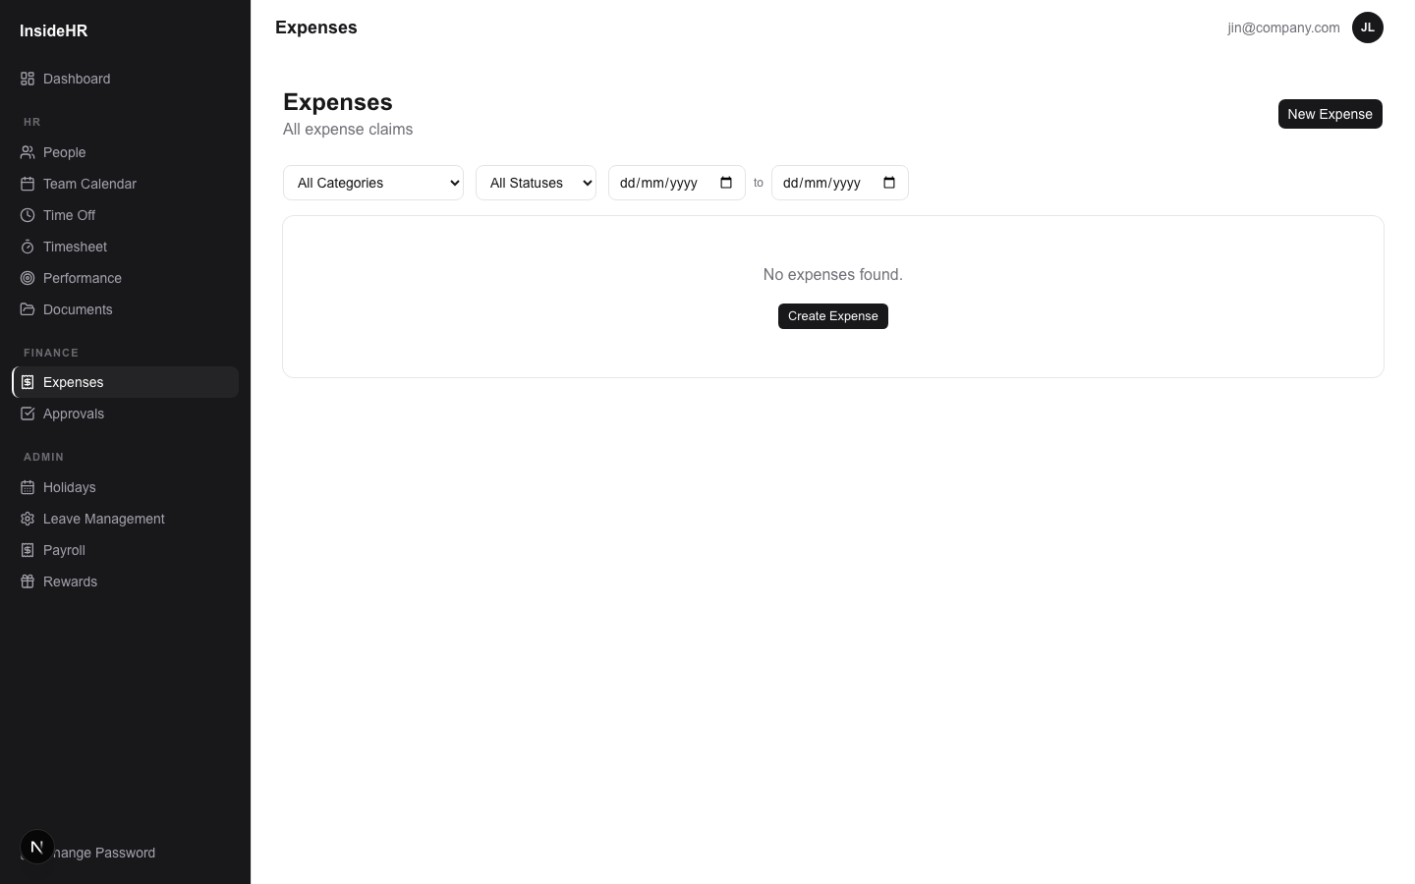
InsideHR · Admin Training
16
Expenses — your own
Admin can also file expenses like any employee.
WHAT YOU CAN DO
Tabs: Draft / For Approval / Approved / Rejected / Reimbursed.
Click "+ New expense" → category, amount + currency, merchant, receipt date, description, receipt upload.
Multi-step approval if configured (manager → admin reimburses).

Slide 17
Performance Reviews
Cycles, scope, goal-setting, evaluation, lifecycle.

Slide 18
InsideHR · Admin Training
18
Performance — the model
Three templates, one data model.
WHAT YOU CAN DO
FULL: store managers + HQ. Goals + 5-point rating + narrative.
LITE: part-timers + casuals. Behavioural 3-point rating, no goals. Promotion-ready flag.
PROBATION: 3-month confirmation review for new hires (MY-compliance lever). Decision: CONFIRMED / EXTENDED / NOT_CONFIRMED.
Per-cycle config: rating labels, goal min/max, employee comment, sales target, attendance, etc.
Cadence is up to you — create a new cycle quarterly, biannually, or ad-hoc.

Slide 19
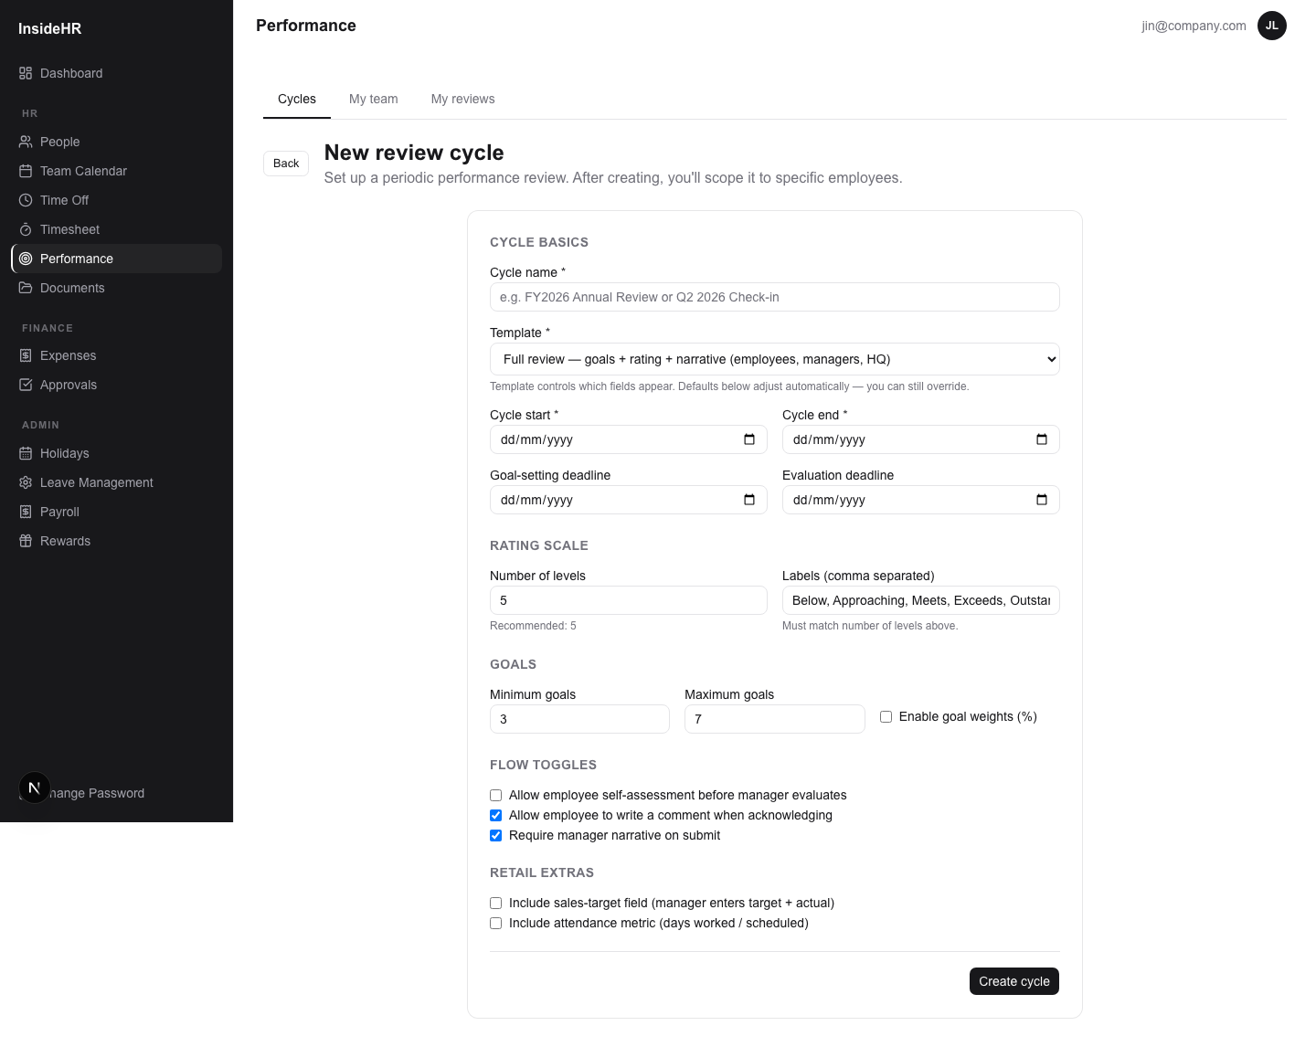
InsideHR · Admin Training
19
Step 1 — Create a review cycle
Set the rules for this round of reviews.
STEP-BY-STEP
1
Sidebar → Performance → Cycles → + New cycle.
2
Name + start/end dates + (optional) goal-setting & evaluation deadlines.
3
Pick a template. The form below auto-adjusts (no rating fields for PROBATION; no goals for LITE).
4
Toggle the retail extras you care about — sales target (with currency), attendance metric.
5
Save → you land on the cycle detail page (status = DRAFT).

Slide 20
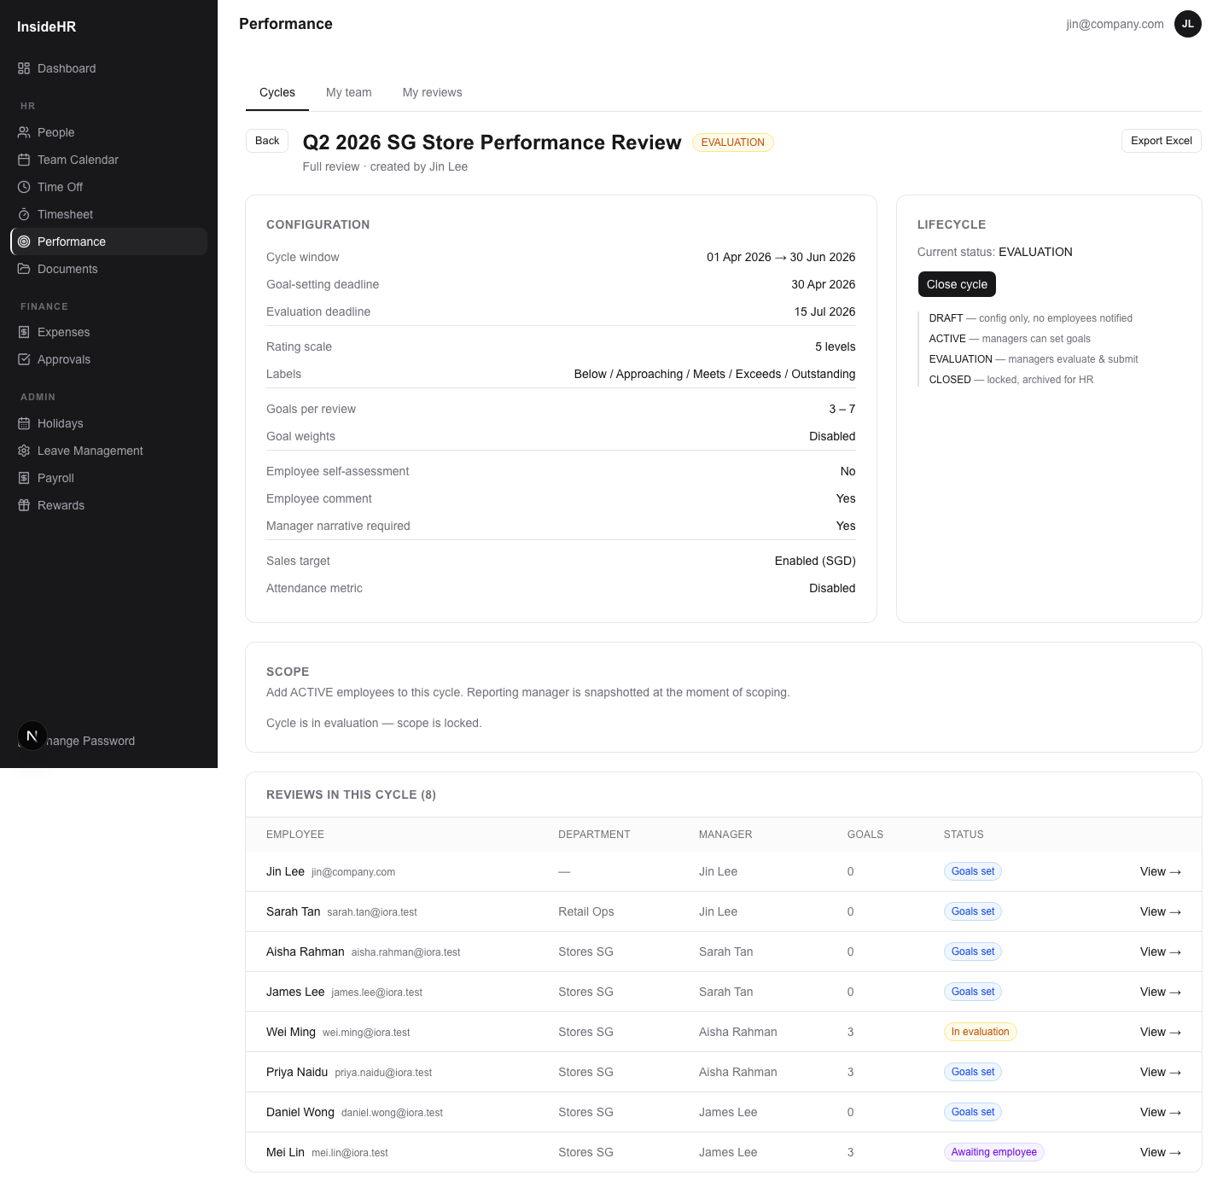
InsideHR · Admin Training
20
Step 2 — Scope the cycle
Pick who is in this cycle.
STEP-BY-STEP
1
On the cycle detail page, find the Scope section.
2
Filter mode: pick employment type / country / department → click "Add matching employees".
3
Picker mode (below): search the list of active employees not yet in this cycle → tick checkboxes → "Add picked".
4
Each scoped employee gets a PerformanceReview row, with their reporting manager snapshotted at this moment.
Manager-snapshot means reorgs mid-cycle don't lose history.

Slide 21
InsideHR · Admin Training
21
Step 3 — Open the cycle
DRAFT → ACTIVE: managers can now set goals.
STEP-BY-STEP
1
Lifecycle panel on the cycle detail page.
2
Click "Open cycle (start goal-setting)" — cycle goes ACTIVE.
3
Each scoped review goes from NOT_STARTED → managers can now write goals for their reports.
4
Once minGoals are saved per review, that review auto-promotes to GOALS_SET.

Slide 22
InsideHR · Admin Training
22
Step 4 — Move to evaluation
ACTIVE → EVALUATION: managers rate + submit.
WHAT YOU CAN DO
Click "Move to evaluation" when the goal-setting window closes.
Goals become read-only; each goal needs an outcome (Missed / Partial / Met / Exceeded) plus an optional comment.
Managers also fill the overall rating, narrative, sales target/actual, attendance — depending on what the cycle includes.
Once a manager submits, the review → PENDING_ACKNOWLEDGEMENT.

Slide 23
InsideHR · Admin Training
23
Step 5 — Watch progress, then close
EVALUATION → CLOSED.
WHAT YOU CAN DO
Cycle detail shows a table of every review with its status pill.
Once all employees have acknowledged, click "Close cycle" → CLOSED, locked from further edits.
Admin can still "Reopen" an individual review if a correction is needed (audit-logged).

Slide 24
InsideHR · Admin Training
24
HR export for closed cycles
Excel workbook with 5 sheets, ready for HR/payroll.
WHAT YOU CAN DO
Cycle — config snapshot.
Reviews — one row per employee with rating, narrative, sales numbers, probation decision.
Goals — every goal across the cycle with outcomes + manager comments.
Rating distribution — for calibration.
Probation outcomes — when applicable.
Click "Export Excel" in the cycle header.

Slide 25
Part-time Timesheets & Payroll
The new module for hourly workers.

Slide 26
InsideHR · Admin Training
26
How the part-time flow works
Employee submits hours → manager approves → admin runs payroll.
WHAT YOU CAN DO
Part-time employees log hours per day, then submit the whole week.
Submitted entries lock from edit; manager sees them in their approval queue.
Manager approves (or rejects with a reason). Rejected entries unlock for the employee to fix.
Approved entries flow into the monthly payroll calculation.
Malaysian Employment Act 1955 multipliers apply automatically (1.5× over 8h/day or 45h/week, 2× PH, 3× PH OT).

Slide 27
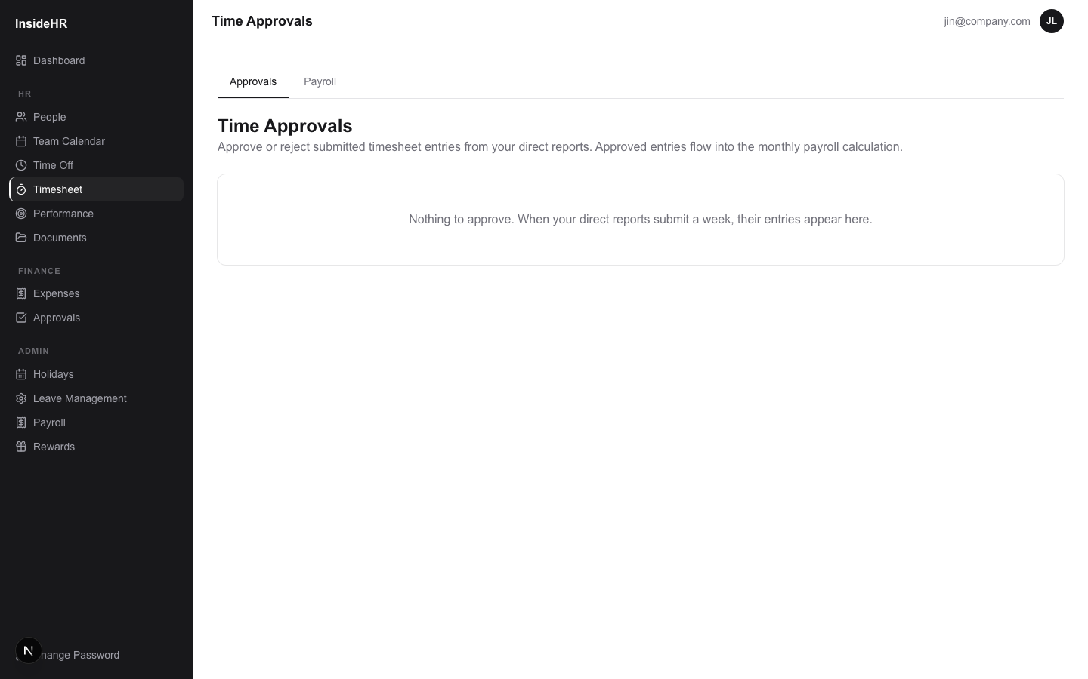
InsideHR · Admin Training
27
Time approvals (admin override)
Admin can also approve directly.
WHAT YOU CAN DO
Same view as the manager approval queue.
Useful when a manager is on leave or terminated mid-week.
Bulk-approve a whole week per employee.

Slide 28
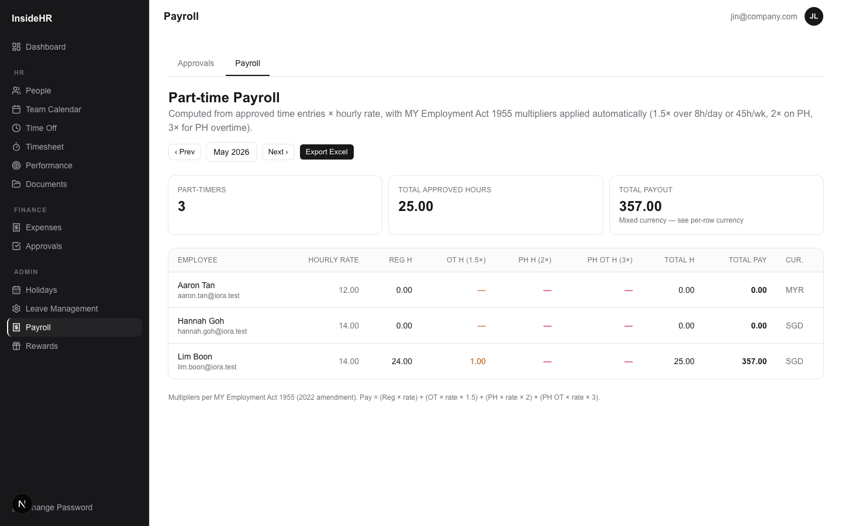
InsideHR · Admin Training
28
Payroll — monthly breakdown
Auto-computed pay per part-timer.
WHAT YOU CAN DO
Per-row split: Regular / OT (1.5×) / PH (2×) / PH-OT (3×) hours × hourly rate.
Currency derived from each employee's country (SGD / MYR).
Prev / Next month buttons; defaults to current month.
Export Excel: summary sheet + line items for your payroll provider.
Multipliers per Employment Act 1955 (2022 amendment).

Slide 29
Rewards & Bonuses
Tie performance to bonus payouts.

Slide 30
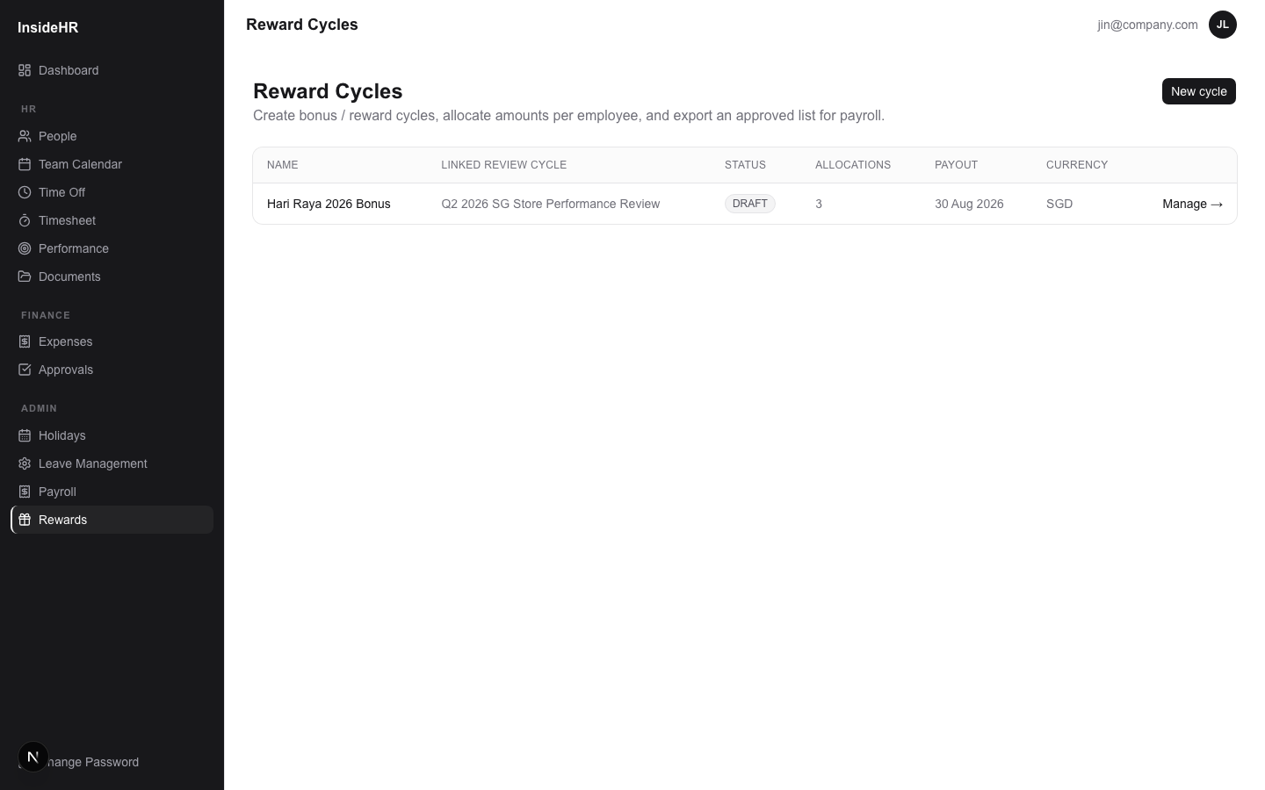
InsideHR · Admin Training
30
Rewards — the model
Discretionary bonus cycles, optionally linked to a perf review.
WHAT YOU CAN DO
Bonus types: PERFORMANCE / CONTRACTUAL_13TH / AD_HOC.
Cycle currency: MYR / SGD / USD.
Lifecycle: DRAFT → APPROVED → PAID → CLOSED — when you transition, all draft allocations cascade with you.

Slide 31
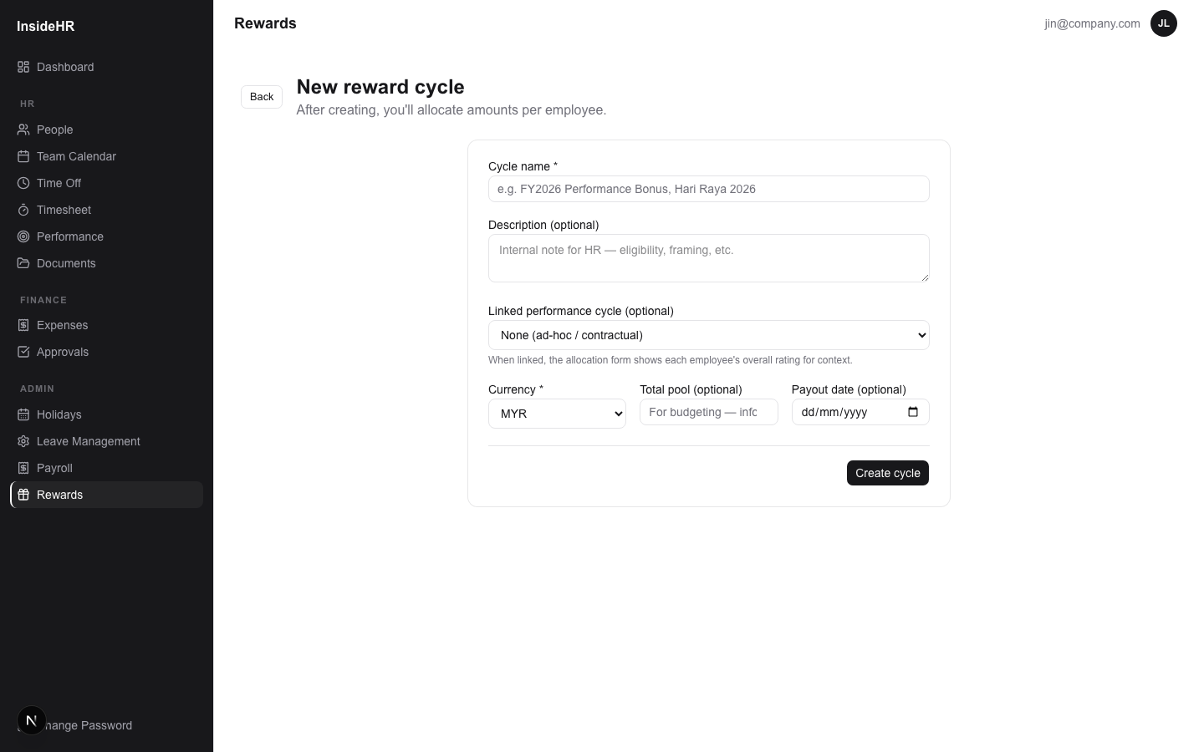
InsideHR · Admin Training
31
Step 1 — Create a reward cycle
STEP-BY-STEP
1
Sidebar → Admin → Rewards → + New cycle.
2
Name (e.g. "Hari Raya 2026 Bonus"), optional description.
3
Optionally link to a perf review cycle — when linked, you'll see each employee's overall rating during allocation, for context.
4
Pick currency, optional total pool (for budgeting), optional payout date.
5
Save → land on the cycle detail page in DRAFT.

Slide 32
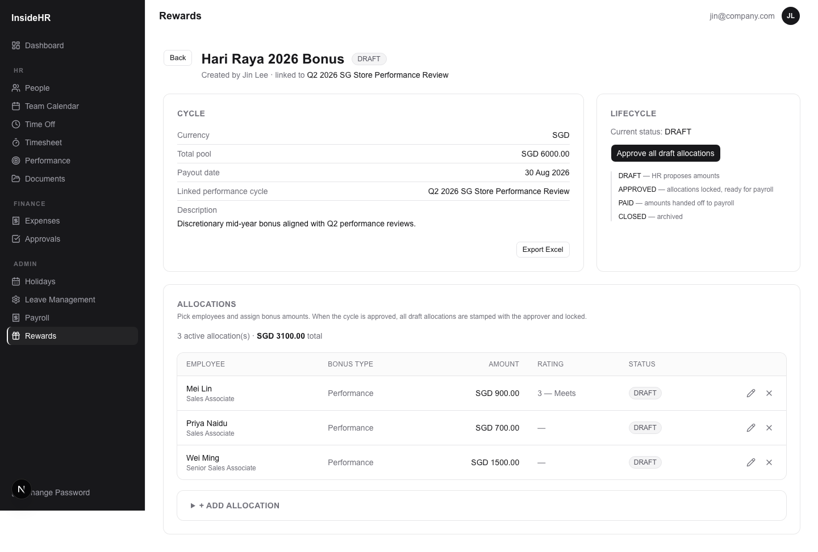
InsideHR · Admin Training
32
Step 2 — Allocate amounts
Per-employee, per-bonus-type allocations.
STEP-BY-STEP
1
Expand "+ Add allocation" — see all active employees with their linked rating.
2
Click "Allocate" next to one — inline form: bonus type, amount, rationale.
3
Each row in the table = one allocation with a status pill.
4
Edit (pencil) or cancel (X) draft allocations any time.

Slide 33
InsideHR · Admin Training
33
Step 3 — Approve, pay, close
Move the whole cycle through its lifecycle.
WHAT YOU CAN DO
"Approve all draft allocations" → cycle APPROVED, draft rows stamped with you as approver, locked.
"Mark as paid" → cycle PAID, all allocations get paidAt timestamp.
"Close cycle" → final archive.
Excel export available at any point: Allocations sheet + Summary by bonus type.

Slide 34
Audit & Permissions
Trace and trust.

Slide 35
InsideHR · Admin Training
35
Audit log
Every state transition leaves a trail.
WHAT YOU CAN DO
Captured per record: who, when, what action, IP.
Includes login, password changes, leave/expense state changes, review submissions, probation outcomes, timesheet submissions, reward approvals.
Visible per-employee on their profile page (recent activity).
Useful for compliance + dispute resolution.

Slide 36
InsideHR · Admin Training
36
Permissions in one slide
Who can do what.
WHAT YOU CAN DO
ADMIN — every page, every action. Can reopen acknowledged reviews; can unlock approved timesheet entries; can transition reward cycles.
MANAGER — sees their direct reports. Approves leave / expenses for them; sets and evaluates their goals; approves their timesheet entries.
EMPLOYEE — own records only. Submit leave / expenses; acknowledge perf reviews; (if PART_TIME) log + submit timesheets.
CONTRACTOR — like EMPLOYEE but excluded from default scoping in some flows.

Slide 37
InsideHR · Admin Training
37
That's the system
Welcome to InsideHR.
WHAT YOU CAN DO
Questions? Ask your HR Admin or IT.
Bugs? File a ticket with what you were doing + a screenshot.
Feedback on features? The system is evolving — your input shapes it.
iORA-style HR for SG + MY operations · v0.1

