Slide 1
InsideHR
Employee Training
Self-service: leave, expenses, reviews, timesheet.
An iORA-style HR system for Singapore + Malaysia

Slide 2
InsideHR · Employee Training
2
Welcome — Employee guide
How to use InsideHR for your own time off, expenses, and reviews.
WHAT YOU CAN DO
InsideHR is the platform for your HR-related needs: applying for leave, claiming expenses, completing your performance review, and (for part-timers) logging your hours.
Your access is limited to your own records — your manager sees your submissions; admin oversees the whole system.
This deck walks each task step-by-step. ~20 slides; ~15 minutes.

Slide 3
InsideHR · Employee Training
3
Logging in for the first time
STEP-BY-STEP
1
Open the InsideHR URL provided by HR.
2
Enter your work email + the temporary password from your welcome email.
3
You'll be forced to change your password on first login (8+ characters, mix it up).
4
After saving the new password, you land on your dashboard. That's home.
Lost your password? Click "Forgot password" on the login screen — you'll get a reset email.

Slide 4
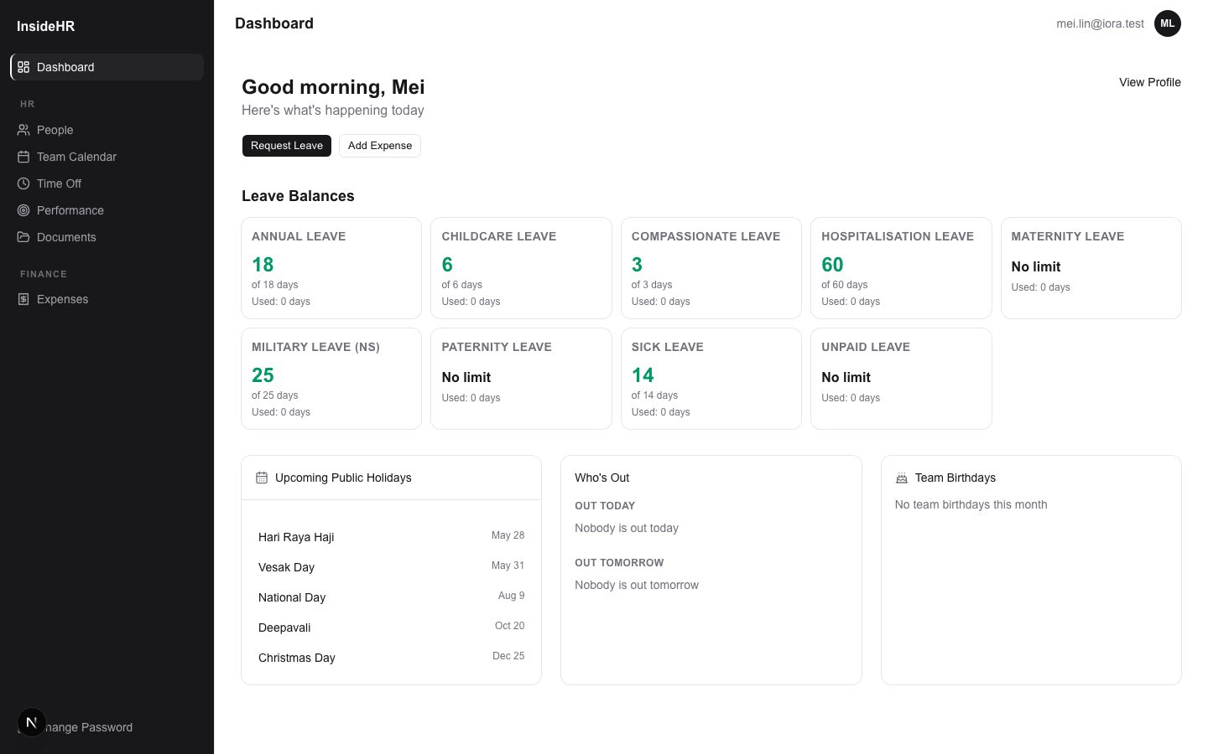
InsideHR · Employee Training
4
Your dashboard
WHAT YOU CAN DO
Top-left widgets summarize your leave balances and any pending requests.
Country holidays show the next few public holidays for your country.
Birthday widget shows colleagues with upcoming birthdays — a nice reminder.
Use the sidebar to navigate to specific features.

Slide 5
Time Off (Leave)
Applying, tracking, balances.

Slide 6
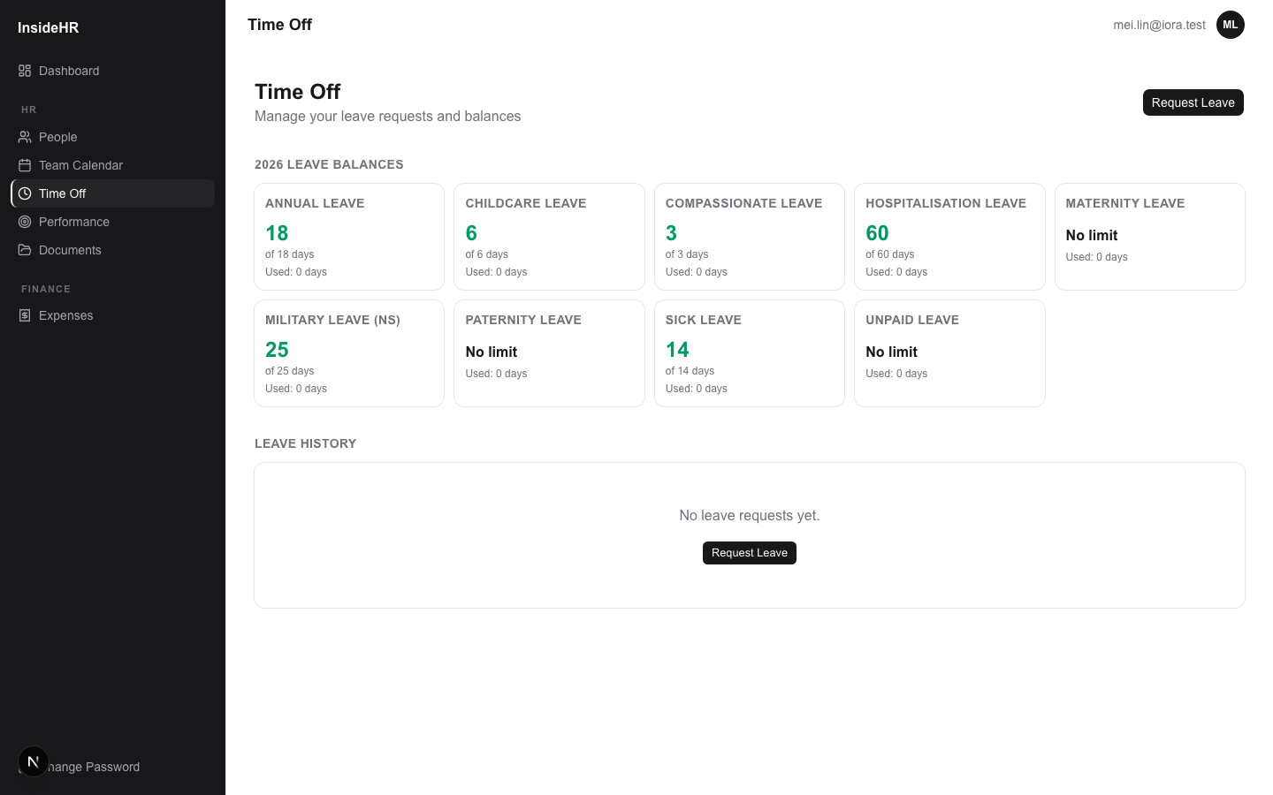
InsideHR · Employee Training
6
See your balances
WHAT YOU CAN DO
Annual leave, sick leave, maternity / paternity leave (if applicable), etc.
Each card shows: available days, used days, pending days, and total entitlement.
If you see a number you don't recognise, ask HR — balances can be manually adjusted.

Slide 7
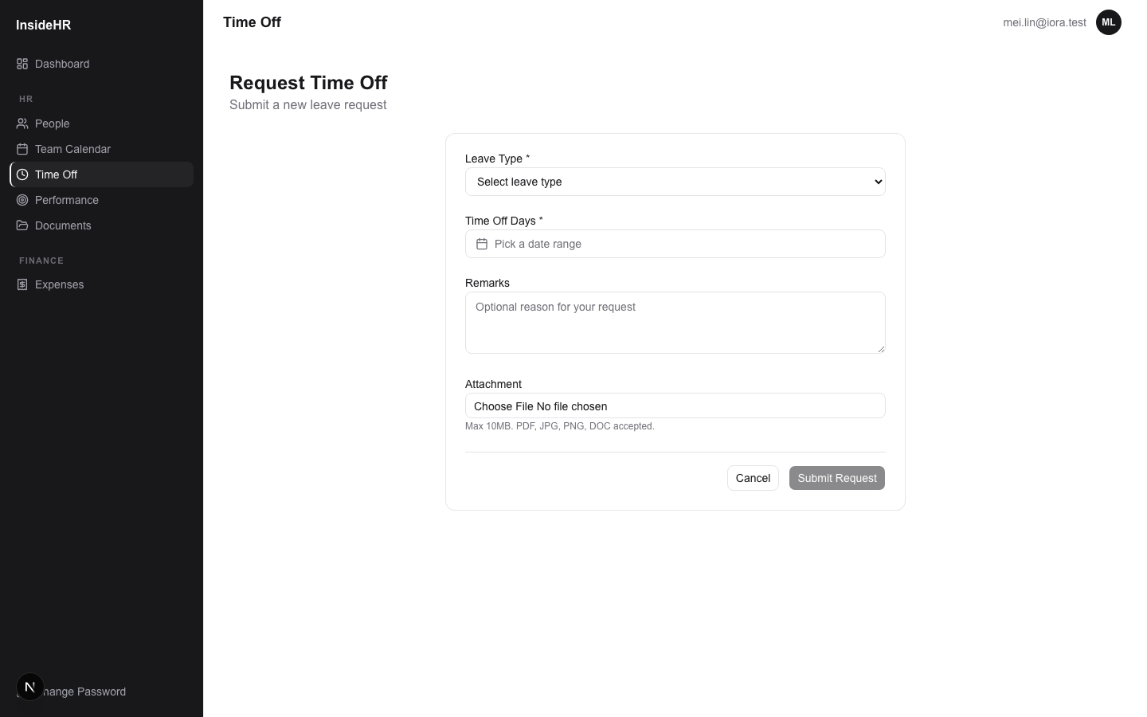
InsideHR · Employee Training
7
Submitting a leave request
STEP-BY-STEP
1
Sidebar → Time Off → "Request leave".
2
Pick the leave type — only ones you have balance for show as available.
3
Use the date picker. Working days are counted automatically (excludes weekends + your country's holidays).
4
If it's a half-day, pick AM or PM.
5
Add an optional reason + (if required) an attachment (e.g. MC for sick leave).
6
Submit → request goes to your reporting manager for approval.
The system shows you a preview of working days deducted before you confirm.

Slide 8
InsideHR · Employee Training
8
Tracking your request
WHAT YOU CAN DO
After submitting, your request shows on the Time Off page with a status pill.
Pending → Approved (deducted from balance) or Rejected (with manager's reason).
You can cancel a still-pending request at any time.
Approved leave appears on the team calendar so colleagues know.

Slide 9
Expenses
Claiming reimbursable spend.

Slide 10
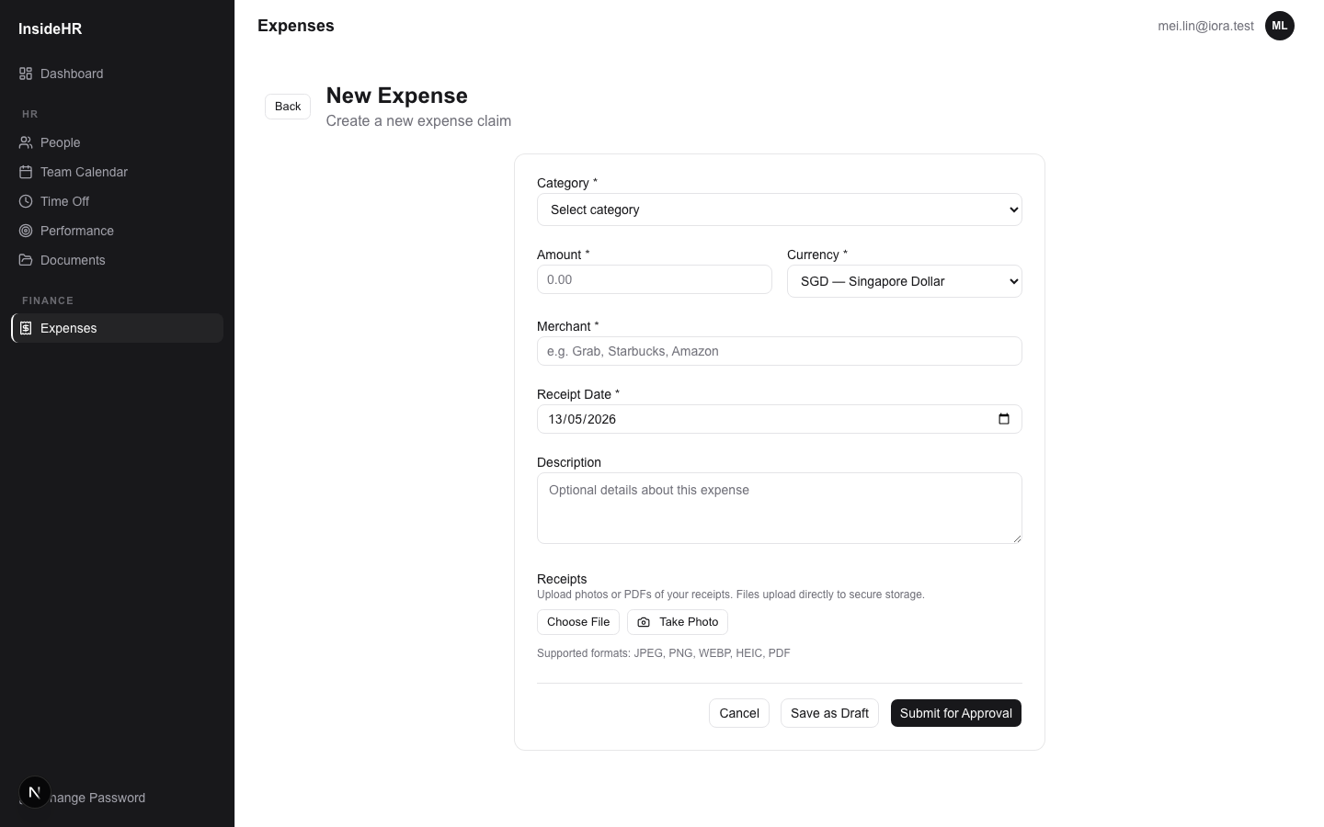
InsideHR · Employee Training
10
Submitting an expense
STEP-BY-STEP
1
Sidebar → Expenses → "+ New expense".
2
Pick a category (Local Transport / Meals / Office / etc.).
3
Amount + currency. Receipt date. Merchant name.
4
Add a description if helpful.
5
Upload the receipt — PDF, JPG, or PNG.
6
Save as Draft, then click "Submit for approval" when ready.
Receipts live securely in Google Drive; only you, your manager, and admin can see them.

Slide 11
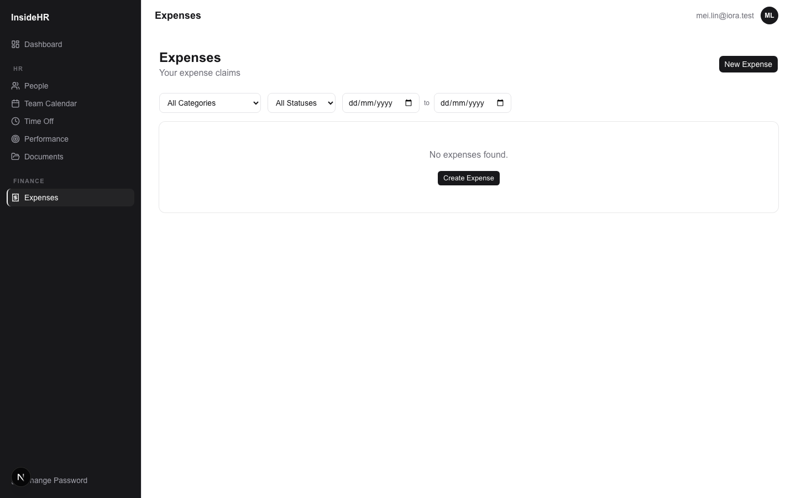
InsideHR · Employee Training
11
Tracking your expenses
WHAT YOU CAN DO
Tabs at top: Draft / For Approval / Approved / Rejected / Reimbursed.
Each row shows the status pill at a glance.
Click into one to see history: when submitted, who approved, when reimbursed.
Rejected expenses come back editable, with the manager's reason.

Slide 12
Your Performance Reviews
What to expect from a review cycle.

Slide 13
InsideHR · Employee Training
13
How review cycles work for you
WHAT YOU CAN DO
Admin runs review cycles every quarter / half-year / year, depending on company practice.
Your reporting manager writes your goals at the start, then evaluates you at the end.
You don't fill out goals yourself in v1 — your manager does. You'll see them as read-only.
At the end, you read your manager's evaluation and "Acknowledge" — that locks the review on record.
If a probation review applies (within your first 3 months), you'll see CONFIRMED / EXTENDED / NOT_CONFIRMED there instead of a rating.

Slide 14
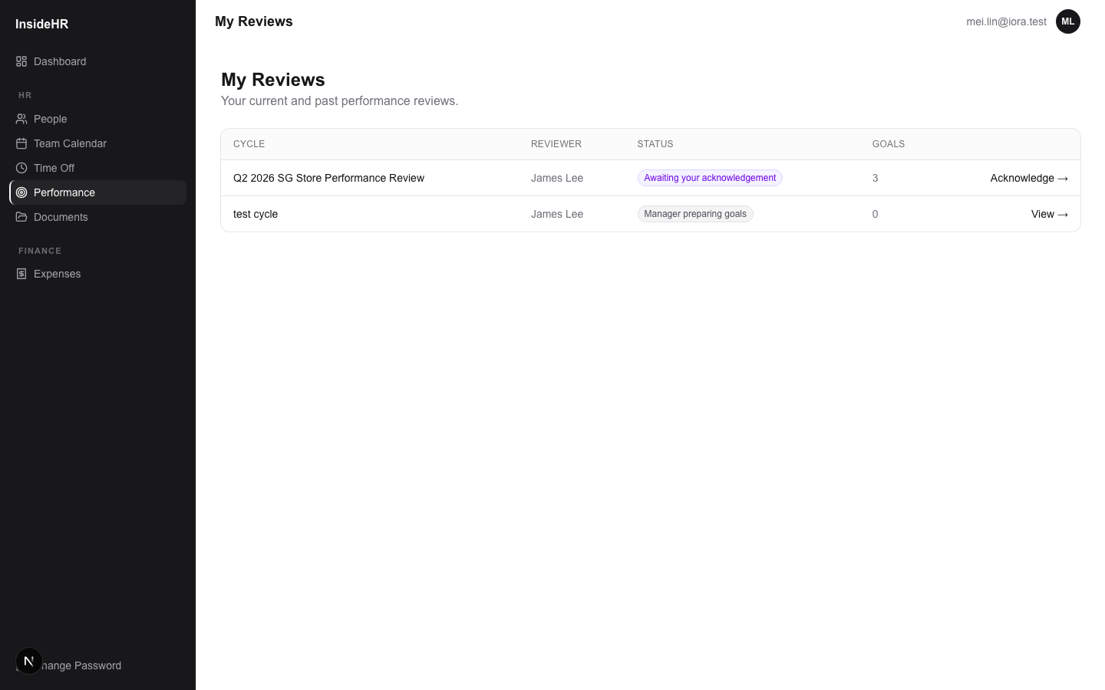
InsideHR · Employee Training
14
Seeing your reviews
WHAT YOU CAN DO
Sidebar → Performance → My reviews.
Each row = one review cycle. Status tells you what's happening now.
Click "View" to see the goals + your manager's evaluation when ready.

Slide 15
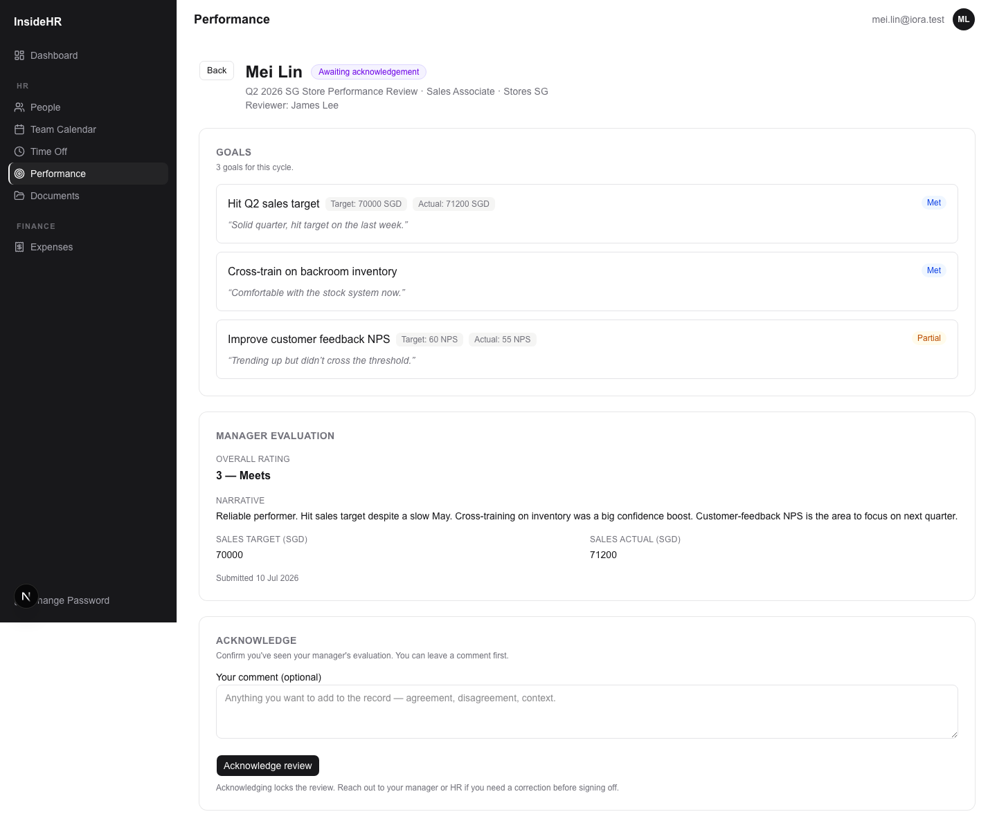
InsideHR · Employee Training
15
Acknowledging your review
STEP-BY-STEP
1
When your review is "Awaiting acknowledgement", click "View →" or "Acknowledge →".
2
Read each goal + outcome + manager comment.
3
Read your overall rating + the manager narrative.
4
Optionally add a comment (agreement, disagreement, context — kept on record).
5
Click "Acknowledge review" → it's now locked. Done.
Acknowledgement isn't agreement — it's just confirmation you've seen it. Disagree? Add a comment and talk to your manager.

Slide 16
Timesheet (Part-time staff only)
Logging your hours daily and submitting weekly.

Slide 17
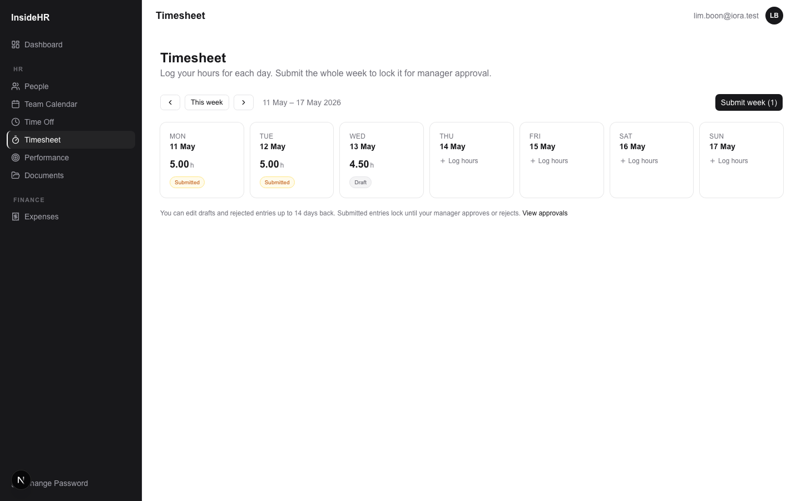
InsideHR · Employee Training
17
Logging your daily hours
STEP-BY-STEP
1
Sidebar → Timesheet → you'll see the current week as 7 day-cards.
2
Click any day → enter hours worked, optional start/end time, optional break minutes, optional note.
3
Save → that day's card shows "Draft" + the hours you logged.
4
Repeat for each day you worked that week.
Public holidays auto-detect from your country's calendar; if you worked on one, you'll get 2× pay (3× for overtime).

Slide 18
InsideHR · Employee Training
18
Submitting your week
STEP-BY-STEP
1
Once all your worked days are logged, click "Submit week" at the top right.
2
All your drafts lock as "Submitted" — your manager gets them in their approval queue.
3
Wait for approval. Approved entries flow into the monthly payroll.
4
If your manager rejects an entry, it comes back as "Draft" with their reason — fix and resubmit.
You can edit drafts and rejected entries up to 14 days back. Submitted entries are read-only until approved or rejected.

Slide 19
Other useful things
Calendar, docs, and your own profile.

Slide 20
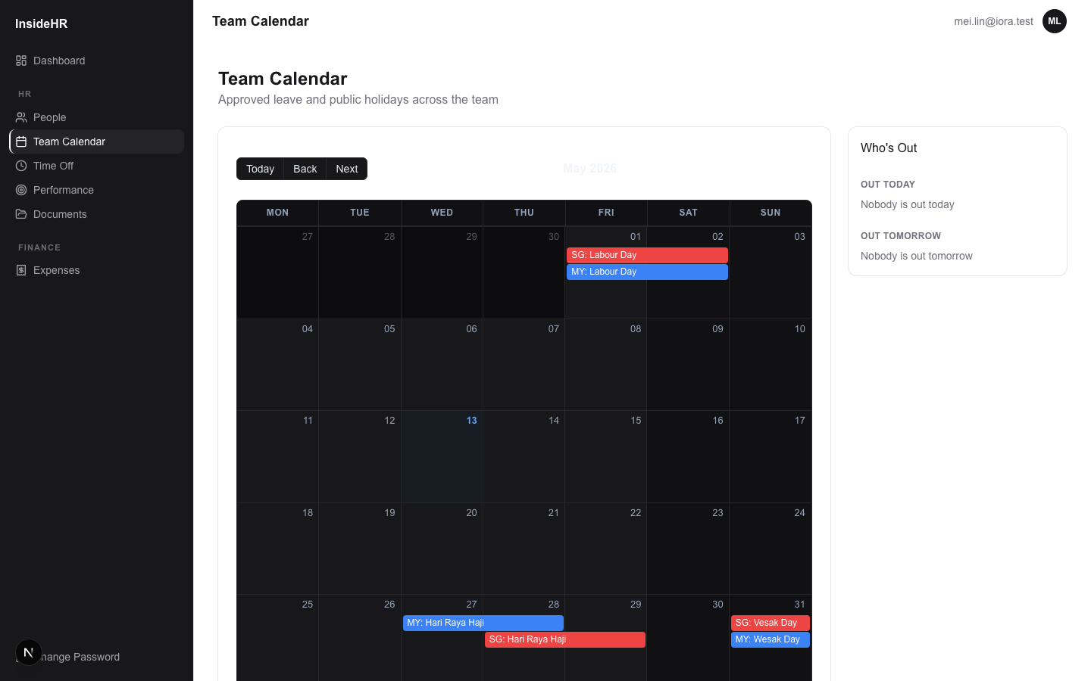
InsideHR · Employee Training
20
Team calendar
WHAT YOU CAN DO
See who's out across your department / company.
Useful for planning meetings or coverage.
Coloured by country.

Slide 21
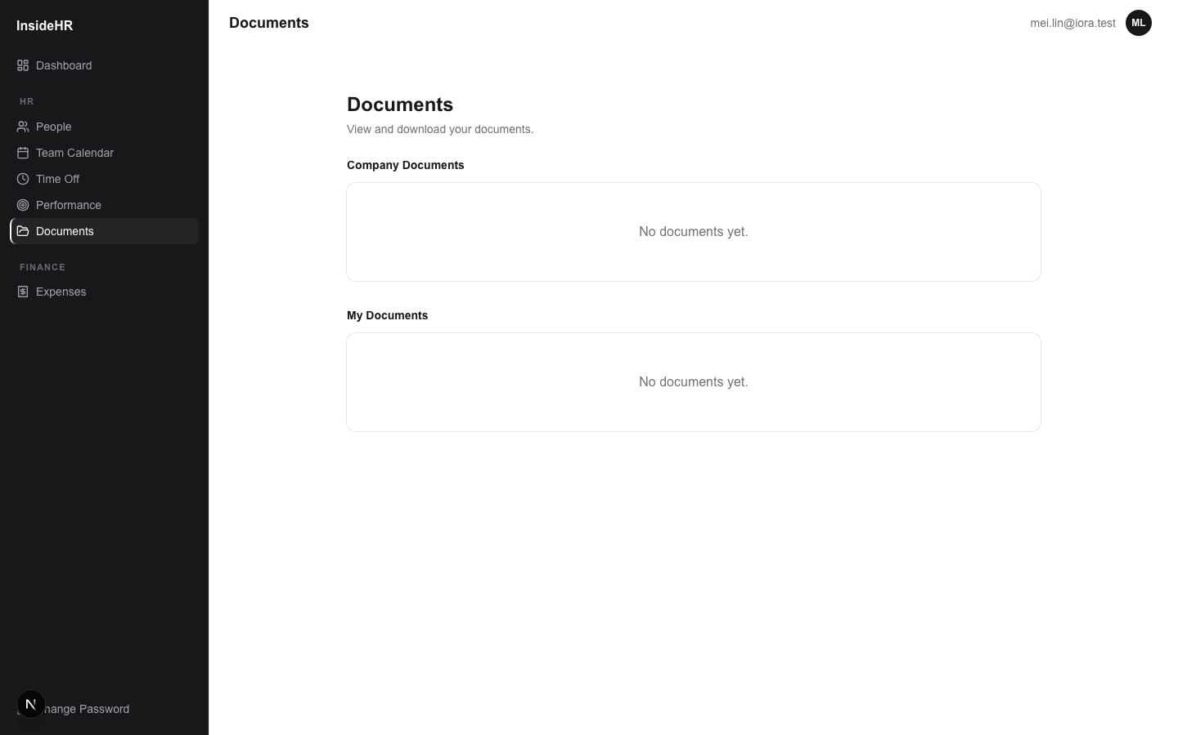
InsideHR · Employee Training
21
Documents
WHAT YOU CAN DO
Two sections: Company documents (handbook, policies, holiday calendar) + My documents (your offer letter, contract, etc.).
Click to download — files are stored in Google Drive.
Can't see something? Ask HR — admin controls who sees what.

Slide 22
InsideHR · Employee Training
22
Your password
WHAT YOU CAN DO
Sidebar bottom → Change Password — update any time.
Forgot your password? Click "Forgot password" on the login screen and you'll get a reset email.
Never share your password with anyone, even HR. They can reset it but not see it.

Slide 23
InsideHR · Employee Training
23
That's everything
Welcome to InsideHR.
WHAT YOU CAN DO
Questions about your records? Ask your manager first, then HR.
Found a bug or have a feature request? Let HR know — they can pass it up.

