Slide 1
InsideHR
Manager Training
Goal-setting, evaluation, approvals.
An iORA-style HR system for Singapore + Malaysia

Slide 2
InsideHR · Manager Training
2
Welcome — Manager role
What you can do for your direct reports.
WHAT YOU CAN DO
As a manager, you see your direct reports' records: leave requests, expense submissions, performance reviews, and timesheets (if you have part-timers).
You approve or reject those requests, you write goals + ratings, you sign off weekly hours.
You can't see other managers' teams or system-wide settings.
This deck walks each thing step-by-step. ~25 slides; ~20 minutes.

Slide 3
InsideHR · Manager Training
3
Logging in
STEP-BY-STEP
1
Open the InsideHR URL.
2
Enter your work email + the temporary password Admin sent you.
3
On first sign-in you'll be forced to change your password.
4
After that, you land on your manager dashboard.
If your email isn't recognised, contact Admin — your account hasn't been created yet.

Slide 4
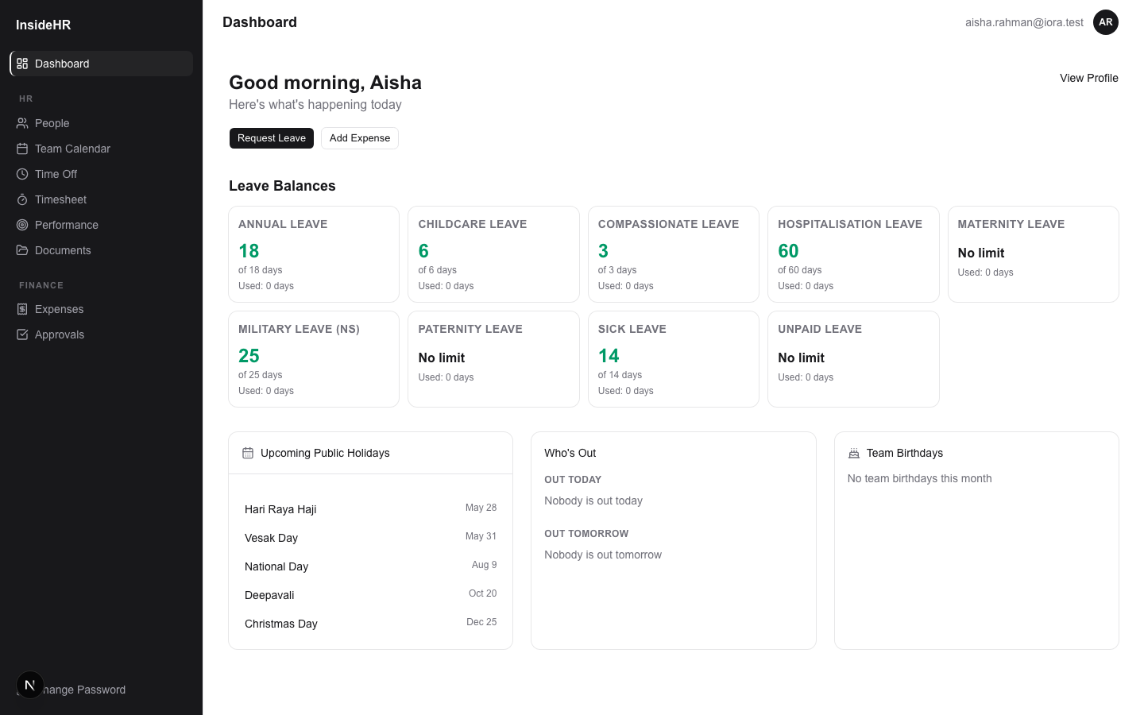
InsideHR · Manager Training
4
Your dashboard
What needs your attention today.
WHAT YOU CAN DO
Approval-count widget — pending leave + expense requests from your reports.
Birthday widget — direct reports' upcoming birthdays.
Use the sidebar to jump to any specific module.

Slide 5
Leave Approvals
Your reports' time-off requests.

Slide 6
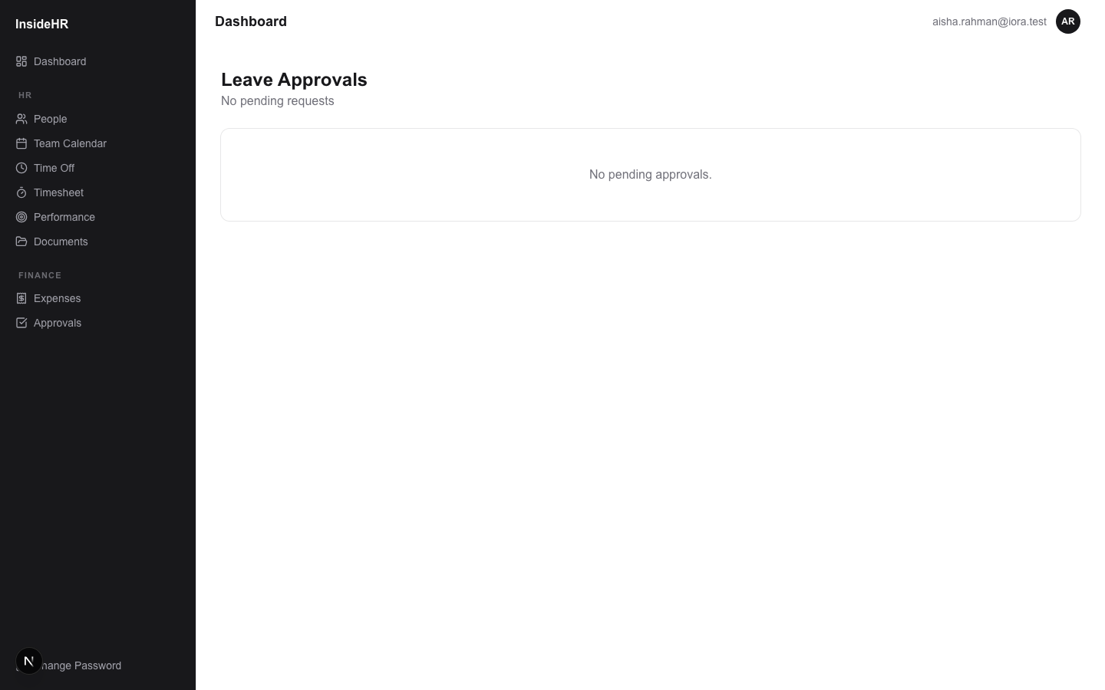
InsideHR · Manager Training
6
The leave approval queue
WHAT YOU CAN DO
One card per pending leave request from your direct reports.
Each card shows: who, dates, leave type, number of working days, balance left.
Approve immediately, or Reject with an optional comment.
Rejection sends the employee an email with your reason.

Slide 7
InsideHR · Manager Training
7
Reviewing a leave request
STEP-BY-STEP
1
Click into the request from the queue.
2
See the full reason + any attachment (e.g. medical certificate).
3
Use the "Approve" or "Reject" buttons. Rejection requires a reason.
4
Approved leave deducts from the employee's balance immediately and shows on the team calendar.
If you're unsure, ask the employee directly first — the system isn't your manager.

Slide 8
Expense Approvals
Reimbursable spend by your reports.

Slide 9
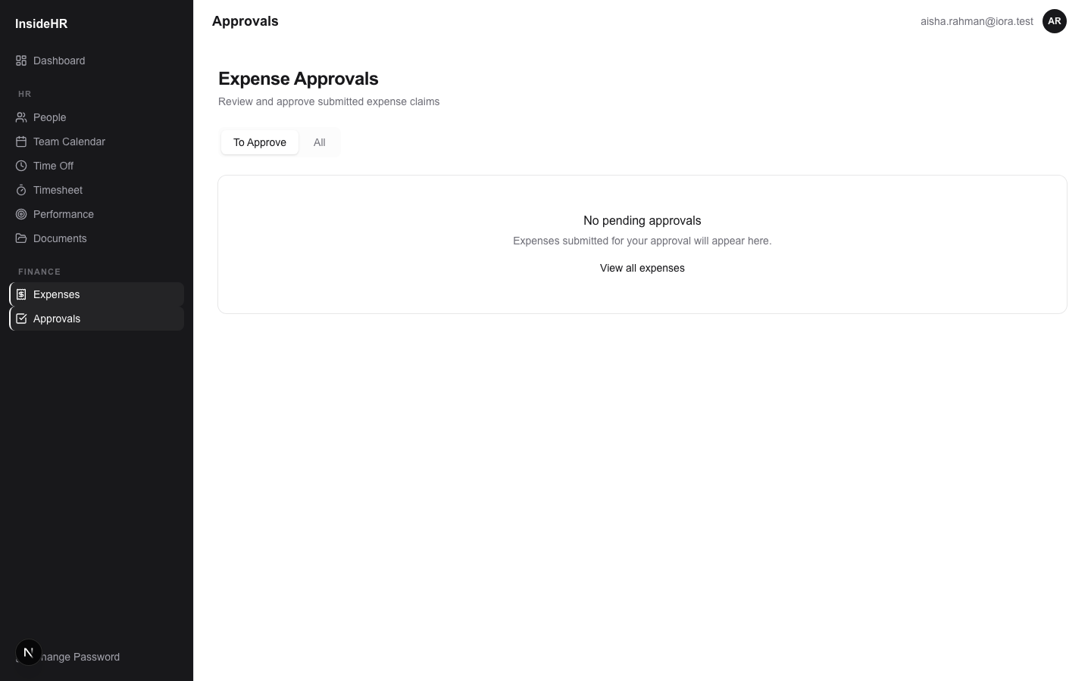
InsideHR · Manager Training
9
Expense approval queue
WHAT YOU CAN DO
Tab: For Approval — expenses your reports submitted, pending your sign-off.
Each row: category, amount + currency, receipt date, merchant.
Click into one → see the full receipt (image preview or PDF download).
Approve (passes to admin for reimbursement) or Reject (back to employee to fix).

Slide 10
Performance Reviews
Setting goals → evaluating → submitting.

Slide 11
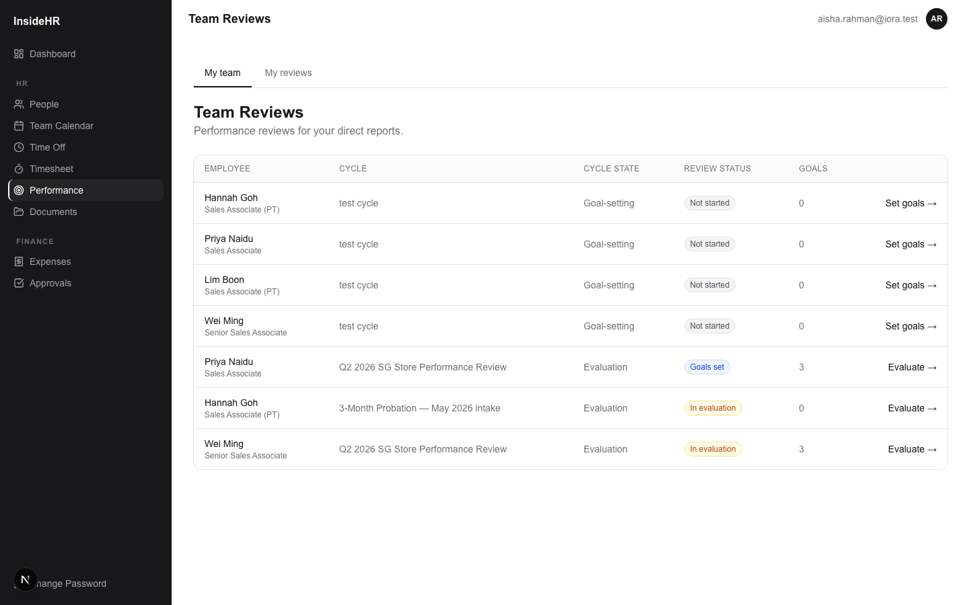
InsideHR · Manager Training
11
Performance — your team queue
WHAT YOU CAN DO
When an Admin scopes you into a cycle, you see your reports here.
Status pill tells you what's needed: "Not started" / "Goals set" / "In evaluation" / "Awaiting employee" / "Acknowledged".
The action link ("Set goals →" / "Evaluate →" / "View →") changes with cycle state.

Slide 12
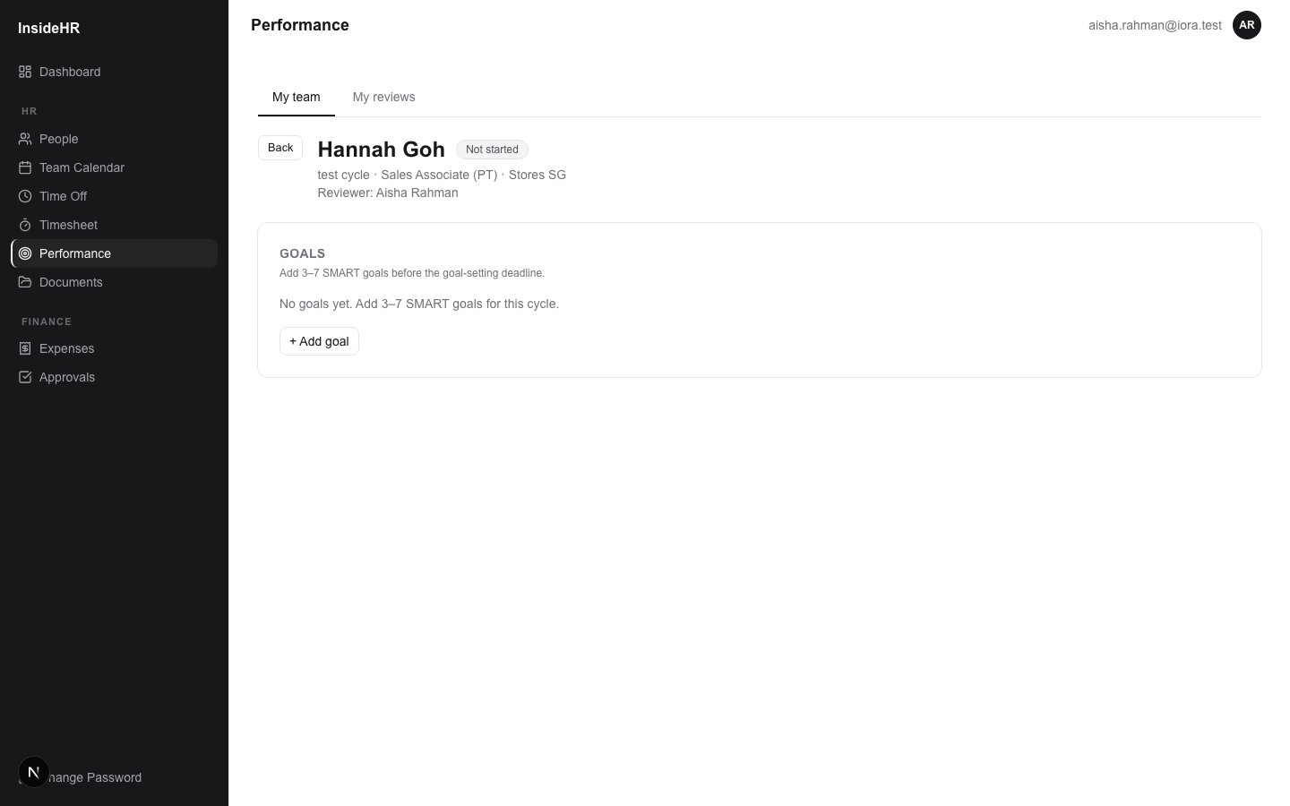
InsideHR · Manager Training
12
Step 1 — Set goals
During the ACTIVE phase of a cycle.
STEP-BY-STEP
1
Click into a report's review → "+ Add goal".
2
Title (1 sentence) + description (the why) + type (qualitative or quantitative).
3
For quantitative goals: set a target value + unit (RM, units, %, NPS, etc.).
4
Hit min goals (usually 3) and the review auto-promotes to "Goals set".
5
You can edit or delete goals freely while the cycle is ACTIVE.
Write SMART goals: specific, measurable, attainable, relevant, time-bound.

Slide 13
InsideHR · Manager Training
13
Step 2 — Evaluate goals
During the EVALUATION phase.
STEP-BY-STEP
1
Goals are now read-only. Each gets an outcome dropdown: Missed / Partial / Met / Exceeded.
2
For quantitative goals, fill in the actual value.
3
Add a comment per goal — what they did well, what they could do better.
4
Save each as you go. The form remembers your work.

Slide 14
InsideHR · Manager Training
14
Step 3 — Overall rating + submit
The summary that flows into bonus decisions.
STEP-BY-STEP
1
Below the goals: Submit review form.
2
Pick the overall rating from the configured scale (e.g. 1–5: Below / Approaching / Meets / Exceeds / Outstanding).
3
Write the manager narrative — strengths, growth areas, context.
4
Fill any retail extras the cycle requires (sales target/actual, attendance, promotion-ready).
5
Click Submit → review goes to the employee for acknowledgement, locked from edits.
Strict mode: all goals must be evaluated before you can submit.

Slide 15
InsideHR · Manager Training
15
Probation reviews
A special 3-month flow for new hires.
WHAT YOU CAN DO
No goals, no rating — just a confirmation decision.
Decision options: CONFIRMED (pass probation) / EXTENDED (additional period) / NOT_CONFIRMED (terminate).
Decision is required to submit. Legally meaningful in Malaysia — a confirmation letter must follow your decision.
Notes field captures your rationale (kept on file).

Slide 16
Timesheet Approvals
If you manage part-time staff.

Slide 17
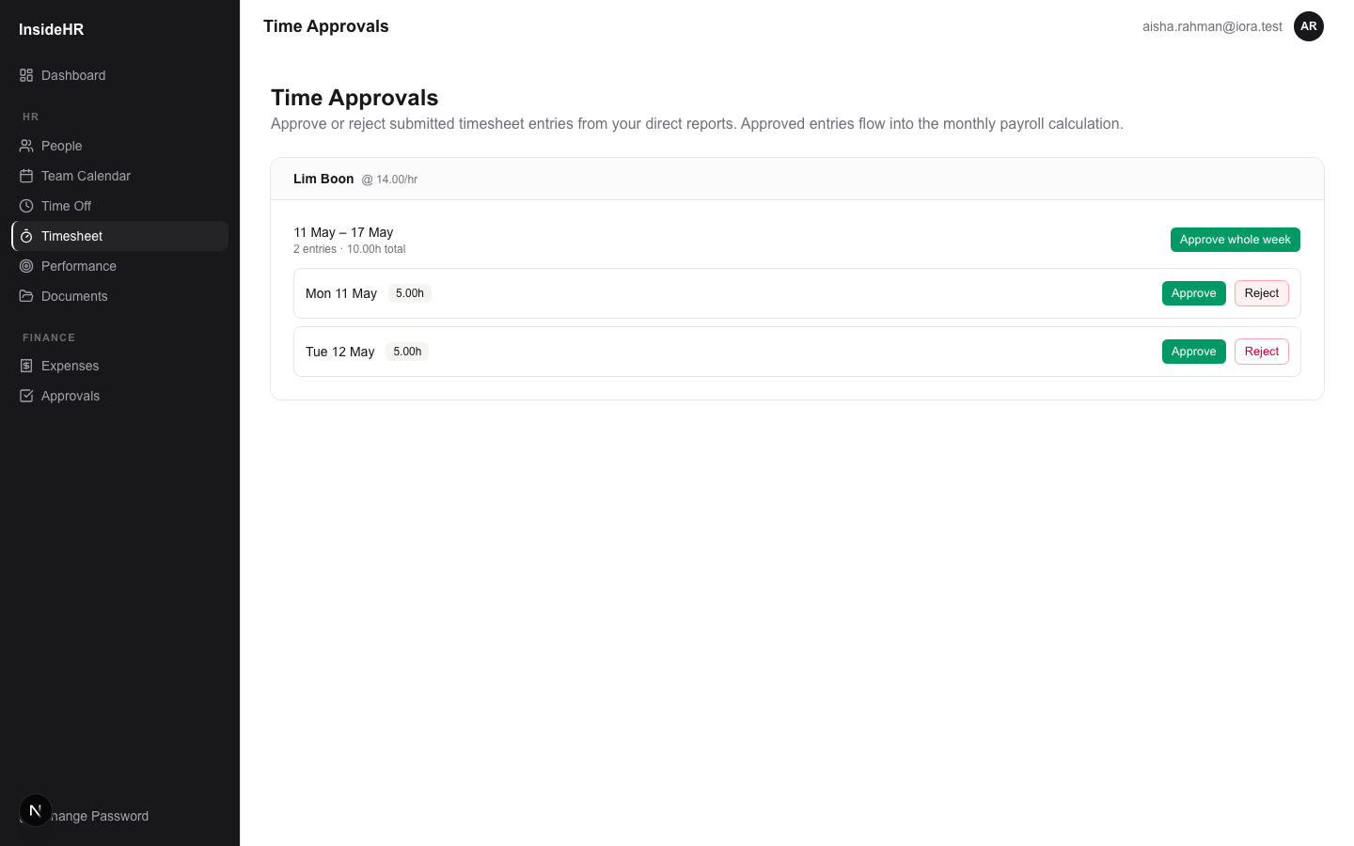
InsideHR · Manager Training
17
The timesheet approval queue
WHAT YOU CAN DO
Sidebar → Timesheet → Approvals tab.
Submissions are grouped per employee, per week.
Each week shows total hours + how many fall on public holidays (with auto-detection).
"Approve whole week" approves all entries in one click, or do it per-entry.

Slide 18
InsideHR · Manager Training
18
Rejecting a timesheet entry
STEP-BY-STEP
1
On a specific entry, click "Reject".
2
A comment box appears — enter a clear reason (this goes to the employee).
3
Click "Send rejection" — entry returns to the employee as DRAFT, with your reason visible.
4
They can fix and re-submit.
Use rejection sparingly. For repeated issues, talk to the employee directly first.

Slide 19
Other day-to-day
Calendars, documents, profile.

Slide 20
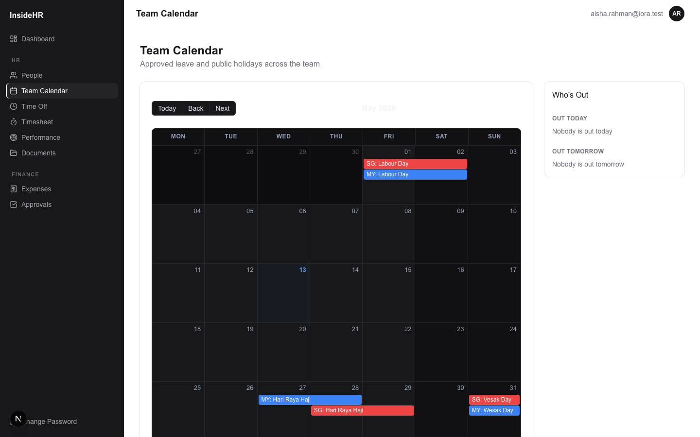
InsideHR · Manager Training
20
Team calendar
WHAT YOU CAN DO
Shows who's out and when across your direct reports.
Coloured by country (SG / MY).
Useful when planning coverage or shift schedules.

Slide 21
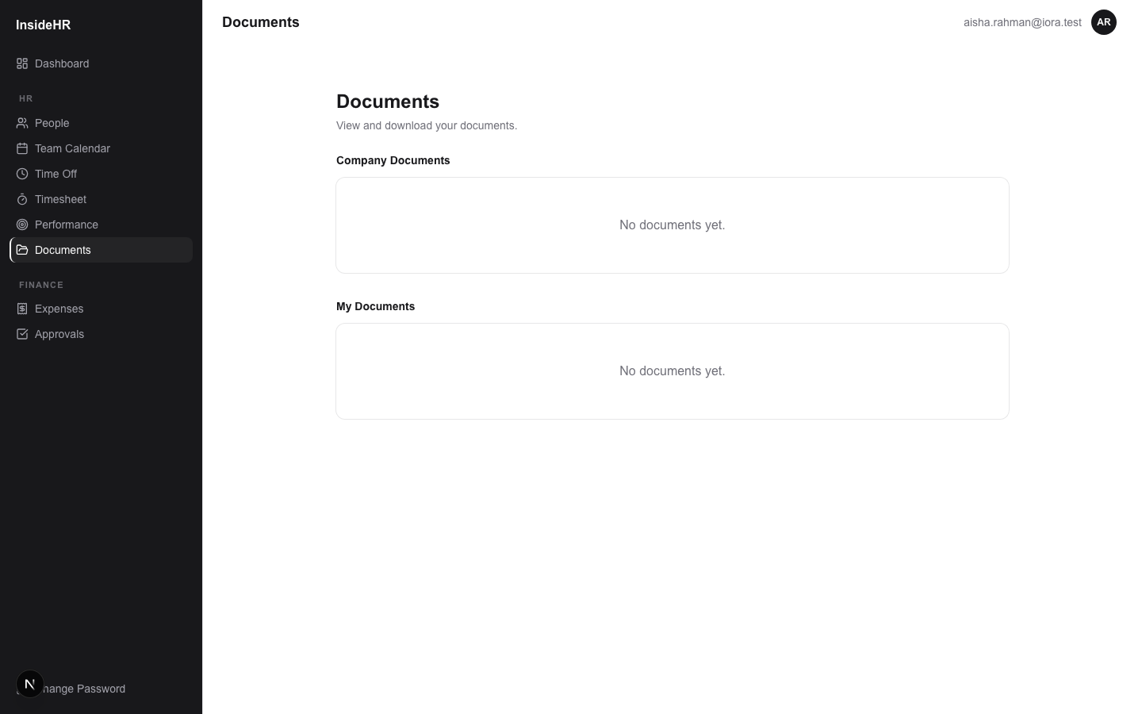
InsideHR · Manager Training
21
Documents
WHAT YOU CAN DO
Read-only company documents (handbook, policies, holiday calendar).
If HR uploaded employee-specific docs to one of your reports, you can read them.
You can't upload — that's HR Admin's job.

Slide 22
InsideHR · Manager Training
22
Your own profile
WHAT YOU CAN DO
Sidebar → Change Password — update your password any time.
Your dashboard widgets are personal — they show YOUR pending approvals + birthdays.
Need to update your phone / NRIC / bank info? Ask Admin for now.

Slide 23
InsideHR · Manager Training
23
That's the manager flow
Walk through every step at your own pace.
WHAT YOU CAN DO
Questions? Ask your HR Admin.
The system enforces fair treatment by giving everyone the same workflow — but you bring the judgment.

