Slide 1
Software Development Life Cycle
Waterfall, Iterative & RAD models

Slide 2
Software Development Life Cycle
Analysis
Design
Implementation (Coding)
Testing
Maintenance

Slide 3
Analysis
Develop a specification / system requirements document.
Research using:
Interviews
Questionnaires / surveys
Observation of users
Inspecting existing documentation

Slide 4
Design
Frontend - GUI Wireframes / Mockups, Color schemes/combos, brand requirements
Processes - Data flow diagrams, Pseudocode, Flowcharts, Gantt charts, high level overview diagrams, abstraction & decomposition - breakdown down into modular parts, Structure Charts, State Transition Diagrams.
Backend - ERD, Database Schemas

Slide 5
Implementation
Coding of the project.
Assets pulled together.
Some testing also takes place - modular test, verification/validation testing.

Slide 6
Testing
Unit Testing - automated testing using predetermined test
User Acceptance Testing
Whole System Testing - server load / concurrent user tests.

Slide 7
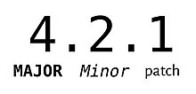
Maintenance
Mostly bug fixes and minor feature addition / improvements.

Slide 8
Waterfall Model
Originally adapted from manufacturing/architecture planning process.
Each step must be completed fully before moving on to the next step.
Rigid design.
Analysis
Design
Implementation
Testing
Maintenance

Slide 9
Waterfall Model
Advantages
Relatively straightforward to manage due to its fixed, linear design.
Costs and times can be accurately estimated.
High accountability due to distinct steps and activities.
Disadvantages
Slow to implement.
Difficult to change course after the design phase.
User feedback only at the analysis phase.
Can’t add or remove features easily.

Slide 10
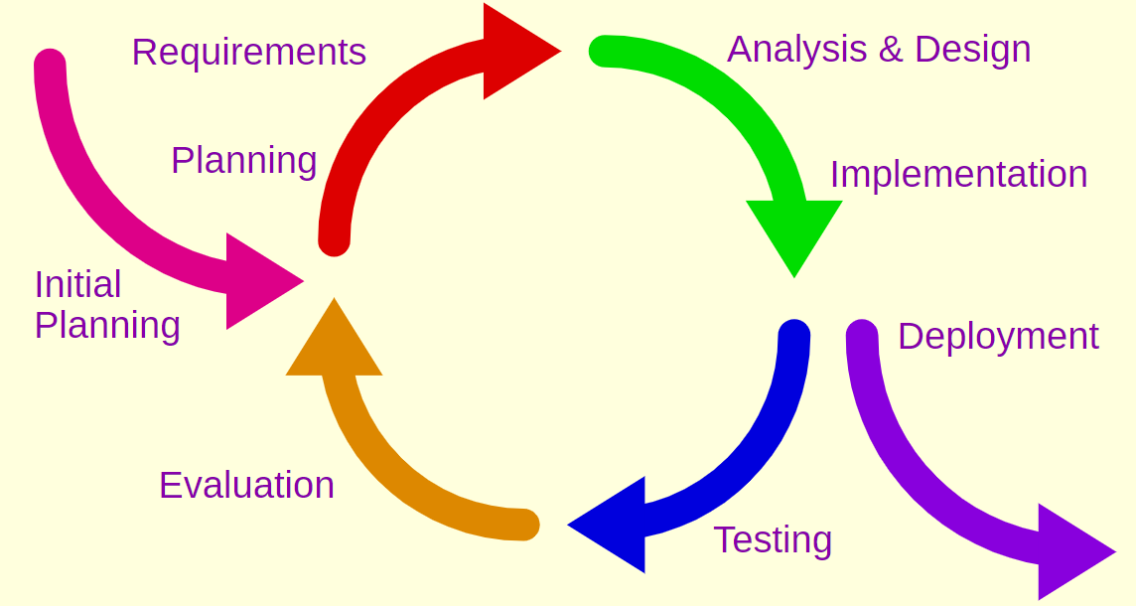
Iterative
An adaption of the waterfall model that takes into account the probability that the project requirements will change as time goes on.
The focus is on building the core system and adding more features through each iteration and subsequent release.

Slide 11
Iterative Model
Advantages
Each cycle is easy to manage, due to the fixed and modular nature of each component.
Extra features can be added.
User feedback is taken at each iteration, rather than just at the very start of the project.
Can adapt and grow as the requirements change.
Easy to budget because you can pause/stop at the end of each mini cycle.
Team can upskill though each cycle.
Disadvantages
Still slow and expensive to implement as the full cycle needs to completed each time.
Harder estimate overall time and cost as the system is constantly growing.
Cycles may never end (but this might not be a bad thing)

Slide 12
Rapid Application Development
Focuses on rapid development through a series of prototypes, followed by a final release.
Not a big focus on initial planning.
Optimised for GUI heavy applications.
Prototyping
Phase
Develop
Demonstrate
Analysis and quick design
Testing
Cutover
Refine

Slide 13
RAD Model
Advantages
Very fast and cheap.
Software constantly evolving before release depending on customer feedback.
Great for GUI heavy projects due to constant user interaction.
Disadvantages
Not suitable for large projects where modular development is required
Difficult to manage due to the rapid and blurred prototyping cycle
Costs and Time cannot be accurately estimated.
Development team need to be highly skilled.
Can lead to feature creep or moving away from initial objectives.
Relies on close and heavy user/customer involvement throughout

