Slide 1
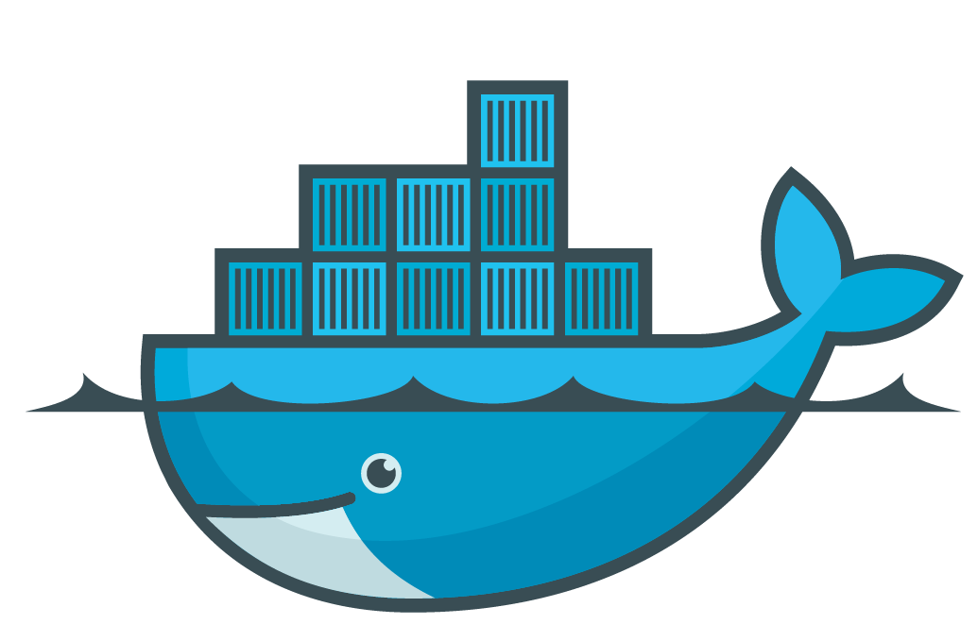

Apache Cassandra
via Docker
Chris Ballance
Diligent Corporation
@ballance

Slide 2
What we’ll cover
Docker Fundamentals
CAP Theorem
Cassandra Fundamentals
Demo of Cassandra deployed with Docker

Slide 3

Docker
Hosting & Coordination

Slide 4
Docker Hub
“GIT for Virtual Machines”
https://hub.docker.com/

Slide 5
Available Docker Images
Ubuntu, Centos, Debian, Fedora
Cassandra, mySQL, mongoDB
Node, Java, Erlang, Ruby, Rails
Wordpress
Redis
Hipache, NGINX
Create your own!

Slide 6
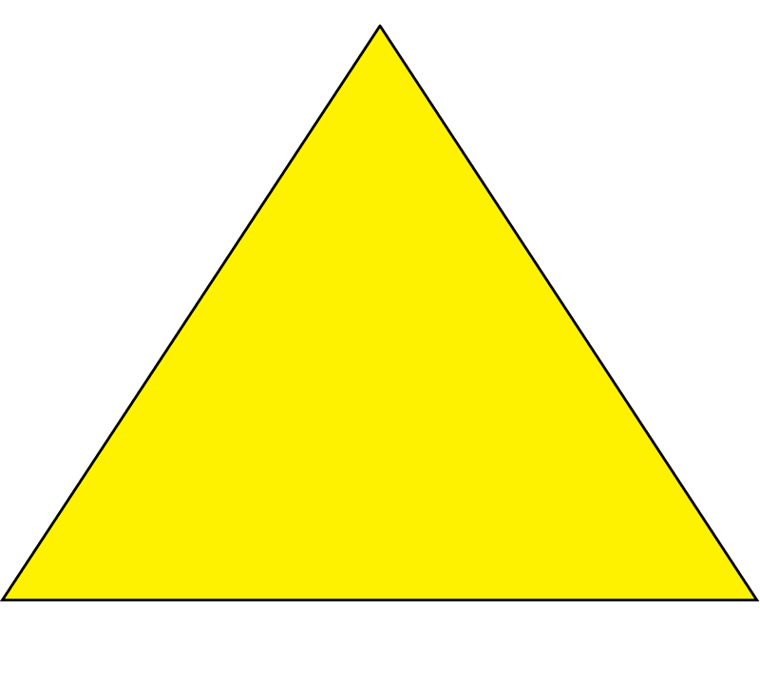
CAP THEOREM
Notes:
Before I get into CAP theorem, I’d like to start off with another very similar triangle you’re already familiar with…

Slide 7
Project Delivery Triangle
Good
Fast
Cheap
Notes:
Before I get into CAP theorem, I’d like to start off with another very similar triangle you’re already familiar with…

Slide 8

Project Delivery Triangle
Good
Fast
Cheap

Slide 9
CAP Theorem
Consistent
Available
Partition Tolerant
Notes:
CAP Theorem is similar. We have three competing interests

Slide 10
CAP Theorem
Consistent
Available
Partition Tolerant
Notes:
Choose two

Slide 11
Consistent
Available
Partition Tolerant
Notes:
Consistency
- Always reads the most recent write
- One version of the truth
- But, if nodes are partitioned, we cannot guarantee consistency.
- We can wait until we’re consistent, but in the meantime we may timeout and cannot continue.

Slide 12
Consistent
Available
Partition Tolerant
Notes:
Every (unfailed) node always returns query results
Eventually consistent
No errors or timeouts, but data may be stale
If partitioned, a node can return its current state, but it may be an old version of the truth

Slide 13
Consistent
Available
Partition Tolerant
Notes:
Are all nodes always consistent?
What is the lag time between node updates?
One version of the truth
Transactions are atomic

Slide 14
Consistent
Partition Tolerance is a myth!
Available
Partition Tolerant
Notes:
-Be dramatic… PARTITION TOLERANCE IS A MYTH!!1!
-This is just the nature of networks. Nothing is guaranteed.
-So really, we just have two competing interests, Consistency, and Availability.
-Choosing which to favor cannot be an entirely technical decision, but something to discuss with your stakeholders and it depends on the type of app you’re building.

Slide 15

We can guarantee Consistency, but not Availability.
We may time out or fail to return anything
Consistent
Available
Partition Tolerant
Notes:
Once choice would be to favor Consistency. While this isn’t as popular with most workflows, it has its place.

Slide 16
We can guarantee Availability, but our data may not be Consistent with other nodes
Consistent
Available
Partition Tolerant
Notes:
-Another choice would be to favor Availability. You’ll find this is very common in social media, and media in general.

Slide 17


Our business needs will drive whether
we choose Consistency or Availability
Partition Tolerant

Slide 18

Implementations
Consistent
RDBMS
SQL Server
MongoDB,
Big Table (GFS)
CA
CP
Available
AP
Partition Tolerant
Cassandra, CouchDB

Slide 19

A contrived example for Consistency
A
B
Notes:
Here’s an example where we’re favoring consistency.
We have a stick guy with data to write, and two nodes to write to and read from.

Slide 20
User writes S1 to Node B
S0
S0
A
B
S1
Notes:
S1 is going to be our payload, and we send it to node B.

Slide 21
User queries Node A Nodes B & A have not sync’d
S0
S1
A
B
S1
Notes:
After we’ve sent our write (S1) to node B, we query Node A for the value of S. We might not even know that we’re being routed to node A for the read when we just wrote to node B. This can be even more confusing to even savvy users if this redirection is fully transparent behind a load balancer (and it typically is).

Slide 22
Query is blocked
until B syncs with A
S0
S1
A
B
?
S1
Notes:
Stick man is not a patient fellow and he’s tapping his foot, waiting for his query to return. He’s probably just going to assume the system is broken after a few seconds…

Slide 23
Once B syncs with A,
the query on A is unblocked
and returns S1 as expected
S1
S1
S1
A
B
S1
:-)
S1
* The query could potentially time out
Notes:
Finally, Node A is able to synchronize with Node B to get S1 and return it to Stick guy. There’s a real risk of starving Stuck guy, and he’s already looking mighty thin.

Slide 24
A contrived example for Availability
A
B
Notes:
Now let’s look at a different approach. This time, we will favor Availability over Consistency.

Slide 25
User writes S1 to Node B
S0
S0
A
B
S1
Notes:
Our buddy, Stick guy, again sends S1 to Node B.

Slide 26
User queries Node A for S1
S0
S1
A
B
S1
Notes:
Now he queries Node A.

Slide 27
Query returns current state of A, but is not consistent with B
S0
S1
S1
A
B
S0
?
S1
Notes:
He immediately gets a reply, but it is stale data, since Nodes A & B have not yet synchronized. We don’t have to wait for the query to return, but we do get stale data that is older than what we have already sent out.

Slide 28
A later query of A yields S1 previously written to B. Eventual consistency has been achieved.
Idempotence
Event Sourcing
Local Caching
Queueing
S1
S1
S1
A
B
S1
:-)
S1
Notes:
On the later query, stick guy gets back the value S1 that he is expecting, consistent with what he previously sent to Node B.

Slide 29
Cassandra

Slide 30
History
Developed for Facebook Inbox Search
Created by one of the authors of Amazon Dynamo
Released as Open Source in 2008
Became an Apache Incubator project in 2009
Graduated to an Apache Top Level Project

Slide 31
Who is using Cassandra in production today?
Twitter
Netflix
Credit Suisse
Cisco
Many more…
http://PlanetCassandra.org/companies/

Slide 32
Benefits
Linear Scalability
Data Sets can be larger than available memory
Multi-master
Built-in support for handling multiple data centers
Decentralized & Distributed - No single point of failure
Integrated caching
Consistency options can be tuned through configuration
Supports MapReduce
Familiar query syntax - CQL (Cassandra Query Language)
Designed for sparse loading of loosely typed data

Slide 33
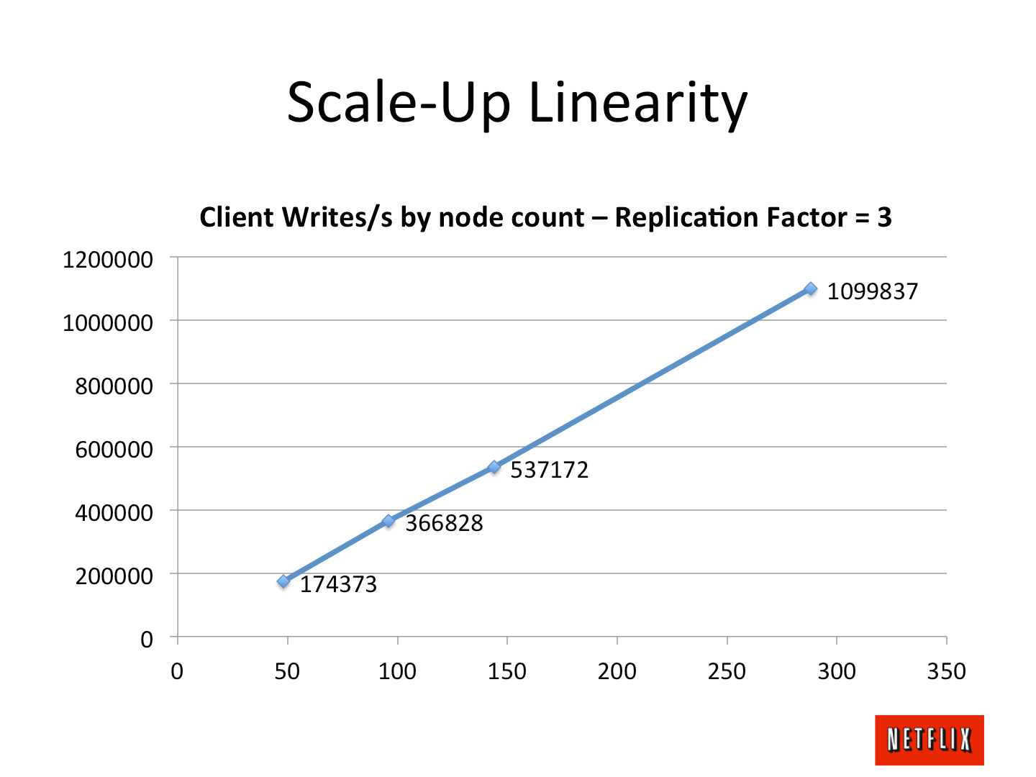
Linear Scalability

Slide 34
Challenges
JOINs are not supported! (not unique to Cassandra)
Not for financial data (eventual consistency)
Tooling is not yet as mature as Oracle or SQL Server

Slide 35
Why NOSQL?

Slide 36
Multiple persistence strategies
Use the right tool for the job. Sometimes more than one tool is appropriate. NoSQL can work in conjunction with SQL solutions. For example, you might have trasactions you continue to store in a Relational Database, and build your new user social graph data in a NoSQL solution. Can’t decide on a local database for a mobile app? Sometimes the best route is to just persist the whole thing as JSON on disk until you need something faster.

Slide 37
Total Cost of Ownership (TCO)
Let’s face it, SQL Server is expensive. If you need it, and can fully justify the cost, then it might be right for you. But as we’ve discussed, RDBMS can be a crutch and a default choice for persistence layers. Defaults are just that, default. They’re a catch-all that is rarely the best choice unless you’re resolving generic default problems

Slide 38
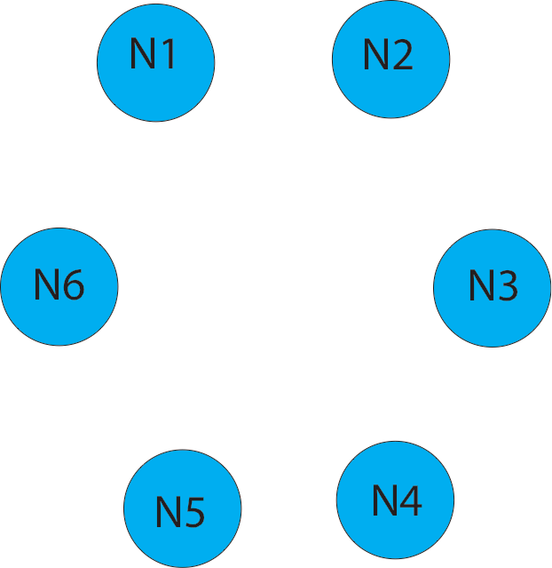
Write (consistency two)

Slide 39

Write (consistency two)
Client

Slide 40
Write (consistency two)
Client

Slide 41
Write (consistency two)
Coordinator
Client

Slide 42
Write (consistency two)
Replicant
Coordinator
Client

Slide 43
Write (consistency two)
Replicant
Coordinator
Client
Replicant

Slide 44
Write (consistency two)
Replicant
Coordinator
Confirm
Client
Replicant

Slide 45
Write (consistency two)
Replicant
Time-out
Coordinator
Confirm
Client
Replicant

Slide 46
Write (consistency two)
Replicant
Time-out
Coordinator
Replicant
Confirm
Client
Replicant

Slide 47
Write (consistency two)
Replicant
Time-out
Coordinator
Confirm
Replicant
Confirm
Client
Replicant

Slide 48
Write (consistency two)
Replicant
Time-out
Coordinator
Confirm
Replicant
Success
Confirm
Client
Replicant

Slide 49
Read (consistency two)
Client

Slide 50
Read (consistency two)
Client

Slide 51
Read (consistency two)
Coordinator
Client

Slide 52
Read (consistency two)
Coordinator
Client

Slide 53
Read (consistency two)
Chosen Node
Coordinator
Chosen Node
Client

Slide 54
Read (consistency two)
Chosen Node
Coordinator
Chosen Node
Client

Slide 55
Read (consistency two)
Inconsistent
Node
Coordinator
Chosen Node
Client

Slide 56
Read (consistency two)
Inconsistent
Node
Coordinator
Chosen Node
Client

Slide 57
Read (consistency two)
Chosen Node
Inconsistent
Node
Coordinator
Chosen Node
Client

Slide 58
Read (consistency two)
Chosen Node
Inconsistent
Node
Coordinator
Chosen Node
Client

Slide 59
Read (consistency two)
Chosen Node
Inconsistent
Node
Coordinator
Success
Chosen Node
Client

Slide 60
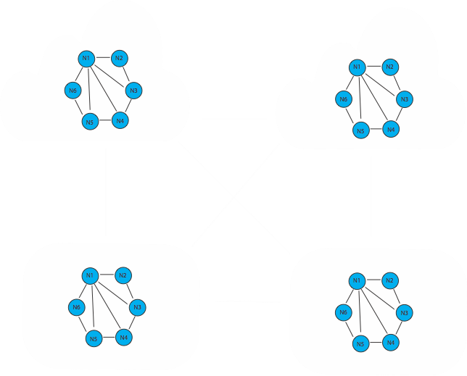
On-premise + Cloud

Slide 61
Consistency Modes
ALL - Every node must have the data
QUORUM - Most nodes must have the data
ONE - At least one node must have the data
TWO - At least two nodes must have the data
THREE - At least three Nodes must have the data
ANY - Any node has the data
EACH_QUORUM - Each datacenter must have a quorum
LOAL_QUORUM - Each node in the datacenter handling the request must have a quorum *Quorum = (replication_factor / 2 ) + 1

Slide 62
Calculating Consistency
R + W > N
R —> Read level consistency
W —> Write level consistency
N —> Number of replicas of the data

Slide 63
Data Replication
SimpleStrategy - Single data center
NetworkTopologyStrategy - Recommended strategy for multiple data centers. Provides Cassandra with info about the location of nodes by rack and datacenter

Slide 64
Deploying Cassandra with Docker
Demo

Slide 65
Additional Resources
Apache Cassandra http://cassandra.apache.org/
Docker https://www.docker.com/what-docker
Docker Hub https://hub.docker.com/explore/
Cassandra for Developers - Paul O’Fallon https://www.pluralsight.com/courses/cassandra-developers
DBA’s Guid to NoSQL: Apache Cassandra (Free eBook) http://is.gd/CassandraFreeEbook
Cassandra 3.0 - DataStax PDF http://docs.datastax.com/en/cassandra/3.0/pdf/cassandra30.pdf

Slide 66
Questions?

