Slide 1
Predicting
Stroke
Events

Slide 2
Agenda
Project Team
Project Details
Machine Learning
ETL, Database and API Setup
Frontend
Heroku Deployment
Project Overview
Acknowledgements
Technologies
Site Tour

Slide 3
Project Team Members
Chris Ballard
Ocean Showers
Heroku, HTML, JavaScript, Python
HTML, CSS, JavaScript, Bootstrap, Plotly, AnyChart
Emily Cruz
Ross Teare
scikit-learn; Decision Trees, Logistic Regression
HTML, CSS, JavaScript, Plotly
Chris Rettig
Andrea Vaughn
Python, SQL, Flask API, HTML, Bootstrap
scikit-learn; Decision Trees, Logistic Regression

Slide 4
Project Overview
Project Goal
Predict the likelihood of an individual having a stroke based on a combination of certain attributes in a dataset.
Target Audience
By synthesizing this dataset, the target audience; physicians and patients alike, will gain a deeper understanding of common attributes that would trigger a stroke.
Dataset Source
Kaggle user Fedesoriano, “Stoke Prediction Dataset”

Slide 5
Technologies
Backend
Flask
SQLalchemy
PostgreSQL
Heroku
Decision Tree Classifier
Logistic Regression
Frontend
HTML
CSS
JavaScript
Bootstrap
Plotly
AnyChart
Data Manipulation and Analysis
pandas
numpy
matplotlib
jupyter

Slide 6

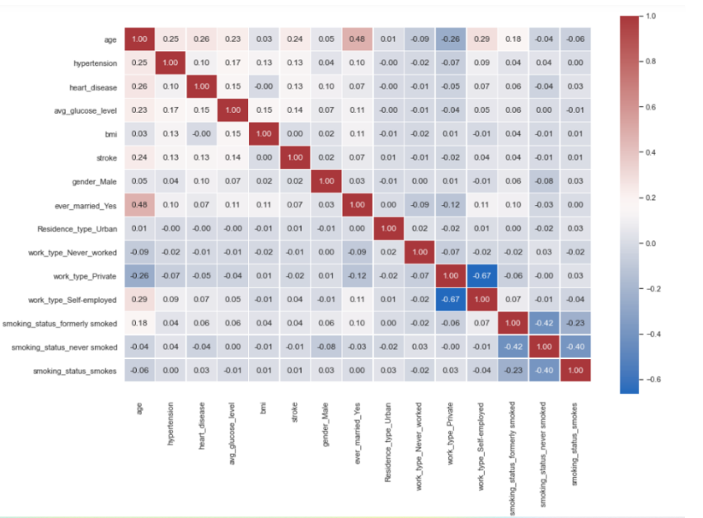
Machine Learning
Decision Tree Classifier
88% Accuracy
Attributes
Age
BMI
Hypertension
Heart Disease
Glucose Levels
Gender
Married
Urban vs Rural
Work Type
Smoking Status

Slide 7
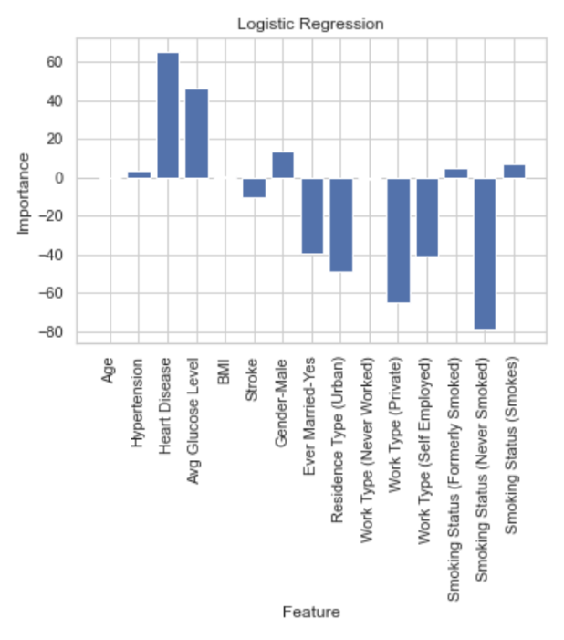
Machine Learning
Logistic Regression
Training Data Score: 0.952857604133032 Testing Data Score: 0.9380445304937076
Positively Correlated Factors
Heart Disease
Average Glucose Level
Gender
Currently Smoking
Formerly Smoking
Hypertension

Slide 8
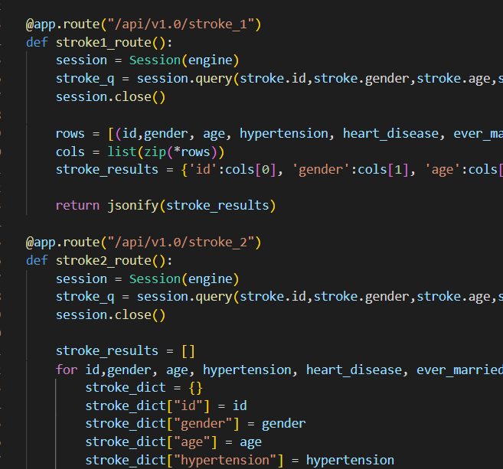
ETL, Database and API Setup
ETL
Juypter, pandas, numpy to clean data and prepare data to be uploaded to SQL
SQL Database
Jupter to upload data into Postgres to create database
Flask API
Python, numpy, sqlalchemy and flask to pull data from SQL database and create Flask API routes

Slide 9

Frontend
HTML
Bootstrap
JavaScript
Plotly
AnyChart
CSS

Slide 10

Heroku Deployment
Create Database on Heroku
Python script creates database on Heroku when time to complete deployement
app.py file
Create routes for each webpage
Reference each html file correctly
app.py and setupdb.py files
Create correct/matching database url to communicate with the deployed database

Slide 11
Acknowledgements
fedesoriano. (2021, January). Stroke Prediction Dataset, Version 1. Retrieved May 11, 2021 from https://www.kaggle.com/fedesoriano/stroke-prediction-dataset/version/1.
American Stroke Association. 2021. About Stroke. https://www.stroke.org/en/.
PresentationGO.com – The free PowerPoint and Google Slides template library
Fred and Sumeet

