Slide 1

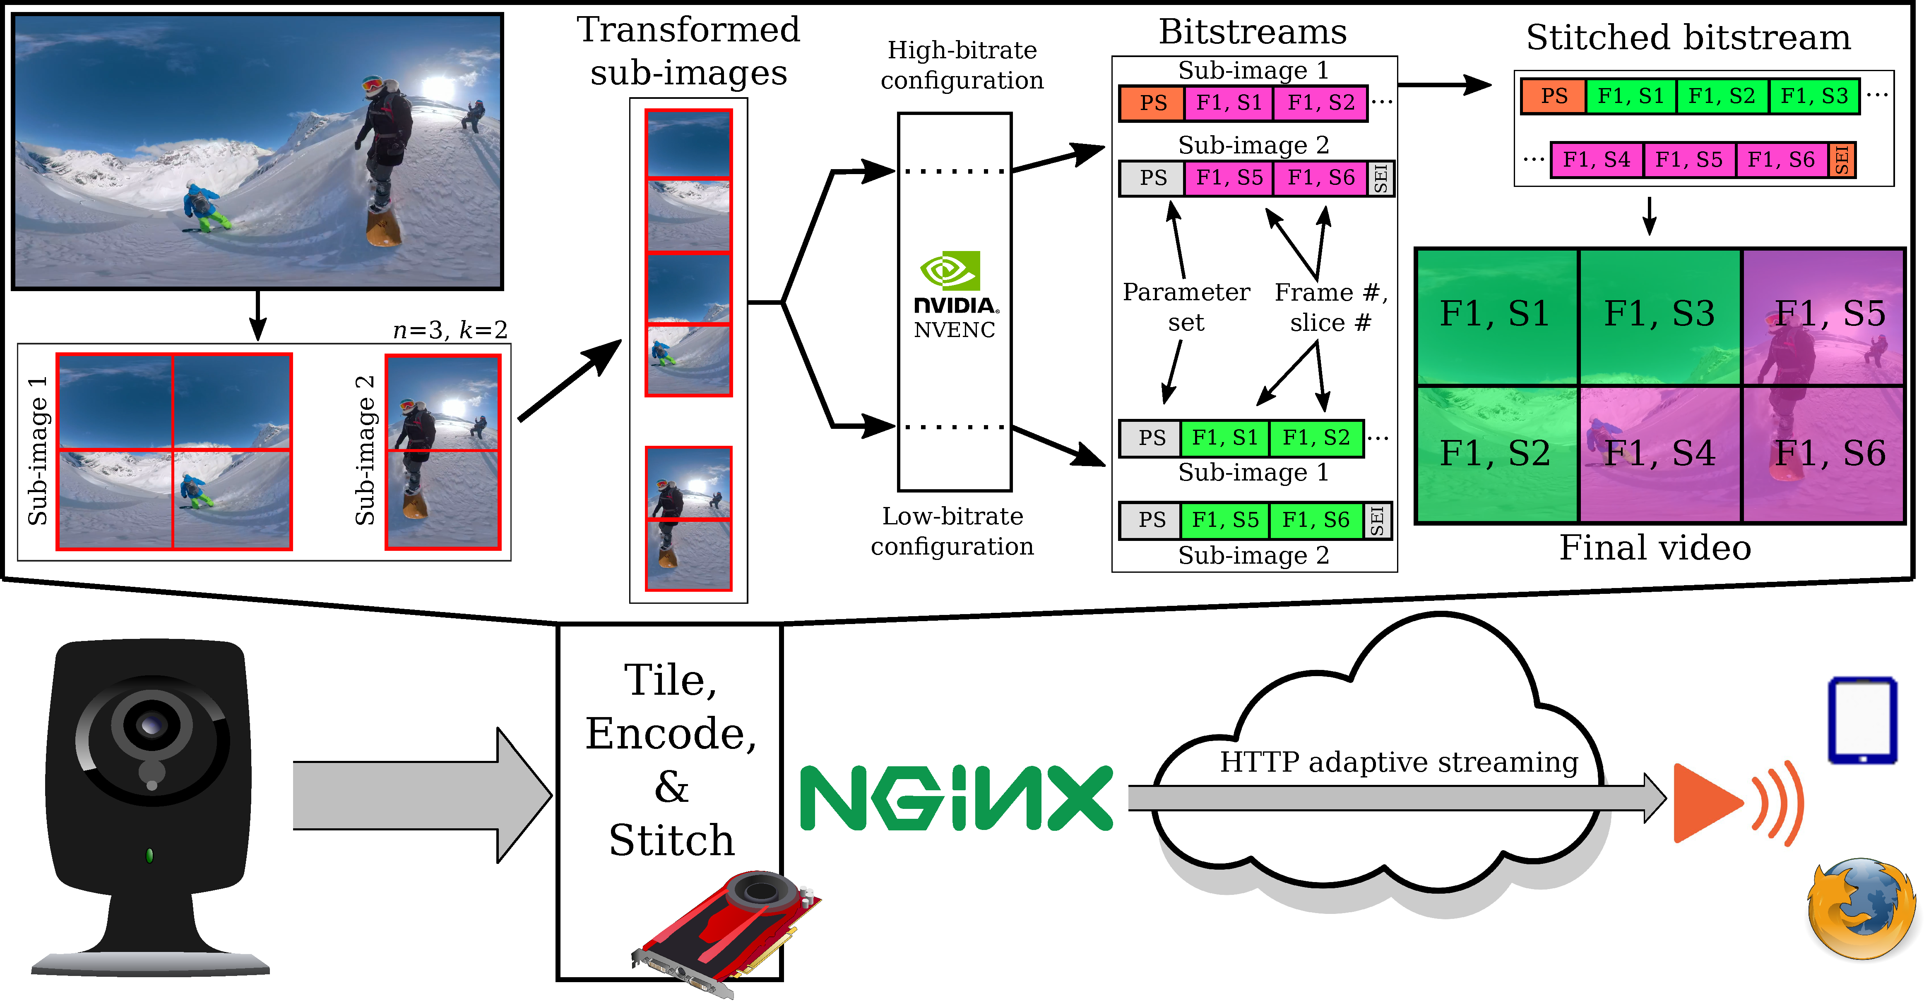
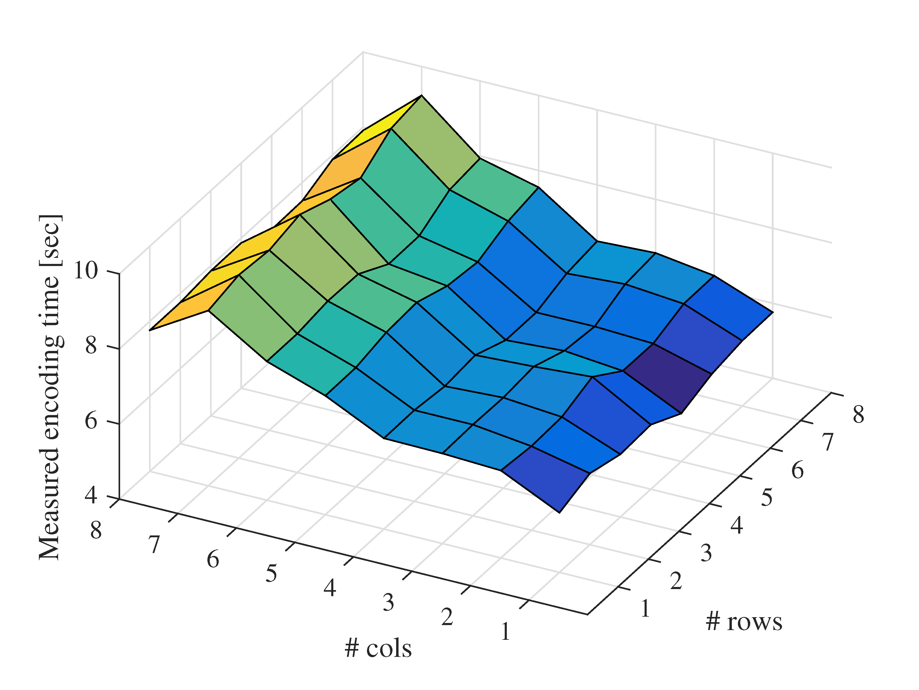
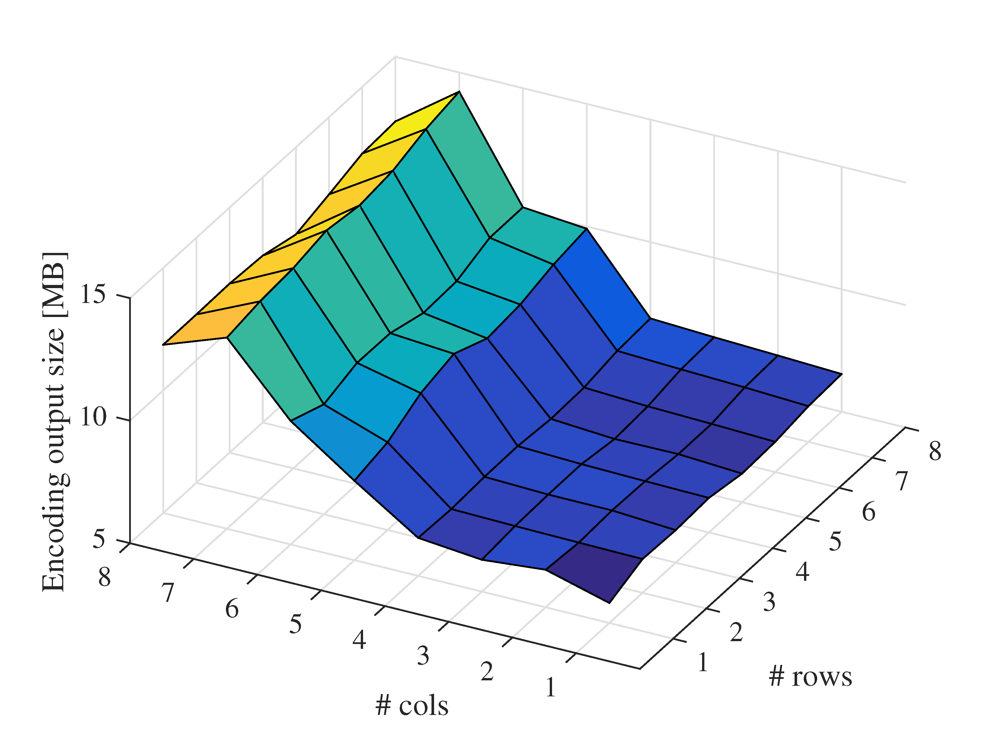
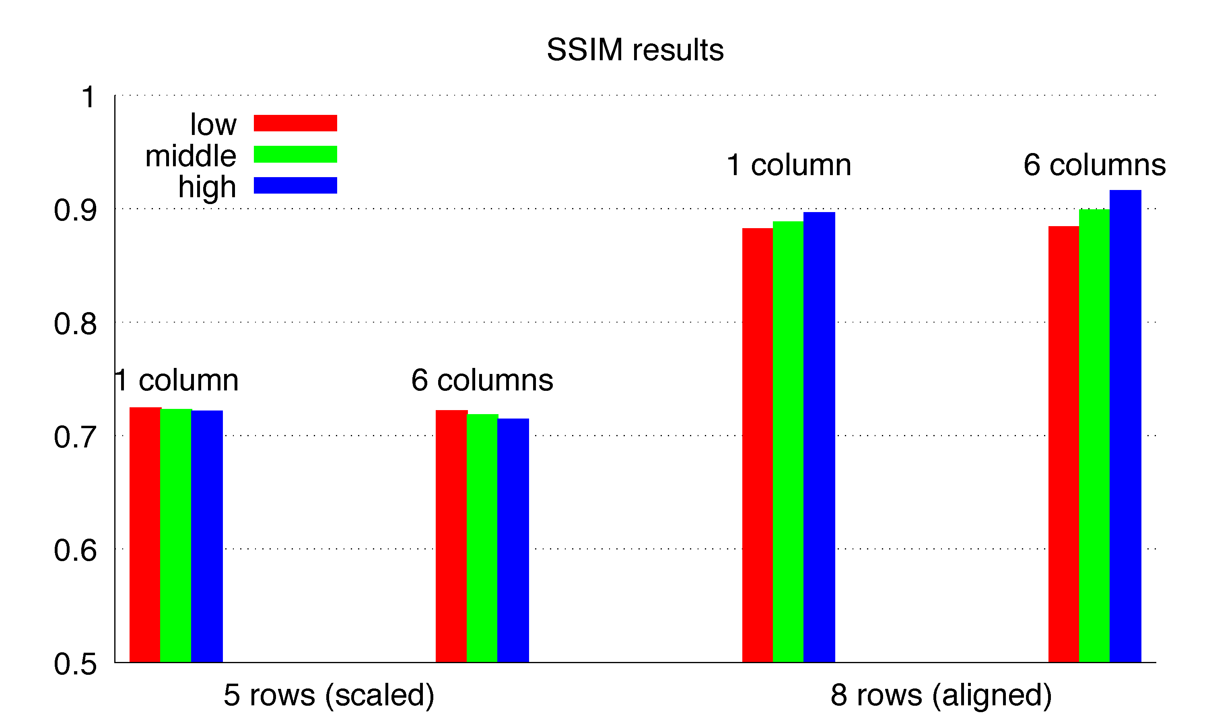

RATS: Adaptive 360-degree Live Streaming (Demo)
University of Oslo
Trevor Ballard¹, Carsten Griwodz², Ralf Steinmetz³, Amr Rizk³
¹University of Central Florida, USA ²University of Oslo, Norway ³Technische Universität Darmstadt, Germany
Problem Statement
Tiled 360°adaptive bitrate video streaming shows significant bandwidth savings “get different tiles in different qualities”
This has been shown for video on demand but it is difficult for 360 live streaming
There is a lack of tiling support in existing hardware encoders for 360 tiled video
RATS Approach
GPU-based HEVC encoding platform to tile, encode, and stitch 360 video at multiple qualities in real-time
Source video stream is divided into columns which are stacked and fed to a hardware encoder for low and high quality encoding
At playback each tile is an independent region, which allows picking which tile appears in the 360 video
Here, stitching is on the server, in general it could be done, e.g. at a 5G edge computing node
Evaluation
Left Figure : Real time required to encode a tiled configuration for 30 seconds of 3840x2048 video. The encoding process is CPU-bound because tiles a rearranged by the CPU.
Middle Figure : Sizes of the encoded tiled videos. The video size grows rapidly when additional encoding contexts are required
Right Figure : SSIM scores between input and tiles video. "Middle“ quality uses a checkerboard pattern. Hardware alignment rules require padding for 3, 5, 6 and 7 rows; 5 and 8 rows are given as representative examples.

