Slide 1
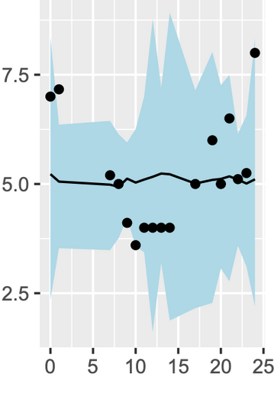
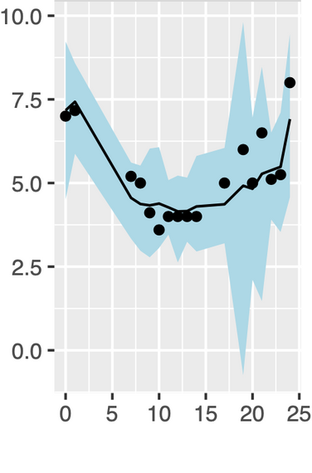
Default
Parameters
Data-Informed Parameters
Fatigue
Time of Day

Slide 2
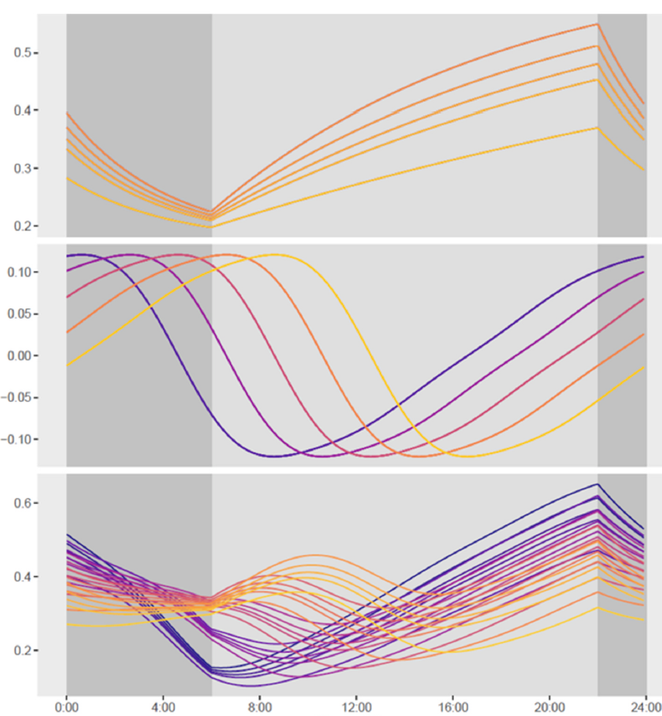

Sleep
Wake
Homeostatic (S)
Circadian (C)
Fatigue (S + C)
Time of Day

