Slide 1
Experiment 1
Notes:
Note that this experiment is the same paradigm as the experiments that Danny ran in March/April (before the incentives and goals were introduced).

Slide 2
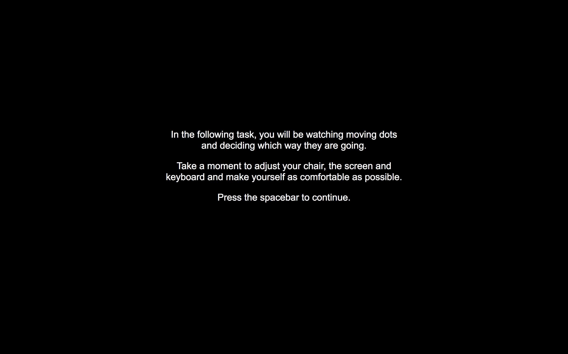

Slide 3
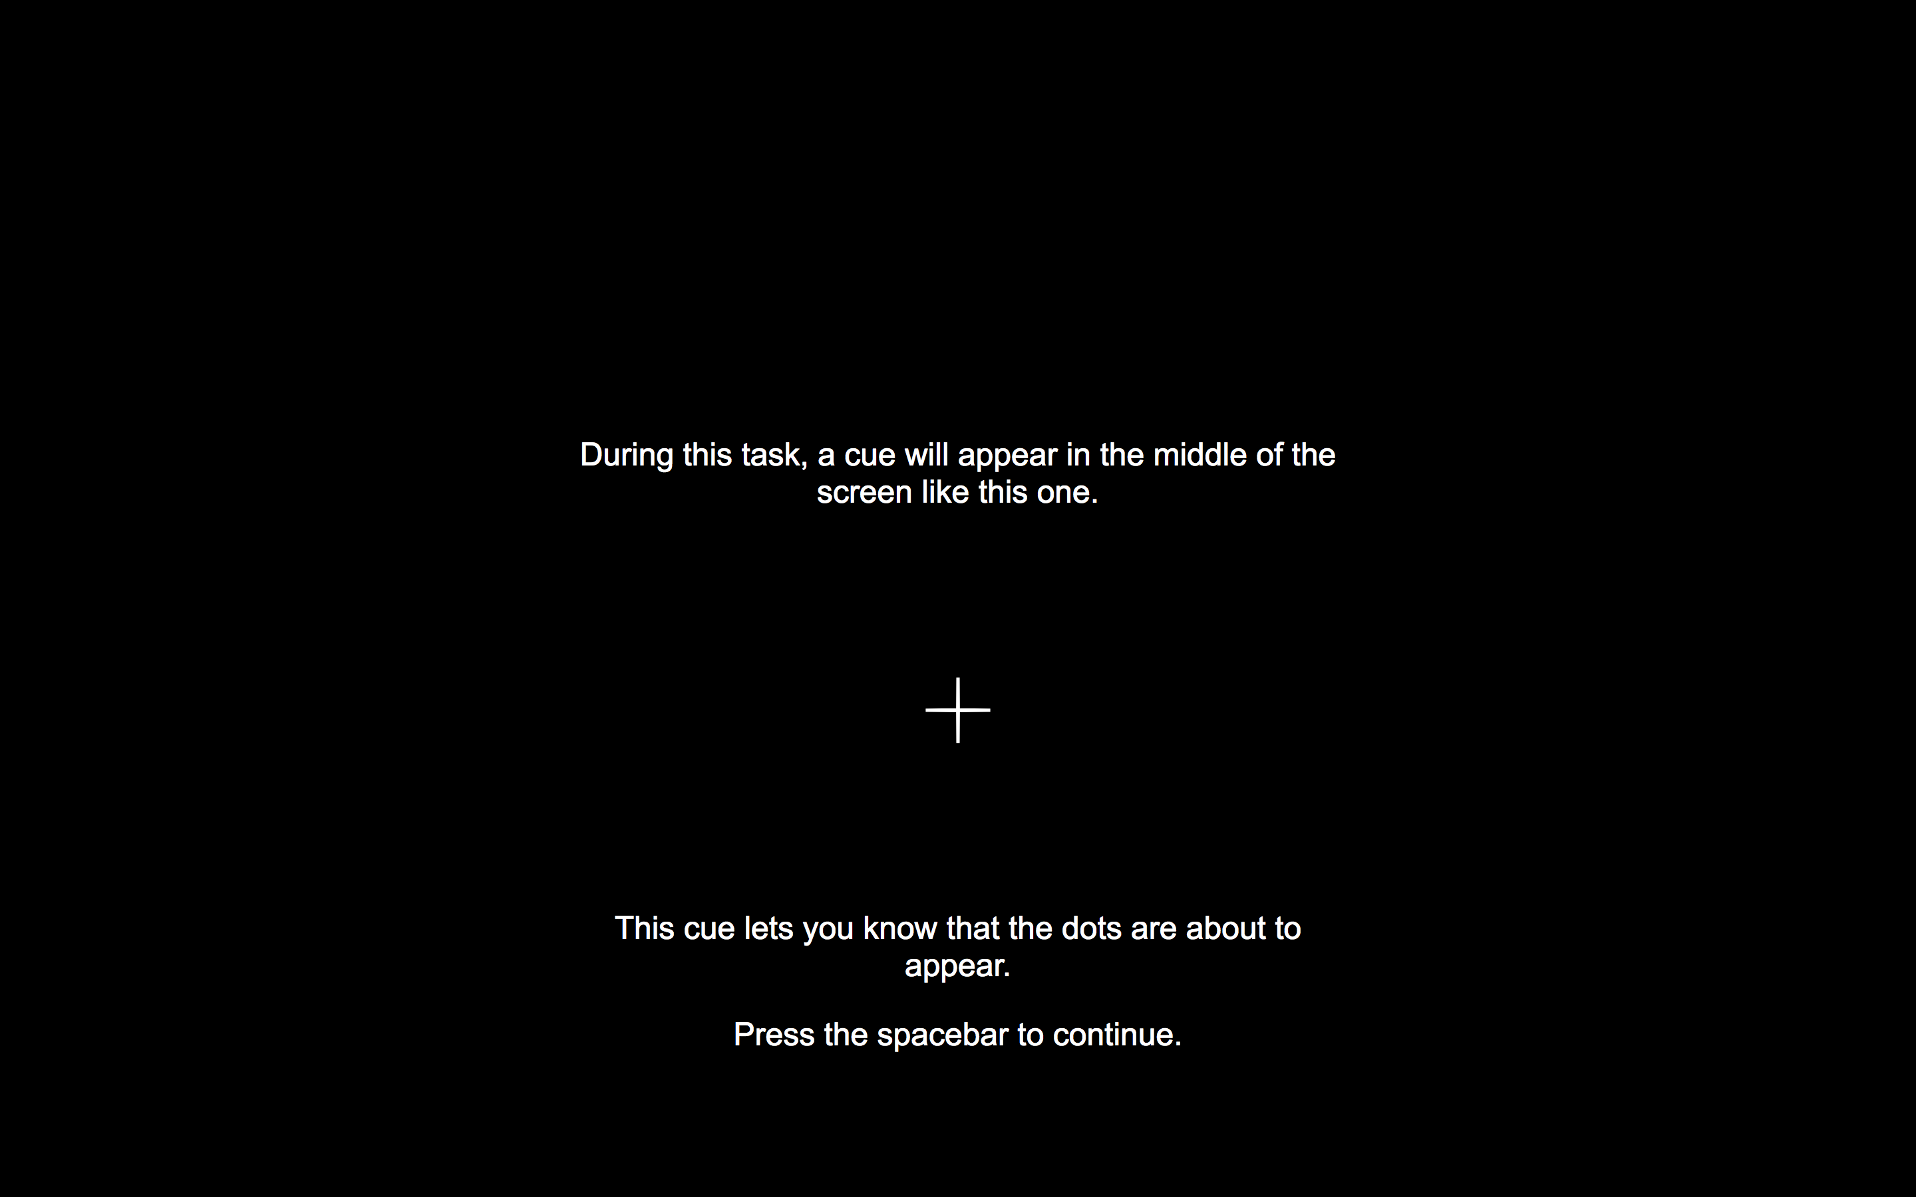

Slide 4
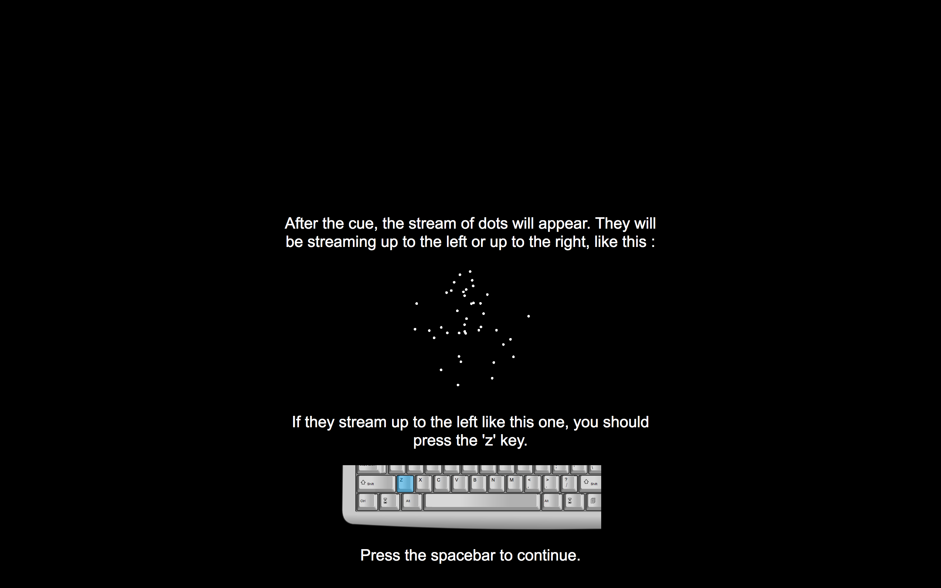

Slide 5
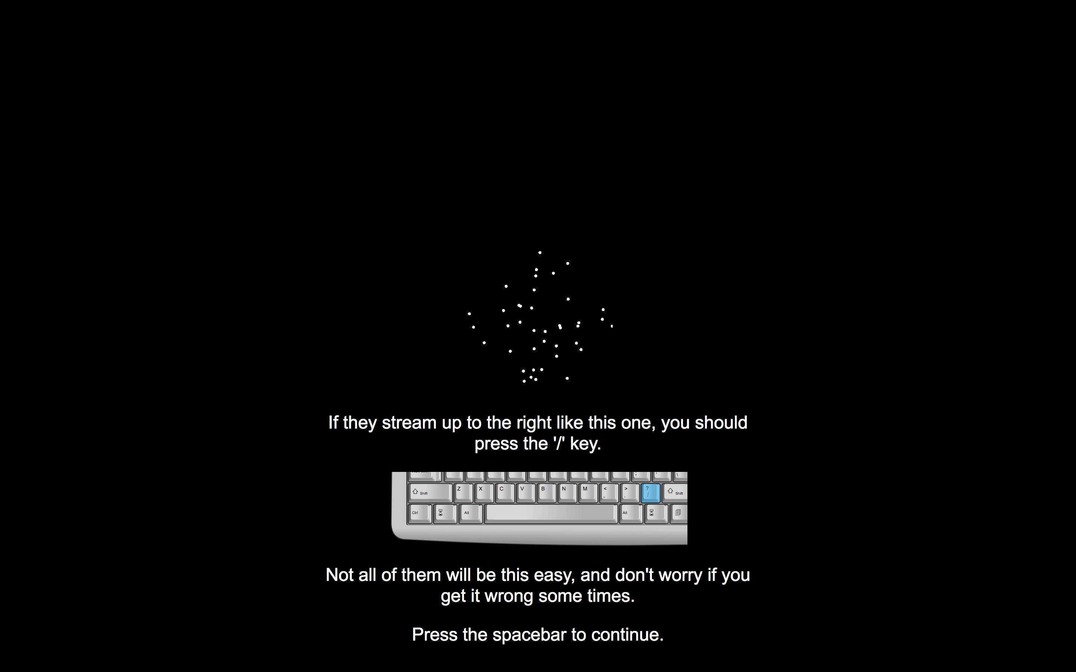

Slide 6
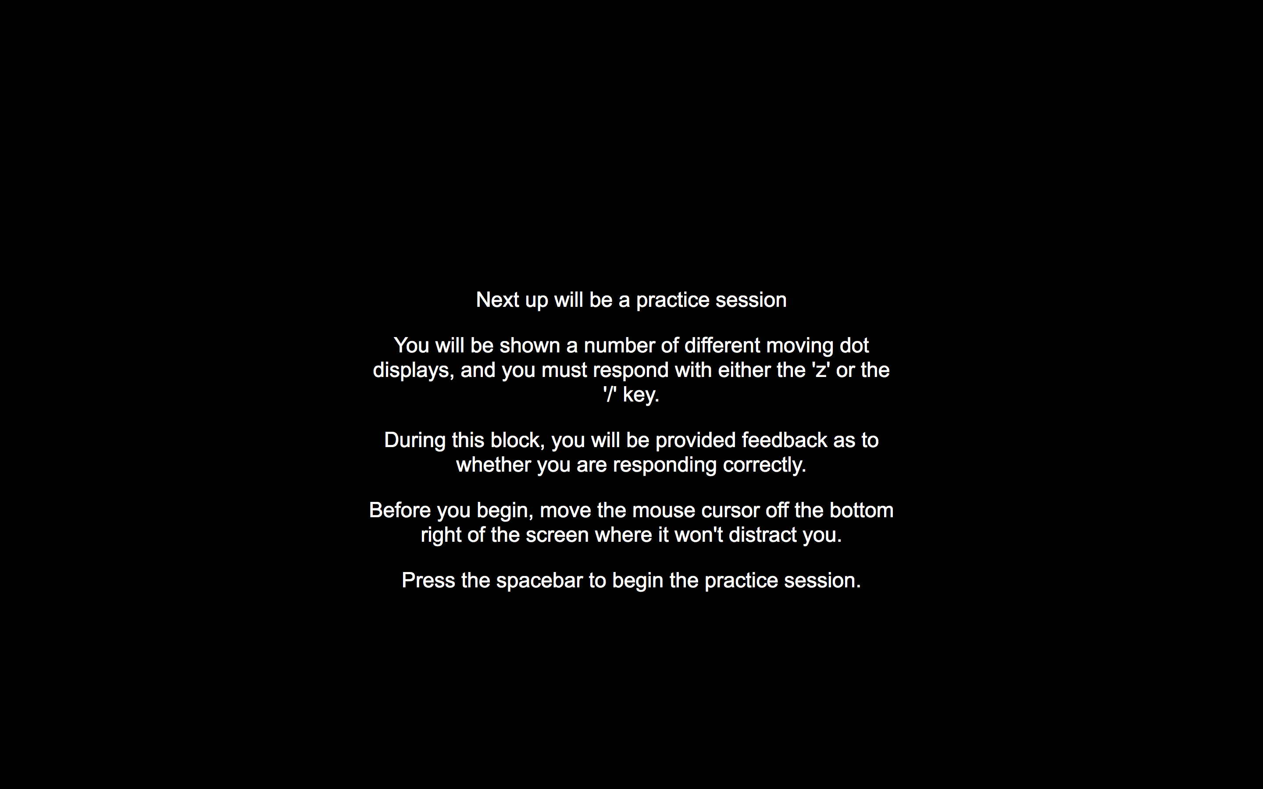
Notes:
Introduction screen for practice block

Slide 7
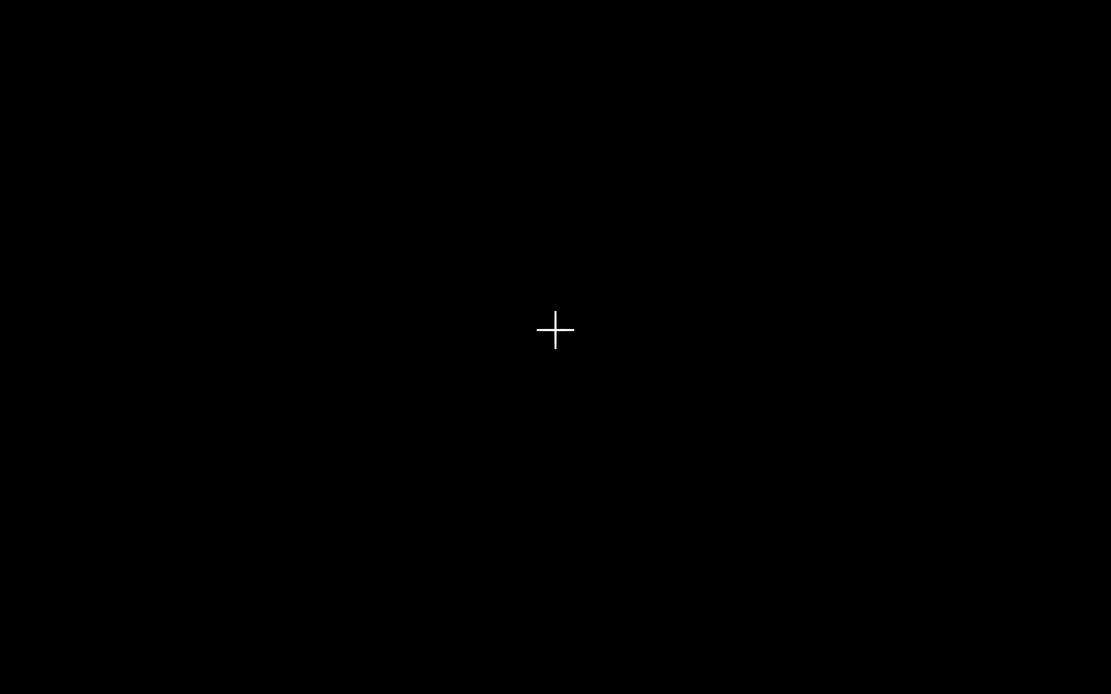
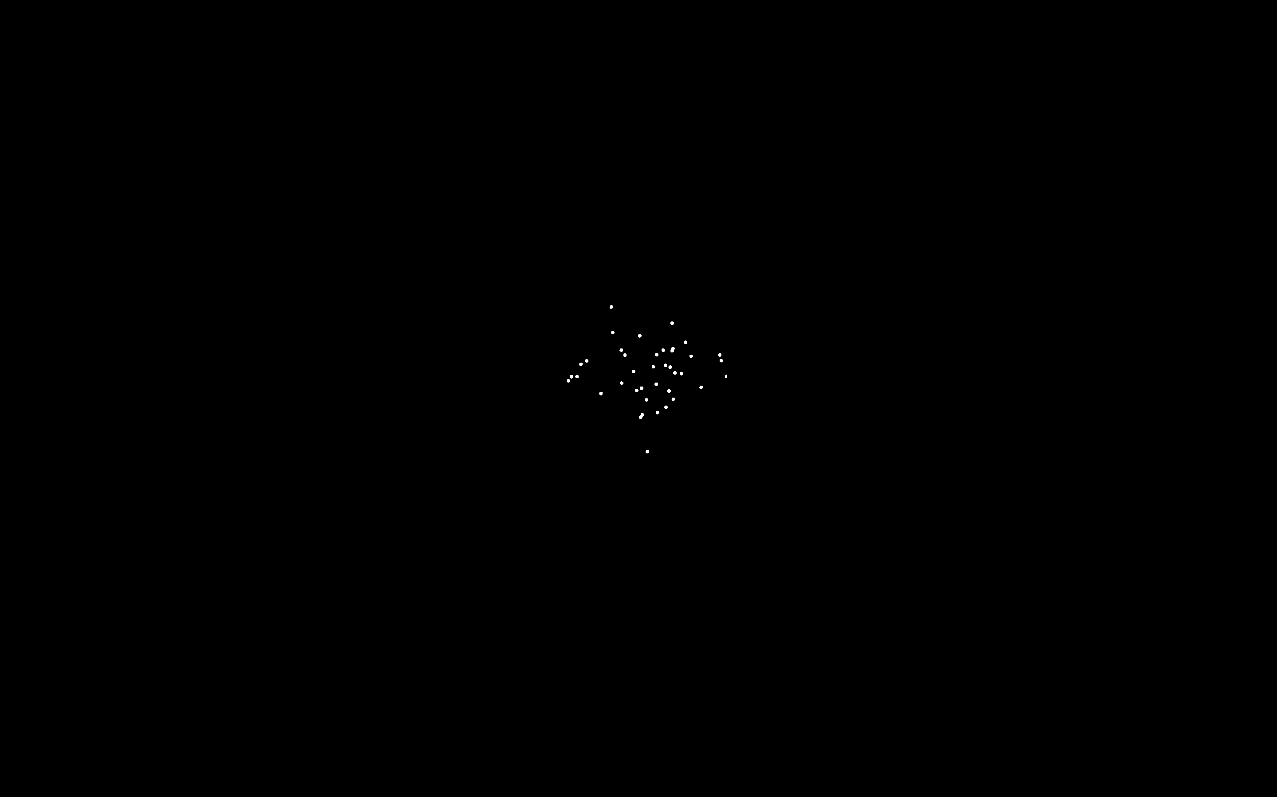
Notes:
Stimulus - fixation cross displayed for 500 ms

Slide 8
Notes:
Stimulus displayed for as long as it takes for participant to make a response.
If response takes longer 2000ms (this variable should be changeable), the message “TOO SLOW” should appear *after the response has been made*.
500ms interval between the response and the next stimulus

Slide 9
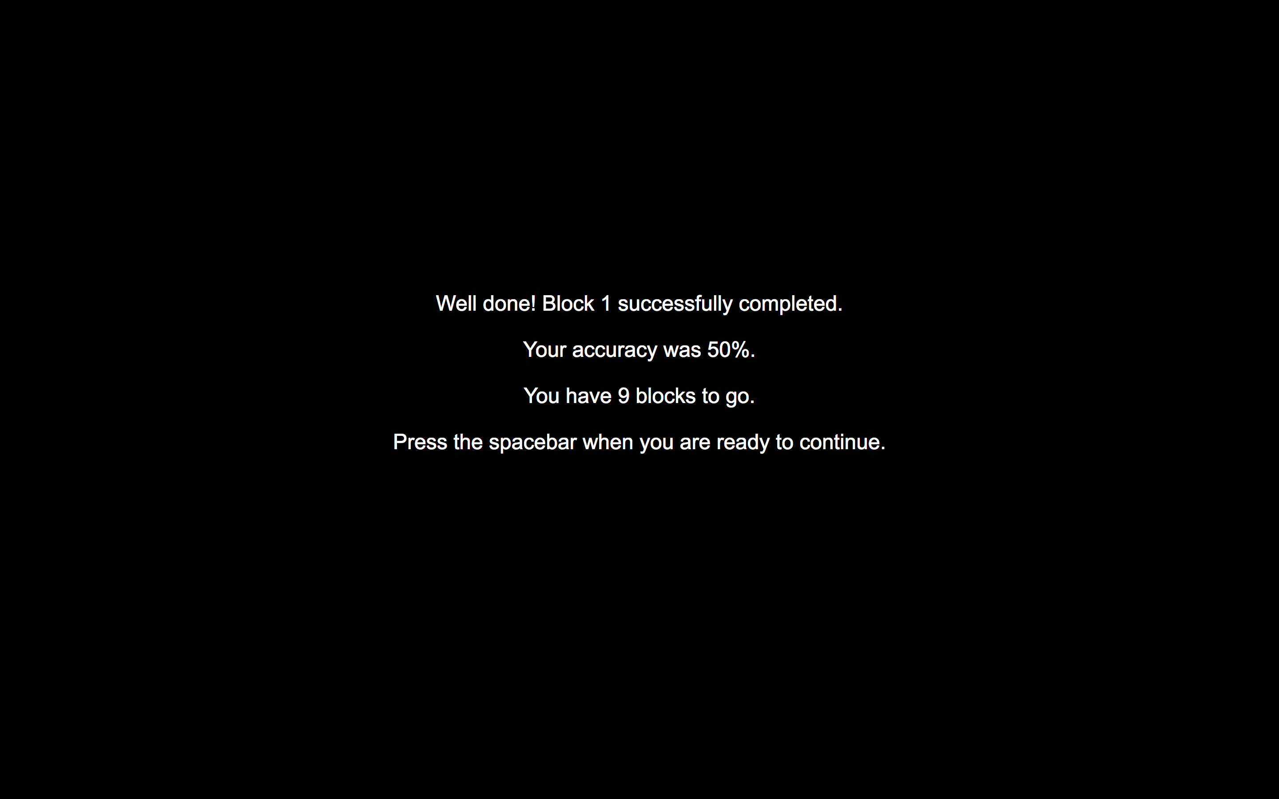
Notes:
Block feedback

Slide 10
In this next block, your aim is to respond as quickly as possible.
Notes:
Experimental block instructions (speed condition)

Slide 11
In this next block, your aim is to respond as accurately as possible.
Notes:
Experimental block instructions (speed condition)

Slide 12
Experiment 2

Slide 13
In the following task, you will be looking at patches
and deciding whether they are light or dark.

Slide 15
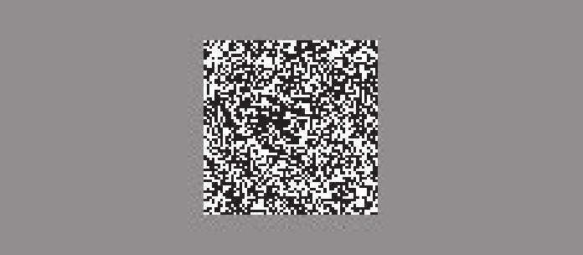
After the cue, the patch will appear. It will either be light, with more white pixels than black, or dark,
with more black pixels than white.
If the patch is light, like this one, with more white pixels with black, you should press the ‘z’ key.
Notes:
Note the font differs between paragraphs here because I used a screenshot, but it should be consistent in the experiment.
Note: this patch is 53% white pixels. It would be ideal if we can use an easier patch here, say 60% white pixels.

Slide 16
After the cue, the patch will appear. It will either be light, with more white pixels than black, or dark,
with more black pixels than white.
If the patch is dark, like this one, with more black pixels than white, you should press the ‘/’ key.
Notes:
Note the font differs between paragraphs here because I used a screenshot, but it should be consistent in the experiment.
Note: this patch is 53% white pixels. It would be ideal if we can use an easier patch here, say 60% white pixels.

Slide 17
If the patch is dark, like this one, with more black pixels than white, you should press the ‘/’ key.
Notes:
It’d be ideal if the patch could be 40% white pixels/60% black for this screen.

Slide 18
You will be shown a number of different patches, and you must response with either the ‘z’ or the ‘/’ key.
Notes:
Introduction screen for practice block

Slide 19
Notes:
Stimulus - fixation cross displayed for 500 ms

Slide 20
Notes:
The patch itself should be 60 X 60 pixels. The grey background should be 320 x 200 pixels.
Stimulus displayed for as long as it takes for participant to make a response.
If response takes longer 2000ms (this variable should be changeable), the message “TOO SLOW” should appear *after the response has been made*.
500ms interval between the response and the next stimulus

Slide 21
Notes:
Block feedback

Slide 22
In this next block, your aim is to respond as quickly as possible.
Notes:
Experimental block instructions (speed condition)

Slide 23
In this next block, your aim is to respond as accurately as possible.
Notes:
Experimental block instructions (speed condition)

