Slide 1

Presented By: B. Sairaj
Electric Vehicle Population Data Analysis

Slide 2
About me
I am Balla Sairaj, a recent graduate with a Bachelor of Technology in Computer Science, from CMR Institute Of Technology.
Why Data Science?
Data Science is the art of extracting meaningful insights from raw data. It helps in identifying patterns, predicting trends, and solving real-world problems using technology and analytics, Data Science drives innovation and supports smarter decision-making. It empowers us to transform large datasets into knowledge that creates impact and shapes the future.

Slide 3
Dataset Overview :
The dataset provides a comprehensive view of EV adoption patterns across counties and cities.
It highlights the dominance of certain manufacturers and the growing preference for Battery Electric Vehicles (BEVs) over PHEVs.
With details on range, incentives, and location, the dataset helps uncover factors influencing consumer adoption.
Dataset contains 250,659 rows and 17 columns. Mix of categorical and numerical data
Key Features Include: VIN (1-10), County, City, State, Postal Code, Model Year, Make, Model
Electric Vehicle Type, Clean Alternative Fuel Vehicle (CAFV) Eligibility, Electric Range, Base MSRP, Legislative District, DOL Vehicle ID
Vehicle Location, Electric Utility, 2020 Census Tract

Slide 4
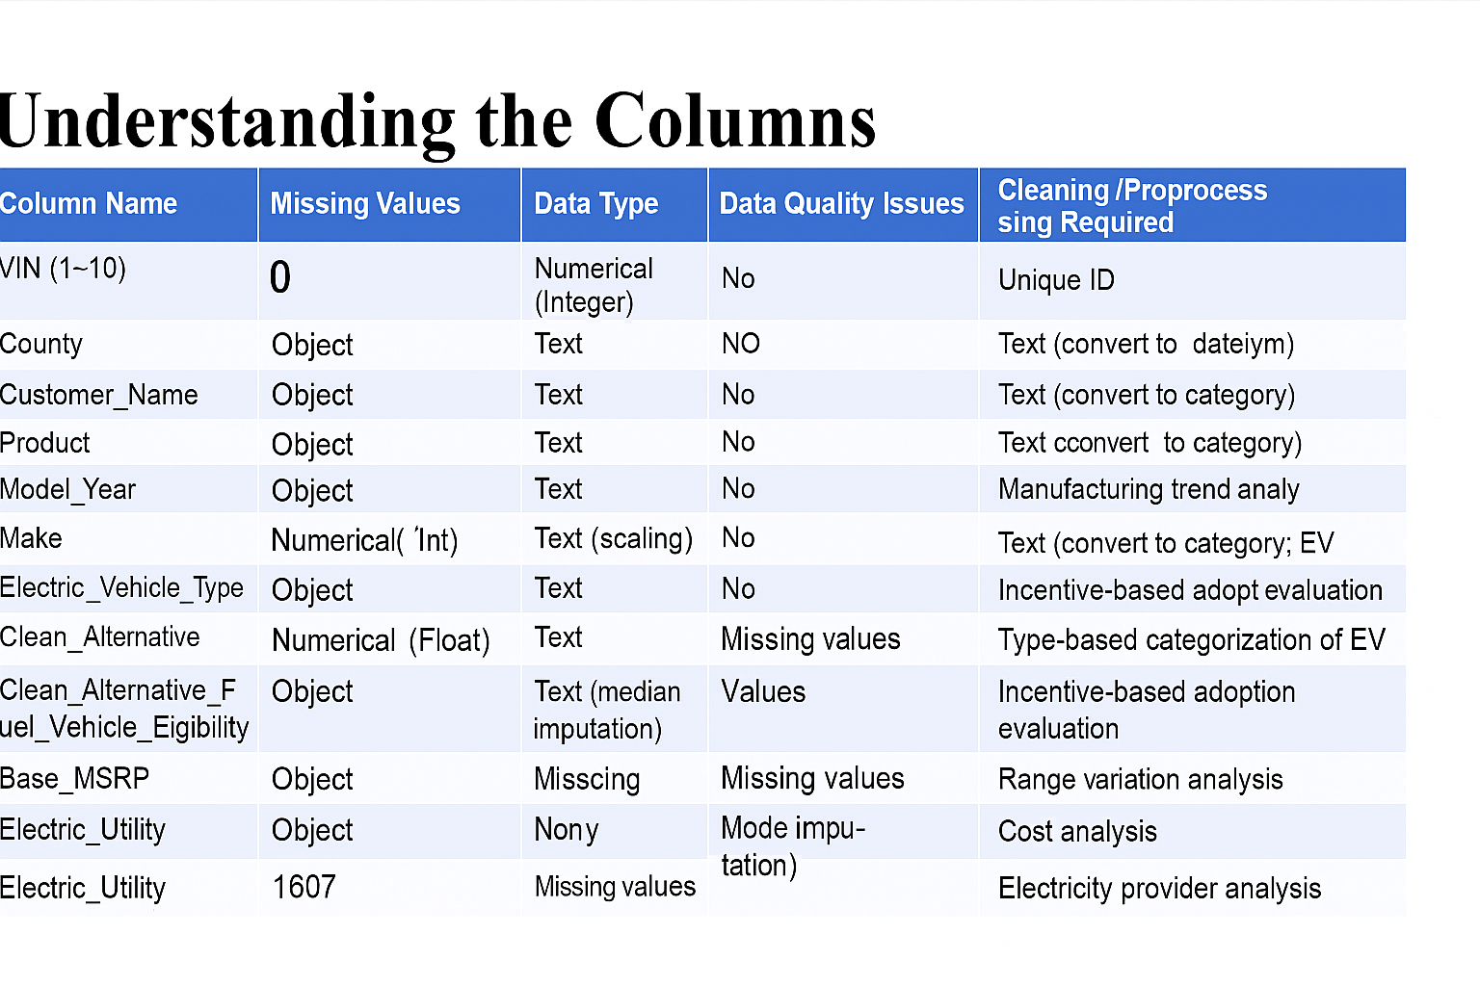

Slide 5
Problem Statement
🔴 Problem: Which type of Electric Vehicle (BEV or PHEV) is most widely adopted?
✅ Goal: Compare adoption trends between BEVs and PHEVs.
🔴 Problem: Which manufacturers dominate the EV market?
✅ Goal: Identify the top-performing EV manufacturers and models.
🔴 Problem: How does electric range and cost (MSRP) affect adoption?
✅ Goal: Analyze the impact of range and pricing on consumer choices.
🔴 Problem: Which counties and cities lead in EV registrations?
✅ Goal: Discover geographical hotspots of EV adoption.
🔴 Problem: Does CAFV eligibility influence adoption?
✅ Goal: Study the role of government incentives in boosting EV registrations.

Slide 6
Insights
Battery Electric Vehicles (BEVs) dominate the dataset compared to Plug-in Hybrid Electric Vehicles (PHEVs).
Tesla is the leading EV manufacturer, followed by Nissan, Chevrolet, Kia, and BMW.
King County has the highest number of EV registrations, making it the central hub of adoption.
Urban areas show significantly higher EV adoption compared to rural regions.
Most BEVs have a higher electric range (200–300+ miles) compared to PHEVs, making them more popular.
CAFV-eligible vehicles (those qualifying for government incentives) are more widely adopted.
The average MSRP (price) of EVs in the dataset suggests EVs are still premium-priced, but adoption is growing.
EV adoption has been steadily increasing year over year, showing a positive growth trend toward clean transportation.

Slide 7
Conclusion
Electric Vehicles (EVs) are experiencing rapid adoption in Washington State, led by Battery Electric Vehicles (BEVs).
Tesla remains the market leader, followed by Nissan, Chevrolet, and Kia.
Government incentives (CAFV eligibility) and electric range are key factors driving consumer adoption.
Urban counties like King and Snohomish show the highest concentration of EV registrations.
The overall trend indicates a steady shift toward clean and sustainable transportation.

Slide 8
Future Scope:
Develop predictive models to forecast EV adoption trends across counties and years.
Build an EV recommendation system based on range, cost (MSRP), and CAFV eligibility.
Create interactive dashboards to monitor real-time EV adoption and policy impact.
Analyze charging infrastructure needs by mapping EV density with utility data.
Extend the study to include temporal trends (yearly growth, future projections).
Provide insights to support government policies and encourage sustainable adoption.

Slide 9

THANK YOU

