Slide 1


tideAssist
Exploring benefits with chatbot
@ballavamsi
https://ballavamsi.com

Slide 2
Assist
Introduction
Features & Benefits
Demo
Use cases
Conclusion
@ballavamsi
https://ballavamsi.com

Slide 3
Assist
Introduction
Help customers make the best decision.
Provide expertise and guidance.
@ballavamsi
https://ballavamsi.com

Slide 4
Assist
Introduction
Help customers make the best decision.
Provide expertise and guidance.
@ballavamsi
https://ballavamsi.com

Slide 5
Assist
Why?
Studies:
PwC Survey
Juniper Research
Business Insider Intelligence
72%
$7.3b
$7b
Customers use for tasks Account inquires, Money transfer, Bill payments
saved globally by use of chatbots in financial services
annually saved by financial services by adoption of chatbots/ smart assistants.
Forrester Research
Mindbower
Chatbots Magazine
4mins
80%
80%
per inquiry, cost savings & increased customer satisfaction
increase
In customer engagement
businesses reported increase in customer satisfaction since implanting chatbots
30%
reduce
In customer service costs
@ballavamsi
https://ballavamsi.com

Slide 6
Assist
Features & Benefits
Powered by OpenAI
Less instructions than a traditional chatbot
Assist customers in understanding tide’s business
Engaging customers
Increase efficiency
@ballavamsi
https://ballavamsi.com

Slide 7
Assist
Demo
@ballavamsi
https://ballavamsi.com

Slide 8
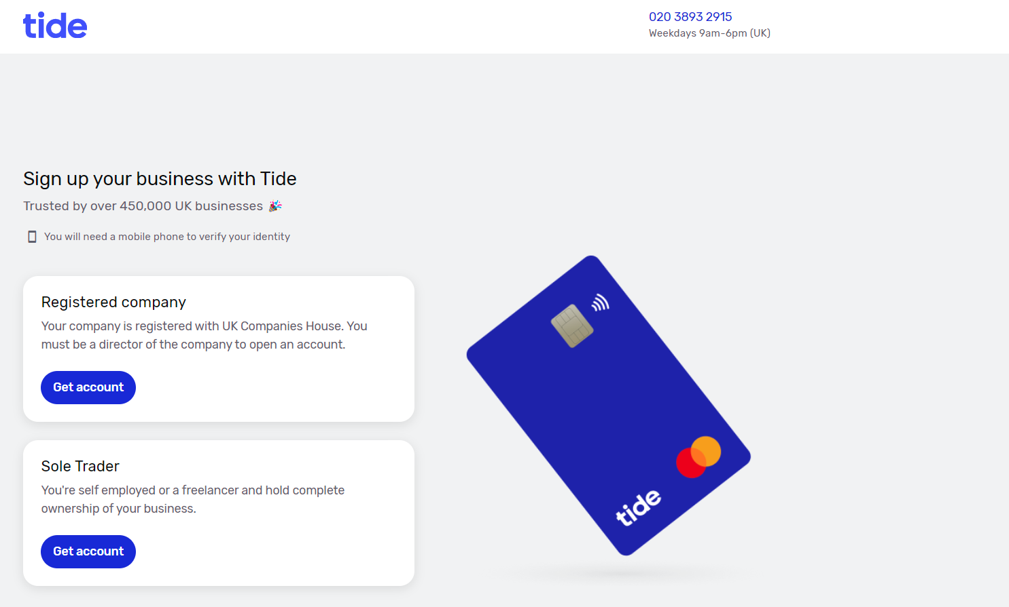
Assist
Use cases
#1
Assist
Hi, How can I help you today?
What are the plans offered?
There are four plans offered by Tide:
Free, Plus, Pro and Cashback.
@ballavamsi
https://ballavamsi.com
Which plan is best for solo trader?

Slide 9
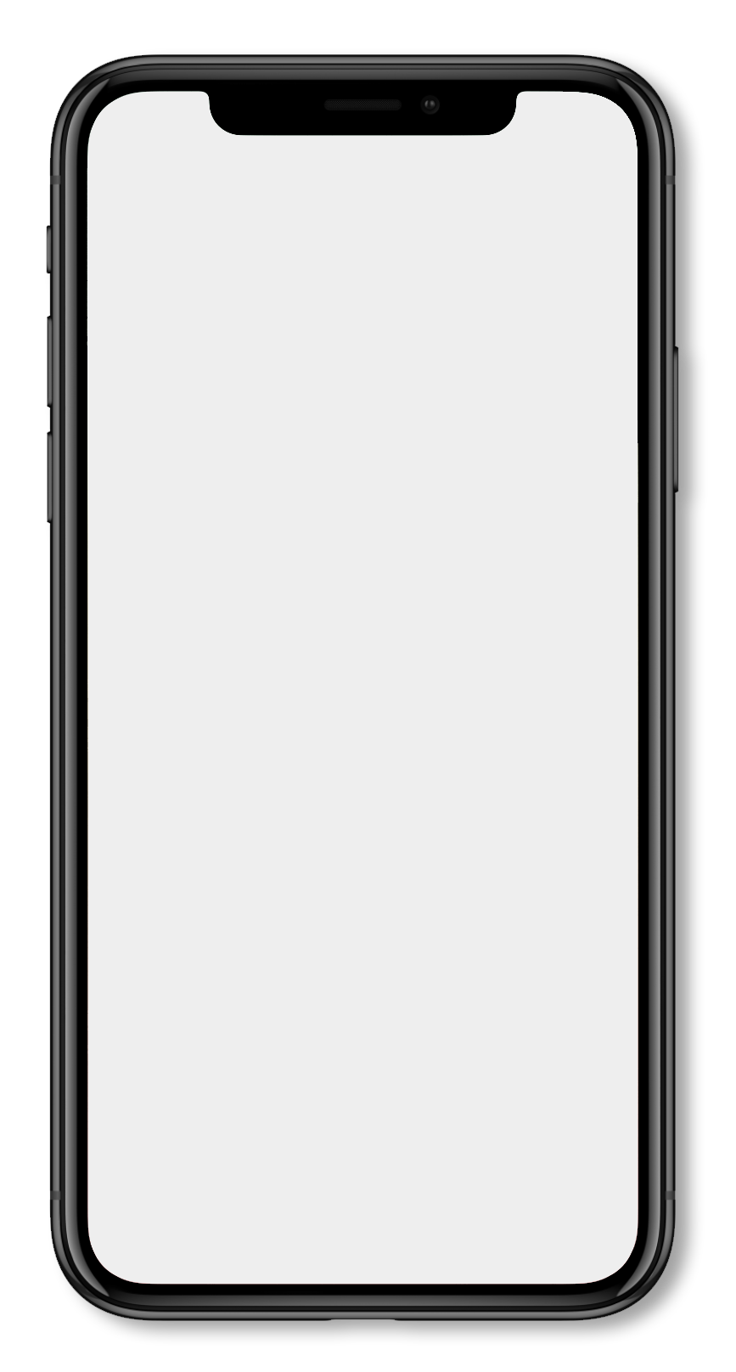
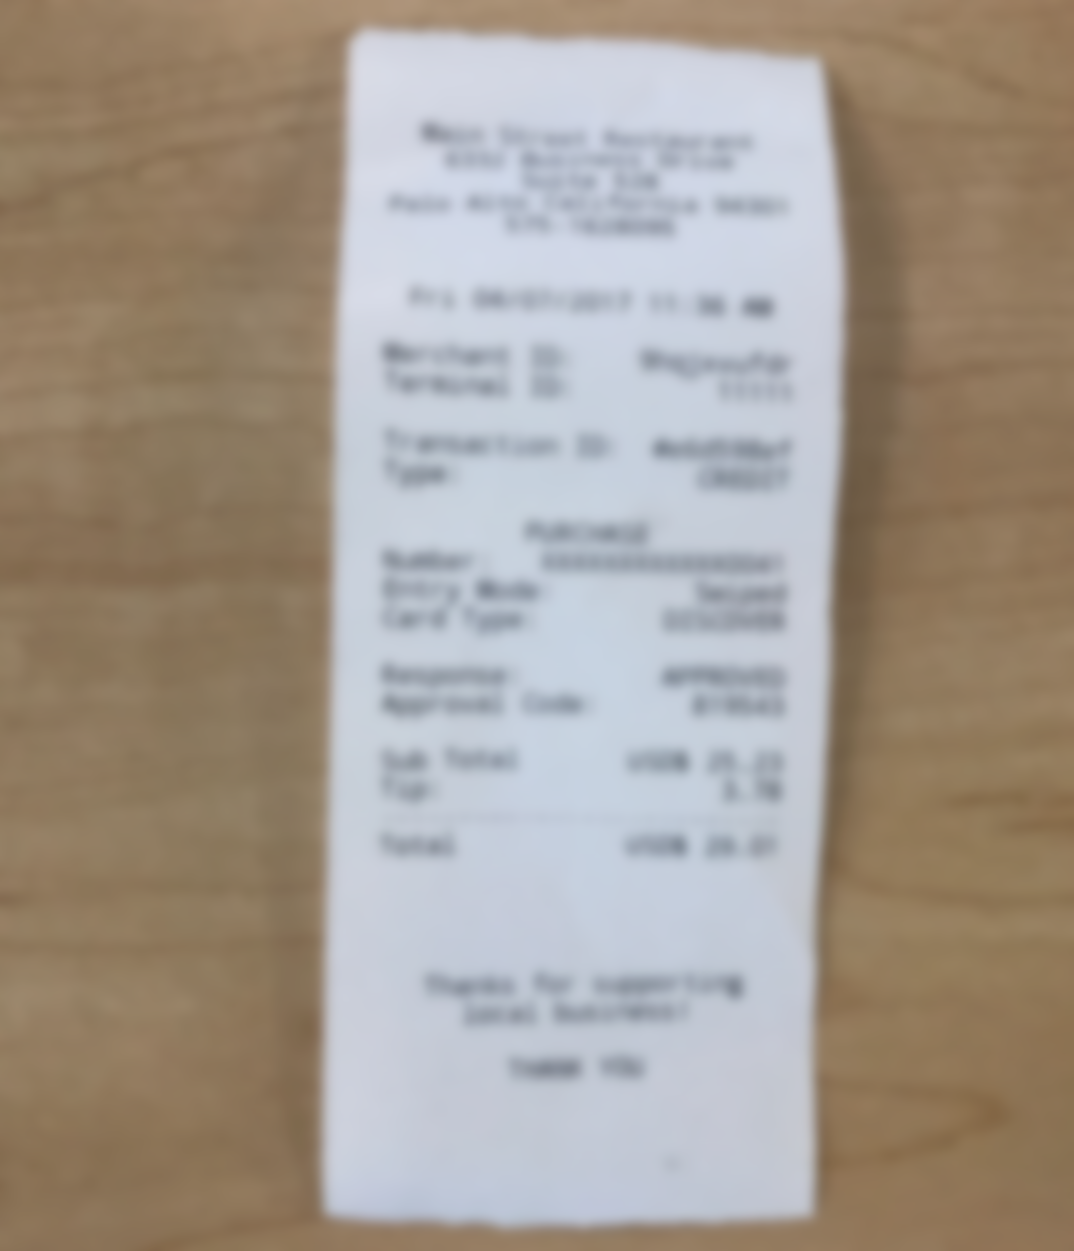
Assist
Assist
Use cases
#2
Hi, How can I help you today?
Upload receipts
Sure, please upload the receipt.
Auto matched receipts to transactions made on 2nd Feb 2023, 10:00AM.
Please confirm.
@ballavamsi
https://ballavamsi.com

Slide 10
Assist
Conclusion
Customers engagement.
Fastest way to get answers.
@ballavamsi
https://ballavamsi.com

Slide 11
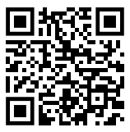


Assist
Thank you
Poll
Do you like Vamsi's idea?
@ballavamsi
ballavamsi.com
ballavamsisrinivas@gmail.com
@ballavamsi
https://ballavamsi.com

