Slide 1


江 号 / Jiang Hao
李雪莹 / Li Xueying
唐 巍 / Tang Wei

Slide 2

Introduction

Slide 3

Story - Background
Everyone has a dream
Hero has no dream
A leaflet – “there is a seed of dream in the castle”
Seek his dream

Slide 4

Story - Truth
Devil took away everyone’s dream
No dream here
Sowed dream seeds in everyone’s mind
Endless power of dream
Fake dreams
Dream is life.
Rebels
Try to seize back real dreams
Fail but leave clues

Slide 5
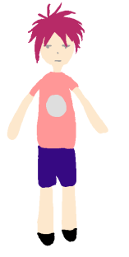
Character
Hero
Name: Empty
Goal: To seek dream
Equip: Gun
Skill:
Shoot
Jump / Double jump

Slide 6

Character
Devil
Name: Dreamer
Goal: To eat more dreams
Equip: Various dreams
Skill:
Shoot
Mind control
Eat dreams
Create objects
Notes:
之前小D署名都是D加一个Q版
最后Boss战 头顶血条Dreamer

Slide 7
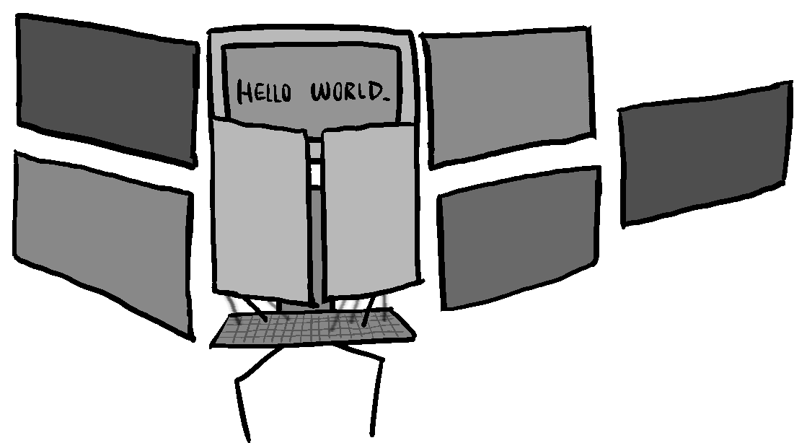
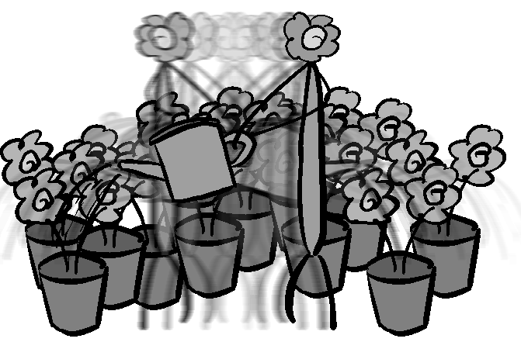
Character
“Dreamers”
Goal: To make their dreams come true
Skill:
Strive to realize their dreams

Slide 8
How to Play

Slide 9



Control
‘A’ – Move to the left
‘Space’ – Jump
‘Space’ in the air – Double jump
‘Left Click’ - Shoot
‘D’ - Move to the right

Slide 10
Hint
Instruction
Controls
New traps
Route guide
Details
Wall painting
Art
…
Level Clear
Get a clue
Help discover the truth

Slide 11
Win or Lose
Win
Defeat the devil (release the dream power)
And be alive
Lose
Touch the strike
Fall out of the scene
Hit by the devil
Notes:
每个level代表城堡的一间房间

Slide 12

Scene – Level 1 (Sample)

Slide 13
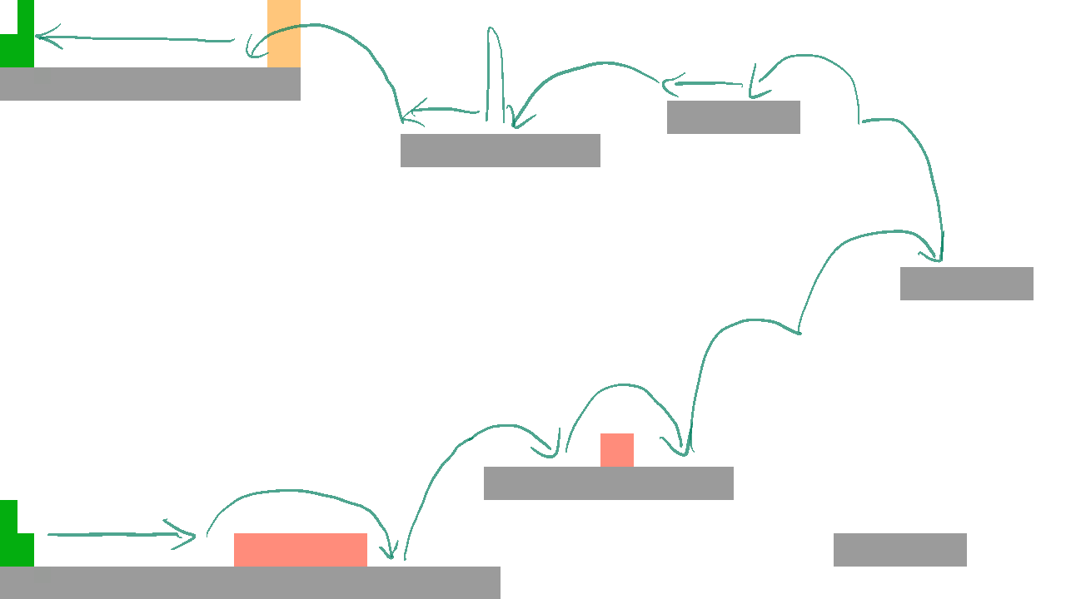
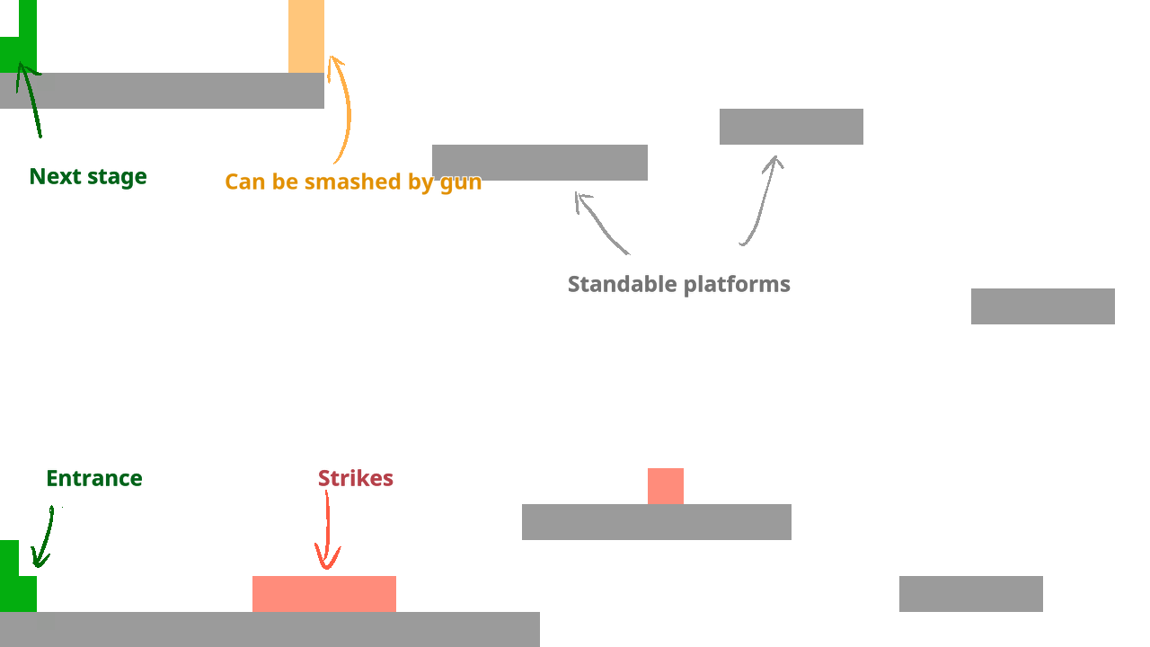
Scene – Level 1 (Sample)

Slide 14

Scene – Level 2 (Sample)

Slide 15
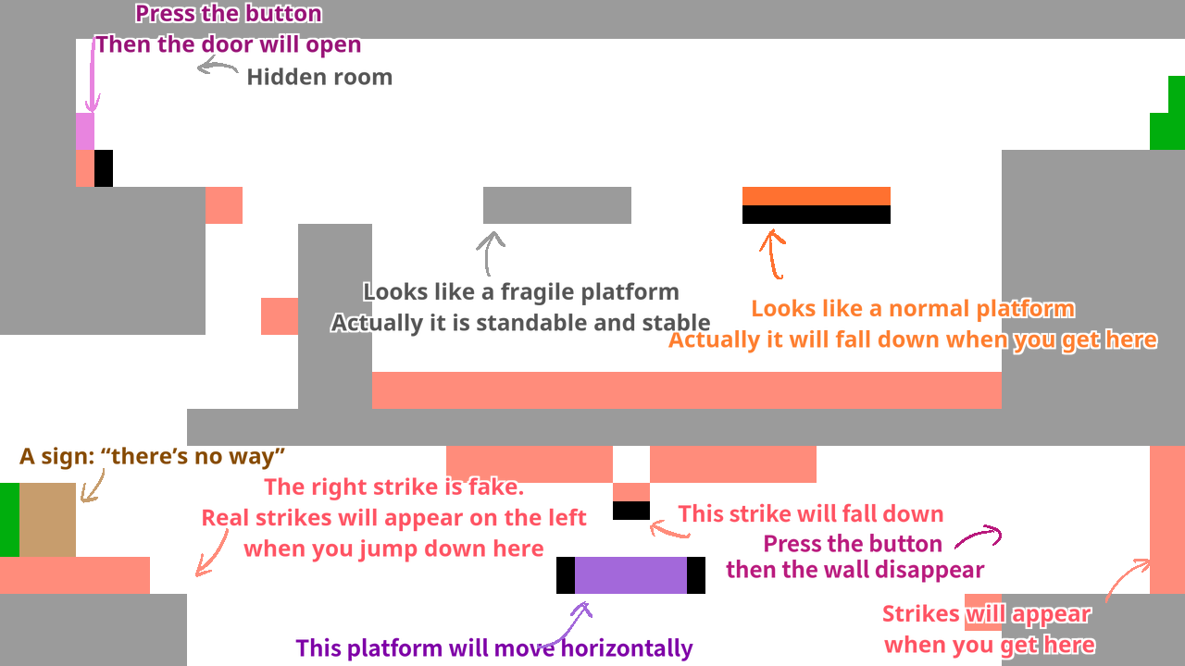
Scene – Level 2 (Sample)
Notes:
No Spoilers

Slide 16

Scene – Level 3 (Sample)

Slide 17
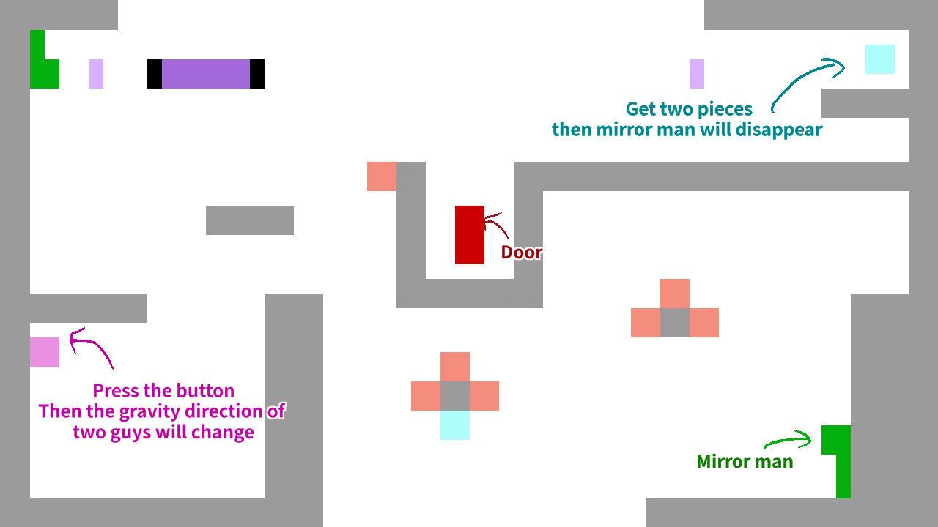
Scene – Level 3 (Sample)

Slide 18
Component

Slide 19
Scene
Object
Background
7 Scenes
Title
Beginning
3 Normal Levels
1 Boss Level
Ending
Hero
Devil
Dreamers
Platforms
Traps
Bullets
…
Music
Sound Effect
Texture

Slide 20

Challenge

Slide 21
Mirror Man

Slide 22
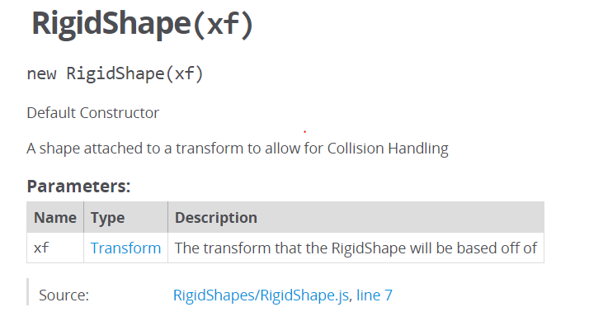
Mirror Man - Solution
Support the opposite gravity system
Modify the xf of rigidShape

Slide 23
Double Jump

Slide 24
Double Jump - Solution
Define a variable
To record the times player have jumped
It will be set to zero if player touch the platform

Slide 25
Move / Jump Distance

Slide 26
Move / Jump Distance - Solution
Design the level carefully
Test A LOT

Slide 27


