Slide 1


江 号 / Jiang Hao
李雪莹 / Li Xueying
唐 巍 / Tang Wei

Slide 2

Introduction

Slide 3
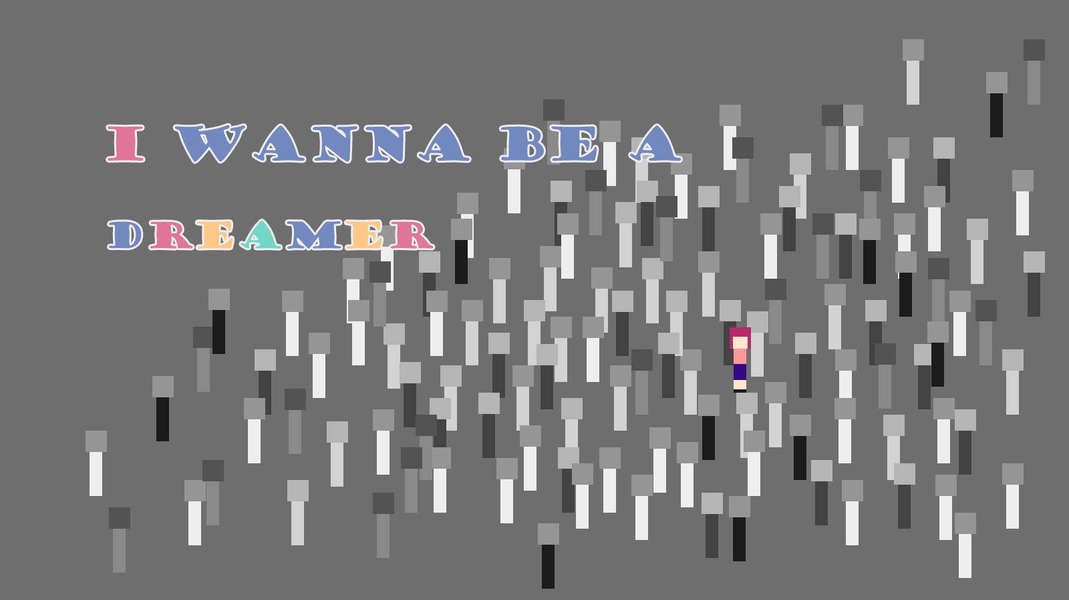
Story - Background
Everyone has a dream
Hero has no dream
A leaflet – “there is a seed of dream in the castle”
Seek his dream

Slide 4
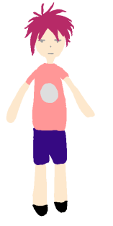
Character
Hero
Name: Empty
Goal: To seek dream
Equip: Gun
Skill:
Shoot
Jump / Double jump

Slide 5
We want you
to mention

Slide 6

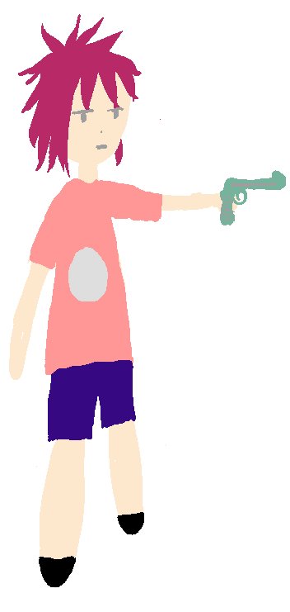
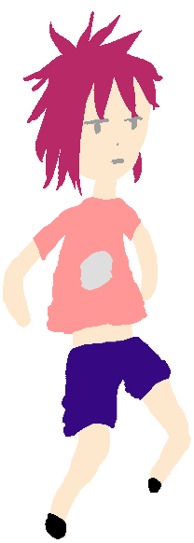
Control
‘Left’ – Move to the left
‘Space’ – Jump
‘Space’ in the air – Double jump
‘C’ - Shoot
‘Right’ - Move to the right
Notes:
We managed to realize the contralbility and make it smooth

Slide 7
TrapSystem
Complex interaction
Deliberate trigger area
Supported by the new rigid system
Position of objects

Slide 8

Other things
Scene switch (try to jump to next scene)
Loading page
Texture
Color scheme
Hint you get
Notes:
每个level代表城堡的一间房间

Slide 9
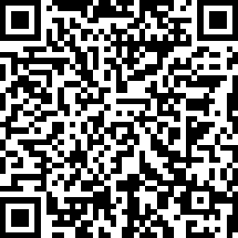
Questionnaire

Slide 10
Walkthrough demo
Notes:
No Spoilers

Slide 11


