Slide 1
Introduction to Web Architecture
Chhorn Chamnap

Slide 2
About Me
Blog: http://chamnapchhorn.blogspot.com/
Twitter: http://twitter.com/chamnap
Rails Developer
JavaScript Developer

Slide 3
Agenda
Basic Web Architecture
HTML
URI
HTTP
Web Architecture Extension
Cookie
Database-driven Website Architecture
AJAX
Web Services
XML
JSON

Slide 4
The World Wide Web

Slide 5
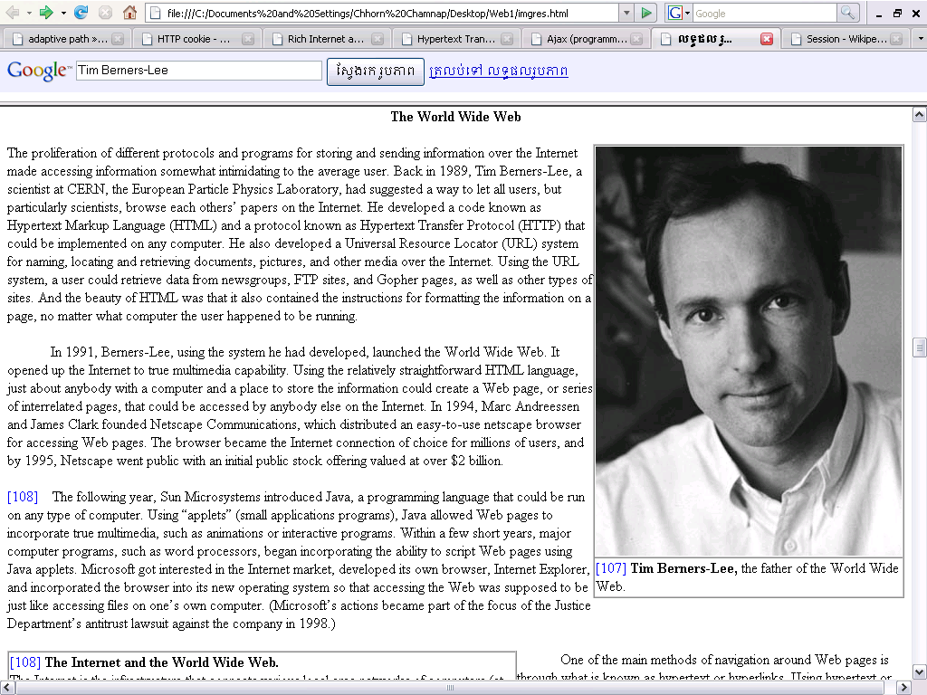
The World Wide Web
In 1989, Tim Berners-Lee had suggested a way to let all users, but particularly scientists, browse each others’ papers on the Internet.
He developed HTML, URLs, and HTTP.

Slide 6
Basic Web Architecture

Slide 7
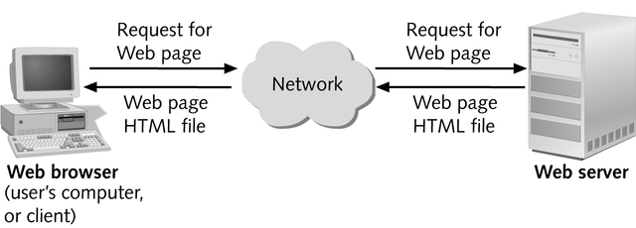
Basic Web Architecture
The web is a two-tiered architecture.
A web browser displays information content,
and a web server that transfers information to the client.

Slide 8
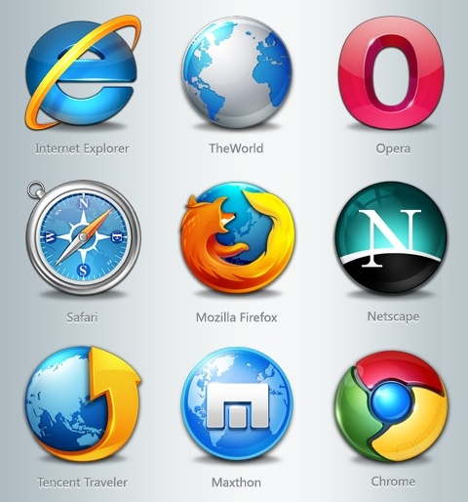
Web Browser
The primary purpose is to bring information resources to the user.
An application for retrieving, presenting, and traversing information resources.

Slide 9


Web Server
The term web server or webserver can mean one of two things:
A computer program that accepts HTTP requests and return HTTP responses with optional data content.
A computer that runs a computer program as described above.

Slide 10
HTML
HyperText Markup Language

Slide 11
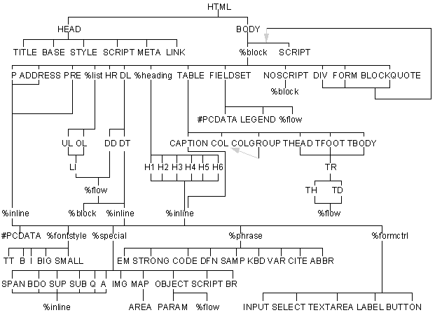
HTML
Document layout language (not a programming language)
Defines structure and appearance of Web pages

Slide 12
URI
Universal Resource Identifier

Slide 13
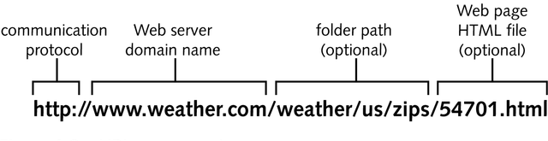
URI
URLs are location dependent
It contains four distinct parts: the protocol type, the machine name, the directory path and the file name.
There are several kinds of URLs: file URLs, FTP URLs, and HTTP URLs.

Slide 14
HTTP
HyperText Transfer Protocol

Slide 15
HTTP
HTTP is a request/response standard of a client and a server.
Typically, an HTTP client initiates a request.
Resources to be accessed by HTTP are identified using Uniform Resource Identifiers (URIs).

Slide 16
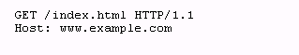
Request message
The request message consists of the following:
Request line
Headers (Accept-Language, Accept, ….)
An empty line
An optional message body

Slide 17
Request methods
HTTP defines eight methods (sometimes referred to as "verbs") indicating the desired action to be performed on the identified resource.
HEAD
GET
POST
PUT
DELETE
TRACE
OPTIONS
CONNECT

Slide 18
Safe methods
HEAD, GET, OPTIONS and TRACE are defined as safe (no side effects).
POST, PUT and DELETE are intended for actions which may cause side effects either on the server.

Slide 19
Status Codes
The first line of the HTTP response is called the status line.
The way the user agent handles the response primarily depends on the code and secondarily on the response headers.
Success: 2xx
Redirection: 3xx
Client-Side Error: 4xx
Server-Side Error: 5xx

Slide 20
HTTP session state
HTTP is a stateless protocol.
Hosts do not need to retain information about users between requests.
Statelessness is a scalability property.
For example, when a host needs to customize the content of a website for a user. Solution:
Cookies
Sessions
Hidden variables (when the current page is a form)
URL encoded parameters (such as /index.php?session_id=some_unique_session_code)

Slide 21
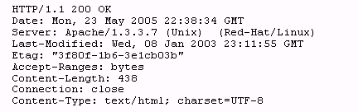
Sample HTTP Request and Response
Client request
Server response

Slide 22
Web Architecture Extension

Slide 23
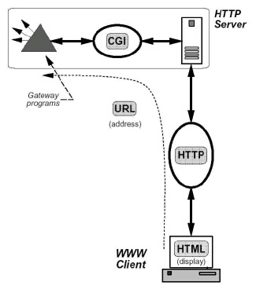
Web Architecture Extension
CGI extends the architecture to three-tiers by adding a back-end server that provides services to the Web server.

Slide 24
Traditional uses of JavaScript
JavaScript is a scripting language designed for creating dynamic, interactive Web applications that link together objects and resources on both clients and servers.
Getting your Web page to respond or react directly to user interaction with form elements and hypertext links
Preprocessing data on the client before submission to a server
Changing content and styles

Slide 25
Cookie
tracking cookie, browser cookie, or HTTP cookie

Slide 26
Cookie
Cookie is a small piece of text stored on a user's computer by a web browser.
A cookie consists of one or more name-value pairs containing bits of information such as user preferences.
A cookie can be used for:
authenticating,
session tracking, and
remembering specific information about users.

Slide 27
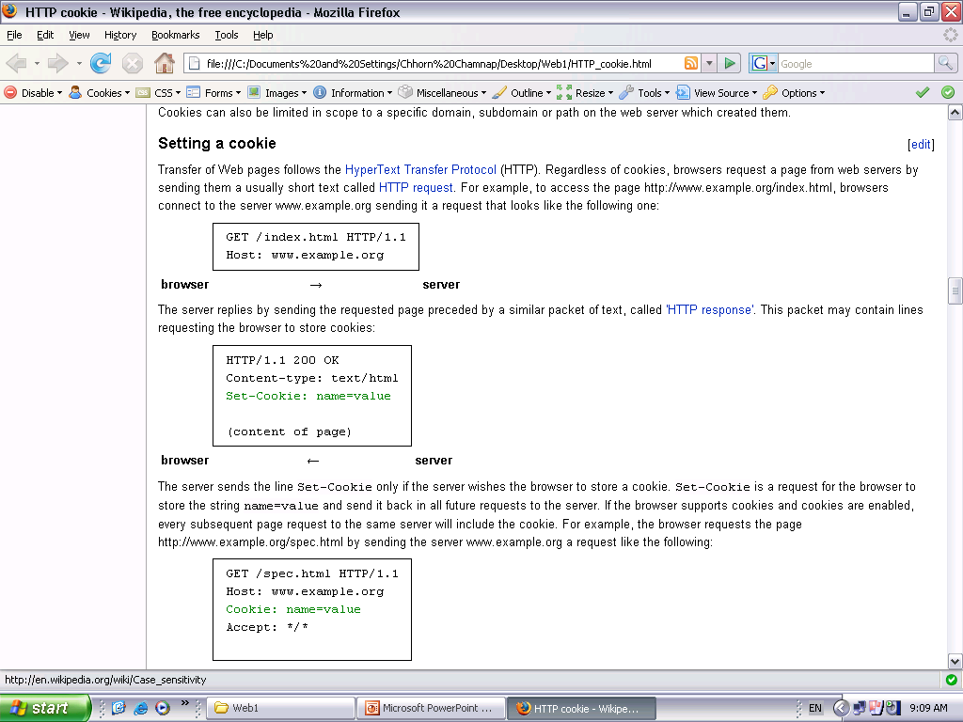
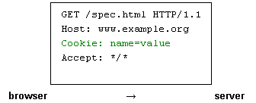
Setting A Cookie

Slide 28
Cookie Expiration
Cookies expire, and are therefore not sent by the browser to the server, under any of these conditions:
At the end of the user session if the cookie is not persistent
An expiration date has been specified, and has passed
The expiration date of the cookie is changed to a date in the past
The browser deletes the cookie by user request

Slide 29
Database-driven Website Architecture

Slide 30
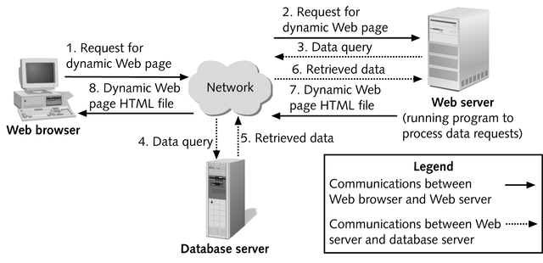
Database-driven Website Architecture

Slide 31
Server-side processing
In server-side processing, the Web server:
Receives the dynamic Web page request
Performs all of the processing necessary to create the dynamic Web page
Sends the finished Web page to the client for display in the client’s browser

Slide 32
Client-side processing
Client-side processing
Some processing needs to be “executed” by the browser, either to form the request for the dynamic Web page or to create or display the dynamic Web page.
Eg. Javascript code to validate user input

Slide 33
Server and Client side processing
Server-side processing
PHP
ASP
ASP.NET
Perl
J2EE
Python, e.g. Django
Ruby, e.g. Ruby on Rails
ColdFusion
Client-side processing
CSS
HTML
JavaScript
Adobe Flex
Microsoft Silverlight

Slide 34
AJAX
Asynchronous JavaScript and XML

Slide 35

Defining Ajax
Ajax isn’t a technology. It’s really several technologies, each flourishing in its own right, coming together in powerful new ways. Ajax incorporates:
XHTML and CSS;
Document Object Model;
XML and XSLT;
XMLHttpRequest;
JavaScript
Jesse James Garrett, essay in
february 18, 2005
Ajax: A New Approach to Web
Applications

Slide 36
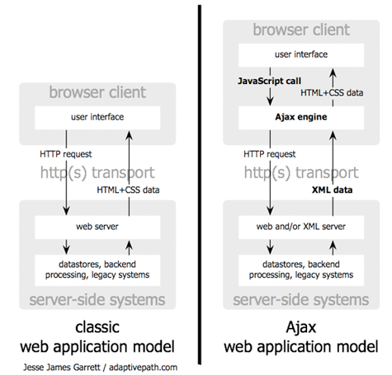

Slide 37
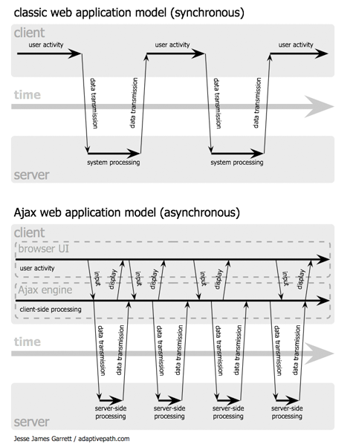

Slide 38
Drawbacks of AJAX
It breaks browser history engine (Back button).
No bookmark.
The same origin policy.
Ajax opens up another attack vector for malicious code that web developers might not fully test for.

Slide 39
Web Services

Slide 40
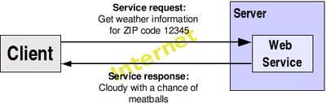
Web Services
Web Service is a software system designed to support machine-to-machine interaction over a network.
Web services are frequently just Internet Application Programming Interfaces (API) that can be accessed over a network.

Slide 41
Web Services (cont.)
Web Services are platform-independent and language-independent, since they use standard XML languages.
Most Web Services use HTTP for transmitting messages (such as the service request and response).
Style of Use
RPC
SOAP
REST

Slide 42
XML
eXtensible Markup Language

Slide 43
XML
XML is a universally agreed markup meta-language primarily used for information exchange.
The two primary building blocks of XML are elements and attributes.
Elements are tags and have values.
Elements are structured as a tree.
Alternatively, elements may have both attributes as well as data
Attributes help you to give more meaning and describe your element more efficiently and clearly.

Slide 44
XML (cont.)
<?xml version=\"1.0\" encoding=\"UTF-8\"?>
<person>
<id type="integer">1111</id>
<last_name>Smith</last_name>
<first_name>John</first_name>
<address>
<city>New York</city>
<street>21 2nd Street</street>
<postal_code type="integer">10021</postal_code> <state>NY</state>
</address>
</person>

Slide 45
JSON
JavaScript Object Notation

Slide 46

JSON
JSON is a lightweight computer data interchange format.
JSON is based on a subset of the JavaScript programming language.
It is considered to be a language-independent data format.
It serves as an alternative to the use of the XML format.
Douglas Crockford is a senior
JavaScript Architect at Yahoo!
He is well known for his work in
introducing JavaScript Object
Notation (JSON).

Slide 47
JSON (cont.)
{ "firstName": "John", "lastName": "Smith", "address": { "street": "21 2nd Street", "city": "New York", "state": "NY", "postalCode": 10021 }, "phoneNumbers": [ "212 555-1234", "646 555-4567" ] }

Slide 48
References
http://gdp.globus.org/gt4-tutorial/multiplehtml/ch01s02.html
http://www.objs.com/survey/WebArch.htm
http://en.wikipedia.org/wiki/World_Wide_Web
http://en.wikipedia.org/wiki/Web_browser
http://en.wikipedia.org/wiki/Web_services
http://en.wikipedia.org/wiki/Web_server
http://www.slideshare.net/warlock/intro-to-web-development
http://www.slideshare.net/rstein/advanced-web-development
http://www.slideshare.net/hblowers/intro-to-web-20-277488
http://www.slideshare.net/cheilmann/the-road-to-professional-web-development
http://en.wikipedia.org/wiki/Common_Gateway_Interface
http://www.edwardsamuels.com/ILLUSTRATEDSTORY/isc5.htm
http://en.wikipedia.org/wiki/Hypertext_Transfer_Protocol
http://en.wikipedia.org/wiki/HTTP_cookie
http://www.adaptivepath.com/ideas/newsletter/archives/111405/index.php

Slide 49
Q&A

