Slide 1

Joe Stein
Building & Deploying Applications to Apache Mesos

Slide 2
Joe Stein
Developer, Architect & Technologist
Founder & Principal Consultant => Big Data Open Source Security LLC - http://stealth.ly
Big Data Open Source Security LLC provides professional services and product solutions for the collection, storage, transfer, real-time analytics, batch processing and reporting for complex data streams, data sets and distributed systems. BDOSS is all about the "glue" and helping companies to not only figure out what Big Data Infrastructure Components to use but also how to change their existing (or build new) systems to work with them.
Apache Kafka Committer & PMC member
Blog & Podcast - http://allthingshadoop.com
Twitter @allthingshadoop

Slide 3
Overview
Quick intro to Mesos
Marathon Framework
Aurora Framework
Custom Framework

Slide 4


Slide 5
Origins
Mesos: A Platform for Fine-Grained Resource Sharing in the Data Center http://static.usenix.org/event/nsdi11/tech/full_papers/Hindman_new.pdf
Datacenter Management with Apache Mesos https://www.youtube.com/watch?v=YB1VW0LKzJ4
Omega: ﬂexible, scalable schedulers for large compute clusters http://eurosys2013.tudos.org/wp-content/uploads/2013/paper/Schwarzkopf.pdf
2011 GAFS Omega John Wilkes https://www.youtube.com/watch?v=0ZFMlO98Jkc&feature=youtu.be

Slide 6
Life without Apache Mesos

Slide 7
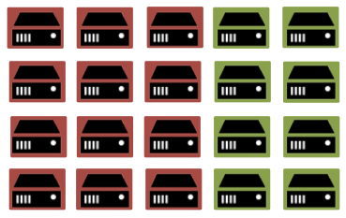
Static Partitioning

Slide 8

Static Partitioning IS Bad
hard to utilize machines
(i.e., X GB RAM and Y CPUs)

Slide 9
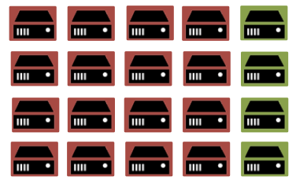
Static Partitioning does NOT scale
hard to scale elastically
(to take advantage of statistical multiplexing)

Slide 10
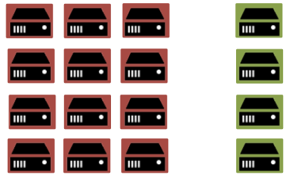
Failures === Downtime
hard to deal with failures

Slide 11
Static Partitioning

Slide 12

Operating System === Datacenter

Slide 13

Mesos => data center “kernel”

Slide 14
Apache Mesos
Scalability to 10,000s of nodes
Fault-tolerant replicated master and slaves using ZooKeeper
Support for Docker containers
Native isolation between tasks with Linux Containers
Multi-resource scheduling (memory, CPU, disk, and ports)
Java, Python and C++ APIs for developing new parallel applications
Web UI for viewing cluster state

Slide 15
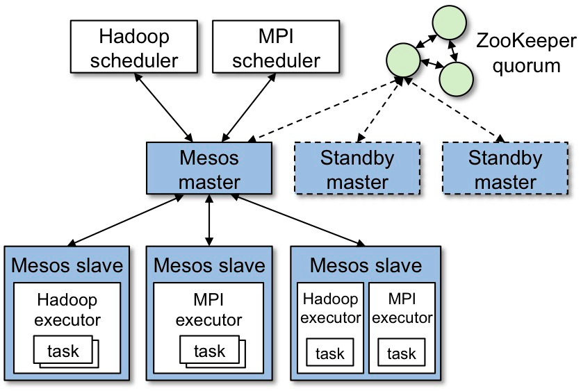

Slide 16
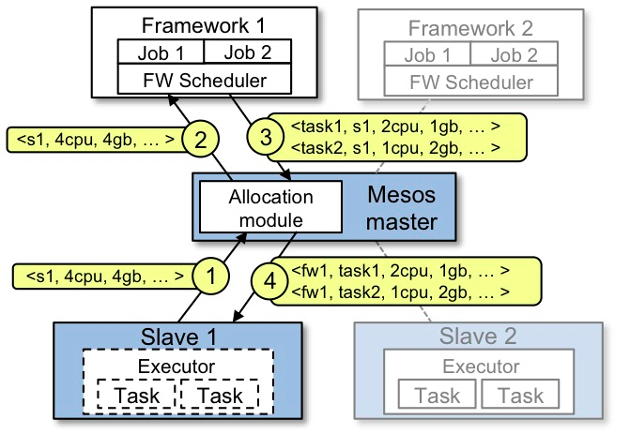

Slide 17
Resources & Attributes
The Mesos system has two basic methods to describe the slaves that comprise a cluster. One of these is managed by the Mesos master, the other is simply passed onwards to the frameworks using the cluster.
Attributes
The attributes are simply key value string pairs that Mesos passes along when it sends offers to frameworks.
attributes : attribute ( ";" attribute )* attribute : labelString ":" ( labelString | "," )+

Slide 18
Resources
The Mesos system can manage 3 different types of resources: scalars, ranges, and sets. These are used to represent the different resources that a Mesos slave has to offer. For example, a scalar resource type could be used to represent the amount of memory on a slave. Each resource is identified by a key string.
resources : resource ( ";" resource )* resource : key ":" ( scalar | range | set ) key : labelString ( "(" resourceRole ")" )? scalar : floatValue range : "[" rangeValue ( "," rangeValue )* "]" rangeValue : scalar "-" scalar set : "{" labelString ( "," labelString )* "}" resourceRole : labelString | "*" labelString : [a-zA-Z0-9_/.-] floatValue : ( intValue ( "." intValue )? ) | ... intValue : [0-9]+

Slide 19
Predefined Uses & Conventions
The Mesos master has a few resources that it pre-defines in how it handles them. At the current time, this list consist of:
cpu
mem
disk
ports
In particular, a slave without cpu and mem resources will never have its resources advertised to any frameworks. Also, the Master’s user interface interprets the scalars inmem and disk in terms of MB. IE: the value 15000 is displayed as 14.65GB.

Slide 20
Examples
Here are some examples for configuring the Mesos slaves.
--resources='cpu:24;mem:24576;disk:409600;ports:[21000-24000];disks:{1,2,3,4,5,6,7,8}' --attributes='dc:1;floor:2;aisle:6;rack:aa;server:15;os:trusty;jvm:7u68;docker:1.5'
In this case, we have three different types of resources, scalars, a range, and a set. They are called cpu, mem, disk, and the range type is ports.
scalar called cpu, with the value 24
scalar called mem, with the value 24576
scalar called disk, with the value 409600
range called ports, with values 21000 through 24000 (inclusive)
set called disks, with the values 1, 2, etc which we can concatenate later /mnt/disk/{diskNum} and each task can own a disk

Slide 21
Roles
Total consumable resources per slave, in the form 'name(role):value;name(role):value...'. This value can be set to limit resources per role, or to overstate the number of resources that are available to the slave.
--resources="cpus(*):8; mem(*):15360; disk(*):710534; ports(*):[31000-32000]"
--resources="cpus(prod):8; cpus(stage):2 mem(*):15360; disk(*):710534; ports(*):[31000-32000]"
All * roles will be detected, so you can specify only the resources that are not all roles (*). --resources="cpus(prod):8; cpus(stage)"
Frameworks bind a specific roles or any. A default roll (instead of *) can also be configured.
Roles can be used to isolate and segregate frameworks.

Slide 22
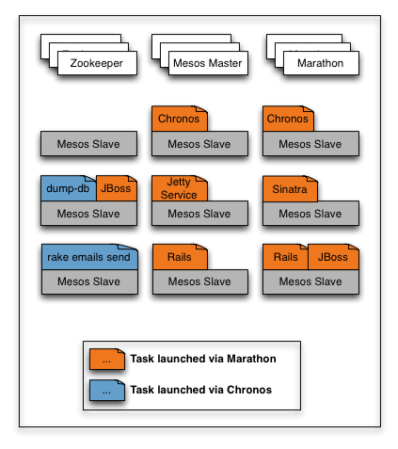
Marathon
https://github.com/mesosphere/marathon
Cluster-wide init and control system for
services in cgroups or docker based on
Apache Mesos

Slide 23
Constraints
Constraints control where apps run to allow optimizing for fault tolerance or locality. Constraints are made up of three parts: a field name, an operator, and an optional parameter. The field can be the slave hostname or any Mesos slave attribute.
Fields
Hostname field
hostname field matches the slave hostnames, see UNIQUE operator for usage example.
hostname field supports all operators of Marathon.
Attribute field
If the field name is none of the above, it will be treated as a Mesos slave attribute. Mesos slave attribute is a way to tag a slave node, see mesos-slave --help to learn how to set the attributes.

Slide 24
Unique
UNIQUE tells Marathon to enforce uniqueness of the attribute across all of an app's tasks. For example the following constraint ensures that there is only one app task running on each host:
via the Marathon gem:
$ marathon start -i sleep -C 'sleep 60' -n 3 --constraint hostname:UNIQUE
via curl:
$ curl -X POST -H "Content-type: application/json" localhost:8080/v1/apps/start -d '{ "id": "sleep-unique", "cmd": "sleep 60", "instances": 3, "constraints": [["hostname", "UNIQUE"]] }'

Slide 25
Cluster
CLUSTER allows you to run all of your app's tasks on slaves that share a certain attribute.
$ curl -X POST -H "Content-type: application/json" localhost:8080/v1/apps/start -d '{ "id": "sleep-cluster", "cmd": "sleep 60", "instances": 3, "constraints": [["rack_id", "CLUSTER", "rack-1"]] }'
You can also use this attribute to tie an application to a specific node by using the hostname property:
$ curl -X POST -H "Content-type: application/json" localhost:8080/v1/apps/start -d '{ "id": "sleep-cluster", "cmd": "sleep 60", "instances": 3, "constraints": [["hostname", "CLUSTER", "a.specific.node.com"]] }'

Slide 26
Group By
GROUP_BY can be used to distribute tasks evenly across racks or datacenters for high availability.
via the Marathon gem:
$ marathon start -i sleep -C 'sleep 60' -n 3 --constraint rack_id:GROUP_BY
via curl:
$ curl -X POST -H "Content-type: application/json" localhost:8080/v1/apps/start -d '{ "id": "sleep-group-by", "cmd": "sleep 60", "instances": 3, "constraints": [["rack_id", "GROUP_BY"]] }'
Optionally, you can specify a minimum number of groups to try and achieve.

Slide 27
Like
LIKE accepts a regular expression as parameter, and allows you to run your tasks only on the slaves whose field values match the regular expression.
via the Marathon gem:
$ marathon start -i sleep -C 'sleep 60' -n 3 --constraint rack_id:LIKE:rack-[1-3]
via curl:
$ curl -X POST -H "Content-type: application/json" localhost:8080/v1/apps/start -d '{ "id": "sleep-group-by", "cmd": "sleep 60", "instances": 3, "constraints": [["rack_id", "LIKE", "rack-[1-3]"]] }'

Slide 28
Unlike
Just like LIKE operator, but only run tasks on slaves whose field values don't match the regular expression.
via the Marathon gem:
$ marathon start -i sleep -C 'sleep 60' -n 3 --constraint rack_id:UNLIKE:rack-[7-9]
via curl:
$ curl -X POST -H "Content-type: application/json" localhost:8080/v1/apps/start -d '{ "id": "sleep-group-by", "cmd": "sleep 60", "instances": 3, "constraints": [["rack_id", "UNLIKE", "rack-[7-9]"]] }'

Slide 29
Running in Marathon
TAG=sample APP=xyz ID=$TAG-$APP CMD=”./yourScript "'$HOST'" "'$PORT0'" "'$PORT1'
JSON=$(printf '{ "id": "%s", "cmd": "%s", "cpus": %s, "mem": %s, "instances": %s, "uris": ["%s"], "ports": [0,0] , “env”:{ “JAVA_OPTS”,”%s”}' "$ID" “$CMD" "0.1" "256" "1" "http://dns/path/yourScriptAndStuff.tgz" “-Xmx 128”)
curl -i -X POST -H "Content-Type: application/json" -d "$JSON" http://localhost:8080/v2/apps

Slide 30
yourScript
#think of it as a distributed application launching in the cloud
HOST=$1
PORT0=$2
PORT1=$3
#talk to zookeeper or etcd or mesos dns
#call marathon rest api
#spawn another process, they are all in your cgroup =8^) woot woot

Slide 31
Persisting Data
Write data outside the sandbox, the other kids will not mind.
/var/lib/data/<tag>/<app>
Careful about starvation, use the constraints and roles to manage this.
Future improvements https://issues.apache.org/jira/browse/MESOS-2018 This is a feature to provide better support for running stateful services on Mesos such as HDFS (Distributed Filesystem), Cassandra (Distributed Database), or MySQL (Local Database). Current resource reservations (henceforth called "static" reservations) are statically determined by the slave operator at slave start time, and individual frameworks have no authority to reserve resources themselves. Dynamic reservations allow a framework to dynamically/lazily reserve offered resources, such that those resources will only be re-offered to the same framework (or other frameworks with the same role). This is especially useful if the framework's task stored some state on the slave, and needs a guaranteed set of resources reserved so that it can re-launch a task on the same slave to recover that state.

Slide 32

Apache Aurora
http://aurora.incubator.apache.org/
Apache Aurora is a service scheduler that runs on top of Mesos, enabling you to run long-running services that take advantage of Mesos' scalability, fault-tolerance, and resource isolation. Apache Aurora is currently part of the Apache Incubator.

Slide 33
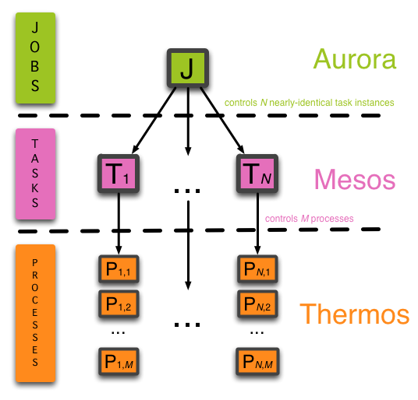
Thermos

Slide 34
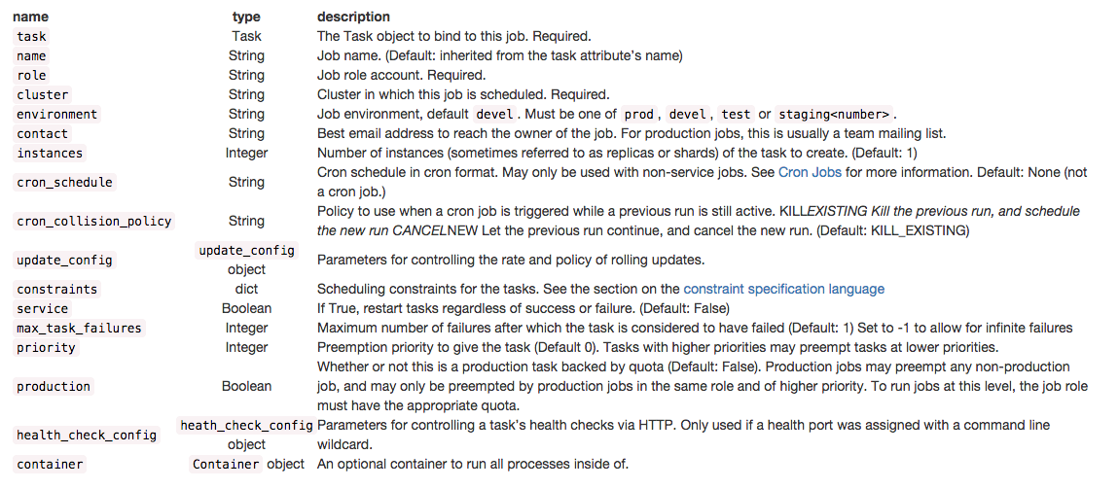
Job Objects

Slide 35
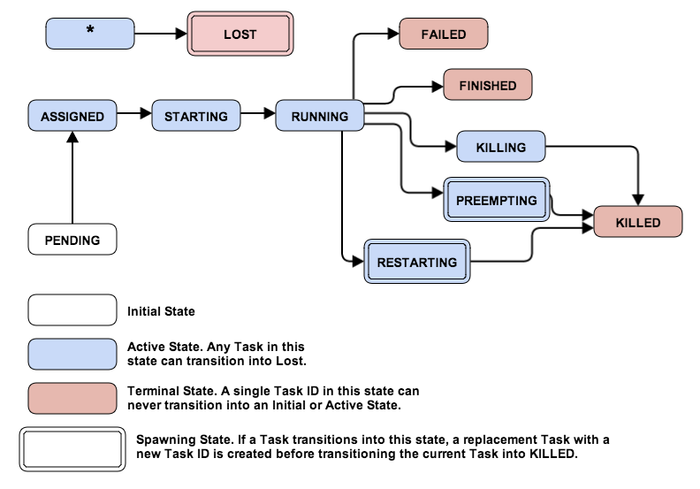
Job Lifecycle

Slide 36
hello_world.aurora
import os hello_world_process = Process(name = 'hello_world', cmdline = 'echo hello world') hello_world_task = Task( resources = Resources(cpu = 0.1, ram = 16 * MB, disk = 16 * MB), processes = [hello_world_process]) hello_world_job = Job( cluster = 'cluster1', role = os.getenv('USER'), task = hello_world_task) jobs = [hello_world_job]
Then issue the following commands to create and kill the job, using your own values for the job key.
aurora job create cluster1/$USER/test/hello_world hello_world.aurora
aurora job kill cluster1/$USER/test/hello_world

Slide 37
Kafka on Aurora
import os import textwrap class Profile(Struct): archive = Default(String, 'https://archive.apache.org/dist') gpg_grp = Default(String, 'https://people.apache.org/keys/group') svc = Default(String, 'kafka') svc_ver = Default(String, '0.8.1.1') svc_ver_scala = Default(String, '2.10') svc_prop_file = Default(String, 'server.properties') jvm_heap = Default(String, '-Xmx1G -Xms1G') common = Process( name = 'fetch commons', cmdline = textwrap.dedent(""" hdfs dfs -get /dist/scripts.tgz tar xf scripts.tgz """) )

Slide 38
Kafka on Aurora
dist = Process( name = 'fetch {{profile.svc}} v{{profile.svc_ver_scala}}-{{profile.svc_ver}} distribution', cmdline = textwrap.dedent(""" command -v curl >/dev/null 2>&1 || { echo >&2 "error: 'curl' is not installed. Aborting."; exit 1; } eval curl -sSfL '-O {{profile.archive}}/kafka/{{profile.svc_ver}}/kafka_{{profile.svc_ver_scala}}-{{profile.svc_ver}}.tgz'{,.asc,.md5} if command -v md5sum >/dev/null; then md5sum -c kafka_{{profile.svc_ver_scala}}-{{profile.svc_ver}}.tgz.md5 else echo "warn: 'md5sum' is not installed. Check skipped." >&2 fi if command -v gpg >/dev/null; then curl -sSfL {{profile.gpg_grp}}/kafka.asc | gpg --import gpg kafka_{{profile.svc_ver_scala}}-{{profile.svc_ver}}.tgz.asc else echo "warn: 'gpg' is not installed. Signature verification skipped." >&2 fi tar xf kafka_{{profile.svc_ver_scala}}-{{profile.svc_ver}}.tgz """) )

Slide 39
Kafka on Aurora
register = Process( name = 'register-service', cmdline = textwrap.dedent(""" export IP=$(host `hostname` | tr ' ' '\n' | tail -1) ./scripts/common/registry.sh -r {{profile.svc}}-{{environment}} -i {{mesos.instance}} -p "$IP:{{thermos.ports[client]}}" """) ) unregister = Process( name = 'unregister-service', final = True, cmdline = textwrap.dedent(""" ./scripts/common/registry.sh -u {{profile.svc}}-{{environment}} -i {{mesos.instance}} """) )

Slide 40
Kafka on Aurora
config = Process( name = 'create {{profile.svc_prop_file}}', cmdline = textwrap.dedent(""" export ZK_CONNECT=$(echo -e `./scripts/common/registry.sh -q zookeeper-{{environment}}-client` | awk '{printf("%s,", $0)}') export IP=$(host `hostname` | tr ' ' '\n' | tail -1) echo -e " broker.id={{mesos.instance}} port={{thermos.ports[client]}} host.name=$IP advertised.host.name=$IP num.network.threads=2 num.io.threads=8 socket.send.buffer.bytes=1048576 socket.receive.buffer.bytes=1048576 socket.request.max.bytes=104857600 log.dirs=kafka-logs num.partitions=1 log.retention.hours=168 log.segment.bytes=536870912 log.retention.check.interval.ms=60000 log.cleaner.enable=false zookeeper.connect=$ZK_CONNECT zookeeper.connection.timeout.ms=30000 " > {{profile.svc_prop_file}} echo "Wrote '{{profile.svc_prop_file}}':" cat {{profile.svc_prop_file}} """) )

Slide 41
Kafka on Aurora
run = Process( name = 'run {{profile.svc}}', cmdline = textwrap.dedent(""" export KAFKA_LOG4J_OPTS="-Dlog4j.configuration=file:kafka_{{profile.svc_ver_scala}}-{{profile.svc_ver}}/config/log4j.properties" export KAFKA_HEAP_OPTS="{{profile.jvm_heap}}" export EXTRA_ARGS="-name kafkaServer -loggc" kafka_{{profile.svc_ver_scala}}-{{profile.svc_ver}}/bin/kafka-run-class.sh $EXTRA_ARGS kafka.Kafka {{profile.svc_prop_file}} """) )

Slide 42
Kafka on Aurora
base_task = Task( processes = [register, unregister, common, dist, config, run], constraints = order(dist, run) + order(common, register) + order(common, config, run) ) staging_task = base_task( resources = Resources(cpu = 1.0, ram = 1280*MB, disk = 5*GB) ) production_task = base_task( resources = Resources(cpu = 24.0, ram = 23040*MB, disk = 10000*GB) )

Slide 43
Kafka on Aurora
DEVELOPMENT = Profile() PRODUCTION = Profile( jvm_heap = '-Xmx4G -Xms4G' ) base_job = Service( name = 'kafka', role = os.getenv('USER') ) jobs = [ base_job( cluster = dc1, environment = 'devel', instances = 4000, contact = ‘root@localhost', task = staging_task.bind( profile = DEVELOPMENT ) ), base_job( cluster = ‘dc1’, environment = 'prod', instances = 150, production = True, contact = ‘root@localhost', task = production_task.bind( profile = PRODUCTION ) ) ]

Slide 44


The future of Kafka on Mesos
A Mesos Kafka framework https://github.com/mesos/kafka

Slide 45
Sample Frameworks
C++ - https://github.com/apache/mesos/tree/master/src/examples
Java - https://github.com/apache/mesos/tree/master/src/examples/java
Python - https://github.com/apache/mesos/tree/master/src/examples/python
Scala - https://github.com/mesosphere/scala-sbt-mesos-framework.g8
Go - https://github.com/mesosphere/mesos-go

Slide 46
FrameworkInfo
https://github.com/apache/mesos/blob/master/include/mesos/mesos.proto
message FrameworkInfo {
required string user = 1;
required string name = 2;
optional FrameworkID id = 3;
optional double failover_timeout = 4 [default = 0.0];
optional bool checkpoint = 5 [default = false];
optional string role = 6 [default = "*"];
optional string hostname = 7;
optional string principal = 8;
optional string webui_url = 9;
}

Slide 47
TaskInfo
message TaskInfo {
required string name = 1;
required TaskID task_id = 2;
required SlaveID slave_id = 3;
repeated Resource resources = 4;
optional ExecutorInfo executor = 5;
optional CommandInfo command = 7;
optional ContainerInfo container = 9;
optional bytes data = 6;
optional HealthCheck health_check = 8;
optional Labels labels = 10;
optional DiscoveryInfo discovery = 11;
}

Slide 48
TaskState
/**
* Describes possible task states. IMPORTANT: Mesos assumes tasks that
* enter terminal states (see below) imply the task is no longer
* running and thus clean up any thing associated with the task
* (ultimately offering any resources being consumed by that task to
* another task).
*/
enum TaskState {
TASK_STAGING = 6; // Initial state. Framework status updates should not use.
TASK_STARTING = 0;
TASK_RUNNING = 1;
TASK_FINISHED = 2; // TERMINAL. The task finished successfully.
TASK_FAILED = 3; // TERMINAL. The task failed to finish successfully.
TASK_KILLED = 4; // TERMINAL. The task was killed by the executor.
TASK_LOST = 5; // TERMINAL. The task failed but can be rescheduled.
TASK_ERROR = 7; // TERMINAL. The task description contains an error.
}

Slide 49
Scheduler
/**
* Invoked when the scheduler successfully registers with a Mesos
* master. A unique ID (generated by the master) used for
* distinguishing this framework from others and MasterInfo
* with the ip and port of the current master are provided as arguments.
*/
def registered(
driver: SchedulerDriver,
frameworkId: FrameworkID,
masterInfo: MasterInfo): Unit = {
log.info("Scheduler.registered")
log.info("FrameworkID:\n%s" format frameworkId)
log.info("MasterInfo:\n%s" format masterInfo)
}

Slide 50
Scheduler
/**
* Invoked when the scheduler re-registers with a newly elected Mesos master.
* This is only called when the scheduler has previously been registered.
* MasterInfo containing the updated information about the elected master
* is provided as an argument.
*/
def reregistered(
driver: SchedulerDriver,
masterInfo: MasterInfo): Unit = {
log.info("Scheduler.reregistered")
log.info("MasterInfo:\n%s" format masterInfo)
}

Slide 51
Scheduler
/**Invoked when resources have been offered to this framework. A single offer will only contain resources from a single slave. Resources associated with an offer will not be re-offered to _this_ framework until either (a) this framework has rejected those resources or (b) those resources have been rescinded.Note that resources may be concurrently offered to more than one framework at a time (depending on the allocator being used). In that case, the first framework to launch tasks using those resources will be able to use them while the other frameworks will have those resources rescinded (or if a framework has already launched tasks with those resources then those tasks will fail with a TASK_LOST status and a message saying as much).*/
def resourceOffers(
driver: SchedulerDriver, offers: JList[Offer]): Unit = {
log.info("Scheduler.resourceOffers")
// print and decline all received offers
offers foreach { offer =>
log.info(offer.toString)
driver declineOffer offer.getId
}
}

Slide 52
Scheduler
/**
* Invoked when an offer is no longer valid (e.g., the slave was
* lost or another framework used resources in the offer). If for
* whatever reason an offer is never rescinded (e.g., dropped
* message, failing over framework, etc.), a framwork that attempts
* to launch tasks using an invalid offer will receive TASK_LOST
* status updats for those tasks.
*/
def offerRescinded(
driver: SchedulerDriver,
offerId: OfferID): Unit = {
log.info("Scheduler.offerRescinded [%s]" format offerId.getValue)
}

Slide 53
Scheduler
/**
* Invoked when the status of a task has changed (e.g., a slave is
* lost and so the task is lost, a task finishes and an executor
* sends a status update saying so, etc). Note that returning from
* this callback _acknowledges_ receipt of this status update! If
* for whatever reason the scheduler aborts during this callback (or
* the process exits) another status update will be delivered (note,
* however, that this is currently not true if the slave sending the
* status update is lost/fails during that time).
*/
def statusUpdate(
driver: SchedulerDriver, status: TaskStatus): Unit = {
log.info("Scheduler.statusUpdate:\n%s" format status)
}

Slide 54
Scheduler
/**
* Invoked when an executor sends a message. These messages are best
* effort; do not expect a framework message to be retransmitted in
* any reliable fashion.
*/
def frameworkMessage(
driver: SchedulerDriver,
executorId: ExecutorID,
slaveId: SlaveID,
data: Array[Byte]): Unit = {
log.info("Scheduler.frameworkMessage")
}

Slide 55
Scheduler
**
* Invoked when the scheduler becomes "disconnected" from the master
* (e.g., the master fails and another is taking over).
*/
def disconnected(driver: SchedulerDriver): Unit = {
log.info("Scheduler.disconnected")
}
/**
* Invoked when a slave has been determined unreachable (e.g.,
* machine failure, network partition). Most frameworks will need to
* reschedule any tasks launched on this slave on a new slave.
*/
def slaveLost(
driver: SchedulerDriver,
slaveId: SlaveID): Unit = {
log.info("Scheduler.slaveLost: [%s]" format slaveId.getValue)
}

Slide 56
Scheduler
/**
* Invoked when an executor has exited/terminated. Note that any
* tasks running will have TASK_LOST status updates automagically
* generated.
*/
def executorLost(
driver: SchedulerDriver,executorId: ExecutorID, slaveId: SlaveID,
status: Int): Unit = {
log.info("Scheduler.executorLost: [%s]" format executorId.getValue)
}
/**
* Invoked when there is an unrecoverable error in the scheduler or
* scheduler driver. The driver will be aborted BEFORE invoking this
* callback.
*/
def error(driver: SchedulerDriver, message: String): Unit = {
log.info("Scheduler.error: [%s]" format message)
}

Slide 57
Executor
/**
* Invoked once the executor driver has been able to successfully
* connect with Mesos. In particular, a scheduler can pass some
* data to it's executors through the ExecutorInfo.data
* field.
*/
def registered(
driver: ExecutorDriver,
executorInfo: ExecutorInfo,
frameworkInfo: FrameworkInfo,
slaveInfo: SlaveInfo): Unit = {
log.info("Executor.registered")
}

Slide 58
Executor
/**
* Invoked when the executor re-registers with a restarted slave.
*/
def reregistered(
driver: ExecutorDriver,
slaveInfo: SlaveInfo): Unit = {
log.info("Executor.reregistered")
}
/** Invoked when the executor becomes "disconnected" from the slave
* (e.g., the slave is being restarted due to an upgrade).
*/
def disconnected(driver: ExecutorDriver): Unit = {
log.info("Executor.disconnected")
}

Slide 59
Executor
/**
* Invoked when a task has been launched on this executor (initiated
* via Scheduler.launchTasks. Note that this task can be
* realized with a thread, a process, or some simple computation,
* however, no other callbacks will be invoked on this executor
* until this callback has returned.
*/
def launchTask(driver: ExecutorDriver, task: TaskInfo): Unit = {
log.info("Executor.launchTask")
}

Slide 60
Executor
/**
* Invoked when a task running within this executor has been killed
* (via SchedulerDriver.killTask). Note that no status
* update will be sent on behalf of the executor, the executor is
* responsible for creating a new TaskStatus (i.e., with
* TASK_KILLED) and invoking ExecutorDriver.sendStatusUpdate.
*/
def killTask(driver: ExecutorDriver, taskId: TaskID): Unit = {
log.info("Executor.killTask")
}

Slide 61
Executor
/**
* Invoked when a framework message has arrived for this
* executor. These messages are best effort; do not expect a
* framework message to be retransmitted in any reliable fashion.
*/
def frameworkMessage(driver: ExecutorDriver, data: Array[Byte]): Unit = {
log.info("Executor.frameworkMessage")
}

Slide 62
Executor
/**
* Invoked when the executor should terminate all of it's currently
* running tasks. Note that after a Mesos has determined that an
* executor has terminated any tasks that the executor did not send
* terminal status updates for (e.g., TASK_KILLED, TASK_FINISHED,
* TASK_FAILED, etc) a TASK_LOST status update will be created.
*/
def shutdown(driver: ExecutorDriver): Unit = {
log.info("Executor.shutdown")
}

Slide 63
Executor
/**
* Invoked when a fatal error has occured with the executor and/or
* executor driver. The driver will be aborted BEFORE invoking this
* callback.
*/
def error(driver: ExecutorDriver, message: String): Unit = {
log.info("Executor.error")
}

Slide 64

Questions?
/*******************************************
Joe Stein
Founder, Principal Consultant
Big Data Open Source Security LLC
http://www.stealth.ly
Twitter: @allthingshadoop
********************************************/

