Slide 1
了解CPU
核心系统数据库组 余锋
http://yufeng.info
@淘宝褚霸
2012-03-17

Slide 2
提纲
概览
测量
利用

Slide 3
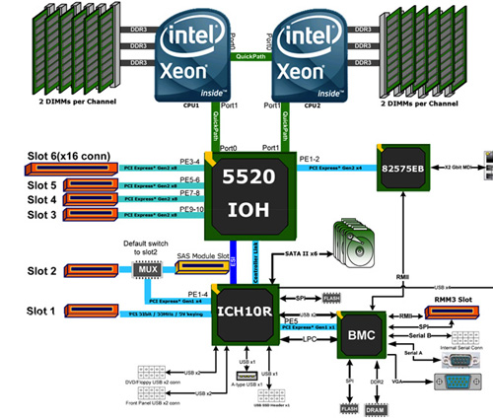
芯片组

Slide 4
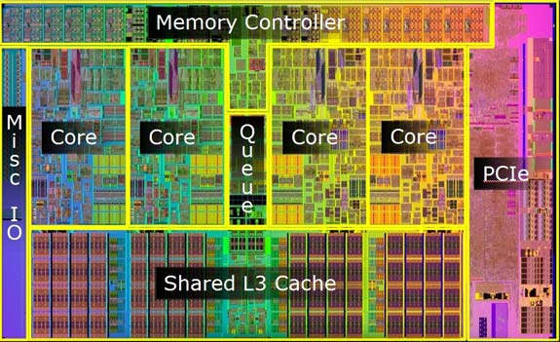
CPU微观图

Slide 5
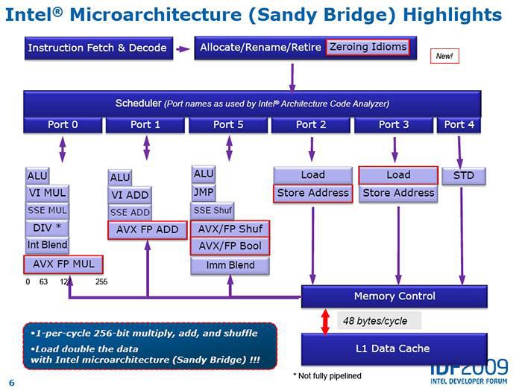

Slide 6
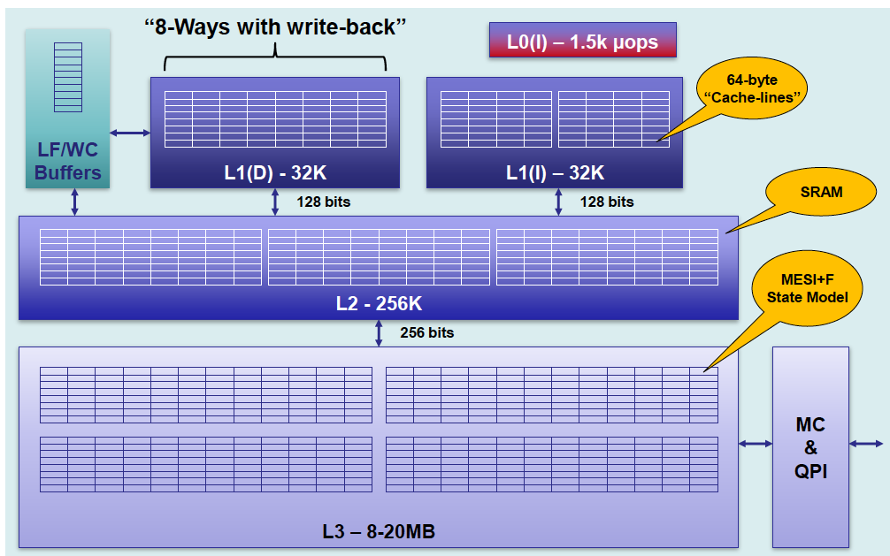
Cache层次结构

Slide 7
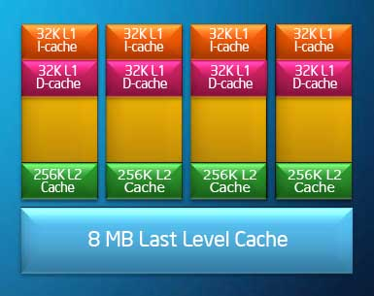
Cache-续
指令Cache
数据Cache

Slide 8
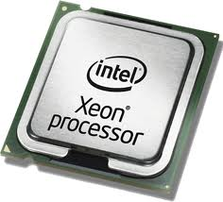
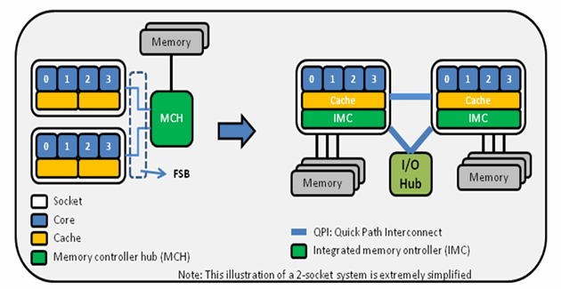
Xeon 5600系列CPU

Slide 9
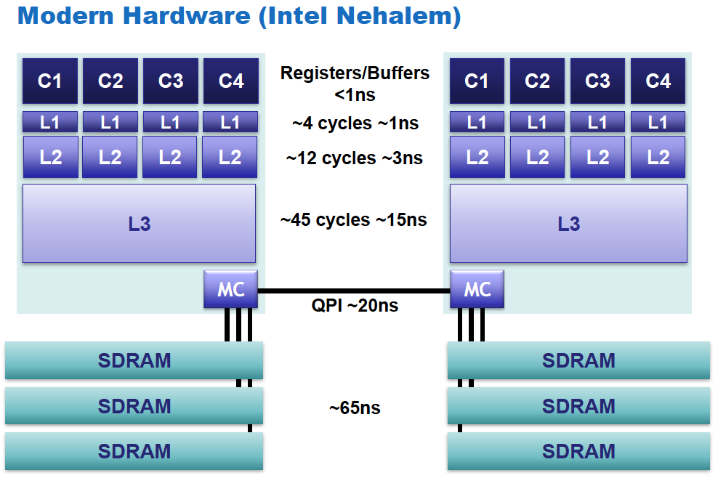
CPU内部各部件访问速度

Slide 10
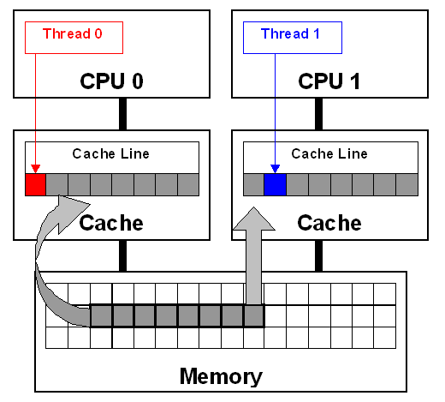
False sharing问题

Slide 11
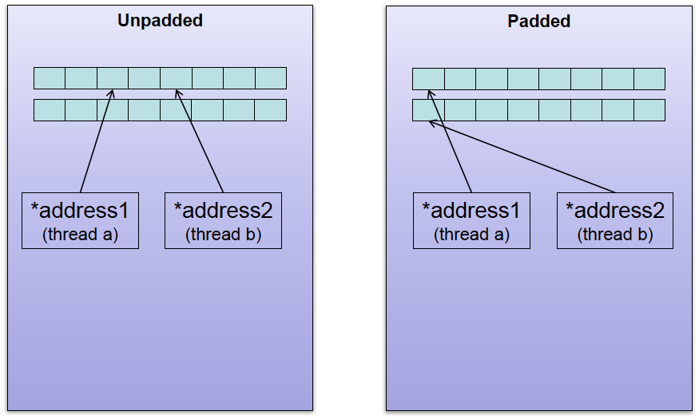
Cache lines

Slide 12
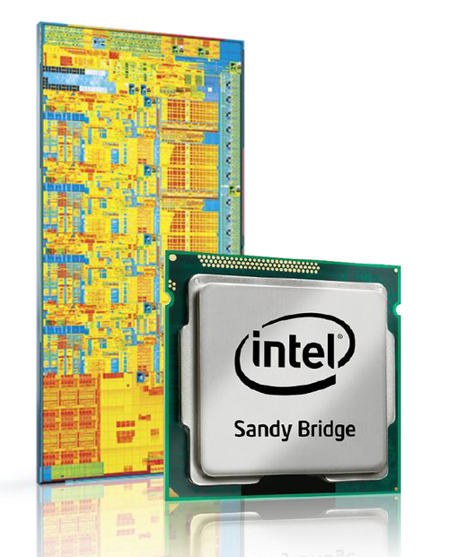
Intel Sandy Bridge来了

Slide 13
Upgraded features from Nehalem include
32 kB data + 32 kB instruction L1 cache (3 clocks) and 256 kB L2 cache (8 clocks) per core
Shared L3 cache includes the processor graphics (LGA 1155)
64-byte cache line size
Two load/store operations per CPU cycle for each memory channel
Decoded micro-operation cache and enlarged, optimized branch predictor
Improved performance for transcendental mathematics, AES encryption (AES instruction set), and SHA-1 hashing
256-bit/cycle ring bus interconnect between cores, graphics, cache and System Agent Domain
Advanced Vector Extensions (AVX) 256-bit instruction set with wider vectors, new extensible syntax and rich functionality
Intel Quick Sync Video, hardware support for video encoding and decoding
Up to 8 physical cores or 16 logical cores through Hyper-threading

Slide 14
lscpu
_{Architecture: x86_64}
CPU op-mode(s): 32-bit, 64-bit
Byte Order: Little Endian
_{CPU(s): 24}
_{On-line CPU(s) list: 0-23}
_{Thread(s) per core: 2}
_{Core(s) per socket: 6}
_{CPU socket(s): 2}
_{NUMA node(s): 2}
Vendor ID: GenuineIntel
_{CPU family: 6}
_{Model: 44}
_{Stepping: 2}
CPU MHz: 2400.461
_{BogoMIPS: 4799.93}
_{Virtualization: VT-x}
_{L1d cache: 32K}
_{L1i cache: 32K}
_{L2 cache: 256K}
_{L3 cache: 12288K}
NUMA node0 CPU(s): 0,2,4,6,8,10,12,14,16,18,20,22
NUMA node1 CPU(s): 1,3,5,7,9,11,13,15,17,19,21,23

Slide 15
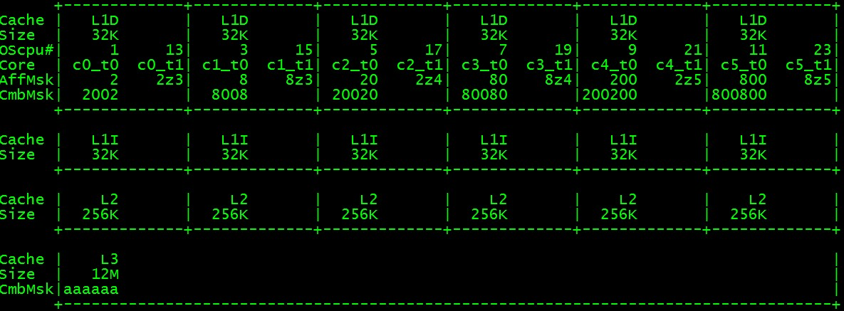
CPU拓扑结构图
# ./cpu_topology64.out

Slide 16
Hwconfig
Processors: 2 x Xeon E5645 2.40GHz 5860MHz FSB (HT enabled, 12 cores, 24 threads)
cpus bits="64"
cores="12"
cores_active="12"
ht_bios_enable="1"
ht_enable="1"
ht_support="1"
sockets="2"
sockets_populated="2"
threads="24"
threads_active="24"

Slide 17
hwconfig -x
apic_id="0"
bits="64"
core_id="0"
cores="6"
cpuid="0x000206c2"
cpuid_level="11"
family_id="6"
fsb="5860MHz“
l1_cache_size="32768"
l2_cache_size="262144“
l3_cache_size="12582912“
model="Intel® Xeon(R) CPU E5645 @ 2.40GHz"
model_id="44"
multi_threading="32"
name="cpu1"
package_id="0"
physical_address_bits="40"
speed="2400461000"
stepping_id="2"
threads="12"
turbo_frequencies="2800000000 2800000000 2666666666 2666666666"
vendor="Intel"
vendor_id="GenuineIntel"
virtual_address_bits="48"

Slide 18
必知性能数字
L1 cache referenc 0.5 ns
Branch mispredict 5 ns
L2 cache reference 7 ns
Mutex lock/unlock 25 ns
Main memory reference 100 ns
Compress 1K bytes with Zippy 3,000 ns
Send 2K bytes over 1 Gbps network 20,000 ns
Read 1 MB sequentially from memory 250,000 ns
Round trip within same datacenter 500,000 ns
Disk seek 10,000,000 ns
Read 1 MB sequentially from disk 20,000,000 ns
Send packet CA->Netherlands->CA 150,000,000 ns

Slide 19
lmbench微观测量
Basic double operations - times in nanoseconds - smaller is better
------------------------------------------------------------------
Host OS double double double double add mul div bogo
------------------------------------------------------------------
Dr4000 Linux 2.6.32- 1.1400 1.9000 8.9500 7.7100
Memory latencies in nanoseconds - smaller is better
------------------------------------------------------------------------------
Host OS Mhz L1 $ L2 $ Main mem Rand mem Guesses
------------------------------------------------------------------
Dr4000 Linux 2.6.32- 2631 1.1590 5.7170 78.0 110.4

Slide 20
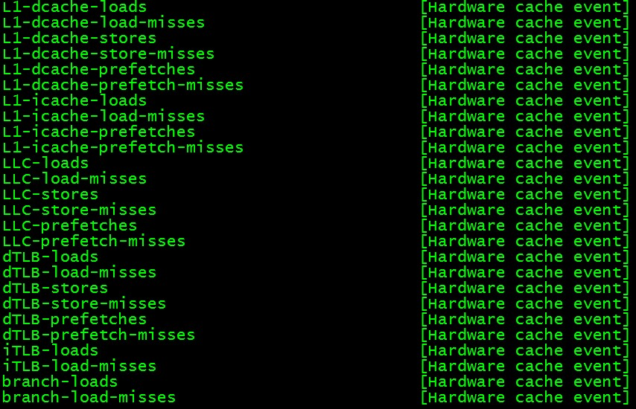
Cache相关硬件事件
perf list

Slide 21
参考材料
lscpu – CPU architecture information查看器 http://blog.yufeng.info/archives/1886
CPU拓扑结构的调查: http://blog.yufeng.info/archives/666
hwconfig查看硬件信息: http://blog.yufeng.info/archives/2086
LMbench 实用的微观性能分析工具: http://blog.yufeng.info/archives/tag/lmbench

Slide 22
提问时间
谢谢大家！

