Slide 1
了解IO协议栈
核心系统数据库组 余锋http://yufeng.info
@淘宝褚霸
2012-03-18

Slide 2
提纲
IO子系统架构图
IO子系统各层分解
IO请求事件跟踪点
blktrace/btt解释

Slide 3
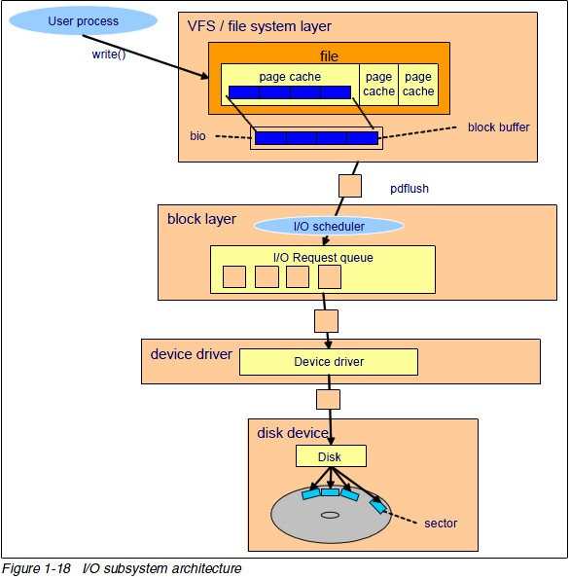
IO子系统架构图
$stap -l 'ioblock.*'
ioblock.end
ioblock.request
$stap -l 'ioscheduler.*'
ioscheduler.elv_add_request
ioscheduler.elv_completed_request
ioscheduler.elv_next_request
blktrace
DM层

Slide 4
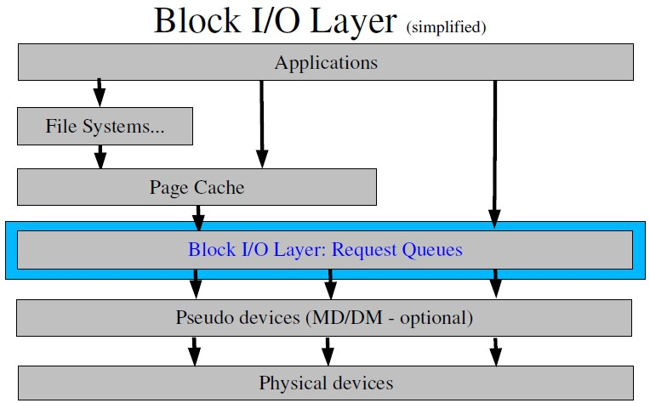
块层框图
buffered io
mmap
direct io

Slide 5
思考
IO子系统有几层？
各层的输入输出分别是什么？

Slide 6
块层
probe ioblock.request
–Fires whenever making a generic block I/O request.
probe ioblock.end
–Fires whenever a block I/O transfer is complete.

Slide 7
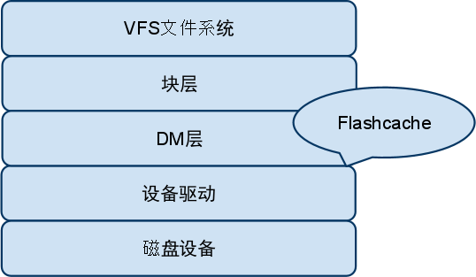
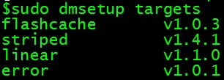
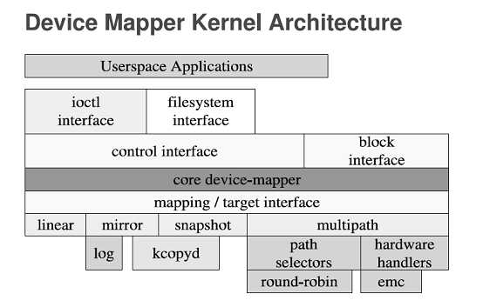
DM 层
LVM2（Linux Volume Manager 2 version)
EVMS(Enterprise Volume Management System)
dmraid(Device Mapper Raid Tool)

Slide 8
请求队列/电梯
probe ioscheduler.elv_add_request.kp
- kprobe based probe to indicate that a request was added to the request queue
probe ioscheduler.elv_next_request
–Fires when a request is retrieved from the request queue
probe ioscheduler.elv_completed_request
–Fires when a request is completed

Slide 9
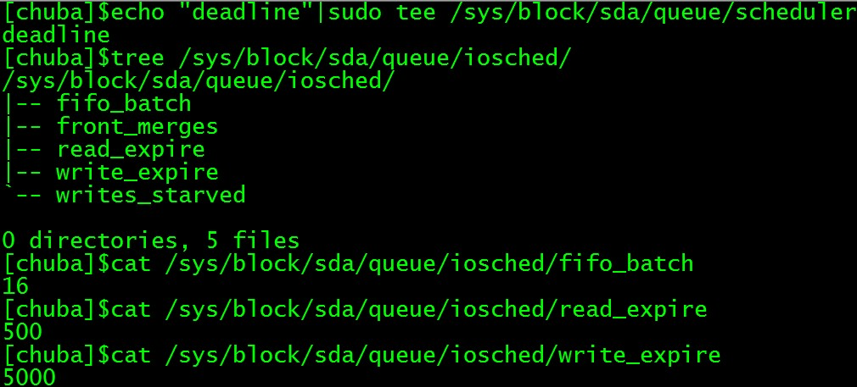
调度器参数微调
# cat /sys/block/sda/queue/scheduler
noop anticipatory [deadline] cfq
文档参考：Documentation/block/deadline-iosched.txt

Slide 10
思考
电梯算法的核心作用是什么？

Slide 11
驱动程序
中断平衡
/proc/irq/IRQ/smp_affinity
软中断平衡
/sys/block/DEV/queue/rq_affinity

Slide 12
块请求关键事件点
$perf list|grep “block:”或者
$trace-cmd list |grep 'block:*‘
$stap -l ‘kernel.trace(“block_*”)‘
block:block_rq_abort
block:block_rq_requeue
block:block_rq_complete
block:block_rq_insert
block:block_rq_issue
block:block_bio_bounce
block:block_bio_complete
block:block_bio_backmerge
block:block_bio_frontmerge
block:block_bio_queue
block:block_getrq
block:block_sleeprq
block:block_plug
block:block_unplug_timer
block:block_unplug_io
block:block_split
block:block_remap
block:block_rq_remap

Slide 13
Tracepoint解释
C -- complete A previously issued request has been completed.
D -- issued A request that previously resided on the block layer
queue or in the i/o scheduler has been sent to the driver.
I -- inserted A request is being sent to the i/o scheduler for addi-tion to the internal queue and later service by the driver.
Q -- queued This notes intent to queue i/o at the given location.
B -- bounced The data pages attached to this bio are not reachable by the hardware and must be bounced to a lower memory location.

Slide 14
Tracepoint解释(续）
M -- back merge A previously inserted request exists that ends on the boundary of where this i/o begins, so the i/o scheduler can merge them together.
F -- front merge Same as the back merge, except this i/o ends where a previously inserted requests starts.
G -- get request To send any type of request to a block device, a struct request container must be allocated first.
S -- sleep No available request structures were available, so the
issuer has to wait for one to be freed.

Slide 15
Tracepoint解释(续）
P -- plug When i/o is queued to a previously empty block device queue, Linux will plug the queue in anticipation of future ios being added before this data is needed.
U -- unplug Some request data already queued in the device, start sending requests to the driver.
T -- unplug due to timer If nobody requests the i/o that was queued after plugging the queue, Linux will automatically unplug it after a defined period has passed.
X -- split On raid or device mapper setups, an incoming i/o may
straddle a device or internal zone and needs to be hopped up into smaller pieces for service.
A -- remap For stacked devices, incoming i/o is remapped to device below it in the i/o stack.

Slide 16
思考
如何可视化IO请求生命期？

Slide 17
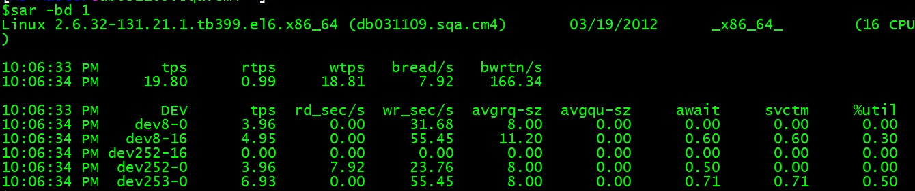
IO行为观察
不觉得信息量太少吗？

Slide 18
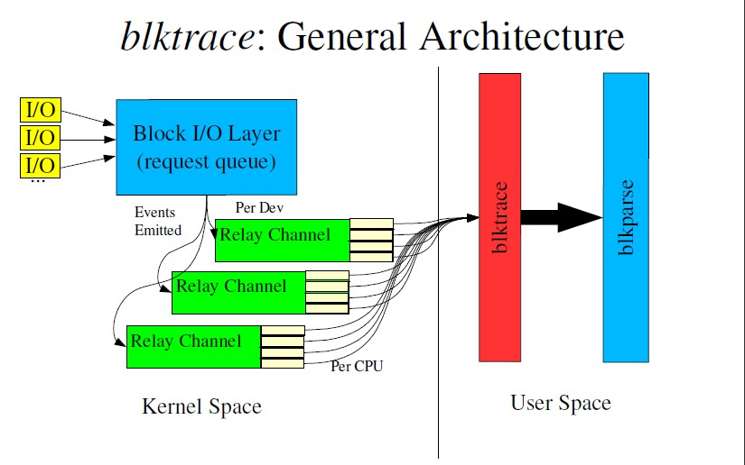
blktrace架构图

Slide 19
blktrace可过滤事件
barrier: barrier attribute
complete: completed by driver
fs: requests
issue: issued to driver
pc: packet command events
queue: queue operations
read: read traces
requeue: requeue operations
sync: synchronous attribute
write: write traces
notify: trace messages
drv_data: additional driver specific trace

Slide 20
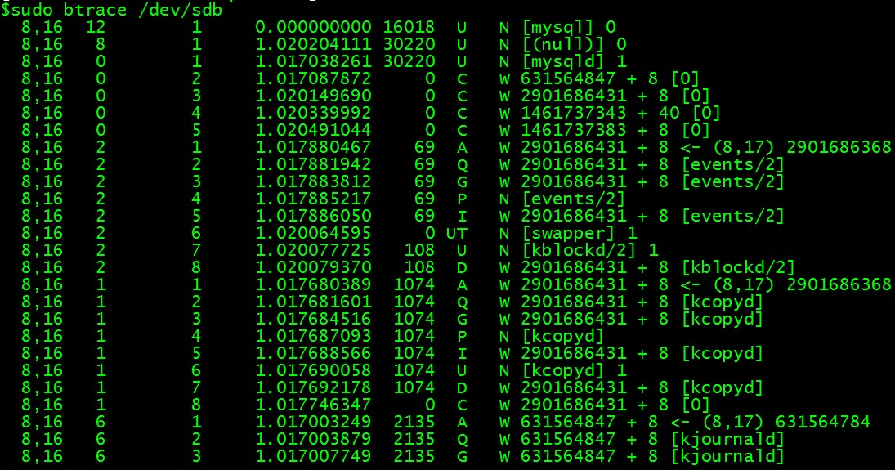
btrace第一感

Slide 21
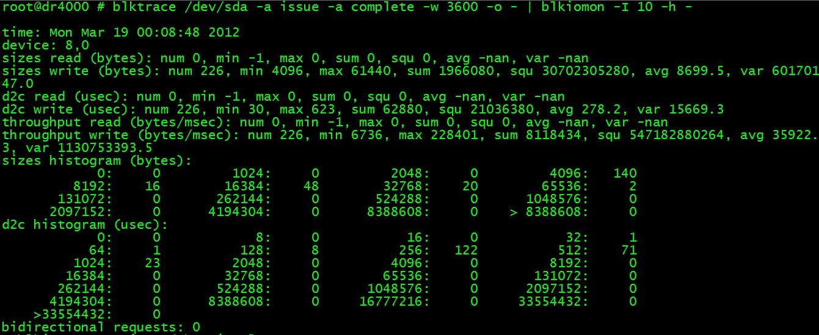
blkiomon

Slide 22
btt
# blktrace /dev/sdb
# blkparse -i sdb -d sdb.bin
# blkrawverify sdb
# btt -i sdb.bin -A

Slide 23
btt: Life of an I/O
Q2I – time it takes to process an I/O prior to it being inserted or merged onto a request queue
Includes split, and remap time
I2D – time the I/O is “idle” on the request queue
D2C – time the I/O is “active” in the driver and on the device
Q2I + I2D + D2C = Q2C
Q2C: Total processing time of the I/O

Slide 24
btt解读
==================== All Devices ====================
ALL MIN AVG MAX N
--------------- ------------- ------------- ------------- -----------
Q2Q 0.000007098 0.085323752 1.189534849 14
Q2G 0.000000685 0.000001737 0.000004757 12
G2I 0.000000272 0.000001724 0.000004240 12
Q2M 0.000000475 0.000001036 0.000001362 3
I2D 0.000002502 0.000244633 0.002238651 12
M2D 0.000004870 0.000065011 0.000178722 3
D2C 0.000055488 0.000145720 0.000219068 15
Q2C 0.000062048 0.000357405 0.002303758 15

Slide 25
btt解读(续)
==================== Device Overhead ====================
DEV | Q2G G2I Q2M I2D D2C
---------- | --------- --------- --------- --------- ---------
( 8, 16) | 0.3889% 0.3859% 0.0580% 54.7575% 40.7717%
---------- | --------- --------- --------- --------- ---------
Overall | 0.3889% 0.3859% 0.0580% 54.7575% 40.7717%

Slide 26
btt解读(续)
==================== Device Merge Information ====================
DEV | #Q #D Ratio | BLKmin BLKavg BLKmax Total
---------- | -------- -------- ------- | -------- -------- -------- --------
( 8, 16) | 15 12 1.2 | 8 10 24 120

Slide 27
btt解读(续)
==================== Device Q2Q Seek Information ====================
DEV | NSEEKS MEAN MEDIAN | MODE
---------- | --------------- --------------- --------------- | ---------------
( 8, 16) | 15 620978236.7 0 | 0(5)
---------- | --------------- --------------- --------------- | ---------------
Overall | NSEEKS MEAN MEDIAN | MODE
Average | 15 620978236.7 0 | 0(5)
==================== Device D2D Seek Information ====================
DEV | NSEEKS MEAN MEDIAN | MODE
---------- | --------------- --------------- --------------- | ---------------
( 8, 16) | 12 776222795.9 0 | 0(2)
---------- | --------------- --------------- --------------- | ---------------
Overall | NSEEKS MEAN MEDIAN | MODE
Average | 12 776222795.9 0 | 0(2)

Slide 28
btt解读(续)
==================== Plug Information ====================
DEV | # Plugs # Timer Us | % Time Q Plugged
---------- | ---------- ---------- | ----------------
( 8, 16) | 5( 1) | 0.226614061%
DEV | IOs/Unp IOs/Unp(to)
---------- | ---------- ----------
( 8, 16) | 0.8 1.0
---------- | ---------- ----------
Overall | IOs/Unp IOs/Unp(to)
Average | 0.8 1.0

Slide 29
btt解读(续)
================= Active Requests At Q Information ================
DEV | Avg Reqs @ Q
---------- | -------------
( 8, 16) | 0.9

Slide 30
思考
除了用户应用，
谁还在使用块层？

Slide 31
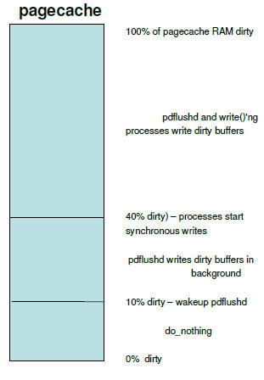
页面回写机制
$stap –l ‘kernel.function("congestion_wait")‘
$perf list|grep "writeback:“
writeback:writeback_nothread
..
writeback:writeback_nowork
writeback:writeback_bdi_register
writeback:writeback_bdi_unregister
writeback:writeback_task_start
writeback:writeback_task_stop
writeback:wbc_writeback_start
writeback:wbc_writeback_written
writeback:wbc_writeback_wait
writeback:wbc_balance_dirty_start
writeback:wbc_balance_dirty_written
writeback:wbc_balance_dirty_wait
writeback:wbc_writepage

Slide 32
参考材料
blktrace相关: http://blog.yufeng.info/archives/tag/blktrace
systemtap相关: http://blog.yufeng.info/archives/tag/systemtap

Slide 33
提问时间
谢谢大家！

