Slide 1
了解IO设备
核心系统数据库组 余锋http://yufeng.info
@淘宝褚霸
2012-03-17

Slide 2
提纲
芯片组
SATA/SAS
SSD
PCIe Flash卡
RAID卡
NVRAM卡
测量工具

Slide 3
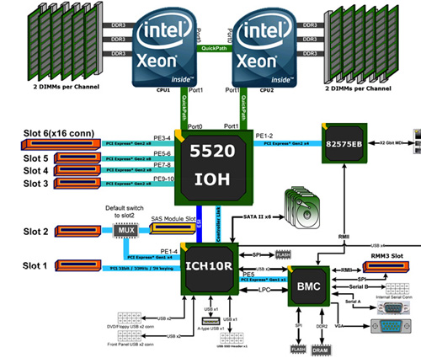
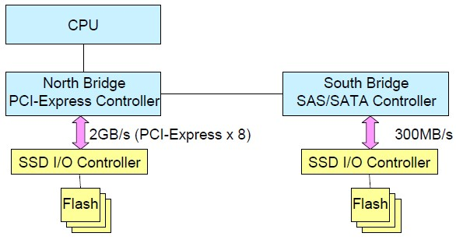
IO芯片组
Raid卡和PCIe卡都插在PCIe卡，直接走北桥

Slide 4
芯片组型号
Processors: 2 x Xeon E5645 2.40GHz 5860MHz FSB (HT enabled, 12 cores, 24 threads)
Chipset: Intel 5500 IOH-24D B3 (Tylersburg), 82801JIR A0 (ICH10R)

Slide 5
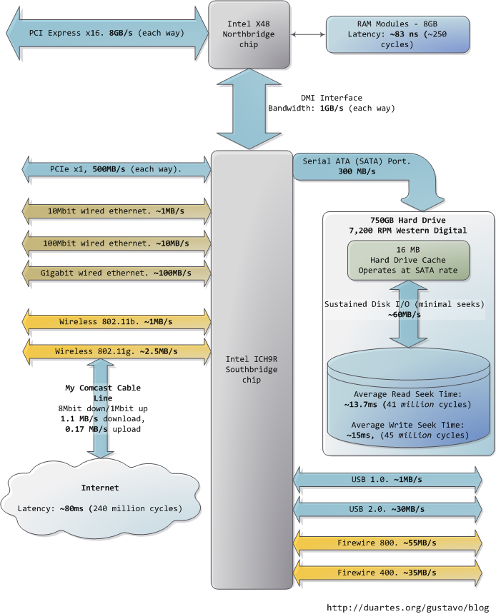
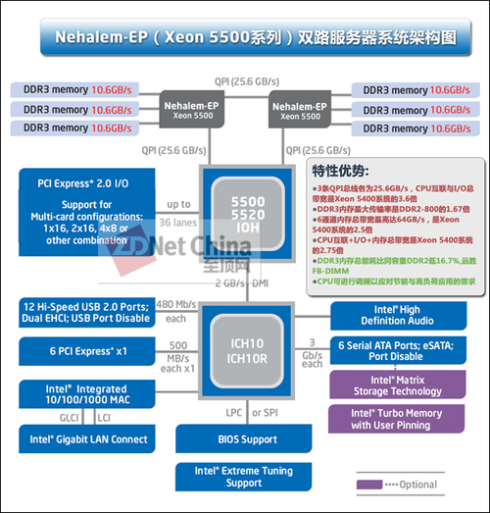
接口速率
PCIe每个X接口速率:
v1.x: 250 MB/s
v2.x: 500 MB/s

Slide 6
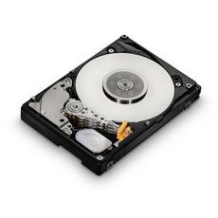
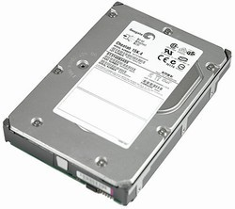
SATA/SAS机械磁盘
SATA II
7200 RPM IOPS: ~90
SAS
15K RPM IOPS: ~180
Disk: sda (scsi0): 100GB JBOD == 1 x HITACHI-HUSSL4010ASS600

Slide 7
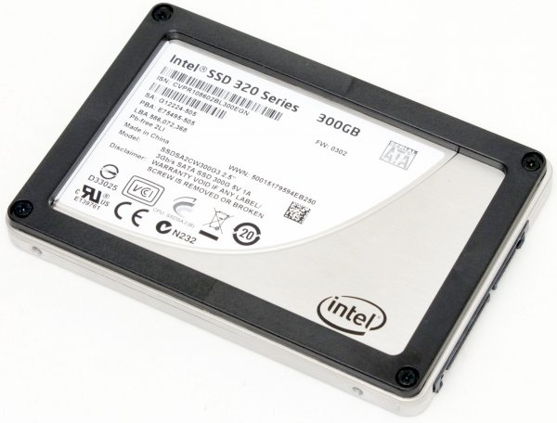
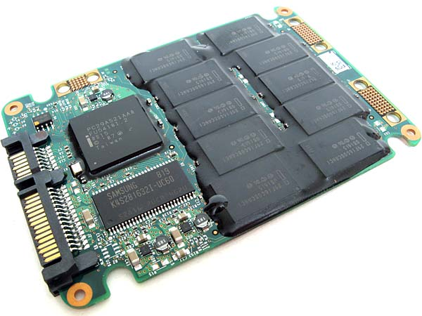
SSD
寿命:200T
SATA II
Intel X25-M IOPS: ~8600

Slide 8
思考
为什么
要有RAID或者HBA卡
接SATA磁盘阵列？
解决什么问题？

Slide 9
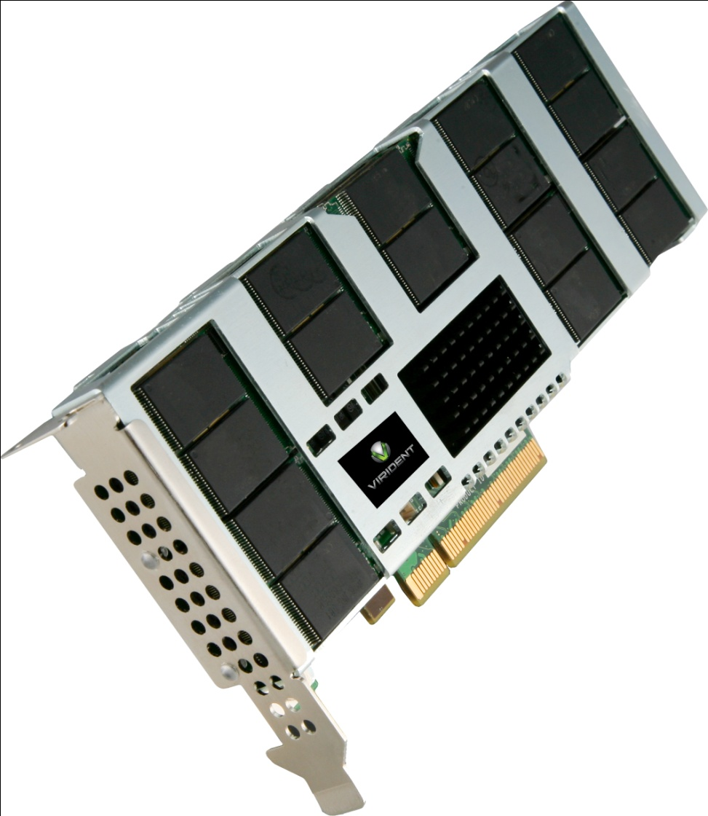
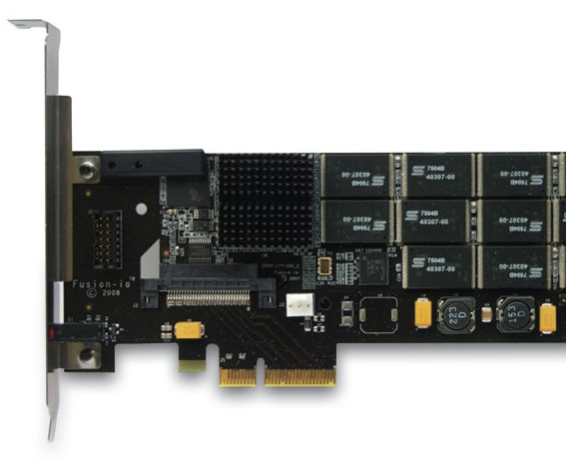
PCIe Flash卡
PCIe 2.0x4
ioDrive IOPS: with Flash 140,000 Read IOPS, 135,000 Write IOPS
掉电数据安全，寿命:5P-15P
PCIe 2.0x8
850 MB/s (4KB)
220,000 IOPS (4KB)
Disk-Control: iodrive0: Fusion-io ioDIMM3 320GB

Slide 10
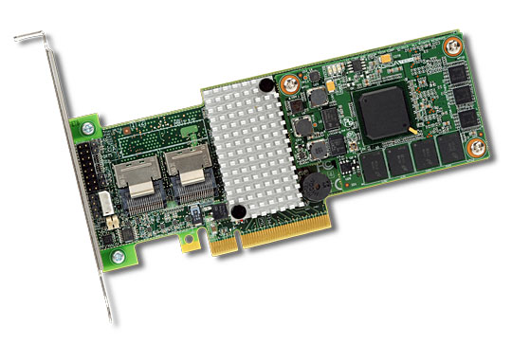
Raid卡
PCIe 2.0x8
Support Up to 128 SATA Devices
Dual Core ROC
1GB cache
Disk-Control: megaraid_sas0: LSI Logic / Symbios Logic MegaRAID SAS 1078

Slide 11
Raid卡(续)-Cache
虚拟卷
预读缓存
NORA (No read ahead)
RA (Read ahead)
ADRA (Adaptive read ahead)
写缓存
WT (Write through),
WB (Write back)
Disk Cache
关闭，考虑到数据安全

Slide 12
Raid卡(续)-BBWC
Nickel Metal Hydride (NiMH)
100 full discharge cycles.
48-hour battery life .
Typical capacity for the HP Smart Array battery pack reduces by 5 to 10 percent over a 3-year period.
Battery recharge takes between 30 minutes and 2 hours
模块化设计可替换

Slide 13
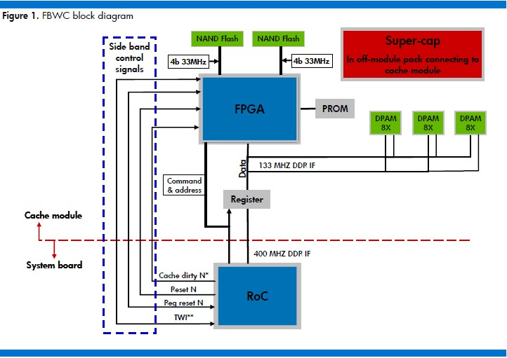
Raid卡 (续）- FBWC

Slide 14
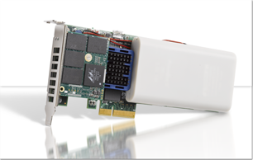
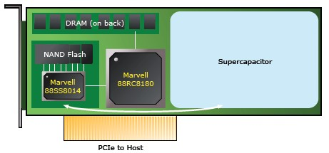
NVRAM卡
寿命:1M hours
DDR backup to persistent flash on powerfailure
Automatic restore from Flash to DDR when power is restored
PCIe 1.1x4
4K Block Writes: 165,000 IOPS
4K Block Reads: 185,000 IOPS
Disk-Control: mvloki0: Marvell Device 8180

Slide 15
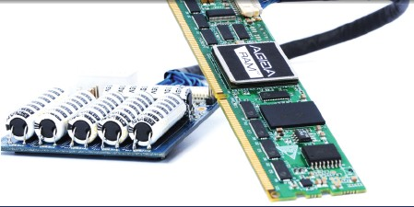
DDR3 Non-Volatile DIMM
static unsigned long ram_start=0xa40000000UL;
static unsigned long ram_size= 0x80000000UL;

Slide 16
思考
PCIe卡的寿命和安全如何保证？
掉电数据安全吗？

Slide 17
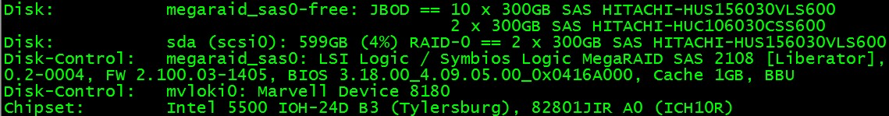
hwconfig
hwconfig
hwconfig –x sample.cfg
firmware="E516"
handle="69"
interface="SAS"
serial="JXYGHLAN"
size="299999690752"
status="free"
volume="megaraid_sas0-free"
volume_handle="74"
wwn="0x5000cca018c378f1”
model="HITACHI-HUS156030VLS600"

Slide 18
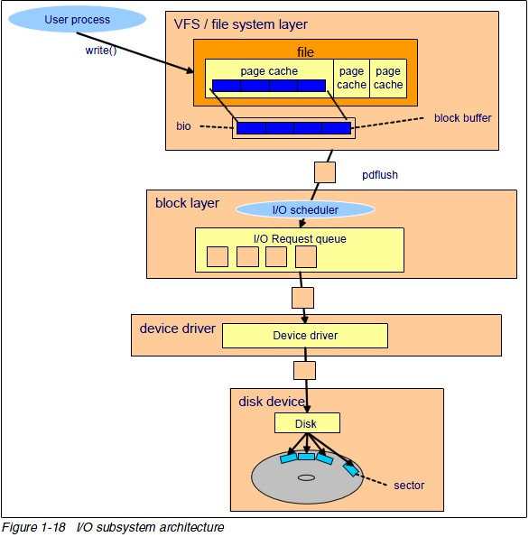
IO子系统架构图

Slide 19
lsblk
# lsblk -i
NAME MAJ:MIN RM SIZE RO MOUNTPOINT
sda 8:0 0 557.8G 0
sda1 8:1 0 500M 0 /boot
sda2 8:2 0 146.5G 0 /
sda3 8:3 0 2G 0 [SWAP]
sda4 8:4 0 1K 0
sda5 8:5 0 408.8G 0 /disk0
nvdisk0 252:0 0 8G 0 /u05

Slide 20
fio设备写饱和脚本
fio a_b_c_d_test
[global]
bs=4K
ioengine=libaio
rw=randrw
rwmixwrite=100
time_based
runtime=3600
direct=1
group_reporting
randrepeat=0
norandommap
invalidate=1
iodepth=8
iodepth_batch=4
iodepth_low=4
iodepth_batch_complete=8
numjobs=1
[test_sda]
filename=/dev/sda
[test_sdb]
filename=/dev/sdb
[test_sdc]
filename=/dev/sdc
[test_sdd]
filename=/dev/sdd

Slide 21
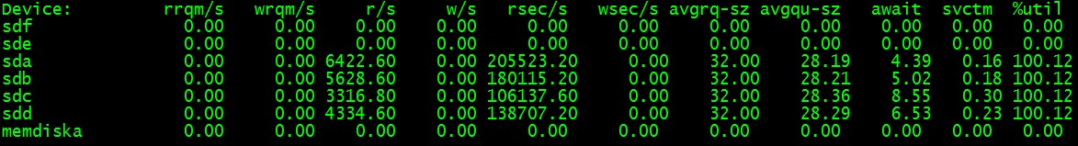
iostat

Slide 22
思考
IO depth对设备性能
有什么样的影响？

Slide 23
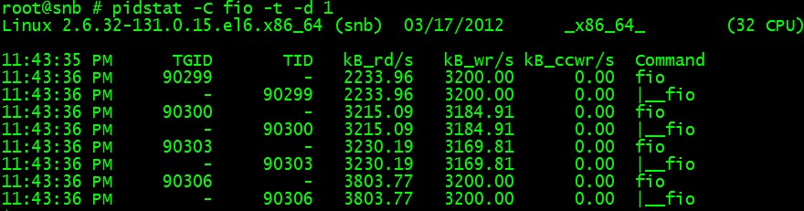
pidstat

Slide 24
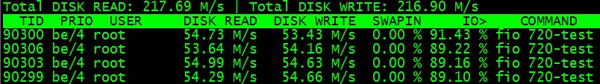
iotop

Slide 25
参考材料
Fio测试工具使用： http://blog.yufeng.info/archives/tag/fio
hwconfig查看硬件信息: http://blog.yufeng.info/archives/2086
Linux下方便的块设备查看工具lsblk http://blog.yufeng.info/archives/1882
Linux TASK_IO_ACCOUNTING功能以及如何使用: http://blog.yufeng.info/archives/2138

Slide 26
提问时间
谢谢大家！

