Slide 1
了解网络
核心系统数据库组 余锋
http://yufeng.info
@淘宝褚霸
2012-07-29

Slide 2
网卡型号
$ sudo hwconfig
Chipset: Intel 82801JIB A0 (ICH10)
Network: eth0 (bnx2): Broadcom BCM5709 Gigabit, 4c:b1:6c:8f:4a:bc, 1Gb/s <full-duplex>
Network: eth1 (bnx2): Broadcom BCM5709 Gigabit, 4c:b1:6c:8f:4a:bc, no carrier
OS: RHEL Server 6.2, Linux 2.6.32-131.21.1.tb477.el6.x86_64 x86_64, 64-bit
TCP/IP Offload Engine(TOE) for increased bi-directional throughput and performance Integrated iSCSI Host Bus Adapter(HBA) functionality Receive Side Scaling (RSS) TCP Segmentation 802.1q VLAN Tagging Link Aggregation and Load Balancing Jumbo Frames iSCSI HBA IPV6 Checksum

Slide 3
千兆网卡带宽

Slide 4
千兆网卡延迟

Slide 5
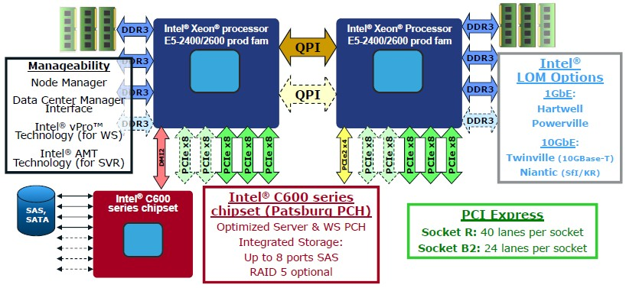
网卡新趋势(1)

Slide 6
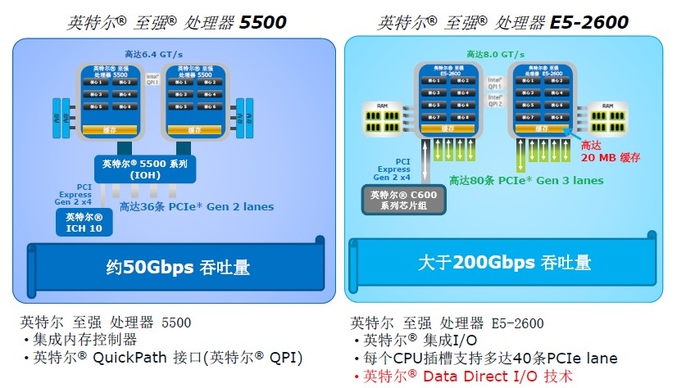
网卡新趋势(2)

Slide 7
性能必知数字
L1 cache reference 0.5 ns
Branch mispredict 5 ns
L2 cache reference 7 ns
Mutex lock/unlock 25 ns
Main memory reference 100 ns
Compress 1K bytes with Zippy 3,000 ns
Send 2K bytes over 1 Gbps network 20,000 ns
Read 1 MB sequentially from memory 250,000 ns
Round trip within same datacenter 500,000 ns
Disk seek 10,000,000 ns
Read 1 MB sequentially from disk 20,000,000 ns
Send packet CA->Netherlands->CA 150,000,000 ns

Slide 8
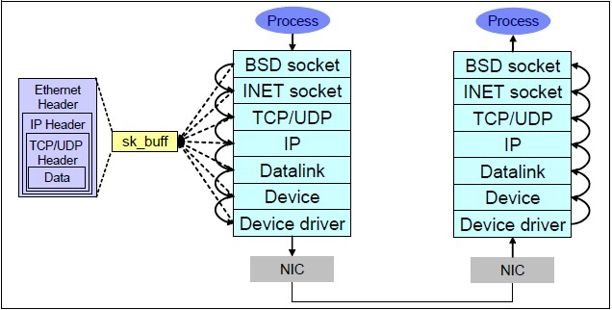
Linux网络协议栈

Slide 9
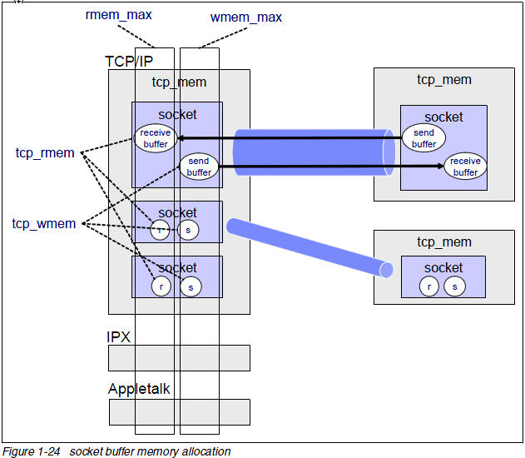
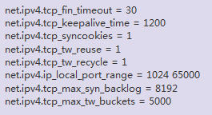
微调协议栈
原则： dmesg可以观察到协议栈在抱怨什么，它抱怨什么我们解决什么！
TCP协议栈内存 不可交换物理内存

Slide 10
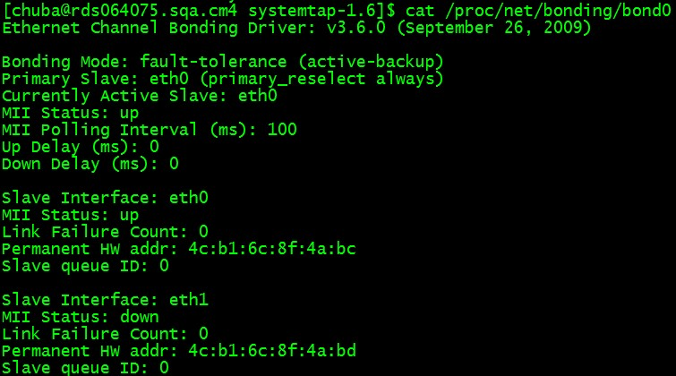
网卡bonding

Slide 11
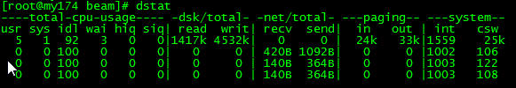


中断平衡
硬中断:
irqbalance 智能的均衡硬件中断。
手动 [root@linux /]#echo ff > /proc/irq/19/smp_affinity
软中断:

Slide 12
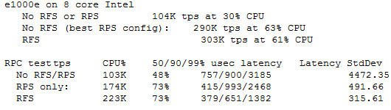
RPS/RFS 解决softirq平衡
RPS is not automatically switched on, you have to configure it.
echo ffff >/sys/class/net/eth0/queues/rx-0/rps_cpus Same for RFS if you prefer to use RFS
echo 16384 >/sys/class/net/eth0/queues/rx-0/rps_flow_cn
显著提高软中断的均衡性，大大提高性能。

Slide 13
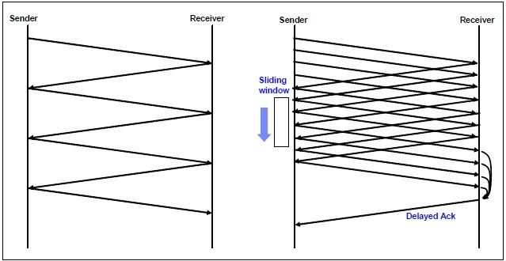
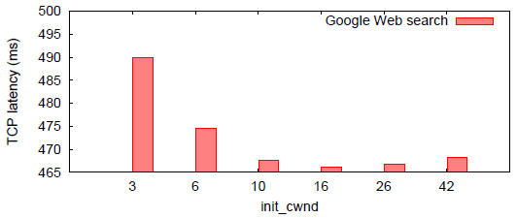
initcwnd调优
通过提高初始拥塞窗口的大小(3)，大大减少短连接的响应时间.
make sure your Linux kernel is 2.6.30 or higher.
ip route change [default via a.b.c.d dev ethX ... ] initcwnd 10

Slide 14
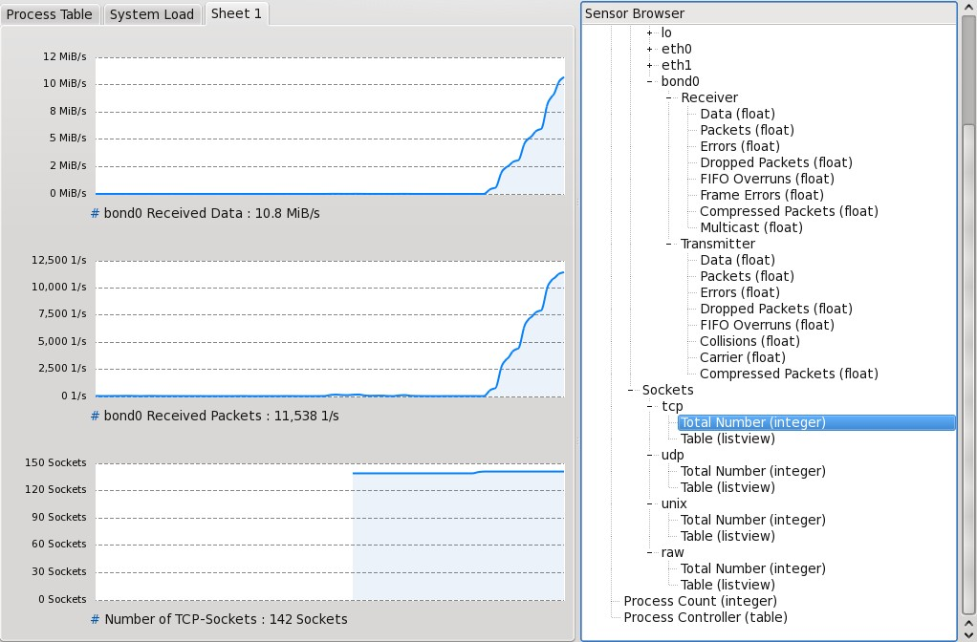
ksysguard观察网络行为

Slide 15
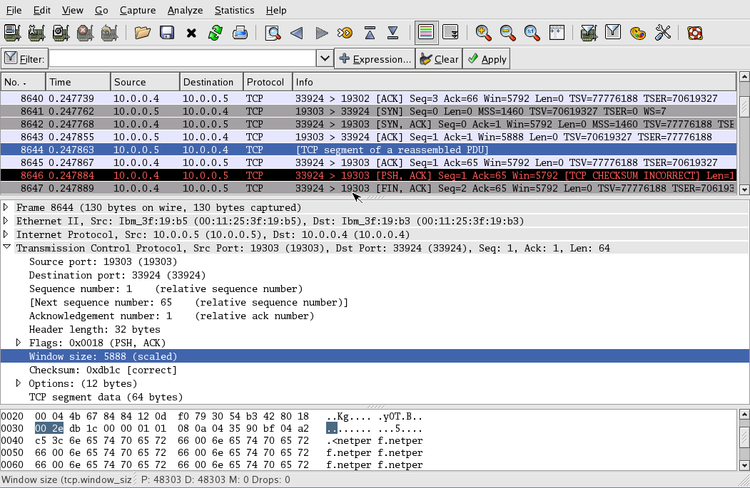
wireshark

Slide 16
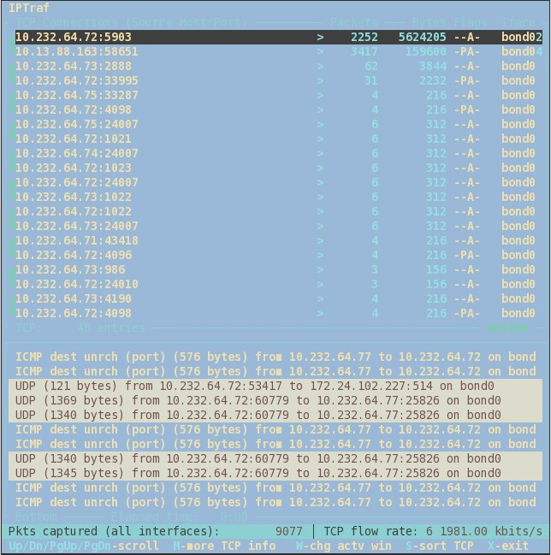
iptraf

Slide 17
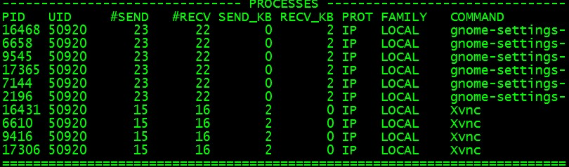
socktop
$ sudo ./socktop -f LOCAL -i 5 -d

Slide 18
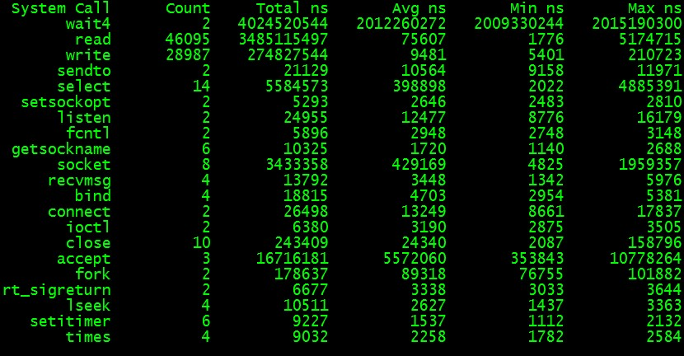
网络系统调用代价
$ sudo ./syscalltimes -n qperf -t -u chuba -p `pgrep qperf`

Slide 19
协议栈缺内存引发问题
$ sudo stap sk_stream_wait_memory.stp
1218230114875167: python(17631) blocked on full send buffer
1218230114876196: python(17631) recovered from full send buffer
1218230114876271: python(17631) blocked on full send buffer
1218230114876479: python(17631) recovered from full send buffer

Slide 20
丢包观察
$ netstat -s|grep drop
281340 outgoing packets dropped
77 packets dropped from out-of-order queue because of socket buffer overrun
7 ICMP packets dropped because they were out-of-window

Slide 21
丢包分析
$ sudo dropwatch -l kas
Initalizing kallsymsa db
dropwatch> start
Enabling monitoring...
Kernel monitoring activated.
Issue Ctrl-C to stop monitoring
1 drops at netlink_unicast+251
15 drops at unix_stream_recvmsg+32a
3 drops at unix_stream_connect+1dc

Slide 22
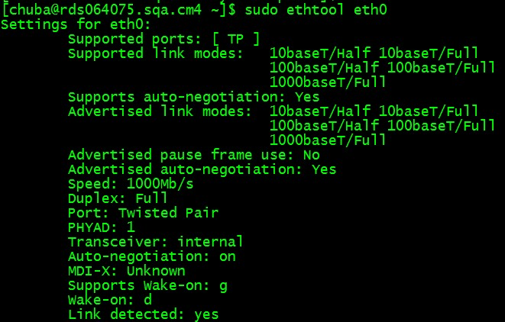
ethtool

Slide 23
提问时间
谢谢大家！

