Slide 1


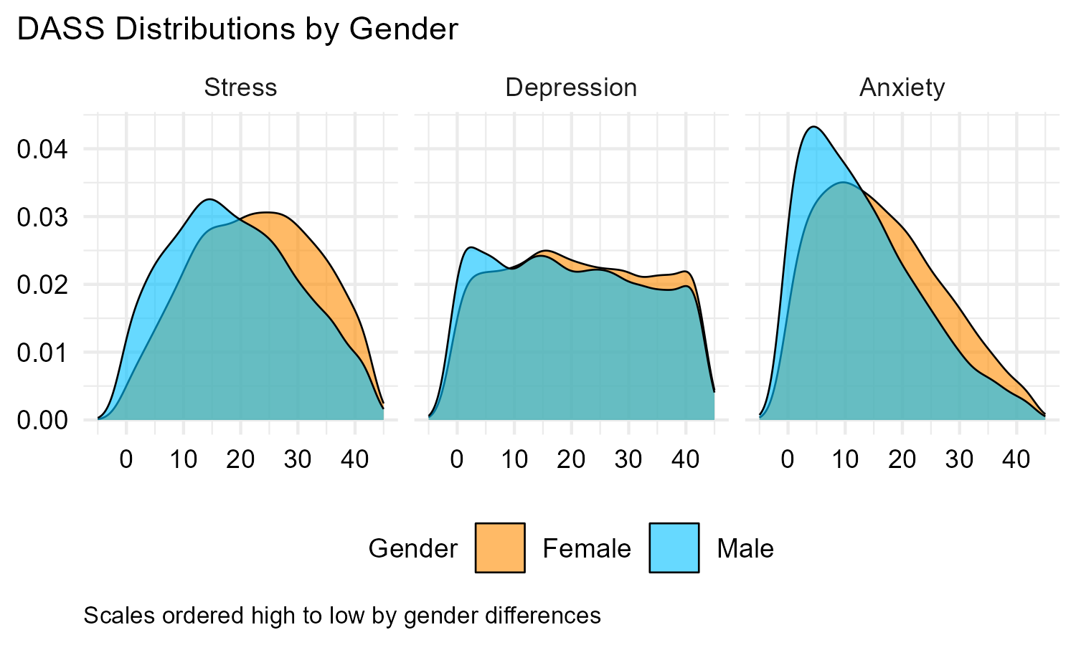
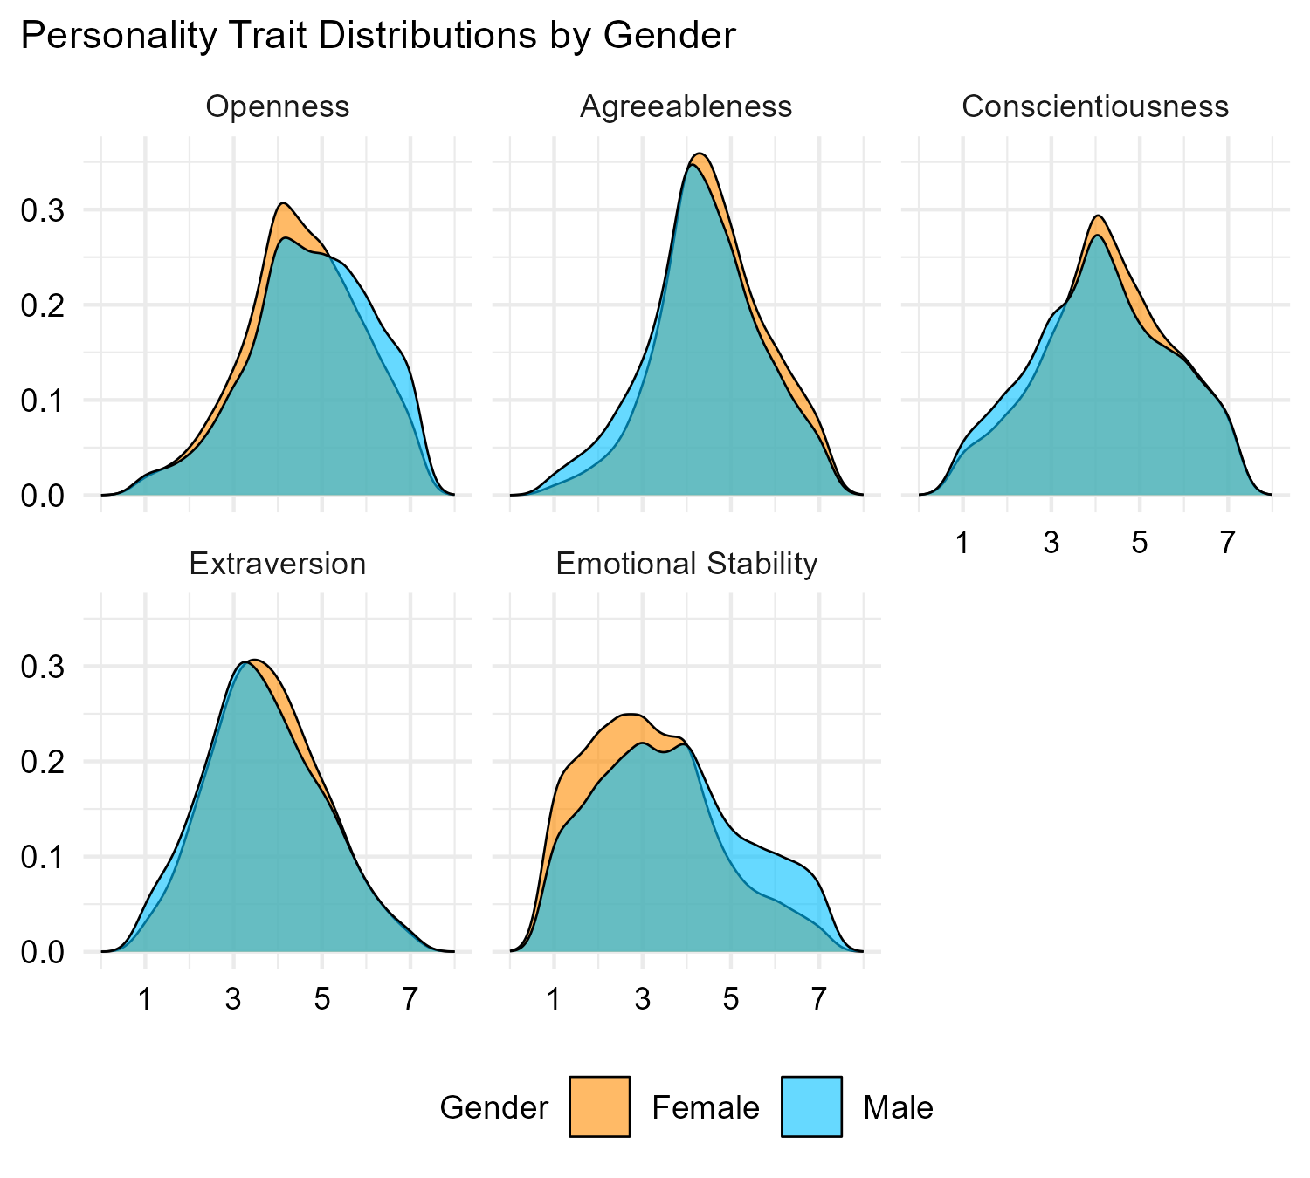
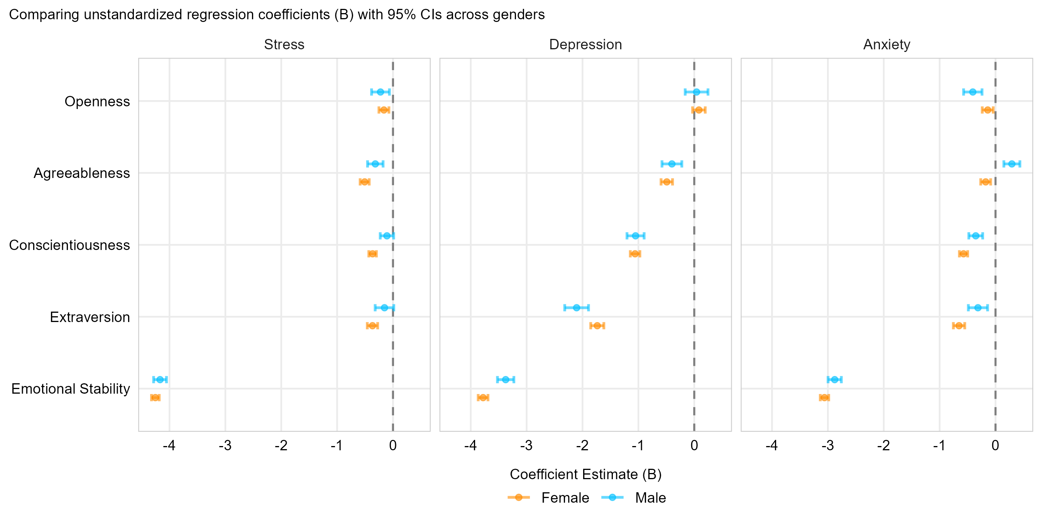





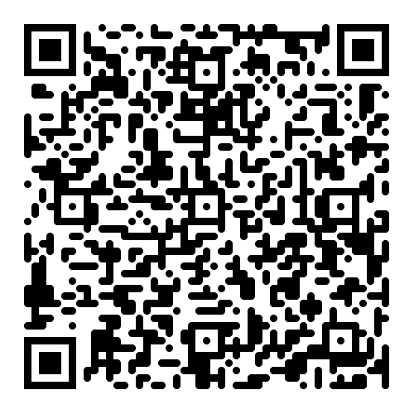
Testing Replication With Open-Source Data
Bradley Allen
DATA 510 Data Science Capstone · Summer 2026
Abstract
Results & Visualizations
Discussion, Limitations & Conclusions
This project leveraged open-source data and open-source-software for replication research in psychological science. Findings included:
Confirmatory Factor Analysis of the 21-item Depression Anxiety Stress Scale (DASS-21)
Gender differences in personality traits
Gender differences in experiencing depression, anxiety, and stress
Personality as a predictor of stress for males and females
Females rated higher on trait agreeableness and lower on emotional stability compares to males (d = .19, d = -.35).
Compared to males, females reported higher levels of depression, anxiety, and stress (d = .10, d = .31, d = .34, respectively).
Emotional stability was the most influential trait for negative emotions.
Discussion: Results supported prior findings, adding to the “credibility revolution” described by Korbmacher et al. (2023). Therefore, this study adds to the growing body of replication studies advancing the cause of repairing public trust in the psychological sciences.
Limitations & future work: This survey was conducted online and may have been completed multiple times by the same participant. Additionally, populations with limited or no access to the internet were under sampled. Results from this study will be used to isolate important features from machine models that predict depression, stress, and anxiety in males and females.
Conclusions: This study showed open-source software can be used to conduct rigorous analysis of open-source data to replicate findings from previous research, thus opening the field of psychological science to a broad swath a researchers looking to contribute to the credibility revolution.
DASS-21 & Personality Trait Distribution Plots
Introduction & Motivation
Fig 2. Distribution of personality scores by gender. The distributions show that on balance, females rate higher in trait agreeableness and lower in emotional stability than males. These differences are small to moderate, replicating previous findings.
Problem & question: In 2011, high rates of replication failure plunged psychological research into a crisis of public trust. This project aimed to repair that trust by testing replication using open-source data and open-source software.
Impact & stakeholders: Replicating findings of gender differences in personality and depression, anxiety, and stress will improve the knowledge base of clinicians who provide mental health treatment.
Fig 1. Distribution of stress, depression, and anxiety by gender. The distributions for stress and anxiety show clear differences with female scores trending higher than male scores, with similar but smaller differences for depression, replicating previous findings that females tend to experience higher average levels of stress, depression, and anxiety.
Personality Coefficient Plot for DASS-21 Indicators
References
Background & Related Work
Fig 3. Distribution of unstandardized personality coefficients. This distribution shows that emotional stability is the most influential trait for personality as a predictor of stress, depression, and anxiety for both males and females.
Furr, M. (2018). Psychometrics: An introduction (3rd ed.). SAGE Publications Inc.
Gomez, R., Summers, M., Summers, A., Wolf, A., & Summers, J. (2014). Depression Anxiety Stress Scales-21: Measurement and structural invariance across ratings of men and women. Assessment, 21(4), 418–426. https://doi.org/10.1177/1073191113514106
Gosling, S. D., Rentfrow, P. J., & Swann, W. B. (2003). A very brief measure of the Big-Five personality domains. Journal of Research in Personality, 37(6), 504–528. https://doi.org/10.1016/S0092-6566(03)00046-1
Korbmacher, M., Azevedo, F., Pennington, C. R., Hartmann, H., Pownall, M., Schmidt, K., Elsherif, M., Breznau, N., Robertson, O., Kalandadze, T., Yu, S., Baker, B. J., O’Mahony, A., Olsnes, J. Ø.-S., Shaw, J. J., Gjoneska, B., Yamada, Y., Röer, J. P., Murphy, J., … Evans, T. (2023). The replication crisis has led to positive structural, procedural, and community changes. Communications Psychology, 1, 3. https://doi.org/10.1038/s44271-023-00003-2
Lovibond, S. H., & Lovibond, P. F. (1995). Manual for the Depression Anxiety Stress Scales (2nd ed.). Psychology Foundation. https://www2.psy.unsw.edu.au/dass/
Nosek, B. A., & Errington, T. M. (2020). What is replication? PLoS Biology, 18(3), e3000691. https://doi.org/10.1371/journal.pbio.3000691
Shrout, P. E., & Rodgers, J. L. (2018). Psychology, science, and knowledge construction: Broadening perspectives from the replication crisis. Annual Review of Psychology, 69(Volume 69, 2018), 487–510. https://doi.org/10.1146/annurev-psych-122216-011845
Uliaszek, A. A., Zinbarg, R. E., Mineka, S., Craske, M. G., Sutton, J. M., Griffith, J. W., Rose, R., Waters, A., & Hammen, C. (2010). The role of neuroticism and extraversion in the stress–anxiety and stress–depression relationships. Anxiety, Stress, & Coping, 23(4), 363–381. https://doi.org/10.1080/10615800903377264
Weisberg, Y. J., DeYoung, C. G., & Hirsh, J. B. (2011). Gender differences in personality across the ten aspects of the Big Five. Frontiers in Psychology, 2. https://doi.org/10.3389/fpsyg.2011.00178
Youyou, W., Yang, Y., & Uzzi, B. (2023). A discipline-wide investigation of the replicability of Psychology papers over the past two decades. Proceedings of the National Academy of Sciences, 120(6), e2208863120. https://doi.org/10.1073/pnas.2208863120
Replication research is vital for improving our understanding of human behavior (Shrout & Rodgers, 2018, Youyou et al., 2023).
Replication with slight methodological changes yields equally rigorous results, and advances the psychological sciences (Nosek & Errington, 2020; Shrout and Rodgers, 2018).
Target studies for replication found:
Females tend to rate lower in emotional stability and higher in agreeableness compared to males (Weisberg et al., 2011);
Emotional stability is the best predictor of depression, stress, and anxiety (Uliaszek et al., 2010);
Confirmatory Factor Analysis (CFA) suggests DASS-21 is suitable for comparison of means between males and females (Gomez at al., 2014)
Data, Engineering & Ethics
Methods & Evaluation
Sources & scale: Open-Source Psychometric Project (2019). The data set contained 39,775 responses to the DASS-21 (Lovibond & Lovibond, 1995) and the Ten-Item Personality Inventory (Gosling et al., 2003).
Pipeline: CSV → cleaned in R → saved as R Markdown HTML → hosted on Git Hub
Ethics & responsible use: Data was collected and cleaned by Open-Source Psychometric Project for public use. There are no known ethical concerns.
Approach: Analyses were conducted in R using R Studio, included R’s built in independent samples t-test, and packages such as lavaan, and effectsize
Validation:
Participants who failed an attention check were removed
Given the large sample size:
Independent sample t-tests were reported by effect size
CFA was reported in terms of Comparative Fit Index (Furr, 2018)
Reproducibility
Repository: https://github.com/ballen-git/data510-capstone/tree/main/deliverables/final_deliverable

