Slide 1
Canyon parcelization

Slide 2
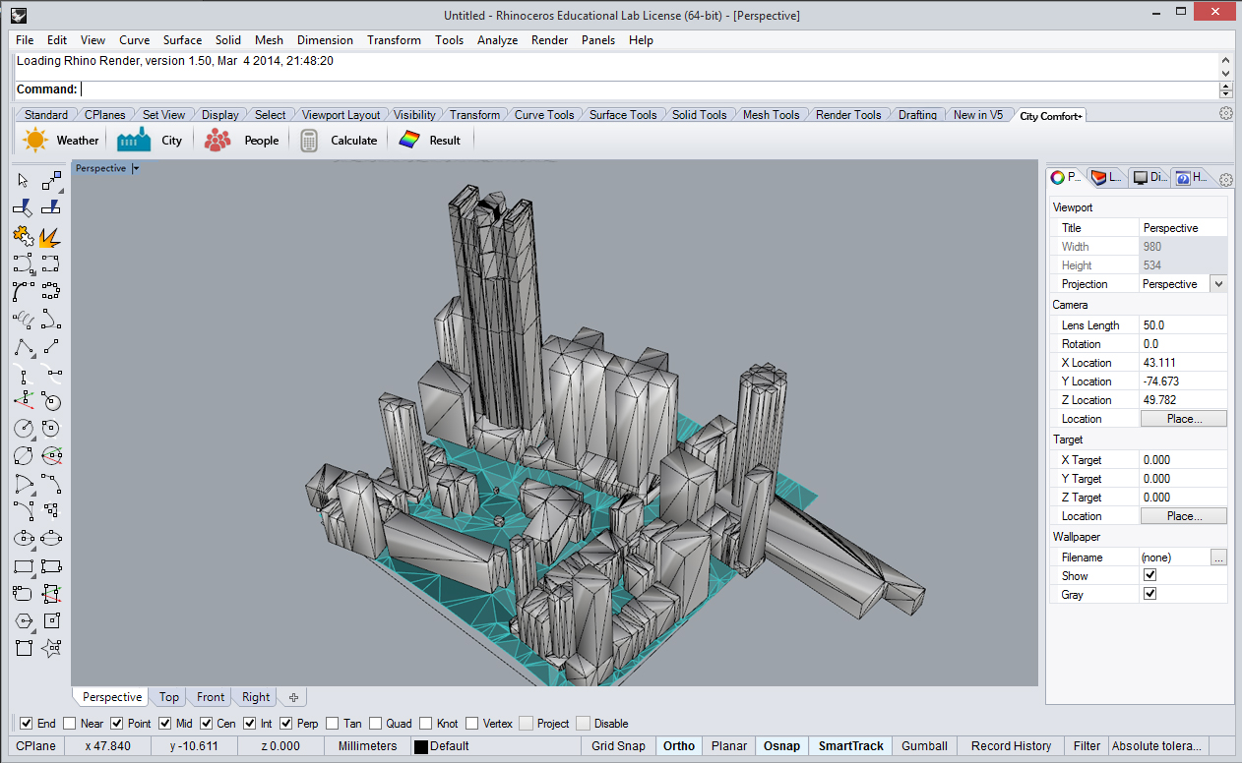
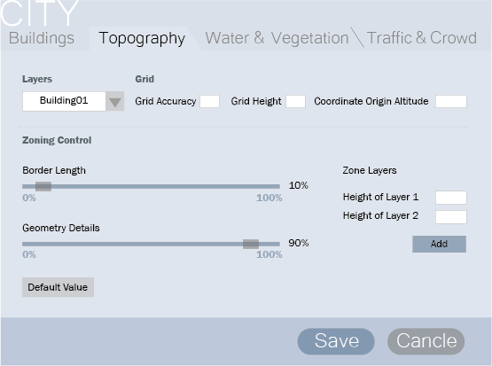

Slide 3
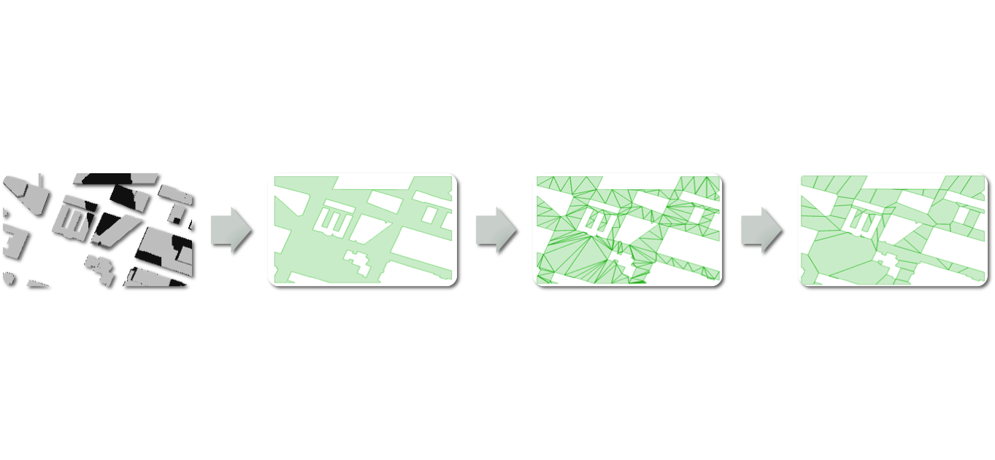
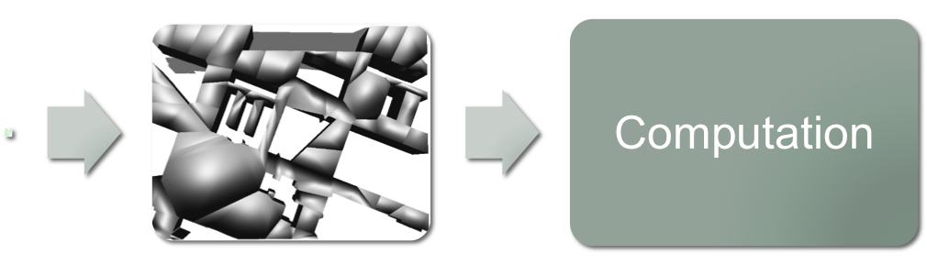
WORK FLOW
.obj file
preprocessing
triangulate
Merge into zones
Extend to 3D

Slide 4
Preprocessing
Clipper.py
Load .obj file.
Reduce dimension by intersecting the objects with the ground, then project the intersection to sea level
Select a zone to be analyzed and subtract buildings from it.

Slide 5
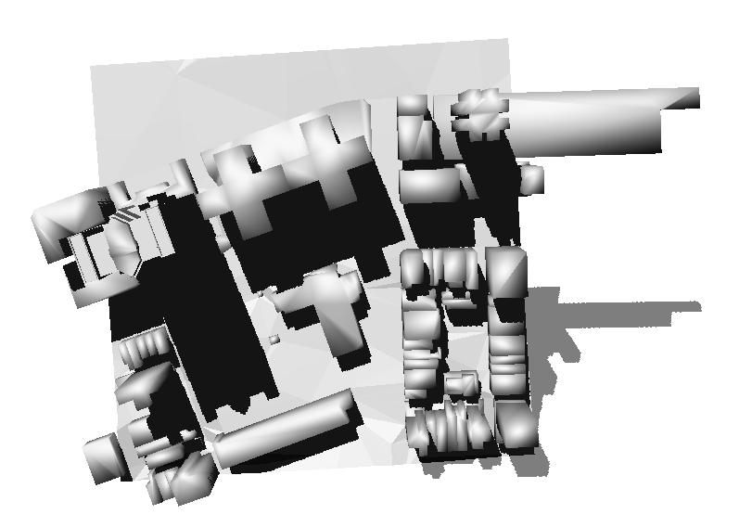
Building Geometry

Slide 6
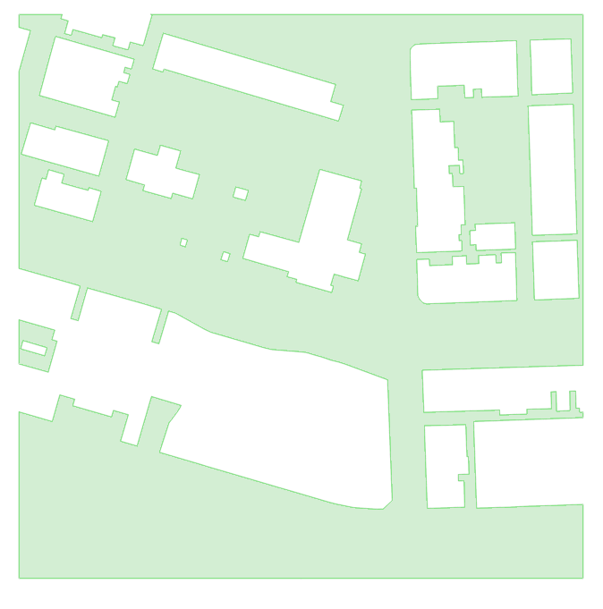
After Preprocessing

Slide 7
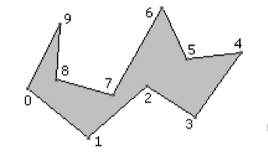
Triangulation by ear clipping
Polypartition.cpp line 377-470.
Ear of a polygon:
A triangle formed by three consecutive vertices with no other vertices inside it.
Ear clipping:
Remove one ear at a time until the remaining polygon is a triangle.
(polypartition.cpp line 429-441, start with the most extruded ear.)
ear
Non-ear

Slide 8
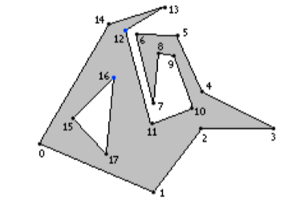
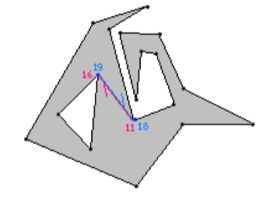
Triangulation by ear clipping with holes
Polypartition.cpp line 174-290.
When there are holes in the polygon, add two edges to cut the hole open before triangulation.

Slide 9
Triangulation by ear clipping

Slide 10
Triangulation by ear clipping
A more detailed introduction to ear clipping can be found here: http://www.geometrictools.com/Documentation/TriangulationByEarClipping.pdf

Slide 11
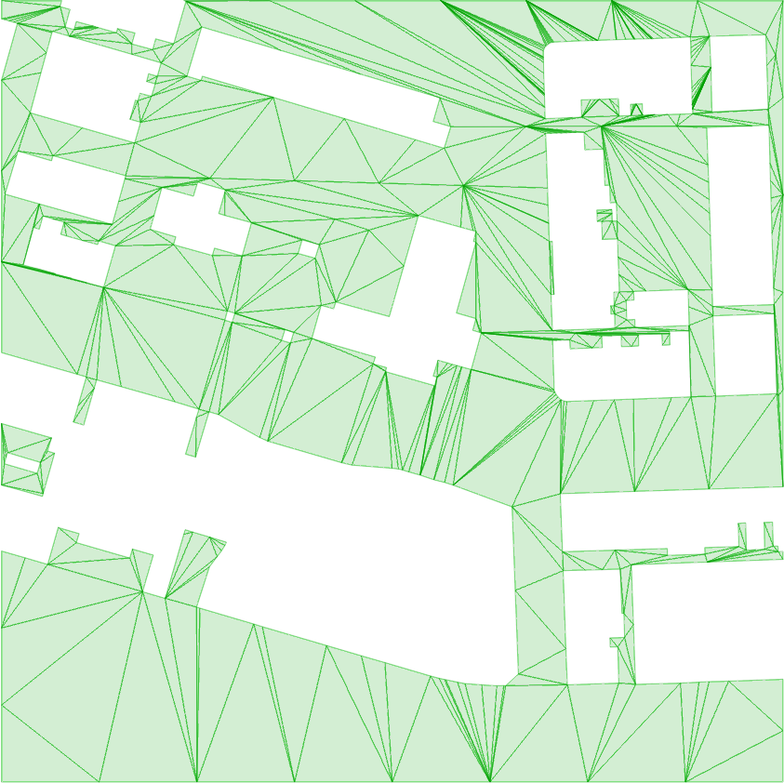
After Triangulation

Slide 12
Merging triangles (Hertel-Mehlhorn algorithm)
Polypartition.cpp line 484-589
A diagonal is essential when removing it creates a non-convex polygon.
(red: essential)
Start with a triangulation, remove an inessential diagonal, repeat.

Slide 13
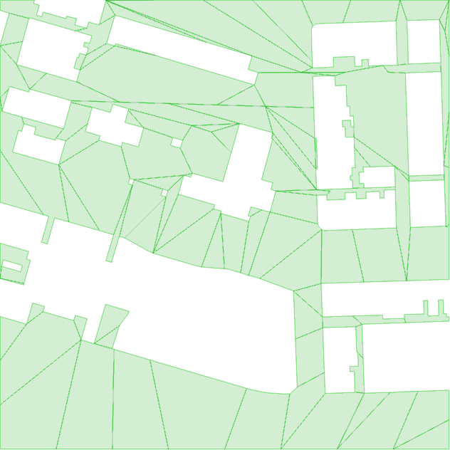
After Merging

Slide 14
Fine Tuning

Slide 15
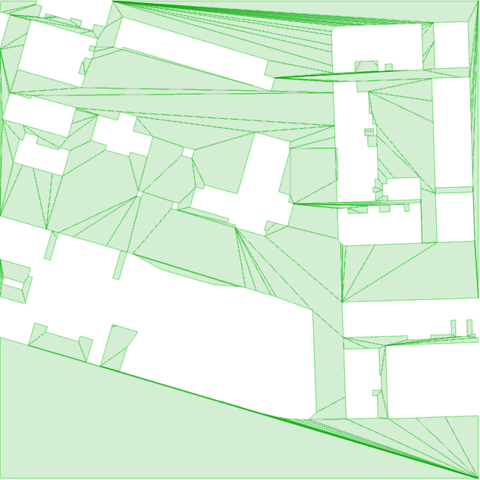

Geometry Details
0.5%
5%

Slide 16
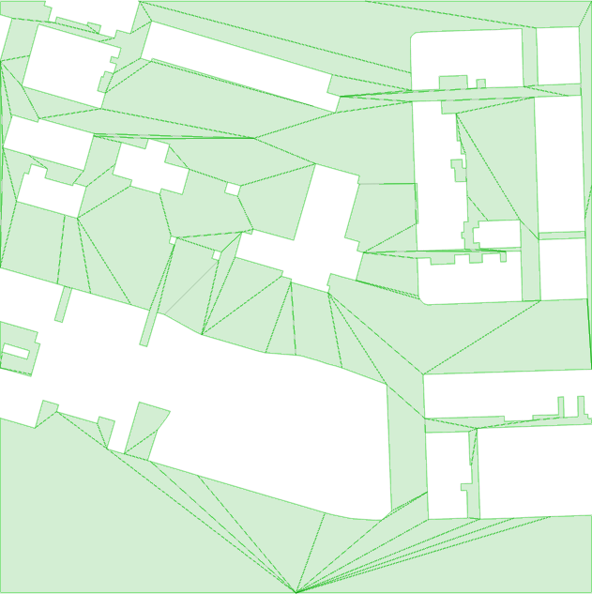
Border Length
50%
13%

Slide 17
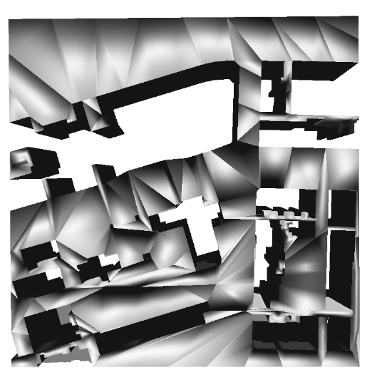
Extend to 3D
User Input: Number of layers and the height of each layer

Slide 18
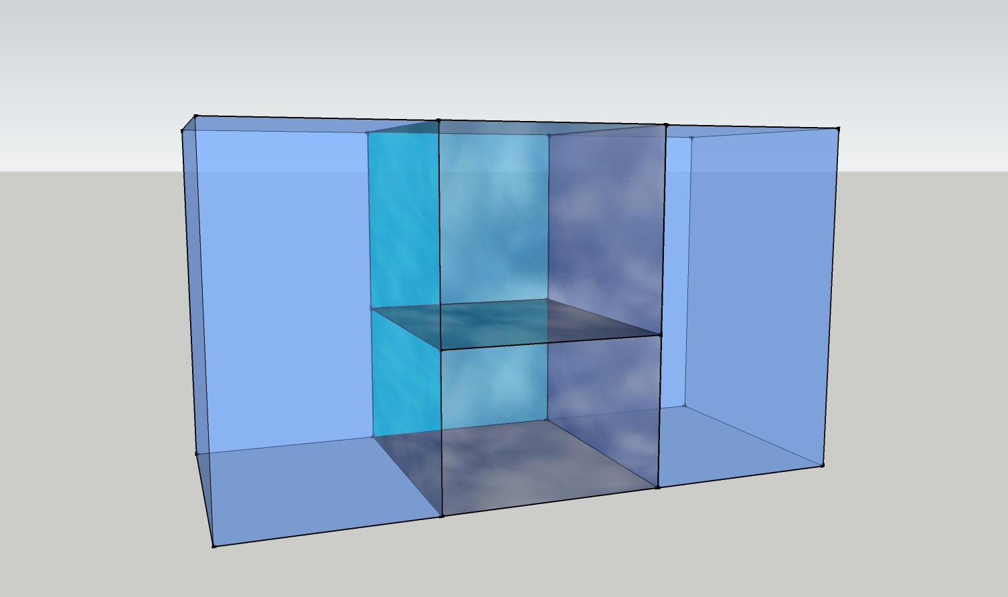
Calculation
Volume of each zone
Area of shared surface
Zone 1_2
Building 1
Building 2
Zone 1_1
Ground
Footprint of each zone

