Slide 1


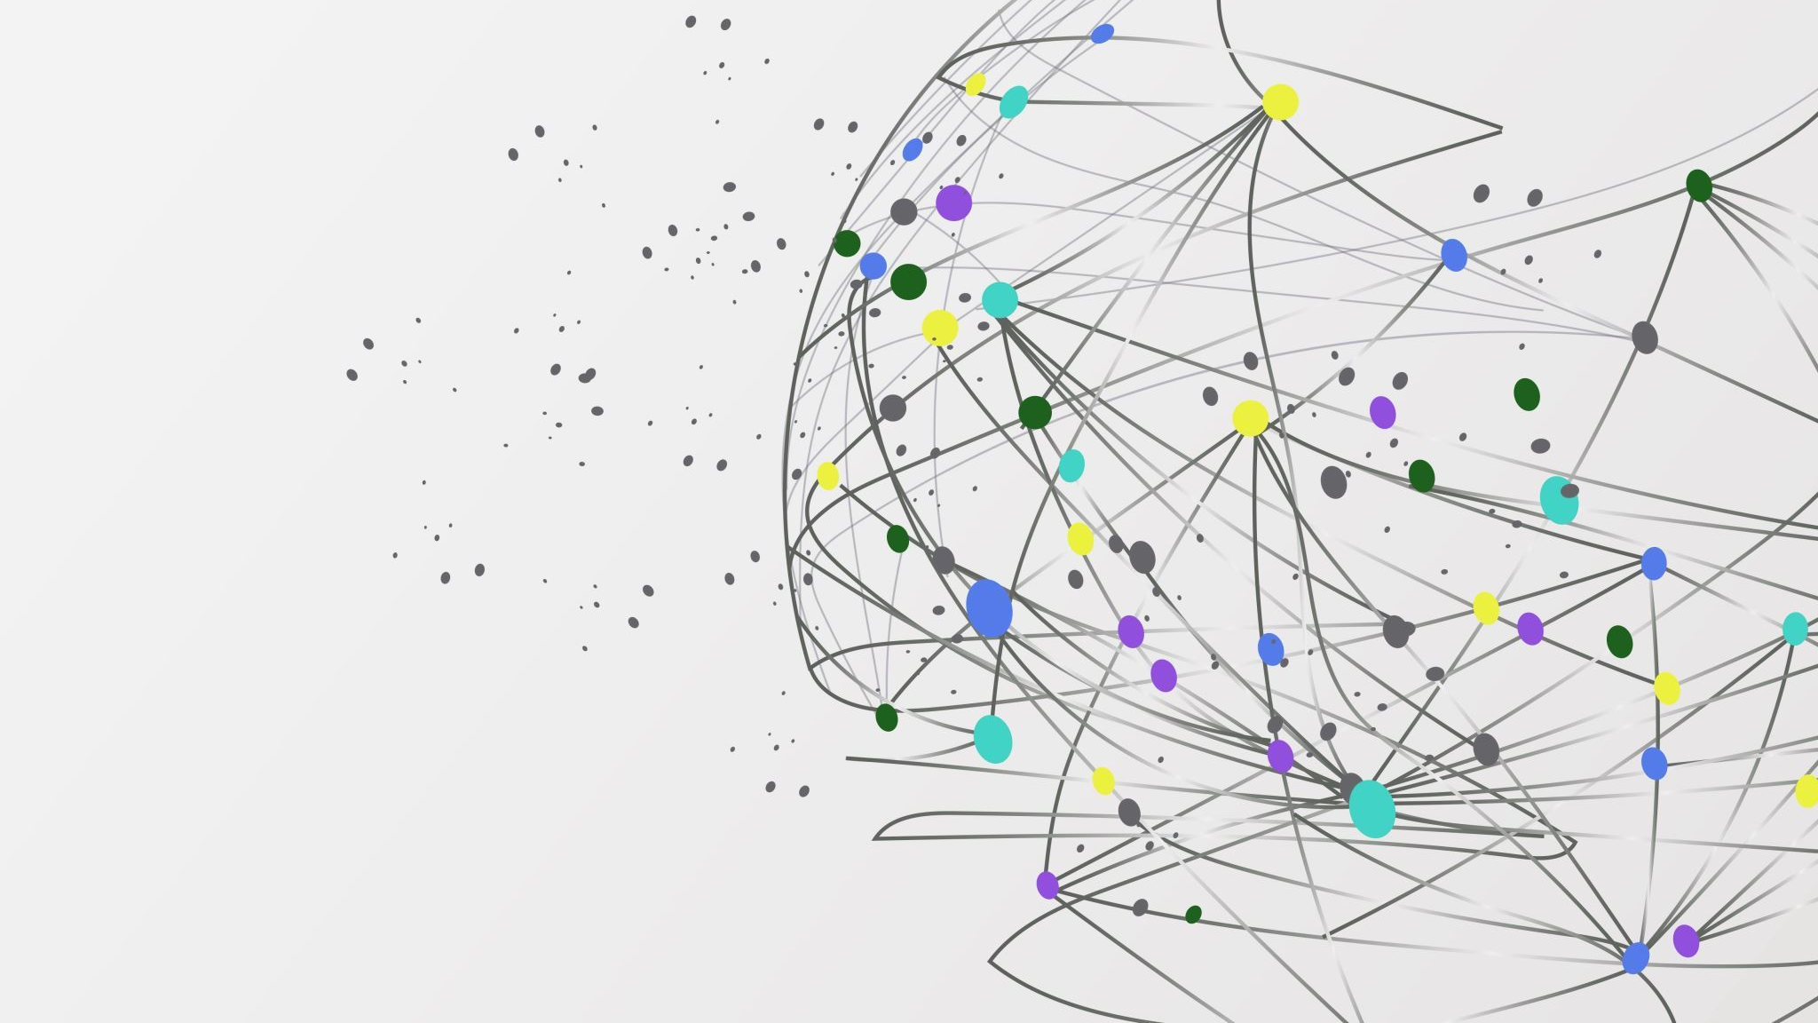
KAIJU

Slide 2
Contents
Introduction
Command Lines
Webserver – KBase & Kaiju
Discussing the Outputs

Slide 3
Intro to Kaiju
Kaiju is a novel metagenome classifier designed for fast and sensitive taxonomic classification of metagenomic sequences.
Utilizes protein-level sequence comparison using the Burrows-Wheeler Transform for maximum exact matches.
Addresses the issue of evolutionary divergence, which affects the sensitivity of k-mer-based classification methods.
Demonstrates improved classification performance, especially for genera underrepresented in reference databases, leading to classification of a larger fraction of metagenomic reads.
Designed to be efficient, capable of processing millions of reads per minute on standard PC hardware.

Slide 4
Advantages
Higher sensitivity compared to current k-mer-based classifiers, with similar or improved precision.
Superior at classifying reads from genera with few or no genomes in reference databases, addressing a common limitation of existing methods.
Offers a web server and freely available source code for accessibility.
Requires significantly less memory and computational resources, making it feasible for use on standard computers.
Demonstrates a substantial increase in the number of classified reads in real metagenomic datasets compared to competitors like Kraken and Clark.

Slide 5
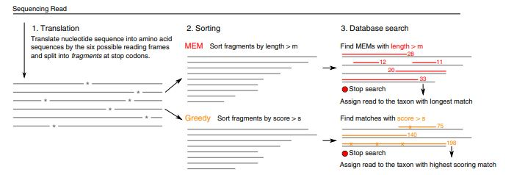
Kaiju Algorithm
Source: https://www.nature.com/articles/ncomms11257

Slide 6
Kaiju Algorithm
Step 1: Metagenomic Read Processing
Kaiju starts by translating each metagenomic read into the six possible reading frames, and these amino acid sequences are then split into fragments at stop codons.
Step 2: Fragment Sorting and Querying
MEM Mode: Fragments are sorted by length and queried against the reference database using backward search in the BWT. Only exact matches (MEMs) longer than a minimum length (m) are considered.
Greedy Mode: Sorts fragments based on BLOSUM62 score, allowing for amino acid substitutions during the backward search to extend matches at their ends.
Notes:
For Reference

Slide 7
Cont'd..
Step 3: Database Search
Performs backward search in the BWT to find maximal exact matches (MEMs) between query fragments and the database sequences.
The search algorithm quickly identifies sequences in the database that share the longest subsequence with the query.
Step 4: Taxonomic Classification
Once a match or matches are found, the taxonomic identifier from the corresponding database sequence is retrieved and printed to the output.
If equally long matches are found in multiple taxa, Kaiju determines their lowest common ancestor (LCA) from the taxonomic tree and outputs its taxon identifier.
Notes:
For Reference

Slide 8
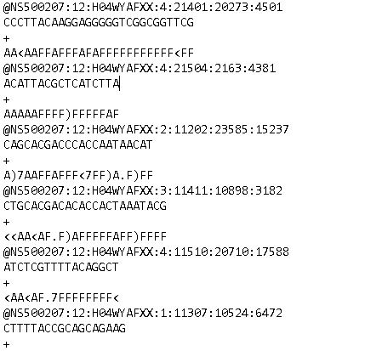
Understanding the Dataset
Dataset: evol1.sorted.unmapped.R1.fastq
R1: Specifies that the file contains the first read of paired-end sequencing data.
unmapped: Indicates that the reads in this file did not align or map to a reference genome
First Line: Starts with '@' followed by a sequence identifier and an optional description. Here: @NS500207:12:H04WYAFXX:4:21401:20273:4501 is an identifier indicating the instrument, run number, flow cell ID, and coordinates among other details.
Second Line: Contains the nucleotide sequence (DNA or RNA). Here - CCCTTACAAGGAGGGGGTCGGCGGTTCG.
Third Line: Begins with a '+' and may be followed by the same sequence identifier (optional) and a description.
Fourth Line: Represents the quality scores for each nucleotide in the sequence, encoded as ASCII characters ( AA<AAFFAFFFAFAFFFFFFFFFFF<FF).
Snippet of the Dataset as viewed on Notepad
Total Reads: 18,753
Average Read Length: 24 nt
Minimum Read Length: 15 nt
Maximum Read Length: 150 nt

Slide 9
Cont'd..
"@NS500207:12:H04WYAFXX:4:21401:20273:4501". This identifier contains specific components that are characteristic of Illumina sequencing output:
Instrument ID (e.g., NS500207): Indicates the specific Illumina sequencer that generated the reads.
Run Number (e.g., 12): A unique identifier for the sequencing run.
Flow Cell ID (e.g., H04WYAFXX): Identifies the flow cell used for the sequencing run.
Lane (e.g., 4): Specifies the lane of the flow cell where the sample was sequenced.
Tile Number (e.g., 21401): Indicates the tile within the lane where the reads were generated.
X and Y Coordinates (e.g., 20273:4501): Provide the position of the read within the tile.
Notes:
For reference

Slide 10

Running Kaiju on Linux
Download Kaiju locally or create a Kaiju container
Download a database you want to use
$ wget <database URL>
$ tar xzf <database.tar>
Or create a database index locally
$ singularity run /ifs/groups/eces450650Grp/containers/kraken-kaiju.sif kaiju-makedb -s <database>

Slide 11
Running Kaiju on Linux
Once done, the directory containing your database should have 3 files
kaiju_db_<database>.fmi
nodes.dmp
names.dmp
Run the following command:
$ singularity run /ifs/groups/eces450650Grp/containers/kraken-kaiju.sif kaiju –t nodes.dmp –f kaiju_db_<database>.fmi –i evol1.sorted.unmapped.R1.fastq

Slide 12
Running Kaiju on Linux
Pros
Cons
Very customizable
Allegedly much faster than the webserver
Much larger selection of databases
Needs very large storage space and RAM (204 GB for nr+euk)
Expect there to be many errors

Slide 13

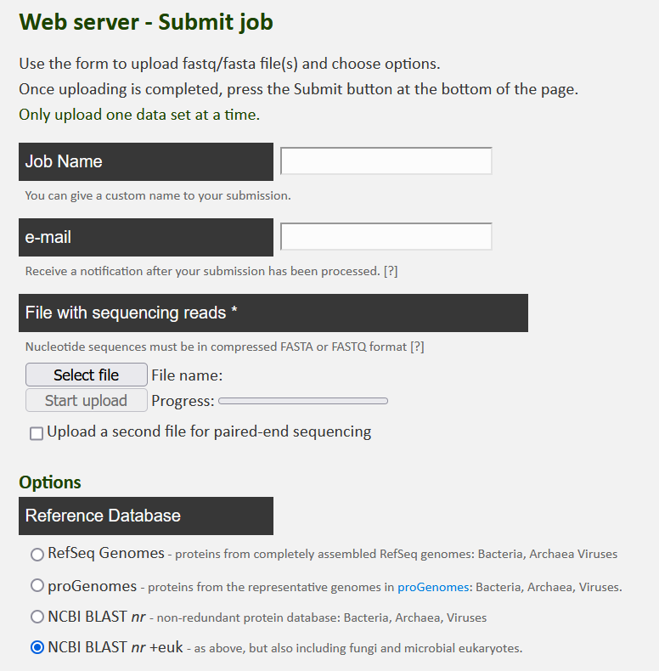
Kaiju Webserver

Slide 14
Kaiju Webserver
Upload a G-zipped FASTA or FASTQ file
Choose a reference database
We used the RefSeq Genomes and NCBI BLAST nr + euk databases
Choose a run mode
Mem or greedy
Adjust other settings

Slide 15
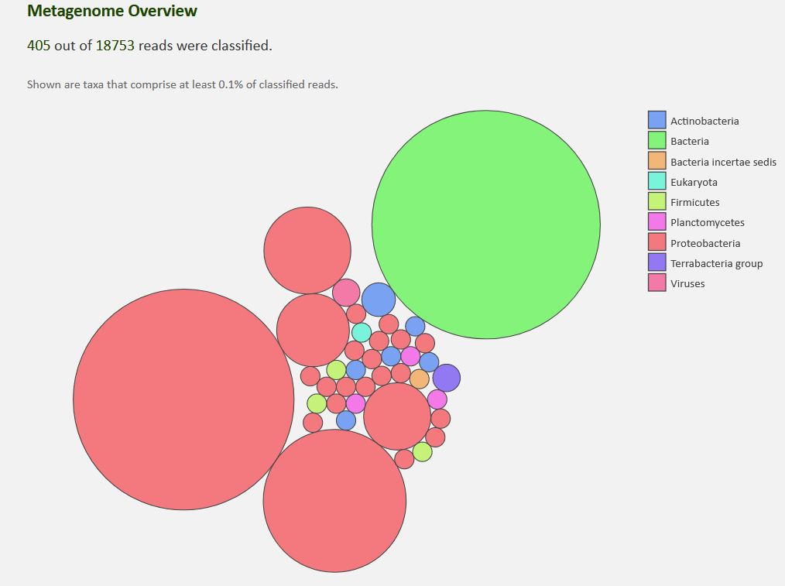
Kaiju Webserver
Job Parameters
Job ID: 16185-2317974664
Job Name: tutorial11
Reference database: nr +euk
Database date: 2021-03
SEG low complexity filter: yes
Run mode: greedy
Minimum match length: 11
Minimum match score: 75
Allowed mismatches: 5
Max. E-value: 0.01
https://kaiju.binf.ku.dk/output/16185-2317974664/krona.html

Slide 16
Kaiju Webserver
Pros
Cons
User friendly
Customizable
Works well will little to no error
Interesting visual results
Fewer available databases
Runs very slowly (over 2 weeks per job)

Slide 17
Kaiju Webserver Vs KBase
Features | KBase | Webserver
Reference Database Options | Offer 8 | Offers 4
Taxonomic Level | Available to select | Not Available
Low Abundance Filter | Range from 0 to 10 | Not Available
Low Abundance Filter | 1% to 100% | Not Available
Subsample Replicates | Available to set replicates | Not Available
Subsample Seed | Available to set a seed for subsampling | Not Available
Filter Low-Complexity | Available | SEG Filter Available
Min Match Length | Available with min. 9 | Available with min. 7
Allow Imperfect Matches? | Selectable b/w Greedy or MEM | Selectable b/w Greedy or MEM
Greedy Parameters | Allows setting max mismatches, min bitscore, and max E-value | Allows setting minimum match score, allowed mismatches, and max E-value
Sorting Option | Available | Not Available
Time to process | 10 mins to 1 hour | About 14 days

Slide 18
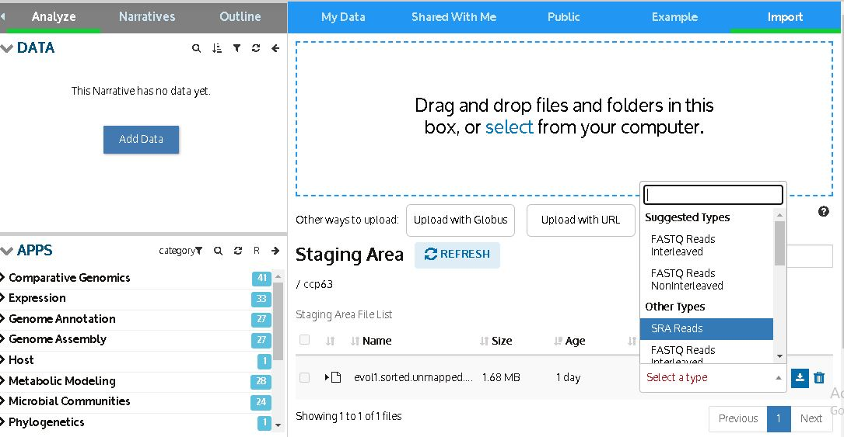
Kaiju on KBase – Data Import

Slide 19
Comparisons
Greedy + NCBI BLAST nr+euk
Greedy + RefSeq
MEM + NCBI BLAST nr+euk
MEM + RefSeq

Slide 20
Parameters:
Features | Description
Taxonomic Level | Select one or more taxonomic levels to include in the summary plots.
Reference DB | Select the reference database to search against for classification.
Low Abundance Filter | Select to filter out taxa with low abundances, e.g. only show genera that comprise at least this percent of the total reads (default is 0.5%).
Subsample Percent | Subsample each data set to run faster.
Subsample Replicates | Add replicates to determine the robustness of measurement.
Subsample Seed | Set the seed for random subsampling.
Filter Low-Complexity | Use the SEG algorithm to remove low-complexity regions from input sequences (recommended).
Min Match Length | The shortest alignment match to use for classification, in base pairs (default is 11).
Allow Imperfect Matches? | Imperfect matches can be used for classification with below thresholds (recommended).
Greedy Max Mismatches | Greedy (imperfect) match maximum mismatches (default is 3 - used to be 5).
Greedy Min Bitscore | Greedy (imperfect) match minimum bitscore (default is 65 - used to be 75).
Greedy Max E-value | Greedy (imperfect) match maximum e-value (default is 0.01 - used to be 0.05).
Sort Plots by | Show abundance plots sorted either by alphabetical of taxa or by total abundance (def is total abundance).

Slide 21
Parameters Used for all tests
For the MEM mode, a minimum match length of 11 amino acids (a.a.) was chosen.
In the Greedy modes, a minimum required match score of 65 was utilized.
Notes:
For the MEM mode, a minimum match length of 11 amino acids (a.a.) was chosen. This parameter setting was based on the observation that a significant percentage of correct classifications (more than 95%) involved matches longer than 11 amino acids.
In the Greedy modes, a minimum required match score of 65 was utilized. This value was selected to avoid random matches, with the understanding that a score of 65 strikes a good balance between sensitivity and precision. This score threshold was established by analyzing the classification performance using a shuffled database to estimate the likelihood of random matches

Slide 22
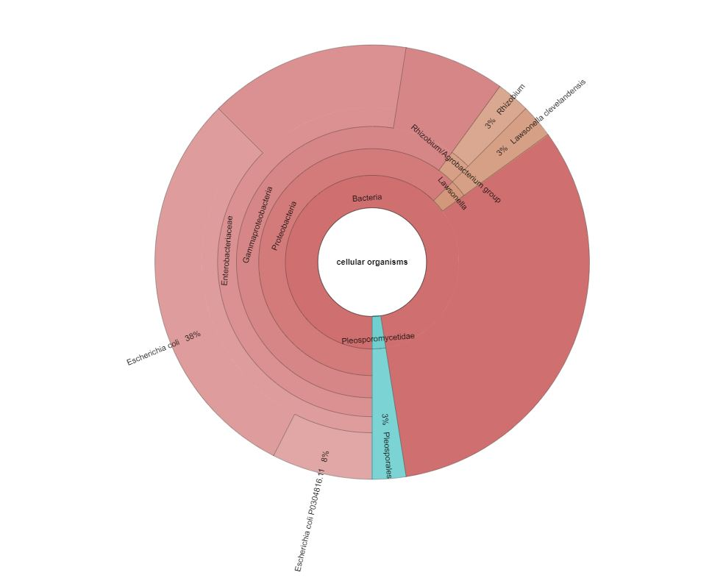
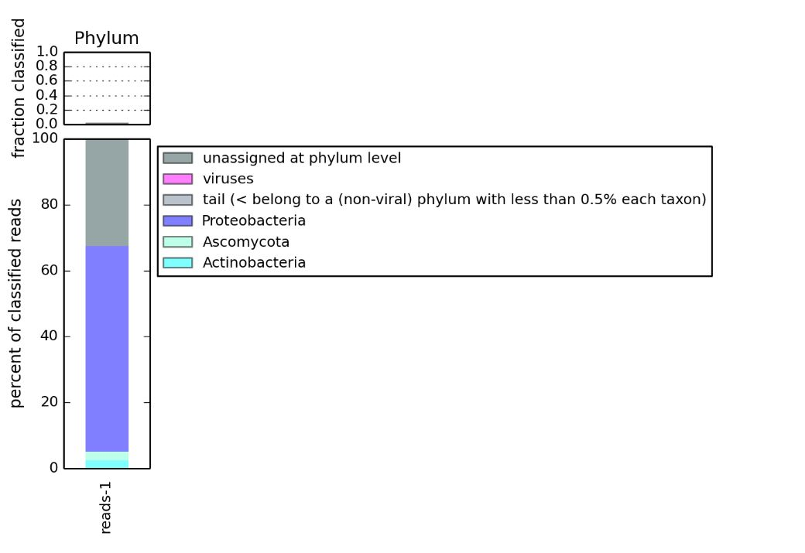
Greedy Mode & NCBI BLAST nr + euk
Krona Plot
Stacked Bar Plot

Slide 23

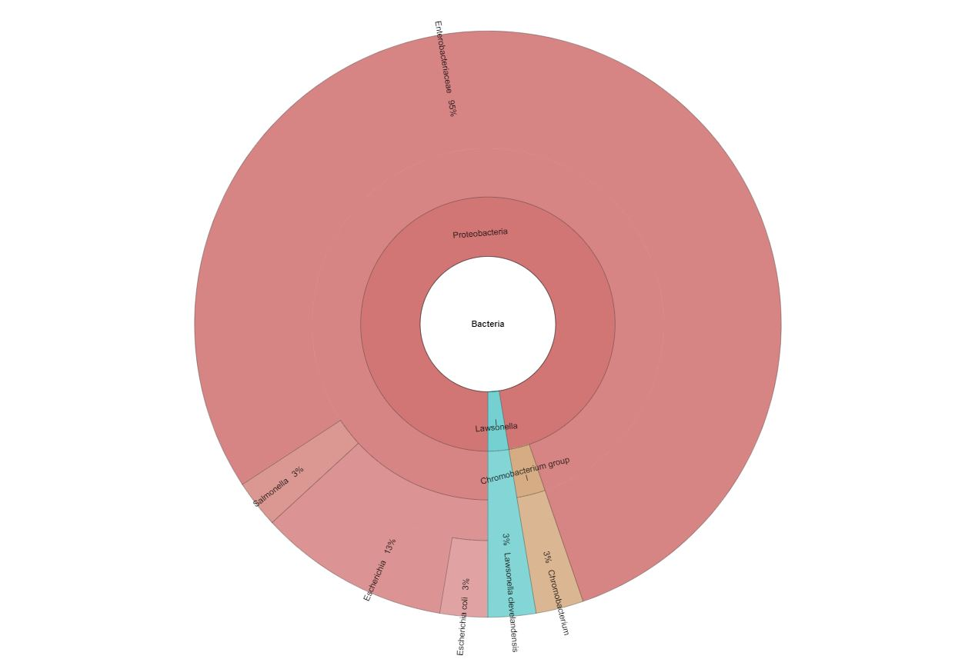
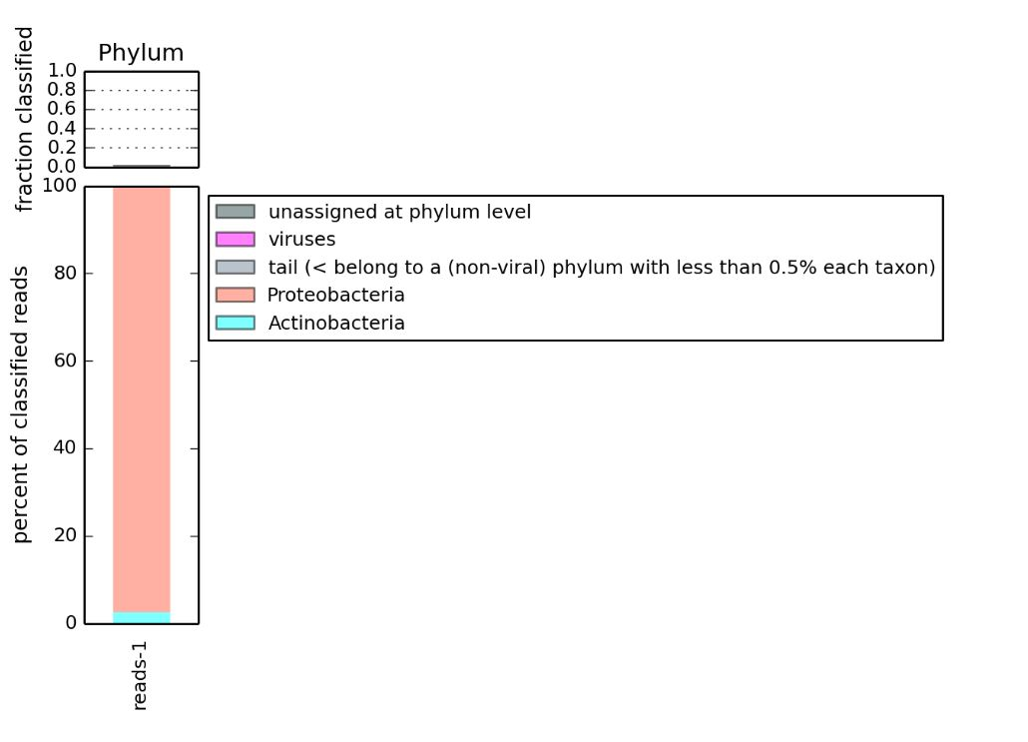
Greedy Mode & RefSeq

Slide 24
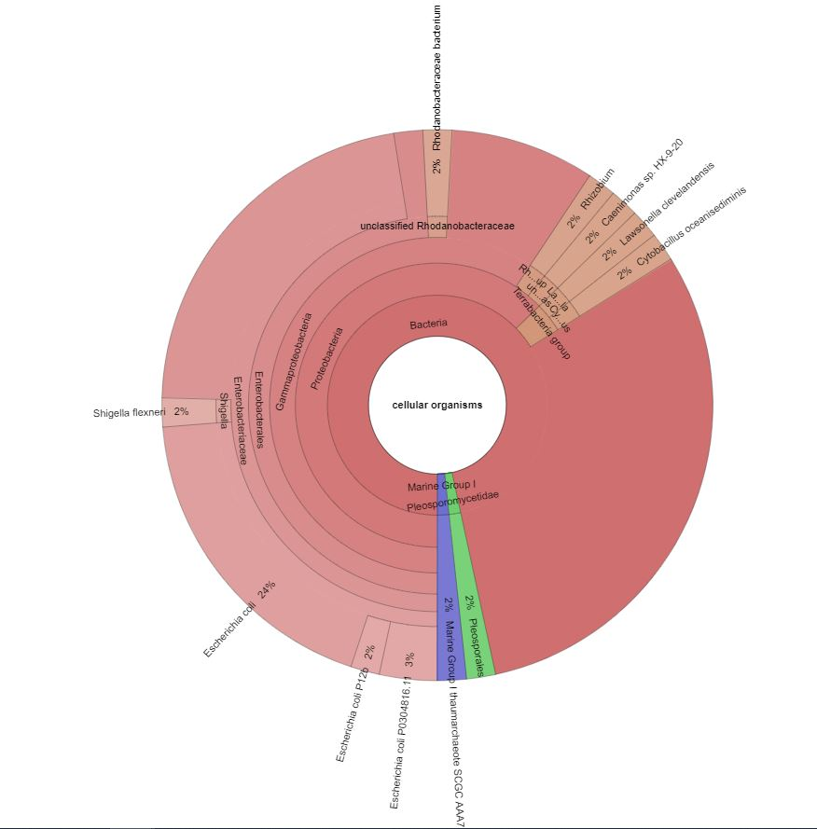
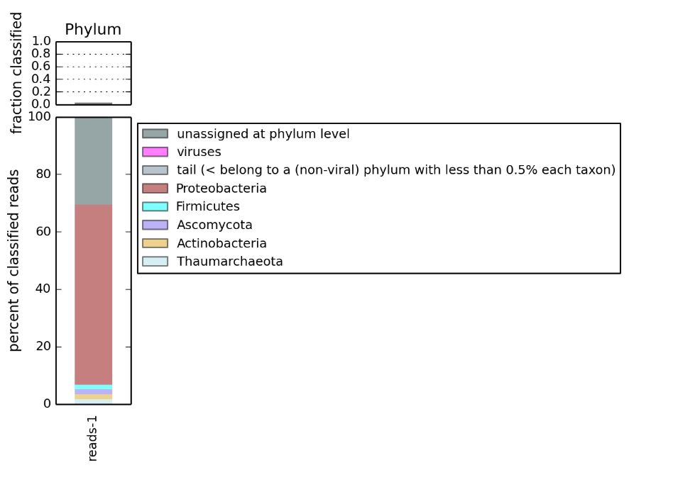
MEM & NCBI BLAST nr + euk

Slide 25
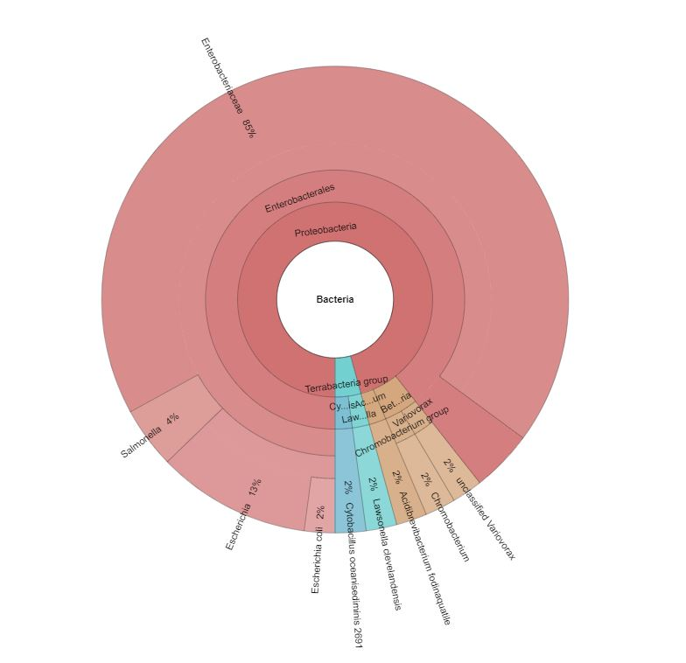
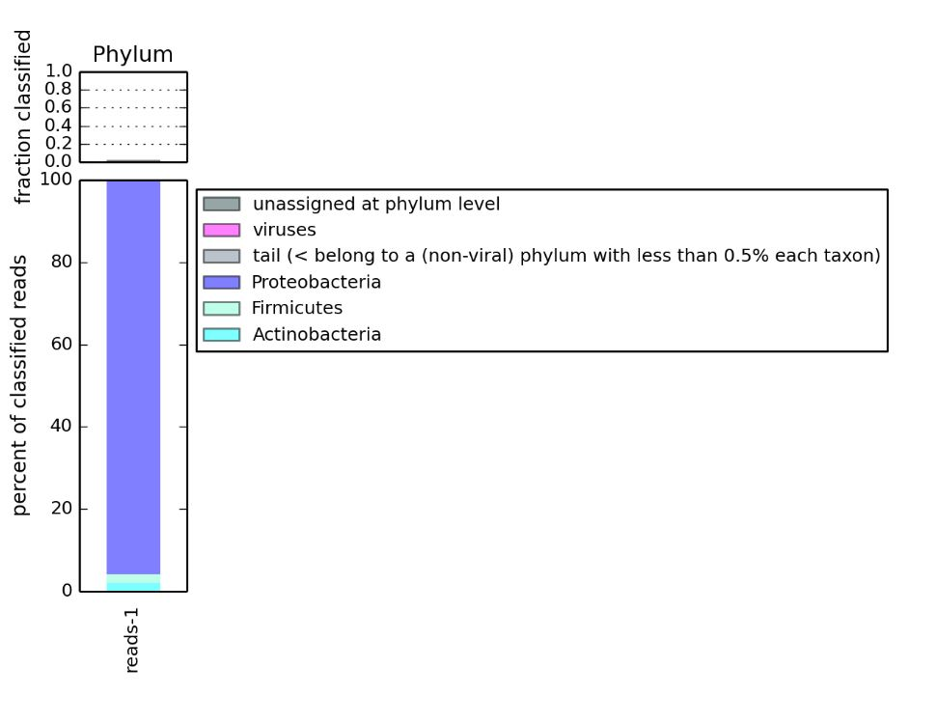
MEM & RefSeq

