Slide 1
PipeRewind
A Time-Travel Debugger for UNIX Shell Pipelines
Luiz Takahashi, Ehzoc Chavez, & Jesse Perez
Washington State University • Systems Programming • Spring 2026
github.com/balloonjazz/Pipe-Rewind

Slide 2
Part 1: Elevator Pitch
Project Goals • Course Themes • Architecture Overview

Slide 3
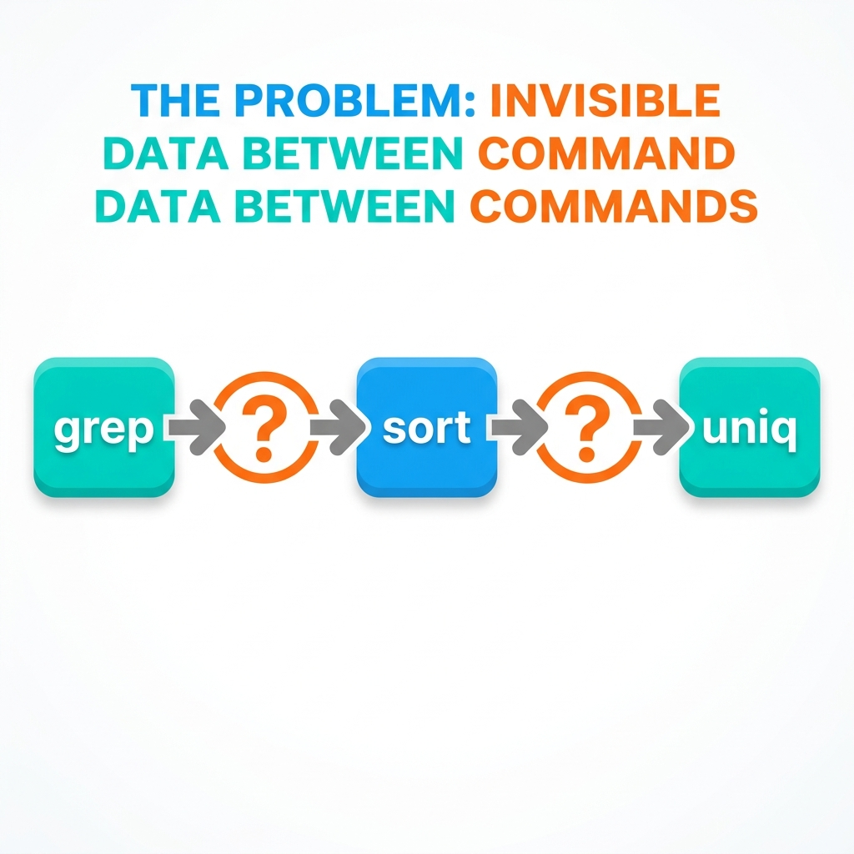
The Problem: Pipelines Are Opaque
When a UNIX pipeline fails, you only see the final output.
$ cat log.txt | grep ERROR | sort | uniq -c
(nothing)
Where did the data disappear?
• Was the file empty?
• Did grep filter everything?
• Did sort crash?
Traditional workarounds:
• tee — requires modifying the pipeline manually
• strace — drowns you in thousands of syscalls
• printf debugging — destroys pipeline transparency

Slide 4
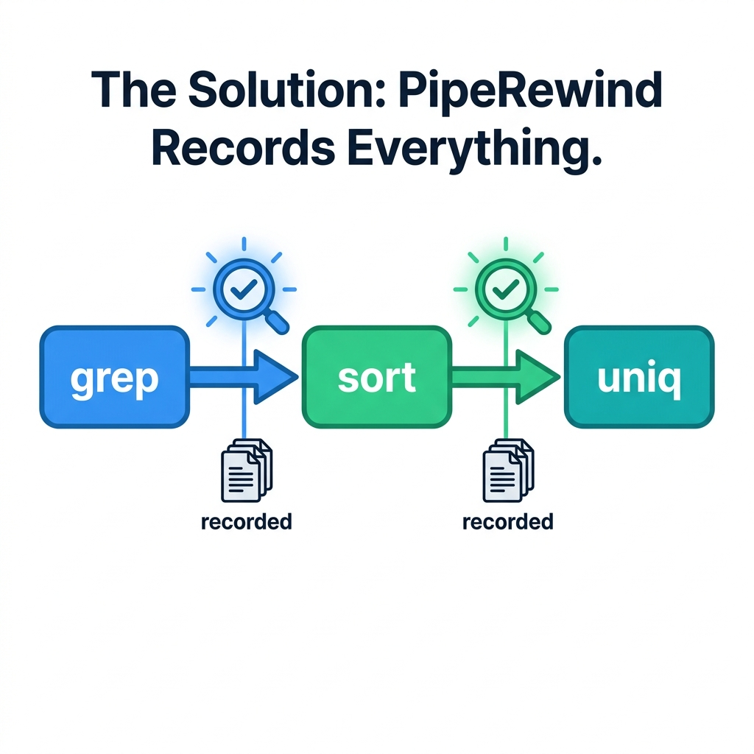
The Solution: PipeRewind
PipeRewind sits between every pair of commands, recording every byte with precise timestamps.
Fully transparent — same output, zero code changes.
Record → Replay → Understand.
• Captures DATA_IN, DATA_OUT, PROC_START, PROC_EXIT events
• Nanosecond timestamps via CLOCK_MONOTONIC
• Binary .prt trace format with random-access index
• Interactive ncurses TUI replay with time-scrubbing

Slide 5
Systems Programming Themes
Process Control
• fork() / execvp() to spawn stages
• waitpid() for lifecycle management
• SIGCHLD handling and exit codes
Event-Driven Concurrency
• epoll_create / epoll_ctl / epoll_wait
• Non-blocking O_NONBLOCK file descriptors
• Single-threaded multiplexing of N pipes
System-Level I/O
• Raw read() / write() on kernel pipes
• dup2() for stdin/stdout redirection
• fwrite() / fseek() for binary trace I/O
pipeline.c • capture.c
capture.c
capture.c • trace.c
Process Scheduling Observation
• /proc/[pid]/status polling
• Detect Running / Sleeping / Blocked
• Real-time state displayed in TUI
POSIX Threading
• pthread_create for live-mode capture
• Shared trace file between threads
• fflush() synchronization strategy
Binary File Formats
• Custom .prt header/event/index layout
• Random-access via terminal index table
• Dynamic index reallocation for live mode
procstate.c • tui.c
tui.c (tui_run_live)
trace.h • trace.c

Slide 6
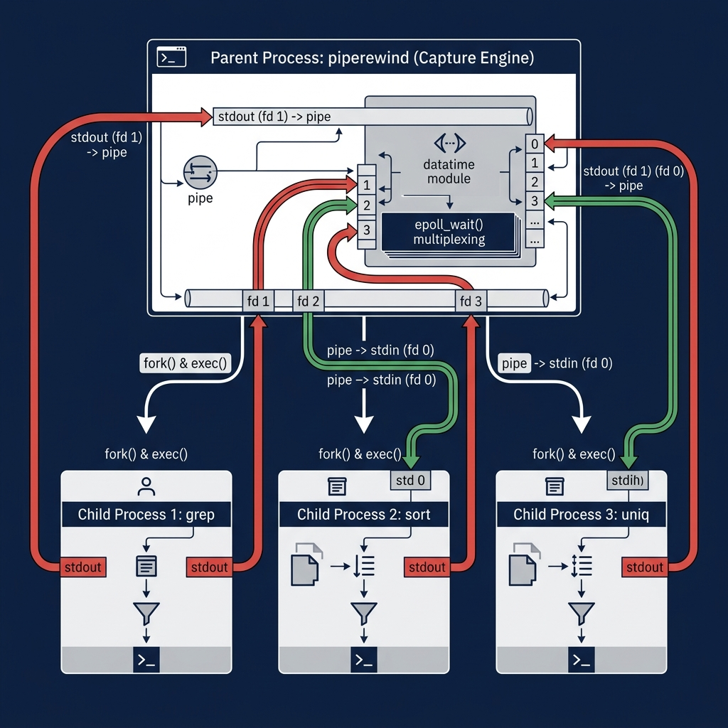
System Architecture
~2,900 lines of C99
7 source files, each with a single responsibility:
main.c — CLI dispatcher (record/replay/live/dump)
pipeline.c — State-machine command parser
capture.c — epoll capture engine
trace.c — Binary trace reader/writer
tui.c — ncurses interactive viewer
diff.c — LCS-based side-by-side diff
procstate.c — /proc state monitor
Dependencies: GCC, Linux epoll, ncurses, pthreads

Slide 7
Part 2: Design Choices & Trade-offs
Key Decisions • Trade-offs • Limitations

Slide 8
Key Design Decisions
Why epoll instead of select/poll?
• O(1) readiness notification vs O(N) scanning
• Scales to arbitrary pipeline depth
• Native Linux kernel support, zero dependencies
• Edge-triggered mode avoids redundant wakeups
Why a custom binary format instead of JSON/text?
• Variable-length events need byte-level control
• Index table enables O(1) random access via fseek()
• 10-100x smaller files than equivalent text logs
• Live append + reader refresh with no parsing overhead
capture.c: epoll_ctl(EPOLLIN)
trace.h: TraceEvent / IndexEntry structs
Why parent-process interposition?
• No ptrace/LD_PRELOAD — no privilege escalation needed
• Transparent: child processes are unmodified
• Parent controls pipe topology with dup2()
• Clean signal handling and waitpid() from one place
Why a sliding window in the TUI?
• 100K+ event traces would exhaust RAM if fully loaded
• Window of 20K events keeps memory under ~16 MB
• Dynamic load/free on navigation boundaries
• Index table makes any window position O(1) to seek
capture.c: fork/exec/dup2 orchestration
tui.c: tui_load_window()

Slide 9
Trade-offs & Known Limitations
Trade-offs We Made
Single-threaded capture engine
Pro: No locking, no race conditions, simpler code
Con: CPU-bound stages could starve the epoll loop
fflush() for live synchronization
Pro: Simple, no mutexes needed between writer/reader
Con: Slight I/O overhead from frequent disk flushes
In-process shell parsing versus calling /bin/sh
Pro: Full control, handles quotes/escapes precisely
Con: No support for redirections, subshells, or variables
Known Limitations
• Linux-only (epoll, /proc are Linux-specific APIs)
• No stderr capture — only stdout/stdin pipes are traced
• Shell features like $VAR, &&, ||, >file not supported
• No persistent bookmarks or annotations in trace files
• TUI requires real terminal (no SSH without pty allocation)
Future work:
• stderr interception
• Trace merging for distributed pipelines
• Compressed .prt format (zlib)

Slide 10
Part 3: Feature Walkthrough
Build • Record • Dump • Replay TUI • Diff • Live Mode

Slide 11
Feature 1: Building & Running
Build (one command):
$ make clean && make
This compiles 7 source files → one piperewind binary.
Makefile links: -lncurses -lpthread
Run the automated test suite:
$ make test
Tests 5 different pipeline configurations:
• 2-stage (echo | cat)
• 3-stage (echo | sort | head)
• 4-stage (echo | sort | uniq -c | sort -rn)
• Single-quoted arguments
• Double-quoted arguments

Slide 12
Feature 2: Recording a Pipeline
$ ./piperewind record -v "echo -e 'banana\napple\ncherry' | sort | head -2"
What happens under the hood:
1. Parse
• State-machine tokenizer splits
• the command string at pipes
• Handles 'single' and "double"
• quote escaping correctly
2. Launch
• fork() each stage as child
• dup2() redirects stdin/stdout
• to interposed capture pipes
• execvp() replaces child image
3. Capture & Write
• epoll_wait() multiplexes all fds
• read() data, timestamp it,
• write DATA_OUT + DATA_IN events
• Forward bytes to next stage stdin
pipeline.c
capture.c
capture.c → trace.c

Slide 13
Feature 3: Inspecting a Trace (dump)
$ ./piperewind dump trace.prt
=== PipeRewind Trace: trace.prt ===
Stages: 3 Events: 14
Stage 0 [pid 9213]: echo -e 'banana\napple\ncherry'
Stage 1 [pid 9214]: sort
Stage 2 [pid 9215]: head -2
--- Events ---
[ 0.07 ms] stage 0 PROC_START
[ 1.54 ms] stage 0 DATA_OUT 20 bytes "banana\napple\ncherry\n"
[ 1.61 ms] stage 1 DATA_IN 20 bytes "banana\napple\ncherry\n"
[ 2.44 ms] stage 1 DATA_OUT 20 bytes "apple\nbanana\ncherry\n"
[ 2.50 ms] stage 2 DATA_IN 20 bytes "apple\nbanana\ncherry\n"
[ 2.58 ms] stage 2 DATA_OUT 13 bytes "apple\nbanana\n"
[ 2.80 ms] stage 2 PROC_EXIT exit_code=0
Every byte accounted for. Every timestamp recorded.

Slide 14
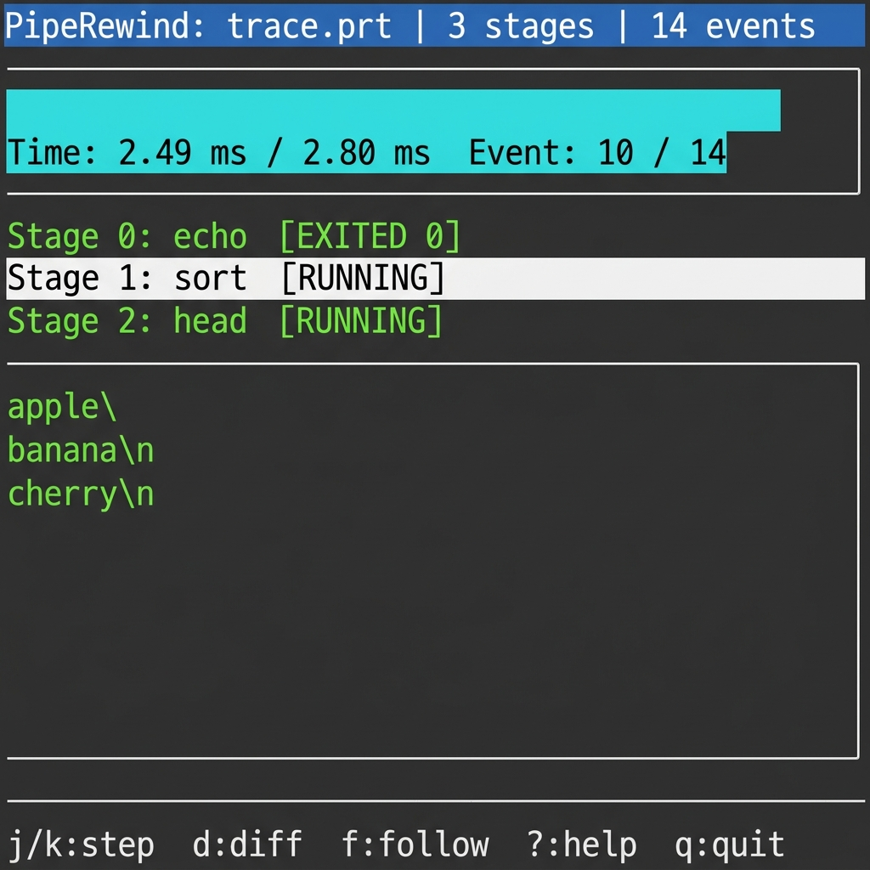
Feature 4: Interactive Replay TUI
$ ./piperewind replay trace.prt
Full-screen ncurses interface:
Header — file name, stage count, event count
Timeline — progress bar with elapsed time
Stages — color-coded status per process
Data panel — raw payload at current time
Navigation:
j/k — step forward/backward by one event
J/K — jump by 10 events
Home/End — jump to first/last event
↑/↓ — select pipeline stage
d — toggle diff view
f — toggle follow mode
h — toggle hex dump view

Slide 15
Feature 5: Side-by-Side Diff View
Press 'd' in the TUI
Compares DATA_OUT of Stage N with DATA_IN of Stage N+1.
Uses Longest Common Subsequence (LCS) algorithm:
• Same logic as git diff
• O(n·m) dynamic programming
• Lines highlighted: green = added, red = removed
Why this matters:
• Instantly see how each stage transforms data
• Pinpoint exactly where corruption occurs
• No manual copy-paste between temp files
Example: sort stage
Stage 0 output: Stage 1 output:
banana apple
apple banana
cherry cherry
Lines are reordered — sort did its job.
If sort had mangled data, you'd see it instantly.

Slide 16
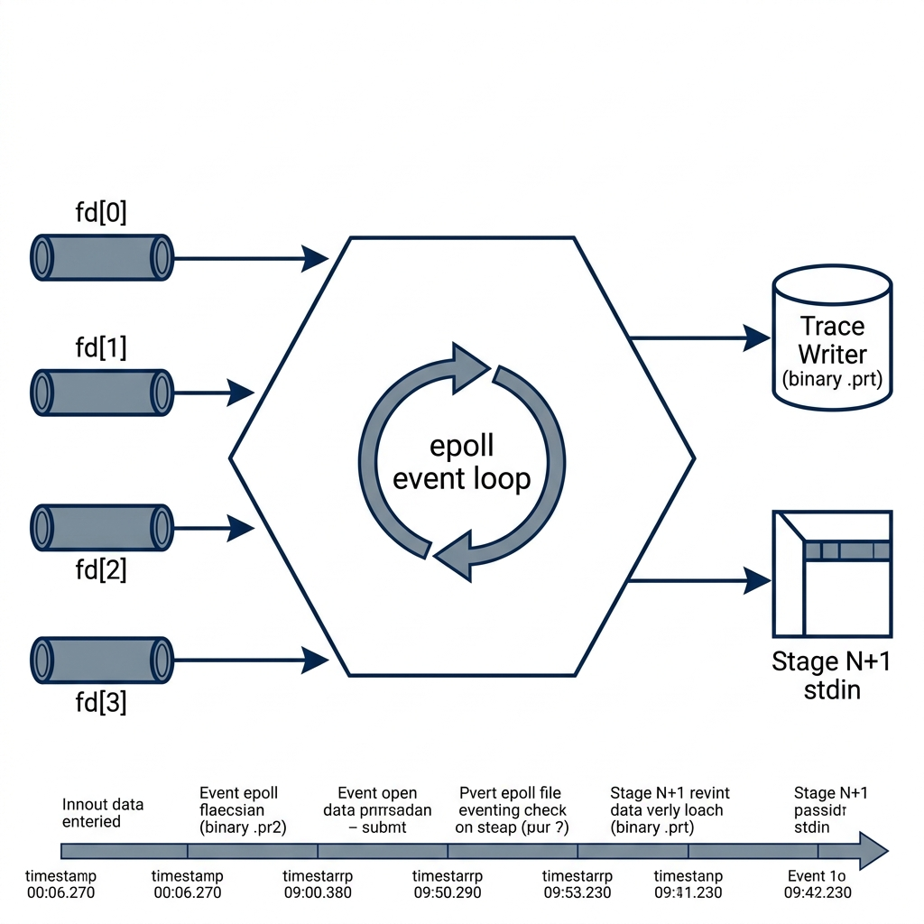
Feature 6: The epoll Capture Loop (Deep Dive)
One loop handles all N stages:
1. epoll_wait() blocks until any pipe has data
2. Lookup: which stage does this fd belong to?
3. read() into 64KB buffer (CAPTURE_BUF_SIZE)
4. Record DATA_OUT event for stage i
5. Record DATA_IN event for stage i+1
6. write() to forward pipe → stage i+1 stdin
7. If read() returns 0: PIPE_EOF, close fd
Performance:
• O(1) per event — no scanning of all fds
• 64KB buffer matches kernel pipe capacity
• Zero-copy forwarding, minimal latency overhead

Slide 17
Feature 7: Process State Monitoring
How does PipeRewind know if a process is blocked?
It reads the /proc/[pid]/status pseudo-file.
$ cat /proc/12345/status | grep State
State: S (sleeping)
The kernel exposes real-time scheduler state through /proc:
• R = Running / Runnable
• S = Sleeping (waiting for I/O or signal)
• D = Disk sleep (uninterruptible, blocked on I/O)
• Z = Zombie (exited but not yet reaped)
TUI color coding: green = Running, yellow = Sleeping, red = Exited
This immediately reveals bottleneck stages in the pipeline.

Slide 18
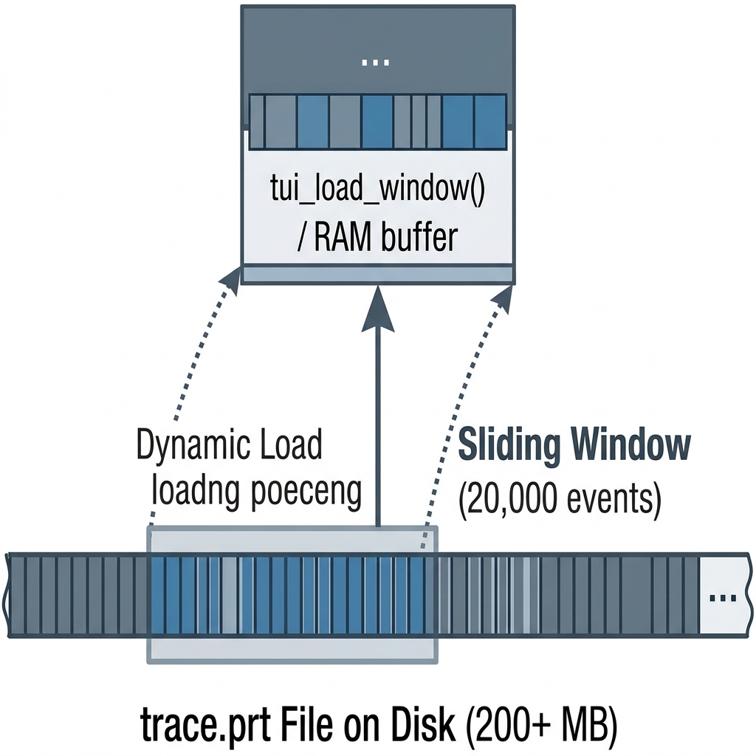
Feature 8: Sliding Window Cache
Problem: Huge traces crash the TUI
A 100K-event trace with payloads could be 200+ MB
Loading everything into RAM is not viable.
Solution: Sliding window of 20,000 events
• tui_load_window(ts, center_idx) loads a chunk
• Payloads are calloc/free'd dynamically
• When user navigates near edge: free old, load new
• Index table gives O(1) fseek() to any event
Result: ~16 MB max regardless of trace size.

Slide 19
Feature 9: Live-Attach Mode
$ ./piperewind live "tail -f log | grep ERROR"
Records and displays simultaneously.
Architecture:
• Background pthread runs capture_run()
• Main thread runs the ncurses TUI
• Shared: trace.prt file on disk
Synchronization:
• Writer calls fflush() after every event
• Reader calls trace_reader_refresh() in the getch() loop
• halfdelay(1) gives 100ms non-blocking input timeout
Follow mode (press 'f'):
Automatically scrolls to the latest event.
Thread model:
┌─────────────────┐
│ Main Thread │
│ ncurses TUI │
│ getch() loop │
│ refresh reader │
└────────┬────────┘
│ shared trace.prt
┌────────┴────────┐
│ Background pthread│
│ capture_run() │
│ epoll → write │
│ fflush() sync │
└─────────────────┘

Slide 20
Feature 10: Binary Trace File Format (.prt)
On-disk layout optimized for random access:
┌──────────────────────────────────────────────────────┐
│ FileHeader (magic 0x50525400, version, num_stages) │ Fixed 32 bytes
├──────────────────────────────────────────────────────┤
│ StageHeader × N (command, pid, per-stage meta) │ N × 280 bytes
├──────────────────────────────────────────────────────┤
│ Event₀ Event₁ Event₂ ... EventK │ Variable-length
│ (each: 24-byte header + payload bytes) │
├──────────────────────────────────────────────────────┤
│ IndexEntry₀ IndexEntry₁ ... IndexEntryK │ K × 16 bytes
│ (timestamp_ns, file_offset → fseek() target) │
└──────────────────────────────────────────────────────┘
Index table = O(1) random access. No sequential parsing needed.

Slide 21
Live Demo
Building • Recording • Dumping • Replaying • Live Mode

Slide 22
Thank You
Luiz Takahashi, Ehzoc Chavez, & Jesse Perez
github.com/balloonjazz/Pipe-Rewind
Questions?

