Slide 1
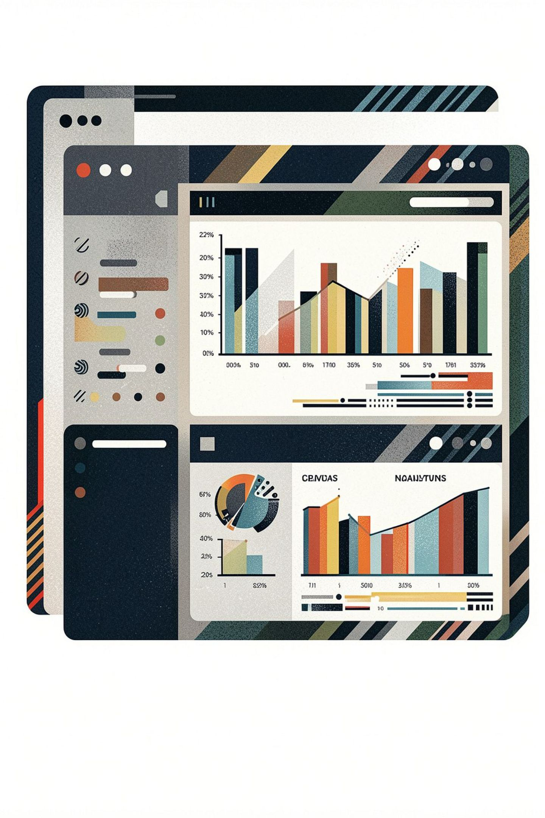
Customer Shopping Insights Dashboard
Business Problem Analysis & SQL Solutions
PYTHON
SQL SERVER
POWER BI
UAE DIRHAMS (AED)

Slide 2

Business Problem Statement
How can the company leverage consumer shopping data to identify trends, improve customer engagement, and optimize marketing and product strategies?
Discounts & Promotions
Do discount offers meaningfully drive purchase volume and customer retention?
Reviews & Ratings
How do customer reviews influence purchasing decisions and product performance?
Seasonal Trends
Which seasons drive the highest sales and how should inventory be aligned?
Payment Preferences
What payment methods do customers prefer and how does this affect conversion?
Repeat Purchases
What behavioral patterns distinguish loyal repeat buyers from one-time customers?

Slide 3
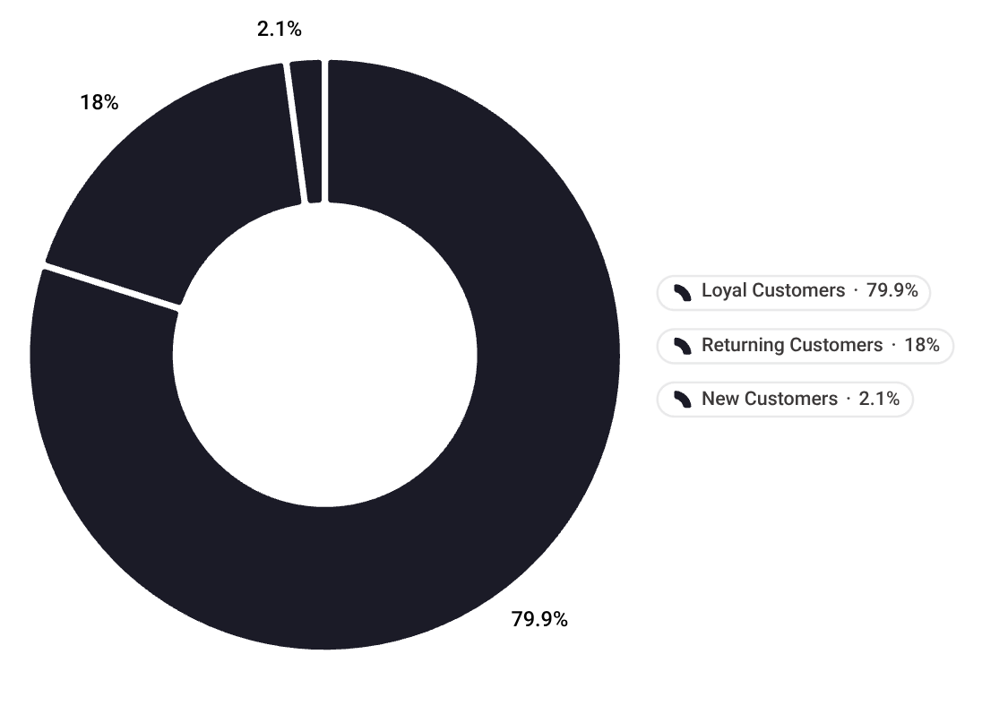



PROBLEM 1
Customer Segmentation & Loyalty
Business Question: Which customer segments drive the most revenue and how can we improve loyalty?
Revenue by Customer Segment
Key Findings
79.9%
Loyal Customers
Drive the majority of total revenue — highest priority segment for retention
18%
Returning Customers
Moderate engagement — strong conversion opportunity with targeted offers
2.1%
New Customers
Small but critical for growth — need onboarding and incentive strategies
Loyalty Improvement Recommendations
🎯 Retain Loyal Customers
🔄 Convert Returning Customers
🚀 Onboard New Customers
Launch a tiered rewards program with exclusive perks, early access, and personalized offers for high-frequency buyers.
Use targeted email campaigns and limited-time promotions to nudge returning buyers toward loyalty tier thresholds.
Implement welcome discounts and guided onboarding flows to increase first-repeat purchase rates and reduce churn.

Slide 4
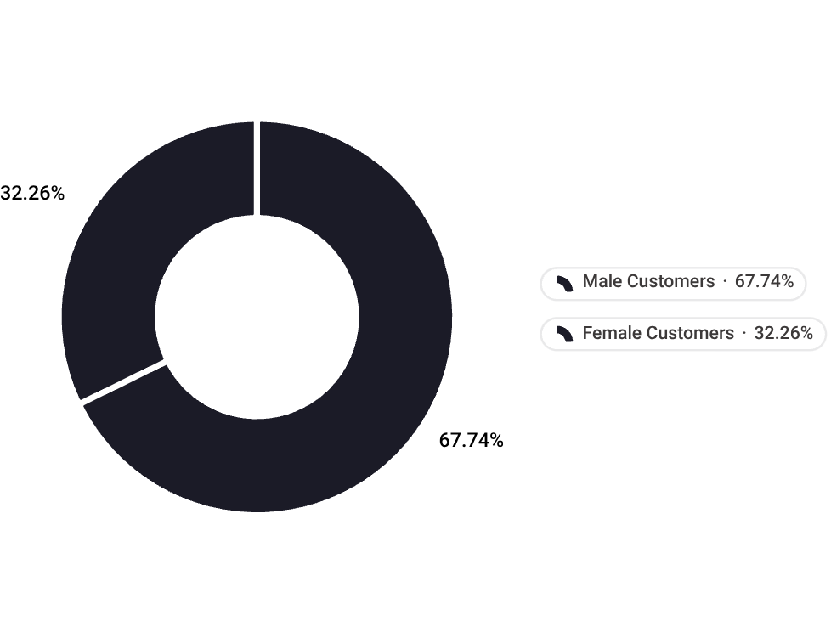


PROBLEM 2
Gender-Based Revenue Disparity
Business Question: Why is there a significant revenue gap between male and female customers, and how can we engage female customers?
Key Findings
67.7%
Male Customers
AED 579,457 — dominant revenue segment
Total Revenue: AED 855,408
32.3%
Female Customers
AED 275,951 — significant growth opportunity
Male customers generate 2.1× more revenue than female customers, revealing a major untapped opportunity to grow the female segment.
Recommended Engagement Strategies
🎯 Targeted Campaigns
💬 Loyalty Programs
Launch female-focused promotions and personalized offers based on purchase history.
Design rewards and membership tiers tailored to female shopping preferences.
📦 Product Expansion
📊 Track Progress
Stock and promote categories with higher female affinity to drive conversion.
Monitor female revenue share quarterly to measure the impact of engagement efforts.

Slide 5



PROBLEM 3
Subscription Strategy Impact
Business Question: Are subscriptions driving revenue growth or cannibalizing non-subscriber sales?
Query Results
Recommendations
Segment | Customers | Avg Spend | Total Revenue
Non-Subscribers | 2,848 | AED 551.20 | AED 1.57M
Subscribers | 1,052 | AED 493.80 | AED 519K
Boost Visit Frequency
Tiered Plans
Exclusive flash deals for subscribers
Incentivize repeat monthly visits
Premium tiers with higher-value perks
Raise average spend per subscriber
Key Findings
Convert Non-Subscribers
Revenue Gap
Target top spenders with trial offers
Personalised onboarding incentives
Non-subscribers generate 3× more total revenue — subscriptions are not yet the growth engine.
Spend Paradox
Subscribers spend AED 57 less per transaction — discounts erode value without driving frequency.
Base Imbalance
At only 27% penetration, subscription adoption limits the program's revenue contribution.

Slide 6


PROBLEM 4
Product Performance & Discounting
Which products have the highest ratings and discounts, and are discounts optimized?
Top 5 Products by Rating
Key Insights
Product | Avg Rating | Discount | Revenue (AED)
Hat | 4.10 | 50.00% | 28,450
Sneakers | 4.08 | 49.66% | 34,210
T-Shirt | 4.05 | 32.14% | 21,890
Jacket | 4.02 | 27.80% | 45,620
Watch | 3.98 | 22.50% | 52,310
Over-Discounting Top Products
Lower Discounts Drive Higher Revenue
Hat (50%) and Sneakers (49.66%) carry the steepest discounts despite being top-rated. Strong ratings signal loyal demand that doesn't require this level of incentive — margins are being eroded unnecessarily.
Watch has the lowest discount (22.5%) yet generates the highest revenue (AED 52,310), demonstrating that reduced discounting can still deliver strong returns.
Recommendation: Review the discount strategy for Hat and Sneakers. Reducing discounts on these high-rated items could significantly improve profit margins without sacrificing sales volume.

Slide 7

Problem 5: Age Group Revenue Distribution
Business Question: Which age groups are most valuable and where should marketing focus?
Revenue by Age Group
Key Insight: Middle-Aged customers (31–60) generate 56.9% of total revenue — making them the most valuable segment by far.
Age Group | Transactions | Revenue (AED) | Share
Middle-Aged (31–60) | 2,231 | 489,842 | 56.9%
Young Adult (18–30) | 1,012 | 221,304 | 25.7%
Senior (60+) | 657 | 143,561 | 16.7%
Youth (<18) | 24 | 5,483 | 0.6%
Marketing Recommendations by Segment
🧑‍💼 Middle-Aged (31–60) — Priority Segment
Double down on loyalty programs, subscription offers, and premium product lines. Personalized email campaigns and exclusive member discounts drive retention.
🧑 Young Adults (18–30) — Growth Segment
Focus on social media advertising, influencer partnerships, and trend-driven collections. Offer first-purchase discounts and referral incentives to grow this base.
👴 Seniors (60+) — Retention Segment
Emphasize comfort, quality, and ease of shopping. Target via email and in-store promotions. Highlight value and reliability over trends.
🧒 Youth (<18) — Emerging Segment
Minimal investment for now. Monitor growth and introduce entry-level products. Gift card campaigns and back-to-school promotions can seed future loyalty.

Slide 8
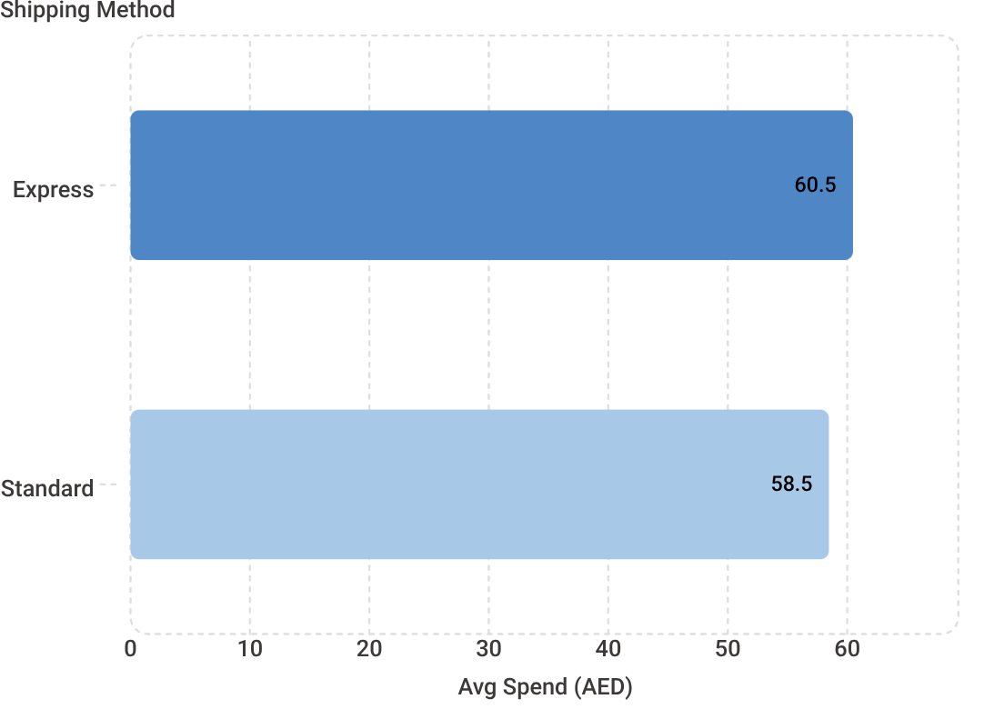
Problem 6: Shipping Method & Spending Behavior
Business Question: Does shipping method choice correlate with higher spending, and should we incentivize express shipping?
Avg Spend by Shipping Method
Recommended Strategies
Free Express Threshold
Offer free express shipping above AED 75 to nudge customers toward larger basket sizes.
Loyalty Perks
Reward loyalty members with express upgrades to reinforce a premium experience and drive repeat purchases.
Checkout Nudges & Promotions
Highlight express benefits at checkout and run flash "Express Deals" to grow adoption among cost-sensitive shoppers.
Key Insight: Express customers spend 3.5% more on average (AED 60.48 vs AED 58.46), suggesting higher buyer intent — though the gap remains modest.

Slide 9
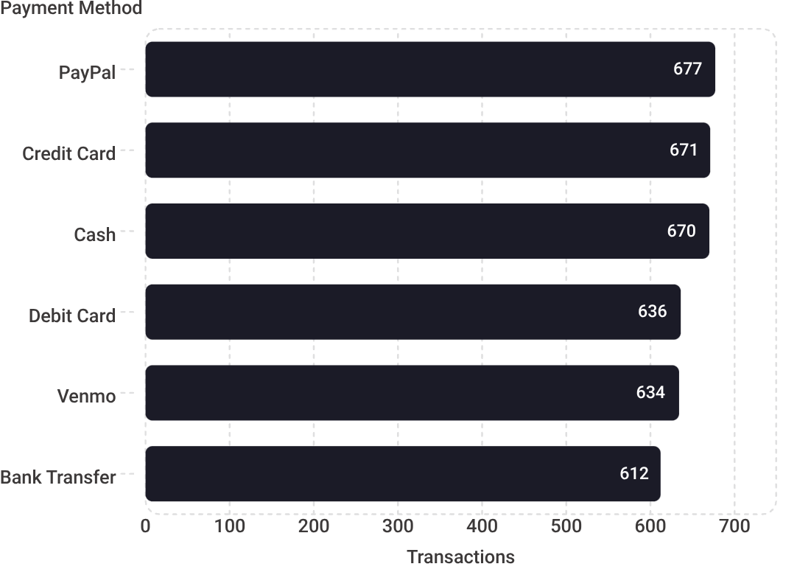
Problem 7: Payment Method Preferences
Which payment methods are most popular and should we optimize checkout for specific methods?
Payment Method Distribution
Key Findings
Remarkably Even Distribution
All six methods cluster tightly between 612–677 transactions — no single dominant preference.
Digital Wallets Lead
PayPal (677) and Venmo (634) together account for ~32% of transactions.
Traditional Methods Remain Strong
Credit Card, Cash, and Debit Card collectively represent ~57% of transactions.
Optimization Recommendations
Streamline all six methods — ensure seamless checkout UX for every payment type.
Promote digital wallets — add PayPal/Venmo express buttons on product and cart pages.
Incentivize bank transfers — offer small discounts or loyalty points to reduce processing fees.

Slide 10
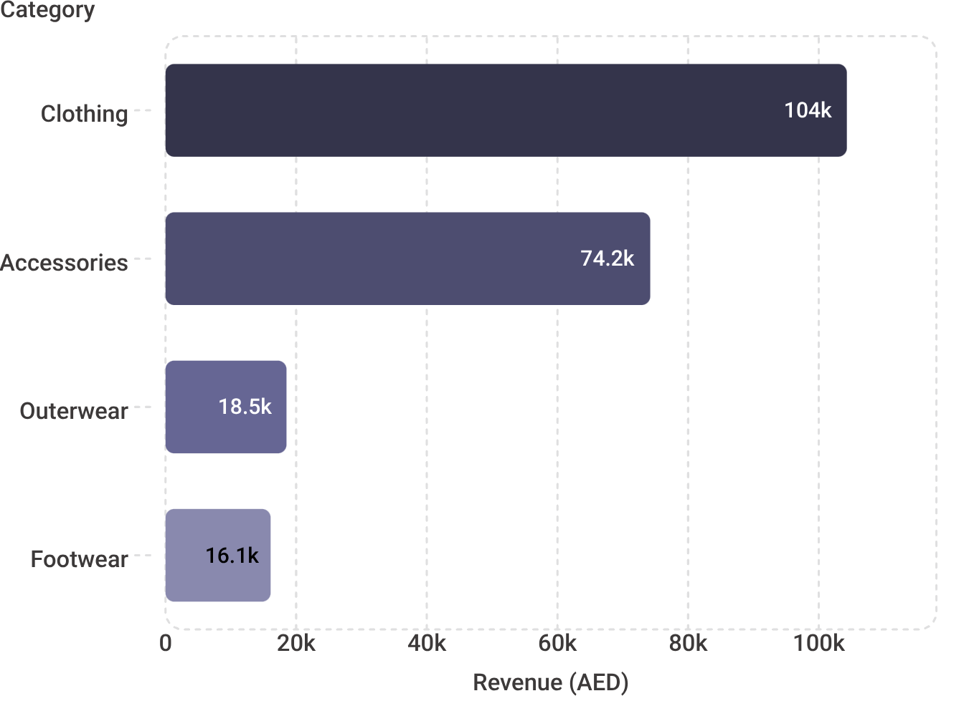

PROBLEM 8
Category Performance & Revenue Optimization
Business Question: Which product categories generate the most revenue and where should inventory focus?
Revenue by Category (AED)
Category-Specific Growth Strategies
👗 Clothing
💍 Accessories
Invest in inventory depth and variety. Use as flagship in all marketing campaigns.
Bundle with Clothing purchases to increase basket size and push revenue higher.
🧥 Outerwear
👟 Footwear
Run seasonal promotions and targeted campaigns during peak demand periods.
Expand SKU range and cross-promote with Clothing to improve visibility.
Clothing dominates with 104.29K AED — over 4× Outerwear and Footwear combined.

