Slide 1
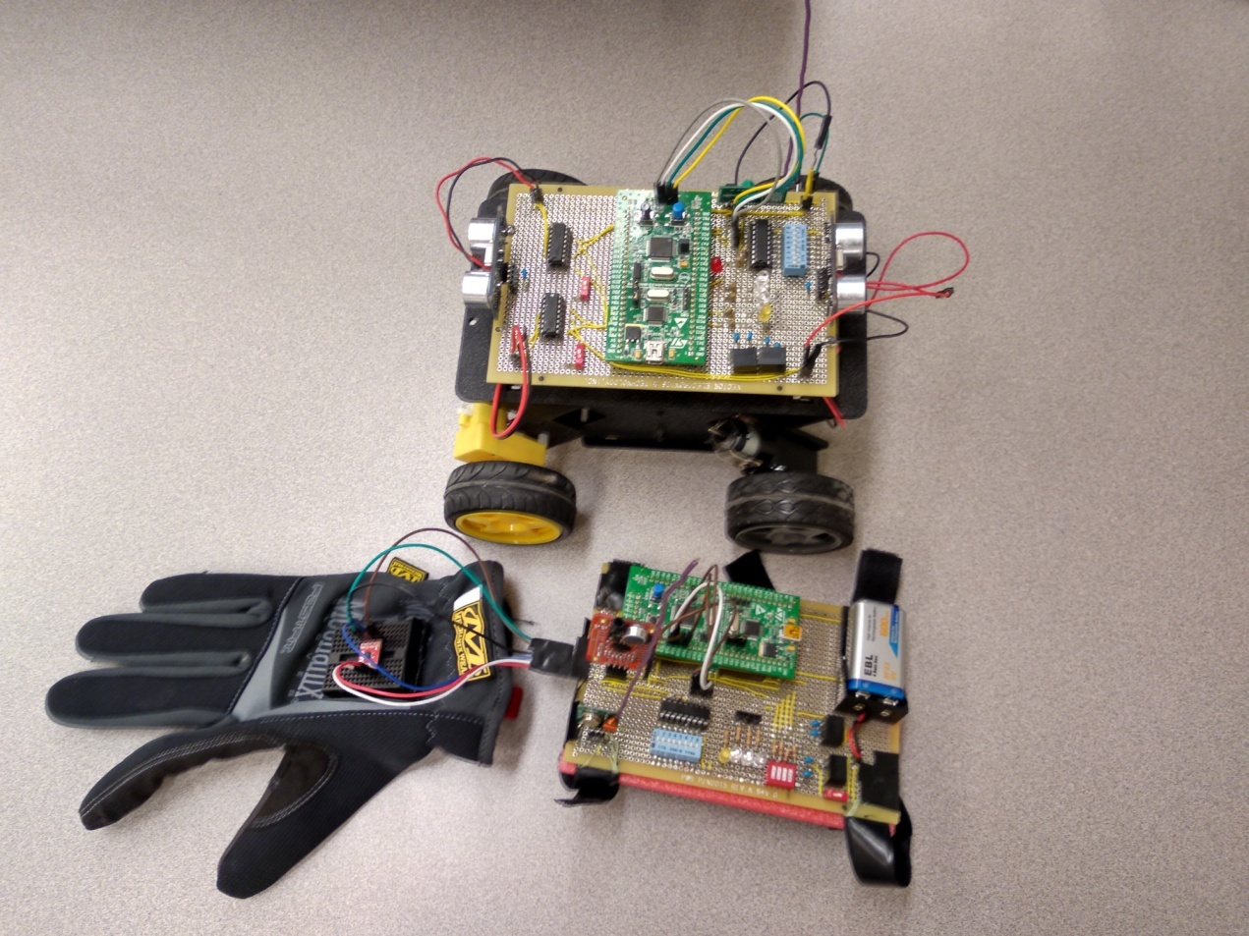
RC Car
ENEL 417 Group Project
Matthew Selin
Mohammed Benhammou Muhammad Baloch
Advisors:
Dr Abdul Bais
Doug Wagner

Slide 2
Project Goals
Provide people who are unable to use conventional controls with alternative solutions
Integrating autonomous and assisted control systems with user control systems

Slide 3
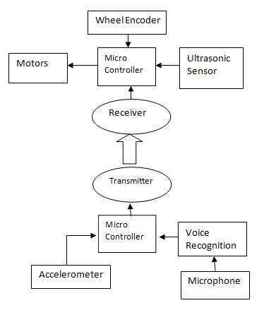
Project Summary
Create alternative controls and assisted driving systems
Gesture Based Control
Voice Based Control
Obstacle Avoidance
Speed Regulation
Wireless Communication

Slide 4

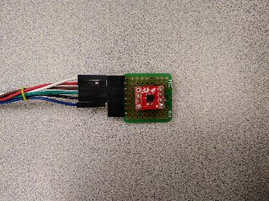
Gesture Based Control
Accelerometer measures the acceleration in three planes

Slide 5


Gesture Based Control

Slide 6
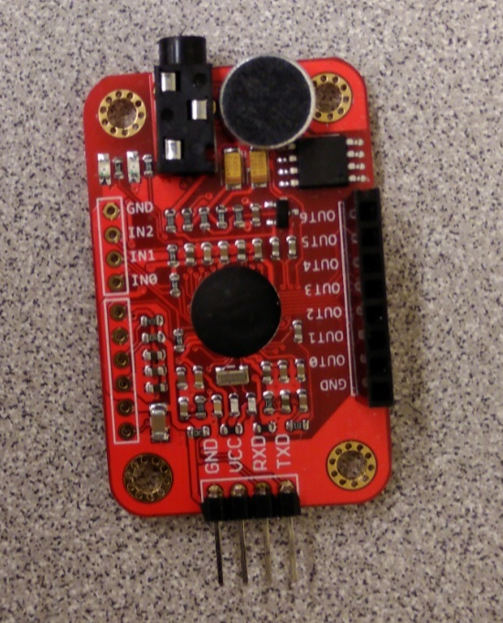
Voice Based Control
Voice Recognition Module V3
Train/Record your own voice signatures
Stores up to 80 signatures
Only 7 signatures effective at one time

Slide 7
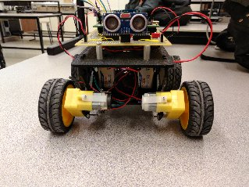
Obstacle Avoidance
Ultrasonic Sensors
Non-contact
Transmits 40 kHz signals
2 cm to 4 m range

Slide 8
Obstacle Avoidance
If an obstacle is detected, the vehicle automatically changes into a different state based on what the users input.

Slide 9

Speed Regulation
Wheel Encoder
Detects wheel rotation
Count number rotations over period of time

Slide 10
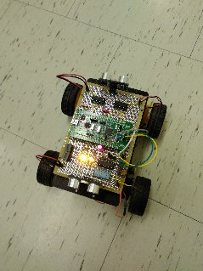
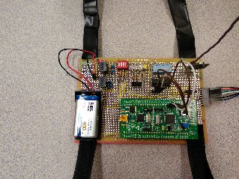
Wireless Communication
433 MHz Radio Frequency signals
ASK (amplitude shift keying) modulation
100 meters range

Slide 11
Project Summary
Create alternative controls and assisted driving systems
Gesture Based Control
Voice Based Control
Obstacle Avoidance
Speed Regulation
Wireless Communication
Notes:
We are presenting this project as a proof of concept for alternative controls
11

Slide 12
Project Summary
We are presenting this project as a proof of concept
We have designed, built and tested a prototype
These alternative techniques of control can be extended into more specific applications

Slide 13

Questions

