Slide 1
Binary Decision Diagram (BDD)
資料結構與程式設計
Data Structure and Programming
12/09/2015

Slide 2
Types of Data Structures
So far, we have learned:
Linear ADT: linked list, (dynamic) array
  Good at insert() and erase() (at ends), but not good at find() and random erase()
Tree: BST, BBST, heap, set/map in STL
  Good at insert/erase/find; can be as good as O(log n)
  Heap is especially good for find min/max
Graph
  Various applications; many established graphic algorithms
Hash/Cache
  Constant time in insert/erase/find, but the data is not sorted
➔ All the above data structures are used as “container classes” to store objects.
➔ Next, we will introduce a data structure to represent “(Boolean) functions”.

Slide 3
Function Representation and Operations
Many of the real life problems need to deal with “function representation and operations”
  Boolean, integer, real numbers, mixed,... etc
  (+, -, *, %), (!, &, |, ^), differential/integral,... etc
  Linear, nonlinear,... etc
  ➔ We will focus on “Boolean” functions
For computer to store and operate on Boolean functions
  Memory efficiency --- how to store?
  Time efficiency --- how to operate?

Slide 4
Function Representation and Operations
Truth table
  Tabular format
  Karnaugh map
  Binary decision tree
Two-level logic
  Sum of product (SOP), or called disjunctive normal form (DNF)
  Product of sum (POS), or called conjunctive normal form (CNF)
Multi-level logic
  Boolean expression
  Circuit netlist
Binary Decision Diagram (BDD)

Slide 5
Boolean Function Representation
In general, Boolean functions can be expressed as…
  f = (a && b || ((c + d) > e)) ^ !g && (a > b)?...
How to record them in computers?
  String? (string f = “(a && b || ((c + d) > e)) ^ !g...”;)
  ➔ No, not friendly for computation
  Expression (syntax) tree? (e.g. circuit)
  ➔ No, not friendly for computation
  ➔ e.g. How do we know “f == g”?
  (canonicity requirement)
&
>
==
~
a
b

Slide 6
Enumeration Method (Truth Table)
For each variable, enumerate its possible values
  Usually convert a variable into Boolean variables
Explicitly write down all the combinations of variable values
  e.g. 2-bit adder
  a1 a0 b1 b0 | f
  ----------------|---
  0 0 0 0 | 0
  0 0 0 1 | 1
  ……… |
  1 1 1 0 | 1
  1 1 1 1 | 0
  If the truth table can be constructed, to prove the tautology or find a test vector is trivial
  However, the size of the truth table is exponential in terms of input size (like simulation)

Slide 7
A better data structure to
represent truth table?

Slide 8
Binary Decision Tree
f
target function
a b c | f
-------|---
0 0 0 | 1
0 0 1 | 0
0 1 0 | 0
0 1 1 | 1
1 0 0 | 1
1 0 1 | 0
1 1 0 | 0
1 1 1 | 1
a = 1
a
input variables
a = 0
b
b
function = 1
c
c
c
c
function = 0
1
0
0
1
1
0
0
1
Still exponential in size

Slide 9
Binary Decision Diagram
f
a
b
b
c
c
c
c
1
0
0
1
1
0
0
1

Slide 10
Binary Decision Diagram
f
a
b
b
b
c
c
1
0

Slide 11
Reduced Ordered Binary Decision Diagram (ROBDD)
f
a b c | f
-------|---
0 0 0 | 1
0 0 1 | 0
0 1 0 | 0
0 1 1 | 1
1 0 0 | 1
1 0 1 | 0
1 1 0 | 0
1 1 1 | 1
b
c
c
1
0

Slide 12
More BDD Examples
a
a
a
b
b
1
0
a
1
0
1
0
a && b
a || b
a
a
1
0
b
b
!a
1
0
a ⊕ b

Slide 13
Reduced Ordered Binary Decision Diagram (ROBDD)
A graphical representation of truth table
  Each level corresponds to an input variable
  → Set of inputs is called “support”
  Each node (and its sub-graph) represents a function
  Each path represents a cube of the function
  → i.e. an input pattern for this function
  Functions with equivalent functionality (sub-graph) are merged together
    Always canonical

Slide 14
ROBDD Reduction Rules (1/2)
Uniqueness
  No two distinct nodes u and v have the same level and left- and right-successors
  level(u) = level(v)
  left(u) = left(v)
  right(u) = right(v)
  ➔ node(u) = node(v)
  Hash(level, left, right) → BDD node
u
=
v

Slide 15
ROBDD Reduction Rules (2/2)
Non-redundant tests
  No variable node u has identical left- and right- successor.
    For each node, left(u) ≠right(u)
u

Slide 16
ROBDD Characteristics
Canonicity
  f = g iff BDD(f) = BDD(g)
  e.g.
  f = ab + ac
  g = a(b+c)
  ➔ BDD(f) = BDD(g)
Ordering dependency
  Given the same functionality, different input variable orderings may lead to significant difference in the number of BDD nodes

Slide 17
Example on Variable Ordering
z = (a⊕b) · (c⊕d) · (e⊕f)
good order
bad order
a
a
b
b
c
c
c
e
e
e
e
d
d
b
b
b
b
b
b
b
b
e
d
d
d
d
f
f
others
f
f
others
1
0
0
1
Notes:
This is an example to show how the variable ordering could affect the size of the ROBDD.
Obviously, the one in the left had side is much better than the one in the right had side.

Slide 18
The Influence of Variable Ordering
Size of BDD
  Can vary from linear to exponential in the number of the variables, depending on the ordering
Hard-to-Build BDD
  Data path components (e.g., multipliers) cannot be represented in polynomial space, regardless of the variable ordering
Heuristics of Ordering
  (1) Put variables that influence most on the top of BDD
  (2) Minimize the distance between strongly related variables
  (e.g., x1x2 + x2x3 + x3x4)
  x1→x2→x3→x4 is better than x1→x4→x2→x3
Dynamic variable reordering (e.g. “sifting”)
Notes:
Size of BDD
can vary from linear to exponential in the number of the variables, depending on the ordering
Hard-to-Build BDD
Data path components (e.g., multipliers) cannot be represented in polynomial space, regardless of the variable ordering
Heuristics of Ordering
(1) Put variables that influence most on the top of BDD
(2) Minimize the distance between strongly related variables
(e.g., x1x2 + x2x3 + x3x4)
x1→x2→x3→x4 is better than x1→x4→x2→x3

Slide 19
Now we know BDD can be used to represent functions
Then given a Boolean function,
➔ How to construct BDD for it?

Slide 20
The basic step: building BDD for a Boolean operator
Given y = AND(f, g), and BDDs for f and g ---
What’s the BDD for
y = (f && g)?
f
g
y
f
g
BDD(f && g) = ?
1
0

Slide 21
BDD Cofactors: Binary Function Decomposition
Shannon expansion of f
  f = x * f_{x} + x * f_{x}
  ➔ f_{x} and f_{x} are called positive/negative cofactors
_
_
_
f = 1
f
2^{n} Boolean space
f_{x}
x
-
f_{x}
_
x*f_{x}
_
x*f_{x}
f = 0
x = 1 ←
→ x = 0
1
0

Slide 22
Cofactor Examples
f = abc + ad + bd
➔
  f_{a} = bc + bd // remove a, drop a term,
  // keep non-a term (i.e. f |_{a=1})
  f_{a} = d + bd
  a * f_{a} = ?
  a * f_{a} = ?
  a * f_{a} + a * f_{a} = ?
What is f_{e}?

Slide 23
BDD Operations
f
f_{x}
Shannon expansion of f
  f = x * f_{x} + x * f_{x}
f * g
= (x * f_{x} + x * f_{x}) *
(x * g_{x} + x * g_{x})
= x * (f_{x} * g_{x}) + x * (f_{x} * g_{x})
f + g
= x * (f_{x} + g_{x}) + x * (f_{x} + g_{x})
Operation:
perform on cofactors individually ➔ Recursion
x
-
_
f_{x}
_
_
_
_
_
_
_
_
_
1
0
_
_

Slide 24
Recursive Function Operations
Boolean operation of 2 BDDs can be performed recursively on their cofactors
  f * g = x * (f_{x} * g_{x}) + x * (f_{x} * g_{x} )
  f + g = x * (f_{x} + g_{x}) + x * (f_{x} + g_{x})
  ➔ Terminal cases for this recursion are
  the operations on constants “0” and “1”
Let u, v be the top variables of BDDs f, and g
  If (u > v) // i.e. u is closer to the top
  f * g = u * (f_{u} * g) + u * (f_{u} * g)
f
g

Slide 25
BDD Operation Example
b
c
(e.g. Perform “b || c”)
Place variables in individual levels
Start from the top variable, recursively apply the computation for its positive and negative cofactors
1
0
1
0
f = b
f = c
positive
cofactor
negative
cofactor
b
b
c
c
1
0
1
0
1
0
f = b || c

Slide 26
BDD Operation Example
b
c
1
0
1
0
f = b
f = c
OR
a
a
a
OR
b
b
b
c
c
c
1
0
1
0
1
0
1
0
f = b || c
f = a&& (b || c)
f = (a && b) || (a && c)
f = a && b
f = a && c

Slide 27
In short,
  f = a && (b || c)
  f = (a && b) || (a && c)
➔ will result in the same BDD
➔ independent of building orders
(ROBDD canonicity characteristics)

Slide 28
Recursive BDD Operations on Cofactors
Do we implement BDD operations this way?
  (repeated computation)
  For example, (f * g) and (f + g) result in the same BDD. However, we need to recursively compute it twice...
  ➔ No “caching” effect....
  (not good enough)
  For each new operator, need to define the evaluation of its terminal cases

Slide 29
Introducing the “ITE Operator”
--- to enhance BDD construction efficiency
ITE stands for “If-Then-Else”
ITE(F, G, H) = F * G + F * H
  e.g. For Shannon Expansion
    f = ITE(x, f_{x}, f_{x}) = x * f_{x} + x * f_{x} // x: top variable
All unary/binary Boolean operations can be implemented by “ite” operators
  AND(F, G) = ITE(F, G, 0)
  OR(F, G) = ITE(F, 1, G)
  NOT(F) = ITE(F, 0, 1)

Slide 30
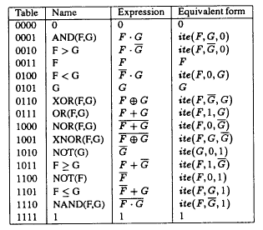
Using ITE Operators for Boolean Functions

Slide 31
Using ITE to enhance BDD construction efficiency
For example,
BDD ( f * g ) BDD ( f + g )
= ITE ( f, g, 0 ) = ITE ( f, 1, g )
= ITE ( f, g, 1 )
= ITE ( f, g, 0 )
➔ DeMorgan’s rule (f * g) = (f + g)
➔ ITE conversion rules to be covered later
Same ITE operation!!

Slide 32
How to apply ITE in BDD construction?
Given two BDDs, A and B
➔ Convert the Boolean operation on (A, B) to ITE representation, say ITE(F, G, H)
Normalize ITE(F, G, H) to ITE(F’, G’, H’)
➔ Check: has ITE(F’, G’, H’) been computed?
➔ If yes, retrieve the previously computed result
Otherwise, recursively compute ITE(F’, G’, H’)
  ➔ Record the { ITE(F’, G’, H’), result } pair in a cache/hash

Slide 33
Recursive Algorithm for ITE Operation
Let Z = ITE(F, G, H), and { v1, v2, ... } be the variable order of Z from top to bottom
  Z = ITE(F, G, H)
  = ITE(v1, ITE(F_{v1}, G_{v1}, H_{v1}), ITE(F_{v1}, G_{v1}, H_{v1})) // 2 cases
  = ITE(v1, ITE(v2, ITE(F_{v1v2}, G_{v1v2}, H_{v1v2}), // 4 cases
  ITE(F_{v1v2}, G_{v1v2}, H_{v1v2})),
  ITE(v2, ITE(F_{v1v2}, G_{v1v2}, H_{v1v2}),
  ITE(F_{v1v2}, G_{v1v2}, H_{v1v2})))
  = ... // until terminal cases
F
G
H
F_{v1}
v1
F_{v1}
G_{v1}
v1
G_{v1}
H_{v1}
v1
H_{v1}

Slide 34
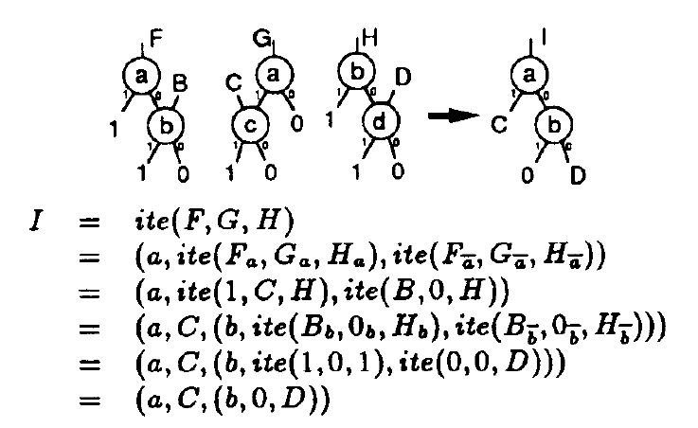
Example of ITE Operations

Slide 35
Terminal Cases for ITE Algorithm
What do the terminal cases mean?
  ITE on constant values?
No, actually we can terminate earlier
  F = ite(G, F, F) = ite(1, F, G) = ite(0, G, F) = ite(F, 1, 0)
  ➔ Return F
  (FYI, the only 4 cases you need to check in your BDD pkg)
What are NOT terminal cases?
  ite(F, G, 0) = F*G; ite(F, G, 1) = not(F) + G
  ite(F, 0, 1) = not(F)
  ite(0/1, 0/1, H) ➔ covered by terminal cases
  How about ite(F, 0, 0) and ite(F, 1, 1)??

Slide 36
How to apply ITE in BDD construction?
Given two BDDs, A and B
➔ Convert the Boolean operation on (A, B) to ITE representation, say ITE(F, G, H)
Normalize ITE(F, G, H) to ITE(F’, G’, H’)
➔ Check: has ITE(F’, G’, H’) been computed?
➔ If yes, retrieve the previously computed result
Otherwise, recursively compute ITE(F’, G’, H’)
  ➔ Record the { ITE(F’, G’, H’), result } pair in a cache/hash

Slide 37
Hash/Cache in BDD constructions
v
F
G
Unique table
v: top variable
F, G: BddNode
➔ Hash(v, F, G) to an unique BddNode
➔ Ensure “canonicity”
Computed table (cache)
F, G, H: BddNode
➔ Cache { ITE(F, G, H), result } to the computed BddNode
➔ Don’t compute the same thing again!!
Complexity of ITE(F, G, H) can be as good as O(|F|*|G|*|H|)
(Why??)

Slide 38
Remember: using ITE to enhance sharing
For example,
BDD ( f * g ) BDD ( f + g )
= ITE ( f, g, 0 ) = ITE ( f, 1, g )
= ITE ( f, g, 1 )
= ITE ( f, g, 0 )
➔What about ITE(F, 0, 1) and ITE(F, 1, 0)?
➔Do they share the same sub-BDD nodes?
Same ITE operation!!

Slide 39
Improving the BDD node sharing
Complexity to compute F?
➔ Fact: F and F are different nodes in BDD
NOT(F) = ite(F, 0, 1) is not a terminal case
  Need to go through every path of BDD(F) and at the end, construct BDDs with interchanged terminal nodes (0, 1)
Any better way?
➔ Complement edge

Slide 40
BDDs with Complement Edges
A complement edge is a flagged edge which denotes the function is complemented (inverted)
  Usually use a “bubble” to denote the inverted edge
  [Note] Only constant “1” node is kept; constant “0” is denoted with complement edge
Can we still guarantee the canonicity?
F
F

Slide 41
Equivalence with Complement Edges
(v, F_{v}, F_{v}) = v * F_{v} + v * F_{v}
= v * F_{v} + v * F_{v}
= (v + F_{v}) * (v + F_{v})
= v * F_{v} + v * F_{v}
= (v, F_{v}, F_{v})
v
v
v
v
v
v
v
v

Slide 42
Canonicity with Complement Edges
What’s the problem?
  If we allow (v, F_{v}, F_{v}) and (v, F_{v}, F_{v}) to co-exist in BDDs, they will have different hash keys and thus hash to different nodes (why?)
  ➔ But by using complement edges, they should point to the same node!!
Solution
  The “then” child should NOT have bubble
  ➔ If happens, apply the rules in the previous page

Slide 43
Improving ITE Cache Hit Rate
Observation
  There may be ITE(F1, F2, F3) = ITE(G1, G2, G3), where F_{i} != G_{i} for some i
    e.g. ITE(F, G, 0) = ITE(F, 1, G) // AND(F, G) = NOR(F, G)
    e.g. F + G
    ITE(F, 1, G) = ITE(G, 1, F) = ITE(F, F, G) = ITE(G, G, F)
  ➔ ITE function may be recursively called many times and return the same result
Objective
  Rearrange the ITE parameters so that the cache hit rate of the computed table can be higher
[Keypoint] Think how the computed cache works!!

Slide 44
Equivalent ITE Operations
Identical parameters ➔ Constant parameter
  ite(F, F, G) ➔ ite(F, 1, G) // F + G
  ite(F, G, F) ➔ ite(F, G, 0) // F * G
  ite(F, G, F) ➔ ite(F, G, 1)
  ite(F, F, G) ➔ ite(F, 0, G)
Symmetrical parameters
  ite(F, 1, G) = ite(G, 1, F)
  ite(F, G, 0) = ite(G, F, 0)
  ite(F, G, 1) = ite(G, F, 1)
  ite(F, 0, G) = ite(G, 0, F)
  ite(F, G, G) = ite(G, F, F)
Complement parameters
  ite(F, G, H) = ite(F, H, G) = ite(F, G, H) = ite(F, H, G)
Which one to choose??

Slide 45
Equivalent ITE Operation Rules
If contains identical or complement parameters
➔ Reduce to constant parameter
If contains symmetrical parameters
➔ The first parameter is given with the smallest “top” variable;
➔ If tied, choose the one with smaller pointer address
If contains complement edge parameters
➔ The first and second parameters cannot be complement edges

Slide 46
Recursive Algorithm for ITE Operation
ite(F, G, H) {
Standardize parameters (F, G, H);
if (terminal case)
return result;
if (ite(F, G, H) in computed table)
return result;
let v be the top variable;
T = ite(F_{v}, G_{v}, H_{v});
E = ite(F_{v}, G_{v}, H_{v});
Process complement edge info for T & E
if (T == E) return T;
if ((v, T, E) in the unique table)
return result;
let R = BddNode(v, T, E);
insert R into unique table;
return R;
}

Slide 47
Other than logic functions,
BDDs can also be used to represent
“Sets” and “Relations”

Slide 48
BDD to Represent a Set
Other than Boolean function, BDD can also represent sets over Boolean variables
  e.g. Use 3-variable BDDs to represent any subset of the numbers in { 0, 1, 2, 3, 4, 5, 6, 7 }
b2
b1
b0
b0
b0
1
0
1
0
1
0
Tautology
Complete set
Null
Empty set
{ 1, 3, 5, 7 }
{ 0, 2, 5, 6, 7 }

Slide 49
BDD to Represent Relations
e.g. 2-bit ring counter: NS = (CS + 1) % 4
R: { (0 → 1), (1 → 2), (2 → 3), (3 → 0) }
C1
CS
2 vars
C0
C0
N1
N1
N1
N1
NS
2 vars
N0
N0
1
0
1
0

Slide 50
Other types of decision diagrams
ZDD
FDD
MTBDD(ADD)
BMD

Slide 51
Zero-Suppressed BDD (ZDD)
However, BDD may not be good for sparse set representation, set cover/union operation, etc
  ➔ ZDD can do better
Proposed: S. Minato, DAC 93
A good tutorial:
  “An Introduction to Zero-Suppressed Binary Decision Diagrams”, Alan Mishchenko, 2001

Slide 52
BDD vs. ZDD
BDD: function representation
ZDD: set cover representation
  ➔ Conversion between BDD and ZDD is easy
Remember, BDD has two reduction rules
  Uniqueness: hash(level, left, right)
  Non-redundant test: eliminate the node whose positive and negative children pointing to the same node
  ➔ ZDD does NOT have (2)
Instead, ZDD’s non-redundancy rule
  Remove the node whose “positive” edge pointing to a constant ‘0’ node

Slide 53
ZDD Examples
set of subsets:
{ {a,b}, {a,c}, {c} }
➔ characteristic function: { (abc) | (110), (101), (001) }
Function: ab + cd
a
a
b
b
a
a
b
c
c
b
b
b
c
d
d
c
c
c
d
1
0
1
0
1
0
1
0
BDD
ZDD
BDD
ZDD

Slide 54
Intuitions on the ZDD non-redundancy rule
If we treat the “cubes” in BDDs as strings of 1/0’s, what does ZDD “suppress” in its representation?
  e.g. characteristic function:
  { (abc) | (110), (101), (001) }
The suppressed ZDD nodes are ---
  Ending 0’s
  Consecutive 0’s, maybe except for the leading 0
    e.g. 100010010 ➔ 1(0)--1(0)-1-

Slide 55
Complexity in Representing Set of Subsets
ZDD upper bound
  Total number of elements appearing in all subsets of a set
BDD upper bound
  The number of subsets multiplied by the number of all elements that can appear in them

Slide 56
ZDD to Represent Cube Covering
Goal: use DDs to record the cubes and perform operations (union/intersect, etc) on them
  E.g. F = ab + cd has 2 cubes
  How does BDD represent them?
  Are they same cubes when we retrieve?
Approach:
  Each input is split into 2 variables
  ➔ positive and negative literals
➔ Char. function for cover { ab, cd }
χ = a1a0b1b0c1c0d1d0
+ a1a0b1b0c1c0d1d0
= 10100000 + 00001010
ZDD
a1
b1
c1
d1
1
0

Slide 57
Other types of decision diagrams
ZDD
FDD
MTBDD(ADD)
BMD

Slide 58
Something about co-factors...
Fallacy: f_{x} ∧ f_{x} = ∅
x = 1
x = 0
2^{n} Boolean space
_
x*f_{x}
_
x*f_{x}
2^{n-1} Boolean space
What is x*f_{x}?
What is ( f_{x} ⊕ f_{x} ) ?
f_{x}
_
f_{x}

Slide 59
Reed-Muller Expansion (ExOR-polynomial)
Let f(x, Y) = x⋅f_{x}(Y) + x⋅f_{x}(Y)
Let f₁(Y), f₂(Y) be some functions of Y.
Then f can be decomposed as f₁ ⊕ f₂⋅x
  What are f₁ and f₂?
  What do they mean? What does ⊕ mean?
Rearrange them, we have: f = x⋅(f₁ ⊕ f₂) + x⋅f₁
  So, what are f₁ and f₂?
Recursively decompose f₁ and f₂, we have:
  f₁ = f₃ ⊕ f₄⋅y f₂ = f₅ ⊕ f₆⋅y
  f = f₁ ⊕ f₂⋅x = a₁ ⊕ a₂⋅x ⊕ a₃⋅y ⊕ a₄⋅xy

Slide 60
Function Decomposition
Shannon Expansion (sum of product form)
  f = x f_{x} + x f_{x}
Reed-Muller Expansion (ExOR-polynomial)
  f = a₀ ⊕ a₁⋅x₀ ⊕ a₂⋅x₁ ⊕ a₃⋅x₀⋅x₁ ⊕....
  ⊕ a_{2n-1}⋅x₀ ⋅x₁ ⋅x₂ ⋅x₃.... ⋅x_{n-1}
  [In recursive form]
  f = f_{x} ⊕ (f_{x} ⊕ f_{x}) ⋅ x (positive davio)
  = f_{x} ⊕ (f_{x} ⊕ f_{x}) ⋅ x (negative davio)
  ➔ f = (negative cofactor) ⊕ (Boolean difference) ⋅ x
  = (positive cofactor) ⊕ (Boolean difference) ⋅ x

Slide 61
[Sideline Help] Extracting Cofactors
Let F = x ⋅ A + x ⋅ B + C
➔ positive cofactor: F_{x} = A + C
➔ negative cofactor: F_{x} = B + C
➔ Boolean difference: F_{d} = F_{x} ⊕ F_{x} = ??
F_{d} = (A ⊕ B) ⋅ C
Any intuitive explanation?

Slide 62
Ordered Functional Decision Diagram
[OFDD, Kebschull, EDAC 92]
Structurally similar to BDD, but each node use “positive (or negative) davio to explain
  Still canonical
  Good for XOR-like circuits
a
a
F_{x}
a
F_{d}
a
b
b
0
1
1
0
1
1
0
F = 0 ⊕ 1 ⋅ a = a
???
???
???

Slide 63
Other types of decision diagrams
ZDD
FDD
MTBDD(ADD)
BMD

Slide 64
DDs for Arithmetic Manipulation
BDD, FDD, OKFDD, etc are useful in verifying Boolean functions
What if the property contains word-level signals and arithmetic operations?
  e.g. 8a + 5ab = 20
  Word-level signals → decomposed into bits
e.g. A truth table for arithmetic functions
an... a2 a1 bm... b2 b1 | f
---------------------------|---
0... 0 0 0... 0 0 | 12
0... 0 0 0... 0 1 | -8
..........................| ..
1... 1 1 1... 1 1 | 7
➔ Decompose ‘f’ into bits and use multiple functions (BDDs) for operation ??
  f₀(an,..., a2, a1, bm,.., b2, b1), f₁(an,..., a2, a1, bm,.., b2, b1),...

Slide 65
Multi-Terminal BDD (also called ADD)
Expanding the terminal of BDDs to multi-value nodes
e.g. 8 - 20z + 2y + 4yz, where y and z are Boolean variables
y | z | F
0 | 0 | 8
0 | 1 | -12
1 | 0 | 10
1 | 1 | -6
MTBDD
y
8 - 20z + 2y + 4yz
z
z
8
-12
10
-6

Slide 66
Boolean Movement Diagram (BMD)
[Bryant, DAC95]
Just like FDD to BDD, where we use “Reed-Muller” (Boolean difference) instead of “Shannon Expansion”
➔ We can apply “Reed-Muller Expansion” on MTBDD too
Let x be Boolean ➔ x = (1 - x)
➔ f = x ⋅ f_{x} + x ⋅ f_{x} = x ⋅ f_{x} + (1 - x) ⋅ f_{x}
= f_{x} + x ⋅ (f_{x} - f_{x}) ⬅ postive davio form

Slide 67
From MTBDD to BMD
Function
MTBDD
y | z | F
0 | 0 | 8
0 | 1 | -12
1 | 0 | 10
1 | 1 | -6
y
z
z
8
-12
10
-6
BMD
⎡ 8 (1-y)(1-z) + ⎤
⎢-12 (1-y) z + ⎥
⎢ 10 y (1-z) + ⎥
⎣ -6 y z ⎦
...(00)
...(01)
...(10)
...(11)
y
F(y, z) =
z
z
= 8 - 20z + 2y + 4yz
8
-20
2
4

Slide 68
*BMD
Similar to EVBDD, where an integer value is annotated on the edge as the weight
➔ We can factor out the terminal nodes and lift the common divisors to the edge values
Function:
8 - 20z + 2y + 4yz + 12x + 24xz + 15xy
x
2
3
*BMD
BMD
x
y
y
y
y
2
4
z
z
z
z
z
8
-20
2
4
12
24
15
-5
2
1
5

Slide 69
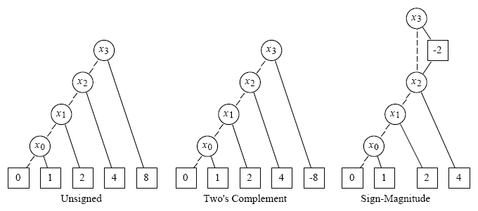
*BMD for Representation of Integers

Slide 70
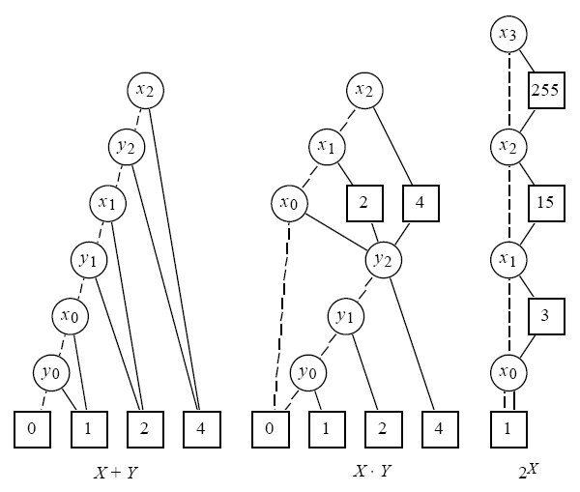
*BMD for Word-Level Sum, Product, and Exponentiation

Slide 71
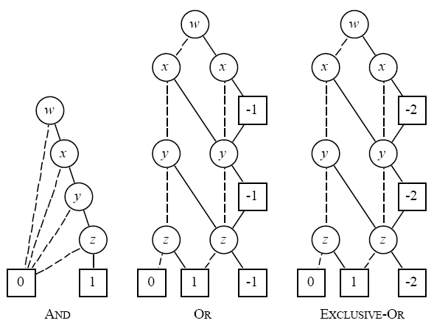
*BMD for Boolean Functions
Notes:
x ∨ y = x + y - xy
x ∨ y ∨ z = x + y + z - xy - yz - xz + xyz
x ⊕ y = xy’ ∨ x’y = xy’ + x’y - xy’x’y = xy’ + x’y = x(1-y) + (1-x)y = x + y -2xy

Slide 72
Canonicity for BMC*
Are these the same?
➔ Need rules to ensure the canonicity!
➔ Negative edge value on “pos-edge” only
5
-5
x
x
-2
3
2
-3
y
y
y
y

Slide 73
Conclusion on various DDs
We have seen various types decision diagrams
  BDD
  FDD
  OKFDD
  MTBDD (ADD)
  EVBDD
  BMD
  *BMD
➔ There are more that are not covered in this class...
A comprehensive study on the comparison / classification of the various DDs can be found at:
  “Decision Diagrams for Discrete Functions: Classication and Unied Interpretation”, Stankovic and Sasao, ASPDAC 98

Slide 74
Computing Cofactors on BDD
Given a function f
➔find its positive/negative cofactor f_{x} / f_{x}
  e.g. Let f = a c + b c
  ➔ f_{c} = b
  ➔ f_{c} = a
  ➔ f_{a} = b c
If x is top variable
➔ cofactors = left and right children
Otherwise,
f_{x}
X
g
h
g

Slide 75
Existential Quantification
∃x.f = f_{x} + f_{x} (⬅ What does this mean?)
x = 1
z
z
x = 0
y
y
∃x

Slide 76
Existential Quantification on BDD
∃x (f) = f_{x} + f_{x} (⬅ How to perform it on BDD?)
If x is top variable
➔ Perform an “OR” on its cofactors
If x is bottom variable
➔ Replace non-zero nodes with ‘1’ (why?)
If x is middle variable
➔ ???
Which one is better??

Slide 77
Existential Quantification
∃x (f) = f_{x} + f_{x}
  e.g. f = a b + a b c + a b c
∃c (f)
= a + b
a
a
b
a
b
b
b
∃c (f)
b
c
c
1
0
1
0
1
0

Slide 78
Cofactors, Boolean Difference, Existential Quantification
Let F = x ⋅ A + x ⋅ B + C
Cofactors
  F_{x} = A + C
  F_{x} = B + C
Boolean difference
  F_{d} = (A ⊕ B) ⋅ C
Existential quantification
  ∃x.F = A + B + C
What if the formula is represented in PoS form?

Slide 79
References
(Original BDD paper) R. E. Bryant, "Graph-based algorithms for Boolean function manipulation", IEEE Trans. on Comp., 35(8):677-691, 1986.
(BDD implementation classic) K. S. Brace, R. L. Rudell, and R. E. Bryant. “Efficient implementation of a BDD package”. In Proceedings of the 27th Design Automation Conference, pages 40-45, Orlando, FL, June 1990.

Slide 80
A Exemplar BDD Package: CUDD
Implemented in University of Colorado at Boulder
  Prof. Fabio Somenzi
The most widely used BDD package in various researches and EDA tools
http://vlsi.colorado.edu/~fabio/CUDD/cuddIntro.html

Slide 81
BDD Complexity
In general, the size of BDD nodes is still exponential to the size of input supports
  Usually can only build BDDs for circuit with #input = 100 ~ 200
    (But consider 2¹⁰⁰ ~ 2²⁰⁰)
Many many optimization techniques, and different variations of DDs… not to be covered in this class...
  (GIEE: “SoC Verification”)

