Slide 1


Bivariate Analysis
Determining relation between 2 variables –
Categorical – Categorical Variables
Categorical – Numerical Variables

Slide 2


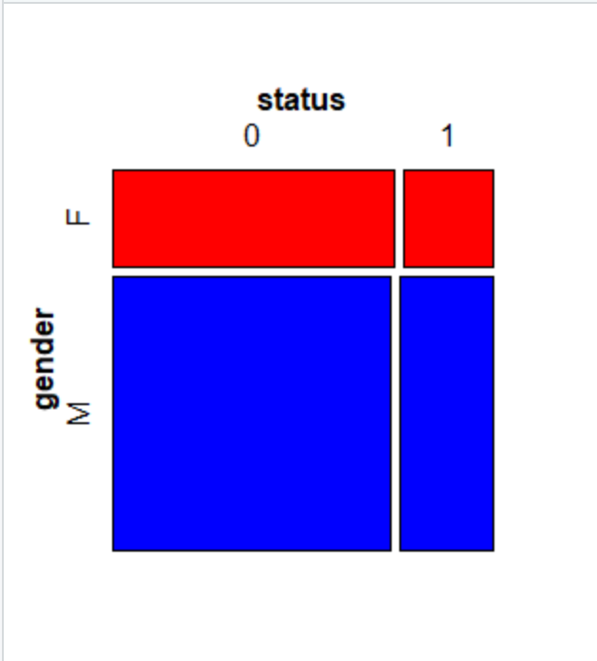
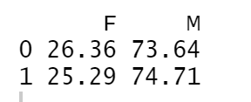
Gender v/s Status
tab2 <- table(data$status,data$gender) # gender wise status round(prop.table(tab2,1)*100,digits =2)
Result in tabular format:

Slide 3
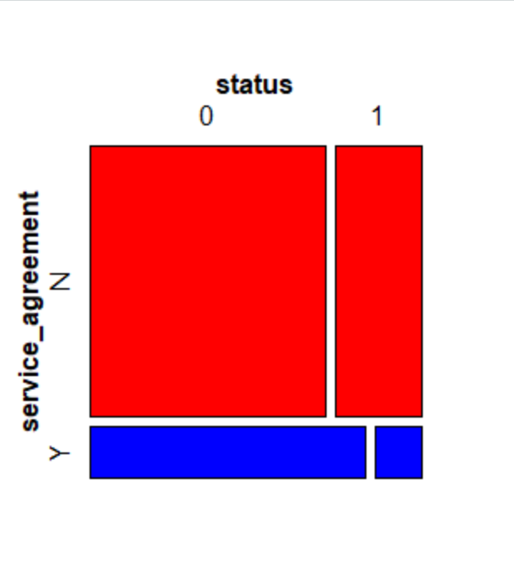

Service Agreement v/s Status
tab3 <- table(data$status,data$service_agreement)
round(prop.table(tab3,1)*100,digits =2)
Result in tabular format:

Slide 4
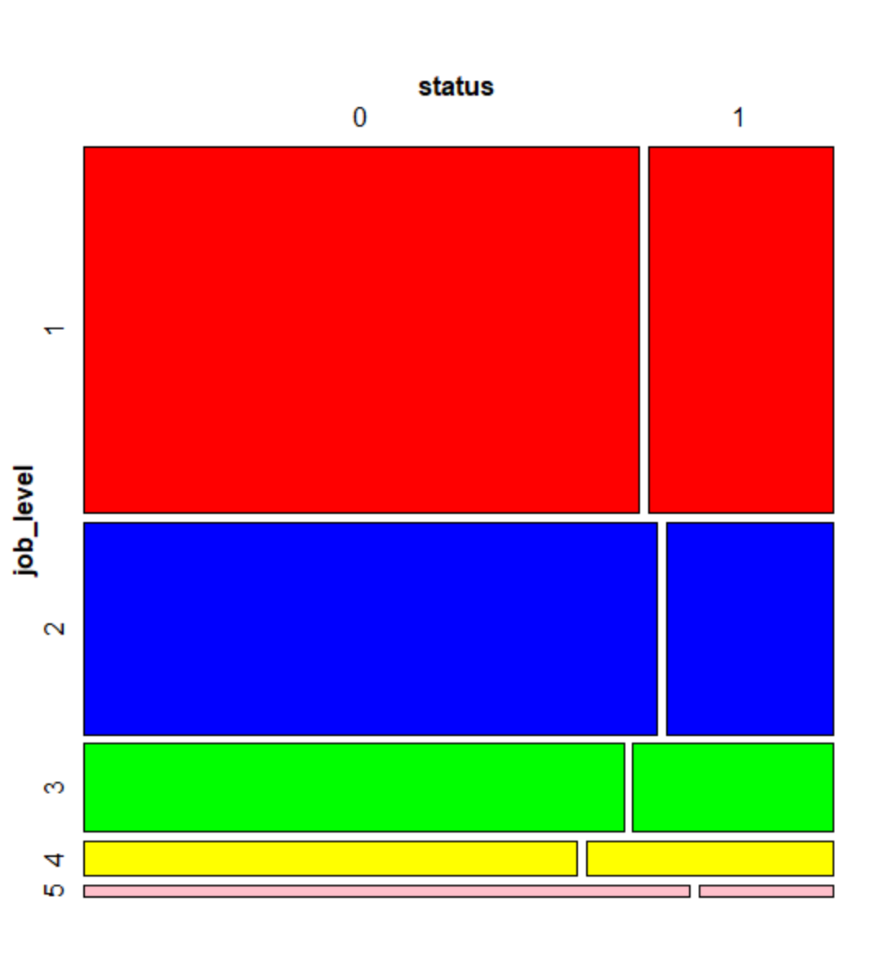
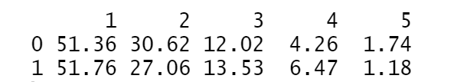
Job Level v/s Status
tab4 <- table(data$status,data$job_level) # has 5 levels as per as.fator
round(prop.table(tab4,1)*100,digits =2)
Result in tabular format:

Slide 5
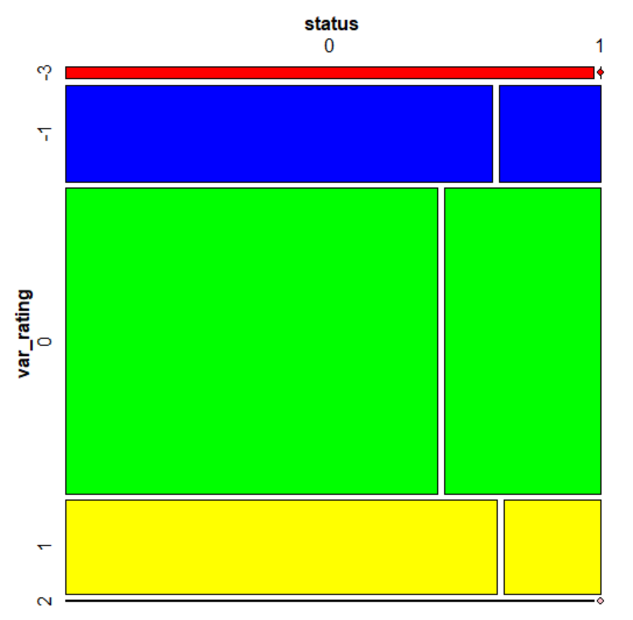
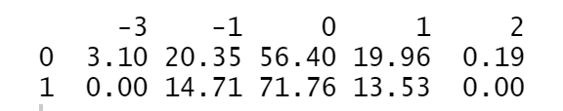
Rating v/s Status
tab5 <- table(data$status,data$var_rating) # has 5 levels as per as.fator
round(prop.table(tab5,1)*100,digits =2)
Result in tabular format:

Slide 6
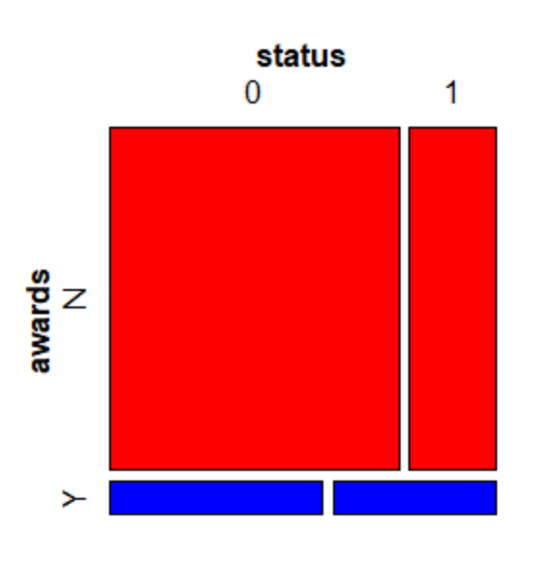
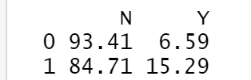
Rating v/s Status
tab6 <- table(data$status,data$rating)
round(prop.table(tab6,1)*100,digits =2)
Result in tabular format:

Slide 7
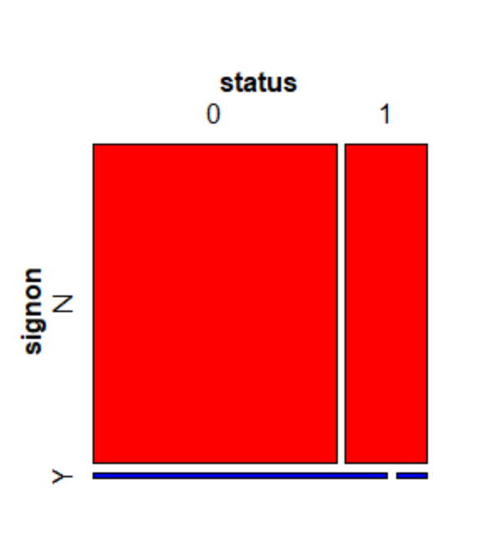
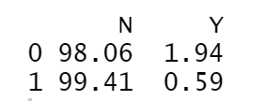
Signon (signing bonus) v/s Status
tab7 <- table(data$status,data$signon)
round(prop.table(tab7,1)*100,digits =2)
Result in tabular format:

Slide 8
Categorical – Numerical Variables

Slide 9
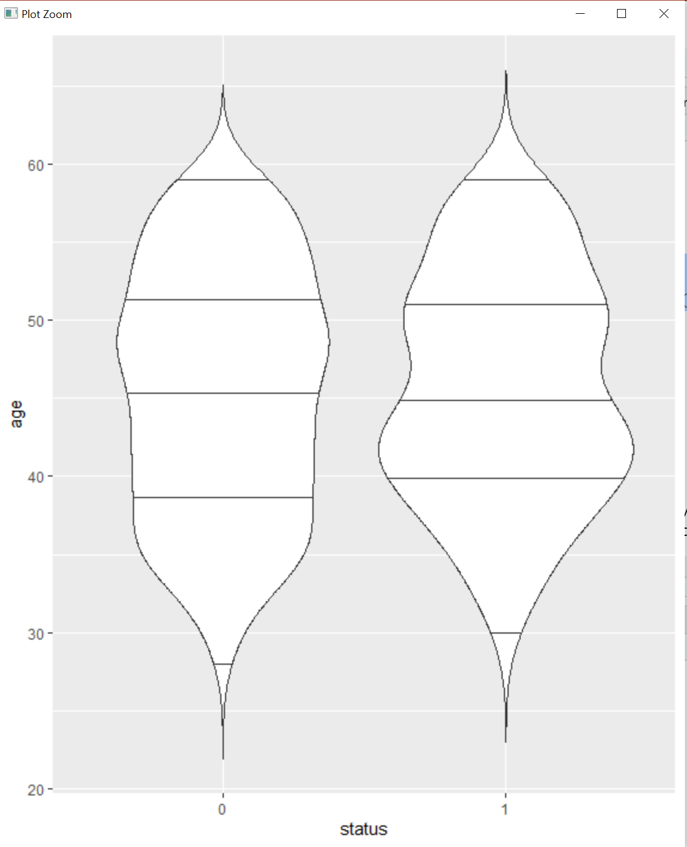
Age v/s Status
p <- ggplot(data, aes(x=status,y=age)) + geom_violin()
p + geom_violin(trim = FALSE) + geom_violin(draw_quantiles = c(0.25,0.5,0.75))
The violin plots can be comopared with the mean, median and mode value for age v/s status

Slide 10
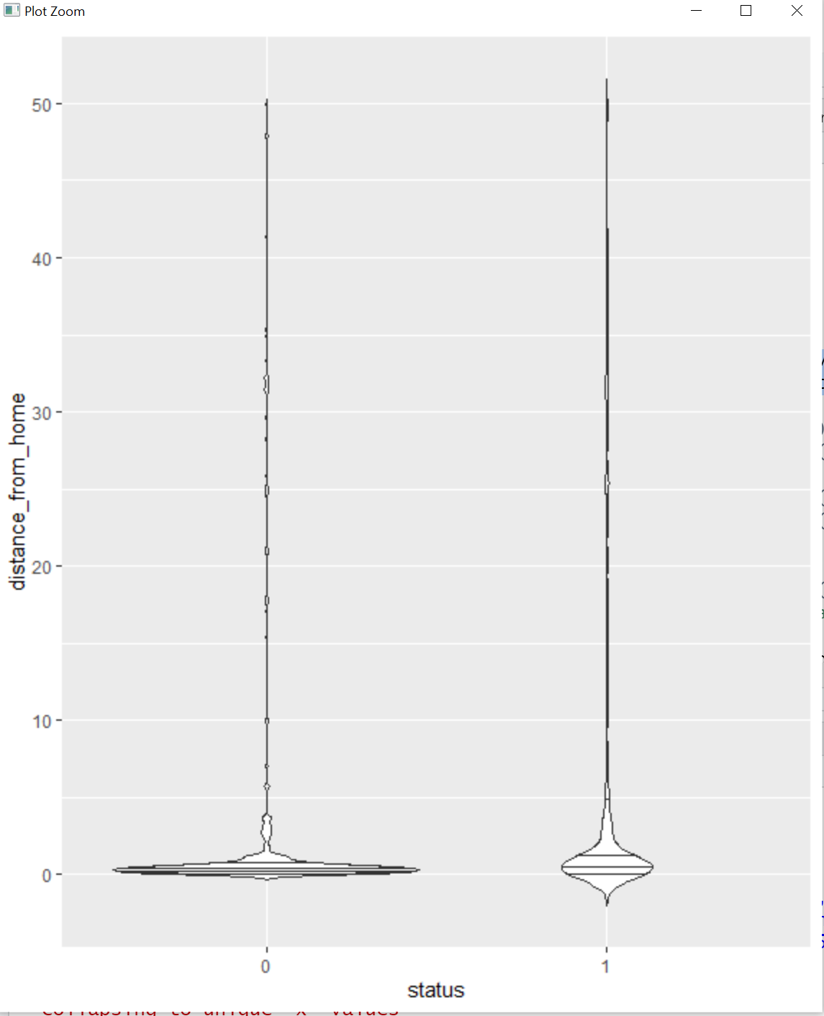
Distance from home v/s Status
p2 <- ggplot(data, aes(x=status,y=distance_from_home)) + geom_violin()
p2 + geom_violin(trim = FALSE) + geom_violin(draw_quantiles = c(0.25,0.5,0.75))
The violin plots can be compared with the mean, median and mode value for distance from home of employees v/s status

Slide 11
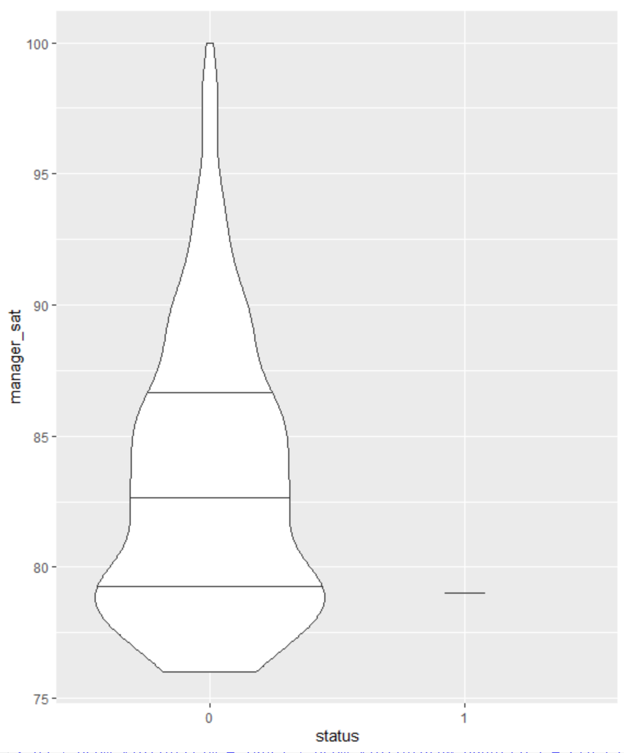
Manager_sat (manager satisfaction) v/s Status
p3 <- ggplot(data, aes(x=status,y=manager_sat)) + geom_violin()
p3 + geom_violin(trim = TRUE) + geom_violin(draw_quantiles = c(0.25,0.5,0.75))
The violin plots can be compared with the mean, median and mode value for manager satisfaction v/s status

Slide 12
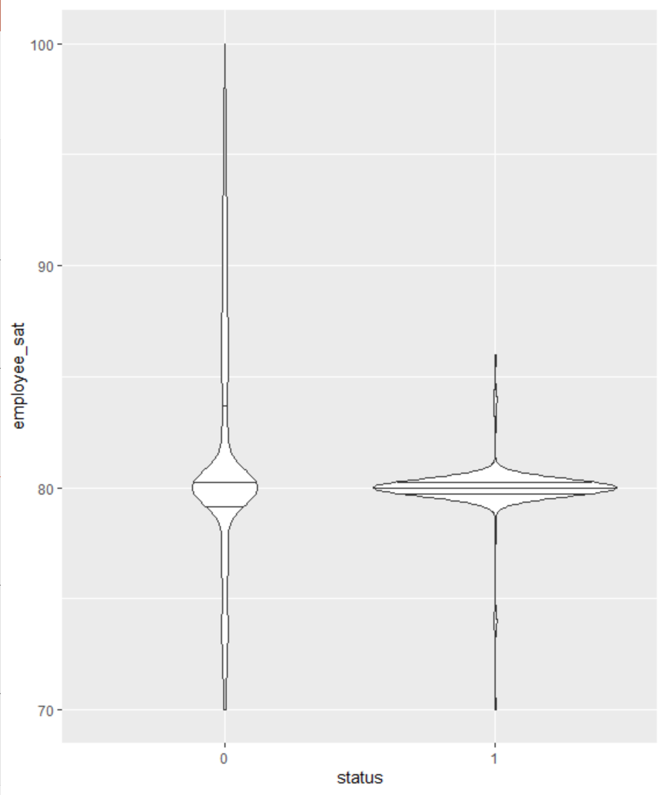
employee_sat (employee satisfaction) v/s Status
p4 <- ggplot(data, aes(x=status,y=employee_sat)) + geom_violin()
p4 + geom_violin(trim = TRUE) + geom_violin(draw_quantiles = c(0.25,0.5,0.75))
Quite interesting to see the skewness in the plots. For the one who underwent attrition, its more skewed on the right whereas the ones who did not undergo attrition, skewness was on the left hand side.
The violin plots can be compared with the mean, median and mode value for employee satisfaction v/s status

Slide 13
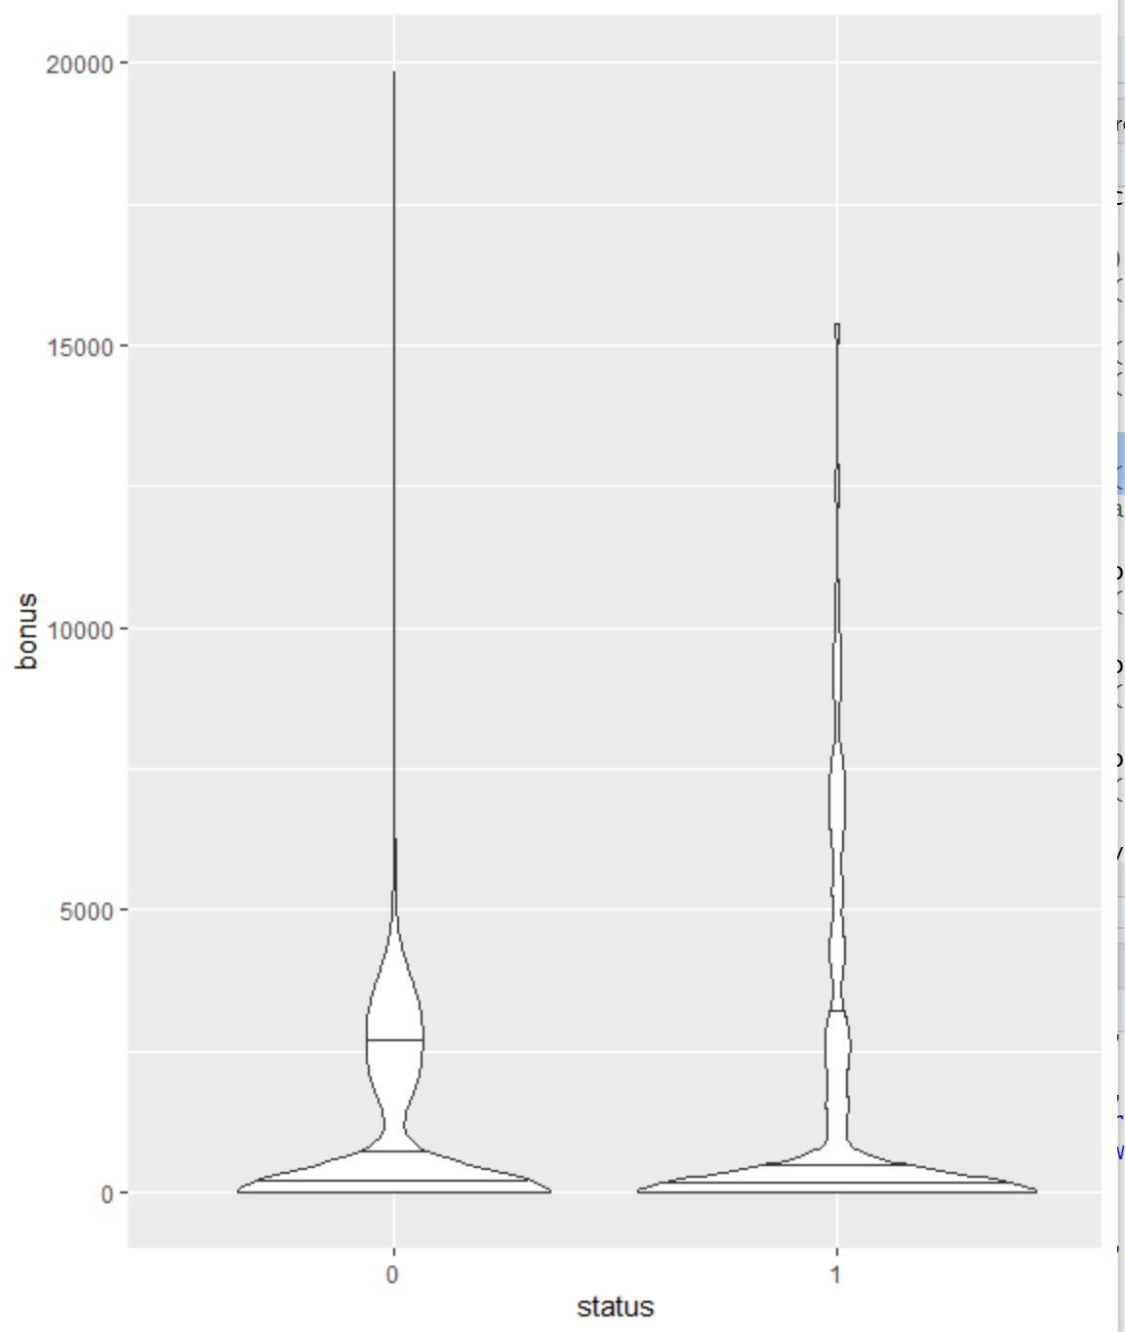
Bonus v/s Status
p5 <- ggplot(data, aes(x=status,y=bonus)) + geom_violin()
p5 + geom_violin(trim = TRUE) + geom_violin(draw_quantiles = c(0.25,0.5,0.75))
The violin plots can be compared with the mean, median and mode value for bonus v/s status

Slide 14
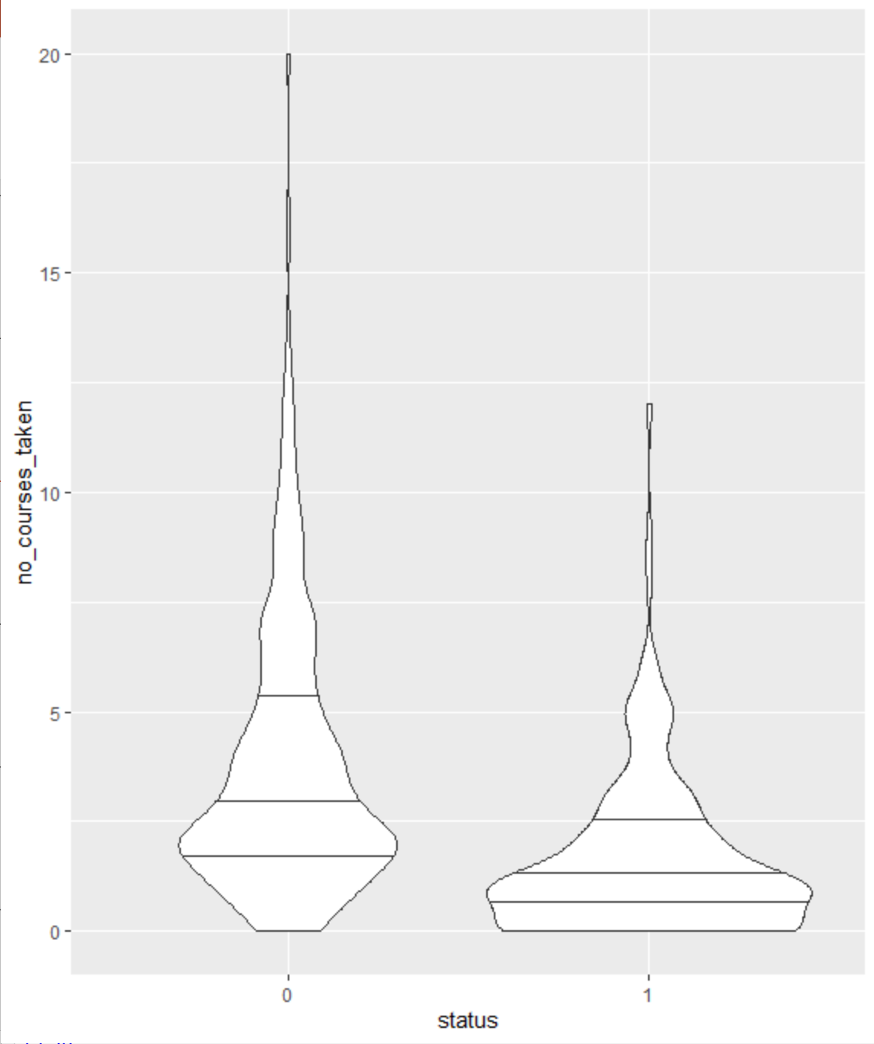
No of courses taken v/s Status
p6 <- ggplot(data, aes(x=status,y=no_courses_taken)) + geom_violin()
p6 + geom_violin(trim = TRUE) + geom_violin(draw_quantiles = c(0.25,0.5,0.75))
From the avg, max, min and median, we could conclude that may be the people are not happy with the courses and hence are leaving the company or could be managed horizontally than vertically or vice-versa

Slide 15
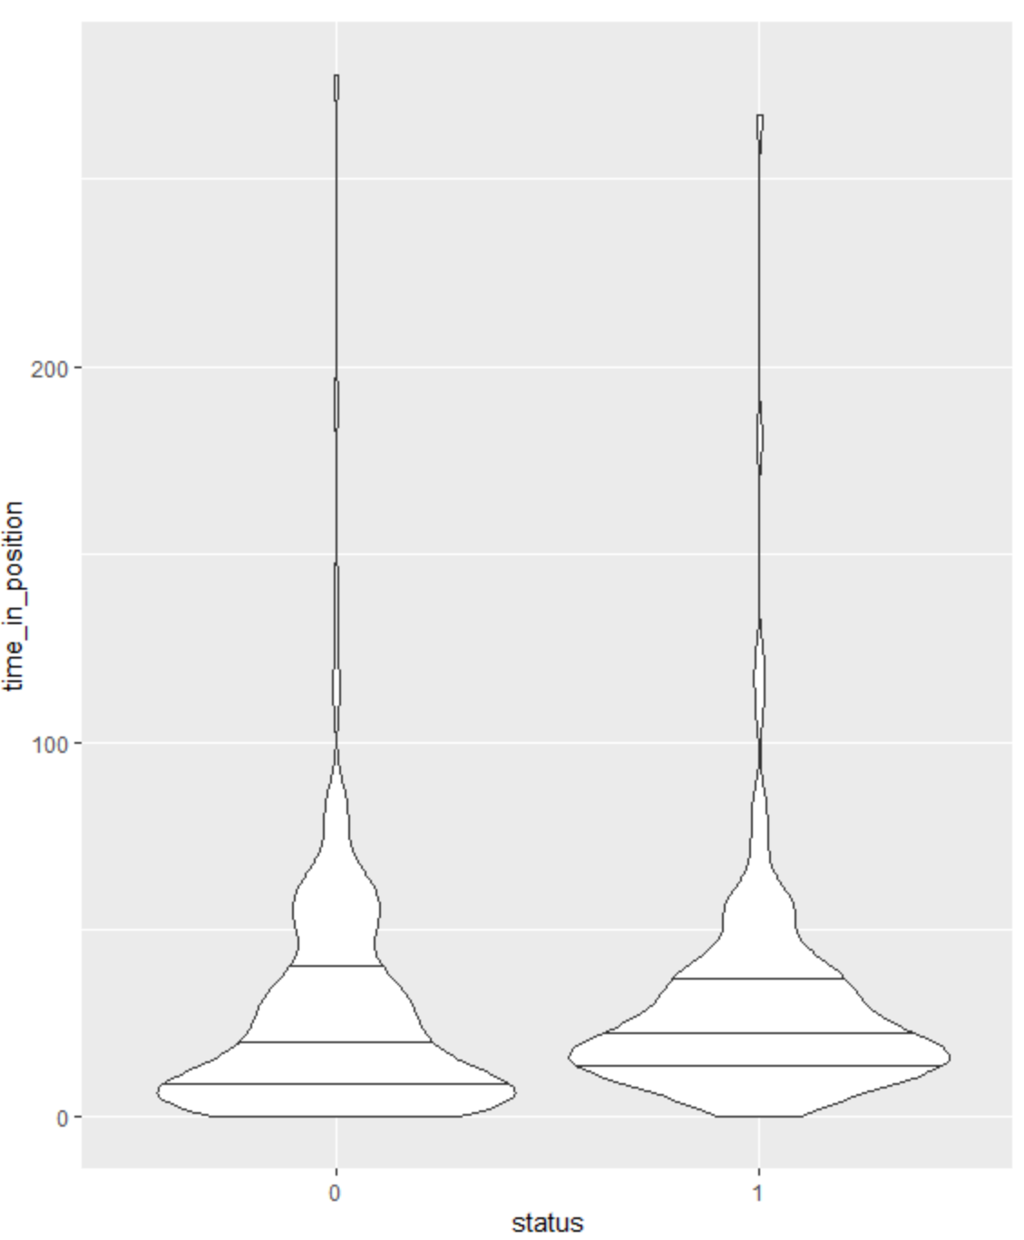
Time in position v/s Status
p7 <- ggplot(data, aes(x=status,y=time_in_position)) + geom_violin()
p7 + geom_violin(trim = TRUE) + geom_violin(draw_quantiles = c(0.25,0.5,0.75)) # maximum value - very very high, so there might be the case that something wrong with the data (outlier might be present)

Slide 16
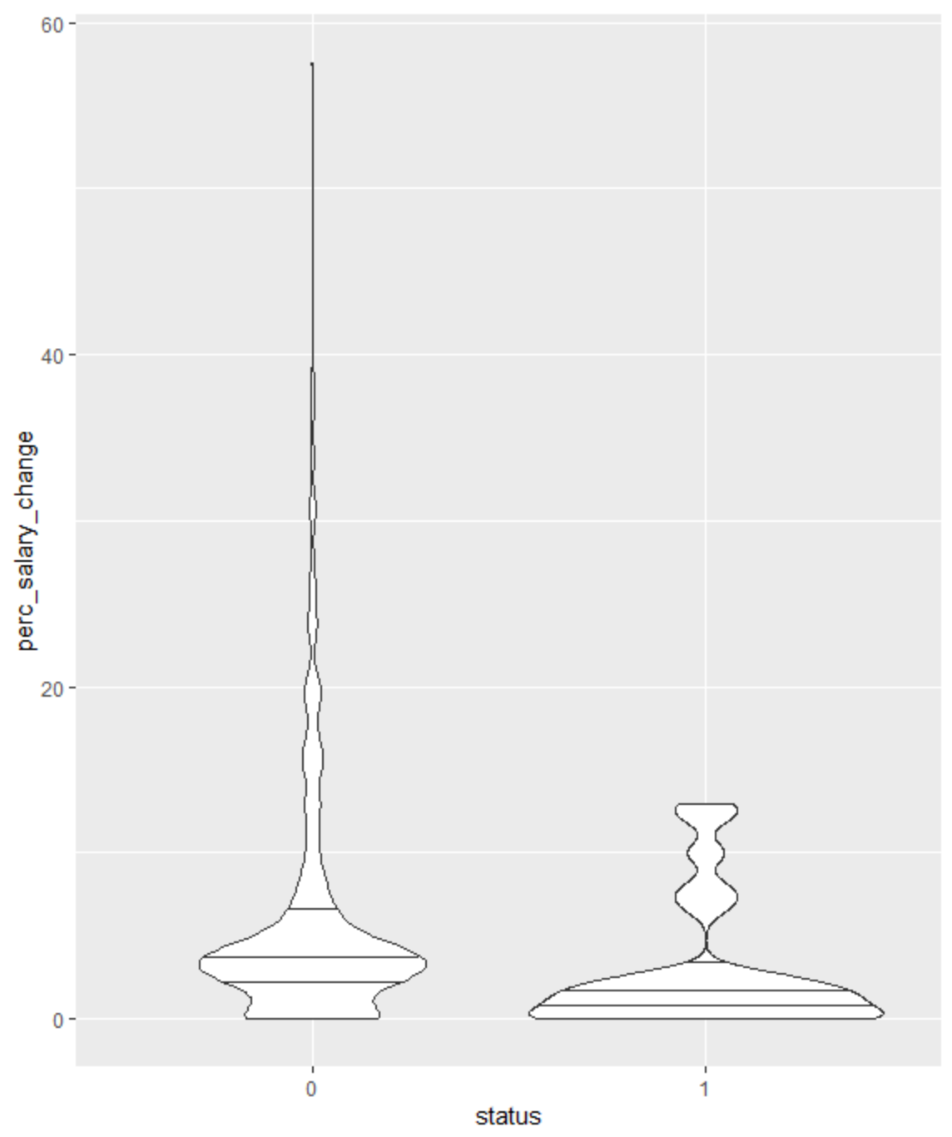
Percentage salary change v/s Status
p8 <- ggplot(data, aes(x=status,y=perc_salary_change)) + geom_violin()
p8 + geom_violin(trim = TRUE) + geom_violin(draw_quantiles = c(0.25,0.5,0.75)) # maximum salary change is the key.. if you do not give a good hike to the employee, they are bound to leave the company.

