Slide 1


Bivariate Analysis
Determining relation between 2 variables –
Categorical – Categorical Variables
Categorical – Numerical Variables

Slide 2


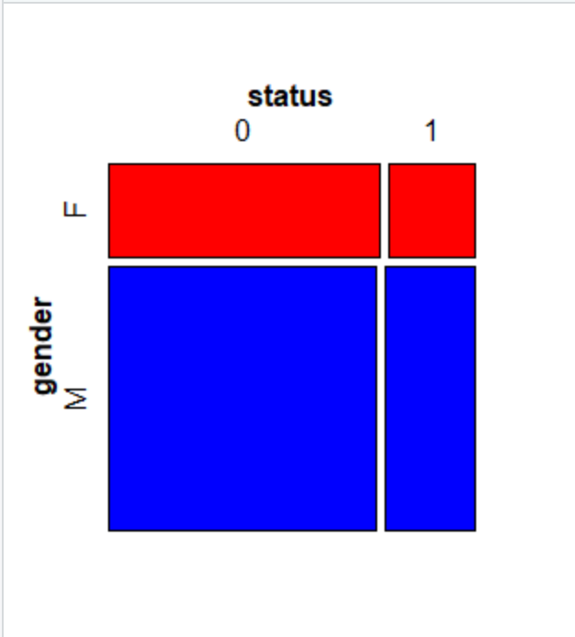
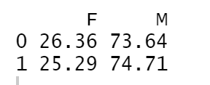
Gender v/s Status
tab2 <- table(data$status,data$gender) # gender wise status round(prop.table(tab2,1)*100,digits =2)
Result in tabular format:

Slide 3
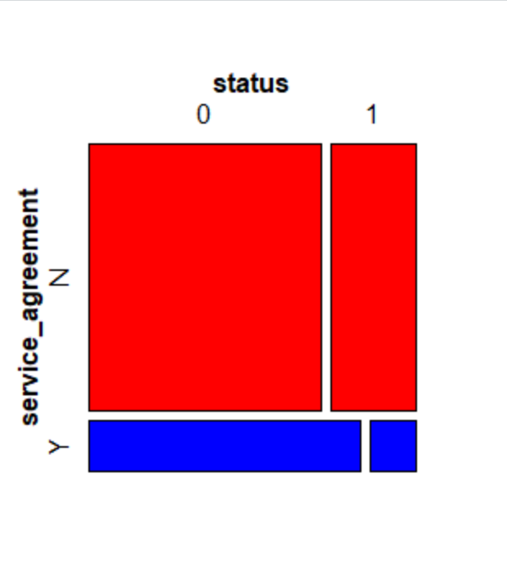

Service Agreement v/s Status
tab3 <- table(data$status,data$service_agreement)
round(prop.table(tab3,1)*100,digits =2)
Result in tabular format:

Slide 4
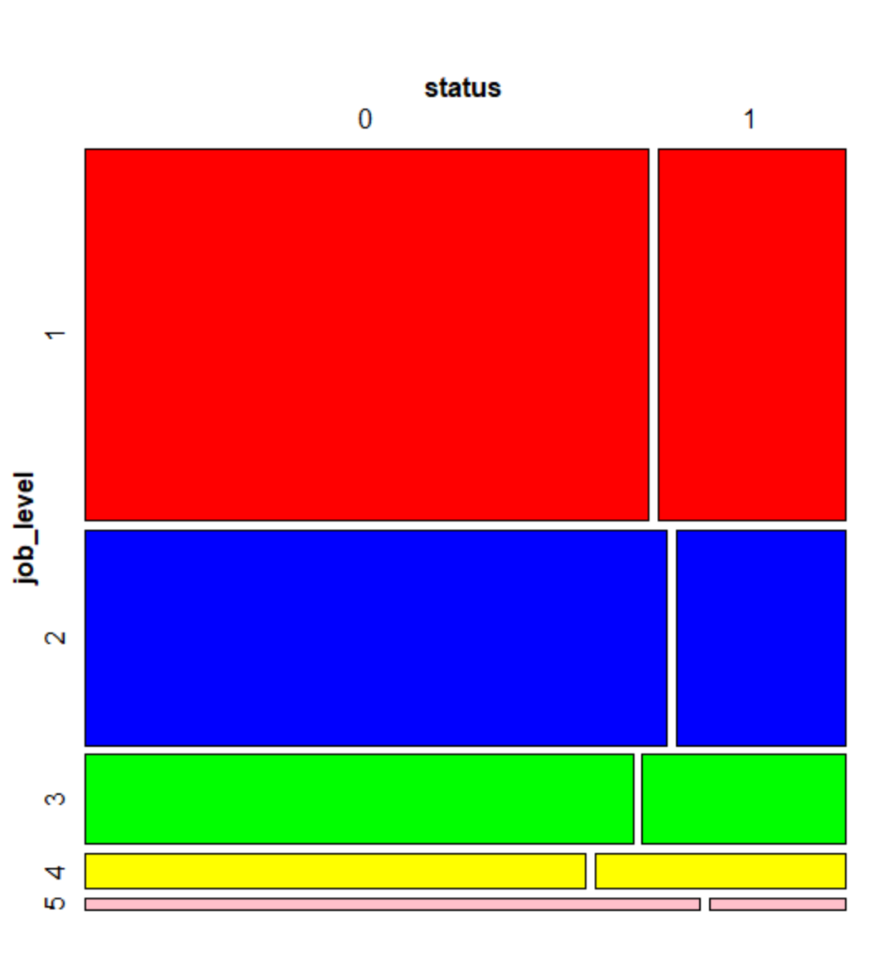
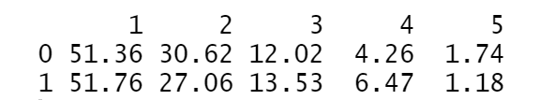
Job Level v/s Status
tab4 <- table(data$status,data$job_level) # has 5 levels as per as.fator
round(prop.table(tab4,1)*100,digits =2)
Result in tabular format:

Slide 5
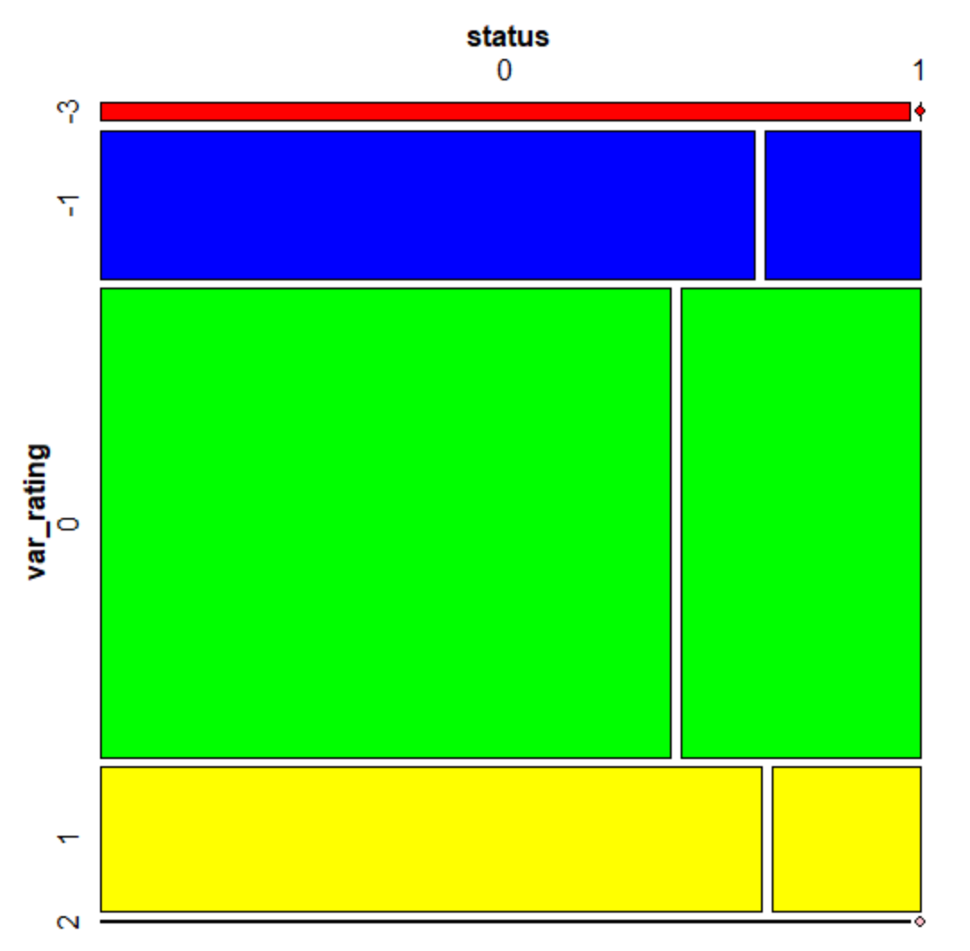
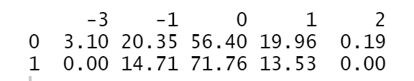
Rating v/s Status
tab5 <- table(data$status,data$var_rating) # has 5 levels as per as.fator
round(prop.table(tab5,1)*100,digits =2)
Result in tabular format:

Slide 6
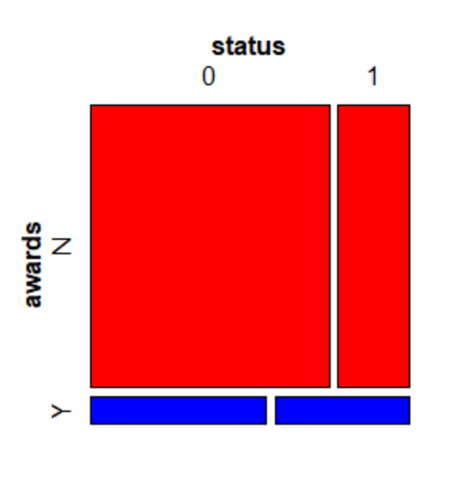
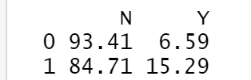
Rating v/s Status
tab6 <- table(data$status,data$rating)
round(prop.table(tab6,1)*100,digits =2)
Result in tabular format:

Slide 7
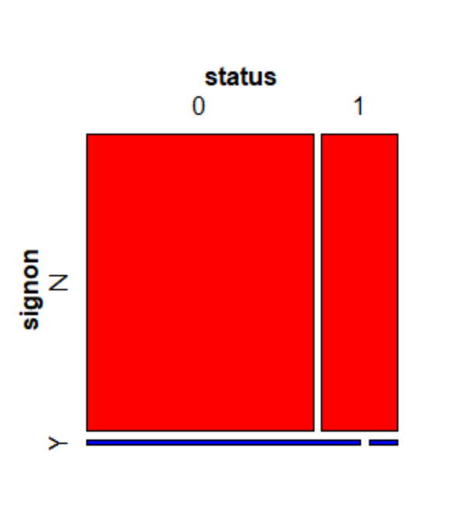
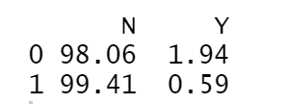
Signon (signing bonus) v/s Status
tab7 <- table(data$status,data$signon)
round(prop.table(tab7,1)*100,digits =2)
Result in tabular format:

