Slide 1
Meridian Home
Market Expansion Strategy
Which Two Markets Should We Enter First?
Prepared by Balraj Kooner | Masters in Business Analytics
July 2026

Slide 2
Situation
• Meridian Home operates 47 stores concentrated in the Northeast and West Coast, with ~$890M in annual revenue and strong brand recognition in the premium home goods segment
• The board has approved expansion into 2 new markets, targeting metros with strong homeowner demographics and limited premium competition
• Five candidate metros were identified across three growth regions: Sun Belt (Nashville, Austin, Charlotte), Mountain West (Denver), Midwest (Indianapolis)

Slide 3
Complication
• Not all five markets offer equivalent returns — market attractiveness, competitive density, and unit economics vary significantly across the candidates
• Entering the wrong market carries substantial risk: $450K pre-opening investment per store, multi-year lease commitments, and reputational risk of a poorly-performing flagship in a new region
• A rigorous, data-driven framework is needed to identify the markets with the highest probability of success across 7 weighted dimensions — and to be honest about where the unit economics are still marginal

Slide 4
Our Recommendation
Enter Charlotte first (Q1 2026); open a single Indianapolis pilot store in parallel
• Indianapolis ranks #1 on market attractiveness (composite 4.25/5.0) — cheapest lease rate ($22.20/sqft) and lowest competitive density of any candidate — but slower population growth (4.9%/5yr) means its financial case needs more runway to prove out than our 3-year model window
• Charlotte ranks #2 (composite 4.08/5.0), sits at Meridian's own East Coast distribution hub (zero logistics cost), and is the only recommended market that clears payback within the model horizon (~31 months)
• Combined risk-adjusted 3-year NPV is currently negative (-$695,888) at the standard 4,500 sqft / 10-FTE format — this is a real constraint, not a rounding error, and the phased approach below is how we manage that risk
• Recommended sequencing: open Charlotte's 2-store cluster now; open 1 Indianapolis pilot store (not 2) to validate real-world performance before committing the second store there

Slide 5
Analytical Framework
Issue Tree
7 Evaluation Dimensions
• Is the market attractive? (size, income, housing, e-commerce penetration)
• Can Meridian compete effectively? (saturation, cannibalization, logistics)
• What is the financial return? (revenue, cost, breakeven, NPV)
Population & Growth
15%
Income & Furnishing Spend
20%
Homeownership & Housing
20%
Competitive Saturation
20%
Retail Lease Cost
10%
Labor Cost
10%
Logistics Proximity
5%

Slide 6
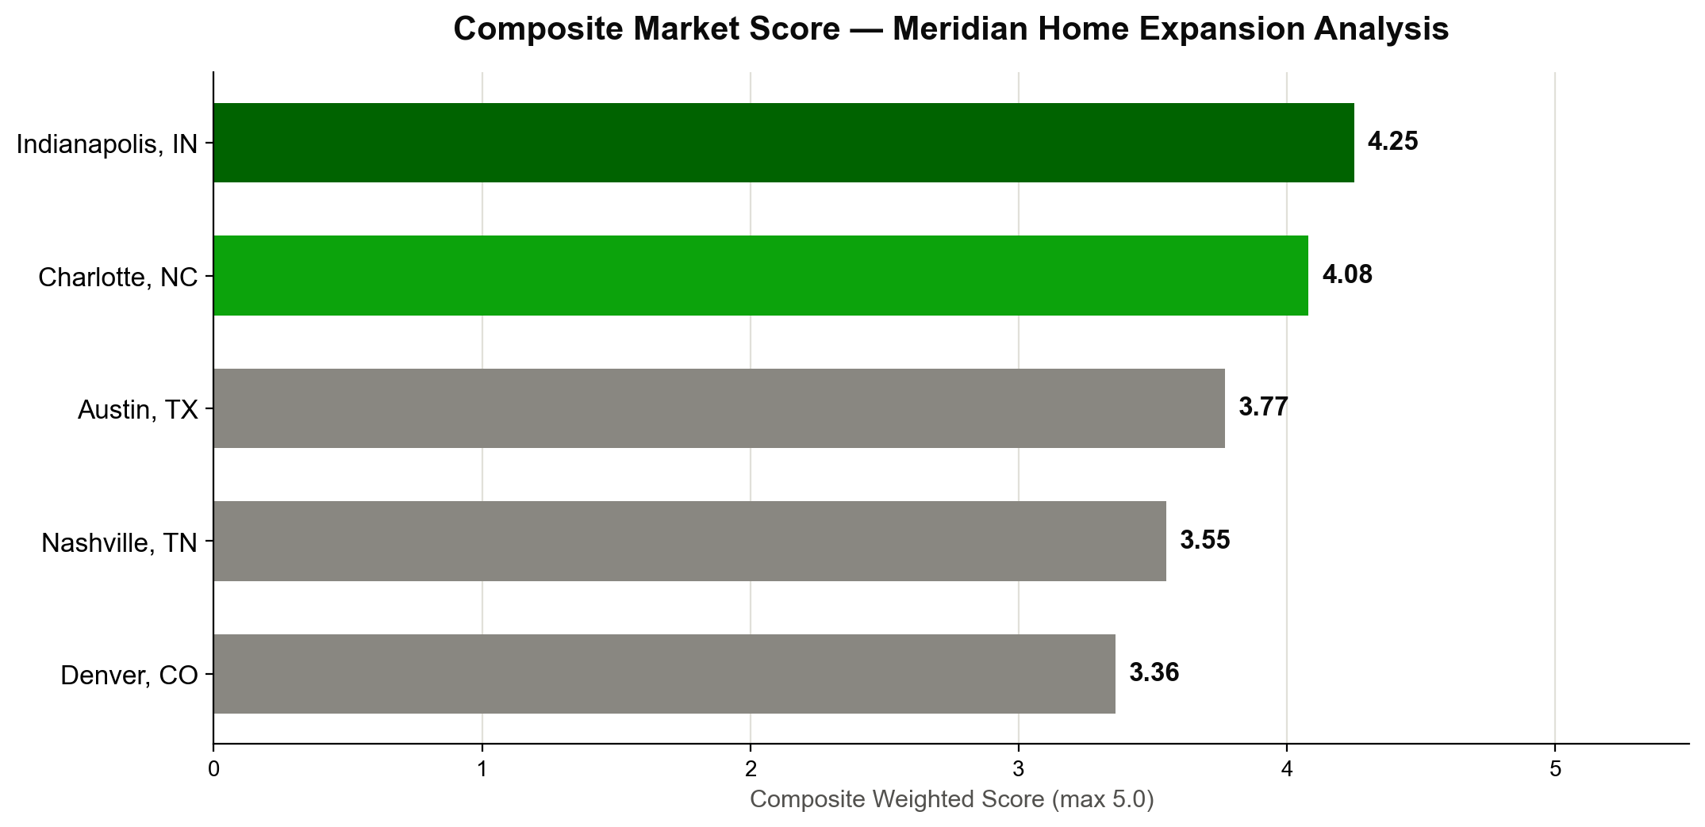
Market Attractiveness Scorecard
Source: US Census ACS, BLS OES/CEX, Zillow Research, NAHB, CommercialCafe — analysis by Balraj Kooner

Slide 7
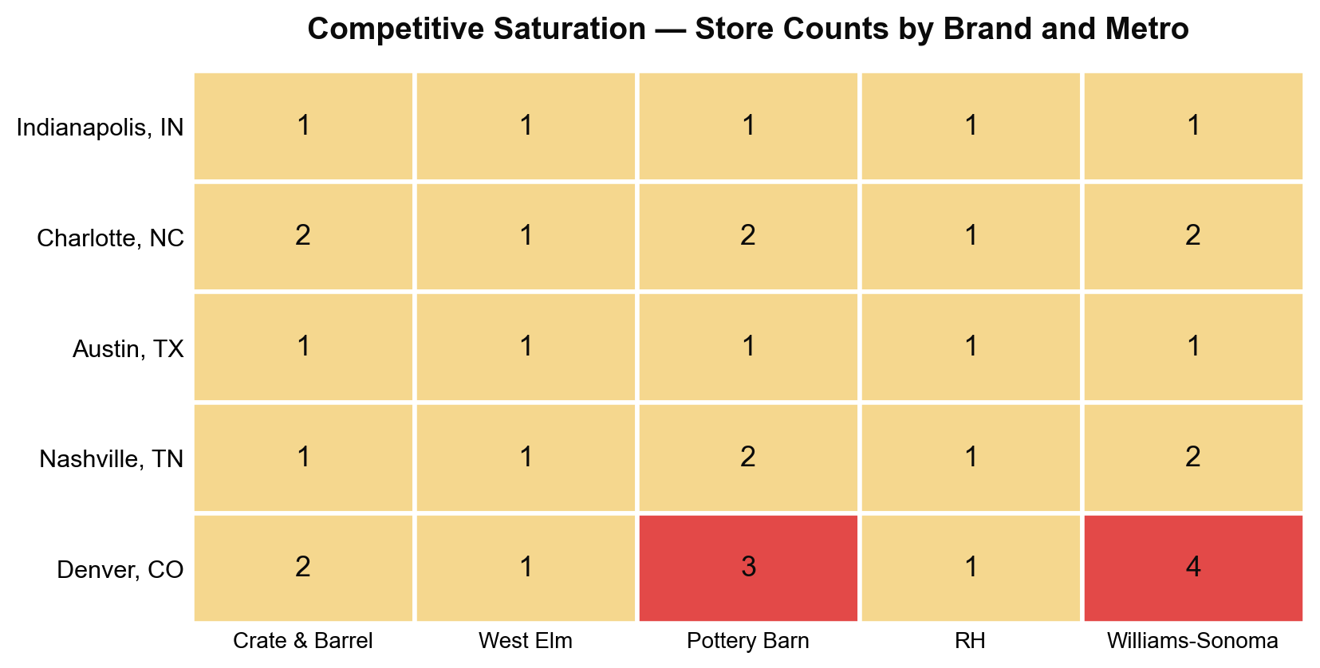
Competitive Saturation Analysis
Indianapolis and Austin show the lowest direct competitor density (~0.21-0.24 per 100k population) — Charlotte offers a reasonable balance of growth and moderate competition (0.29 per 100k)

Slide 8
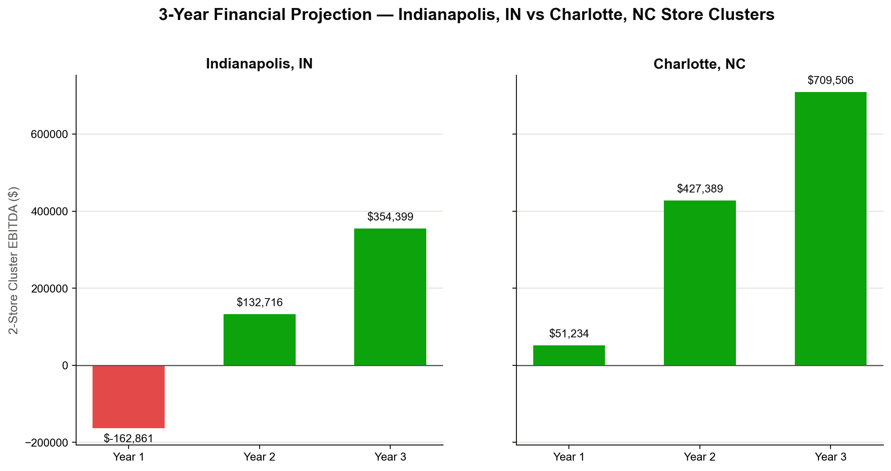
3-Year Financial Projection — Recommended Markets
Combined Year 3 EBITDA
Charlotte Payback Period
Combined Risk-Adj. NPV
$1,063,905
31 months
-$695,888

Slide 9
Key Risks and Mitigation
Risk
Probability
Mitigation
Combined NPV is negative at the modeled 4,500 sqft / 10-FTE format
High
Phase Indianapolis as a single pilot store; revisit store format (sqft, staffing) before the second store
Competitive response from West Elm or Pottery Barn
Medium
Pre-commit to Charlotte's 2-store cluster to establish critical mass before competitors react
Ramp-up slower than modeled (consumer awareness lag)
Medium
Year 1 budget includes incremental local marketing spend beyond the 3%-of-revenue baseline

Slide 10
18-Month Implementation Roadmap
• Month 1-2: Market validation (real estate broker engagement, trade area confirmation) — both markets
• Month 2-4: Charlotte site selection and LOI negotiation (2-store cluster)
• Month 4-6: Charlotte lease execution and buildout
• Month 6: Charlotte stores open — Q1 2026
• Month 6-8: Indianapolis single-store site selection and LOI (pilot format)
• Month 8-10: Indianapolis pilot buildout
• Month 10: Indianapolis pilot store opens
• Month 10-18: Performance monitoring against model; go/no-go decision on Indianapolis store #2

