Slide 1
MET CS-602 Server Side Web Development
Inventory Tracking System
Term Project
Submission Date :- Aug 22, 2019
Submitted On :- Aug 21, 2019
Developed By
Balramjot Saini

Slide 2
Two Sections
Administrator or Back-End.
User or Front-End.

Slide 3
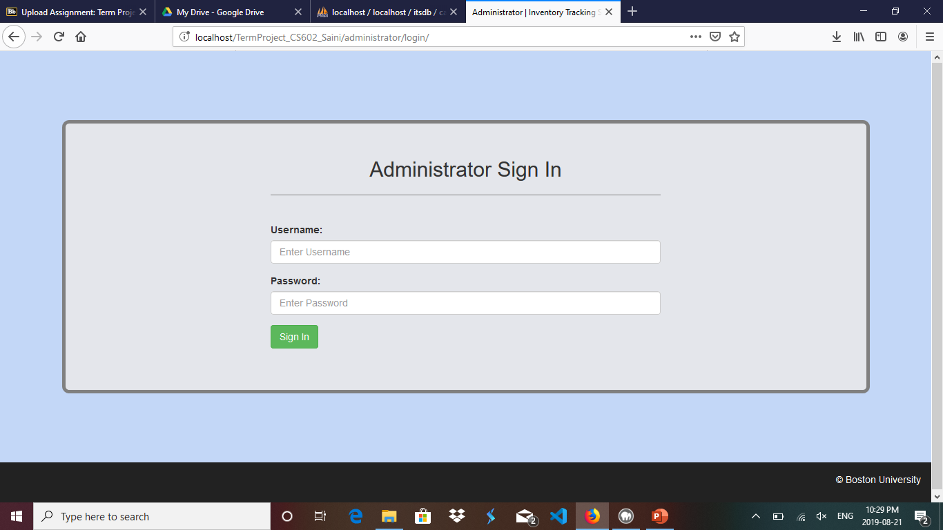
Administrator
Link :- http://localhost/TermProject_CS602_Saini/administrator/
Login

Slide 4
Login – Administrator
Link :- http://localhost/TermProject_CS602_Saini/administrator/
Admin used this screen to logged in into console.
Empty fields validations along with verifying username and password with database before login. If not verified, error message displayed on the screen.

Slide 5
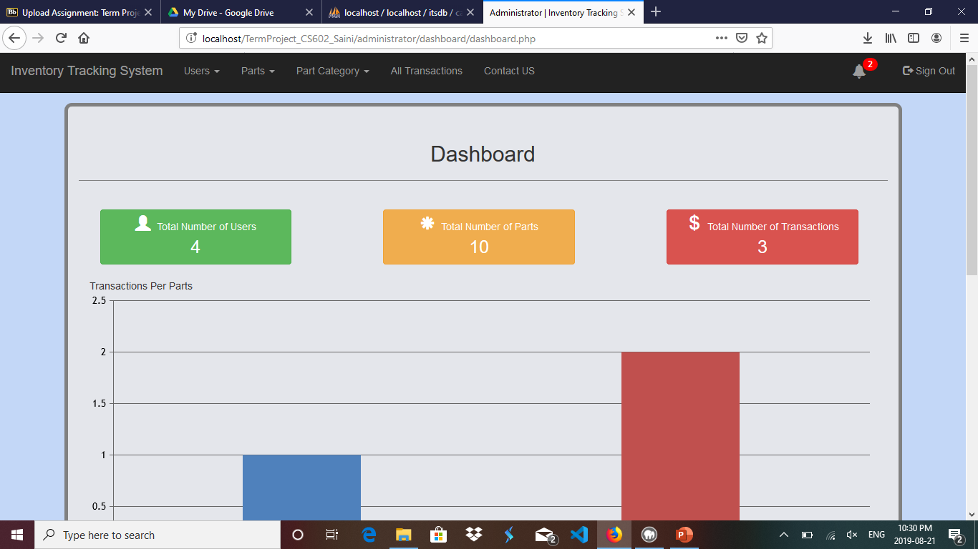
Administrator
Dashboard

Slide 6
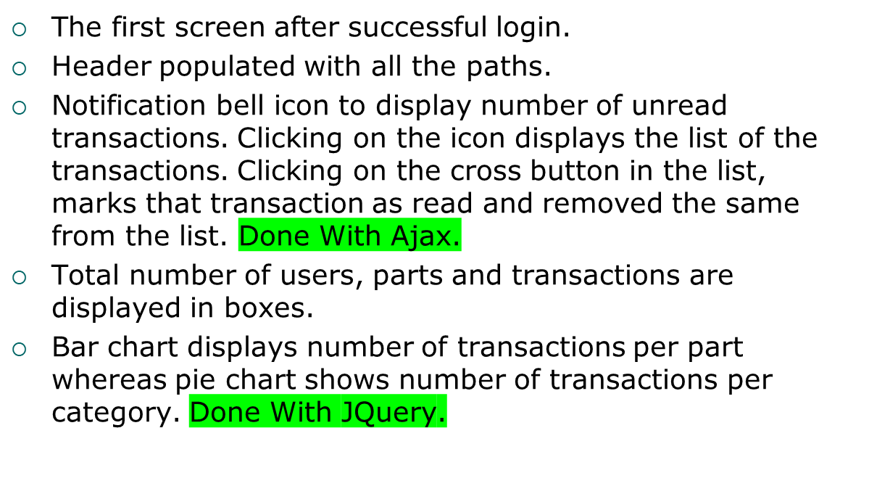
Dashboard - Administrator

Slide 7
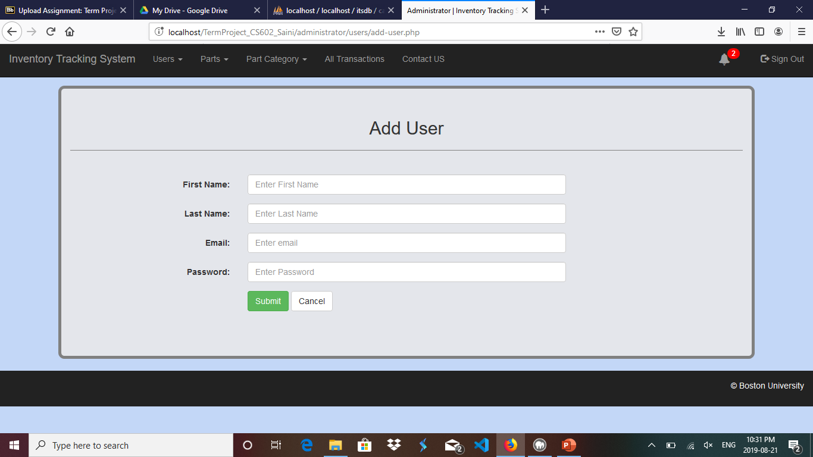
Administrator
Link :- Users >> Add Users
Add User

Slide 8
Add User – Administrator
Link :- Users >> Add Users
This form used to insert a create a new user.
All the fields are set as required.
Email field accepts the value to be email only.
Form check for already existing email, if found error is shown as no user can have same email address.

Slide 9
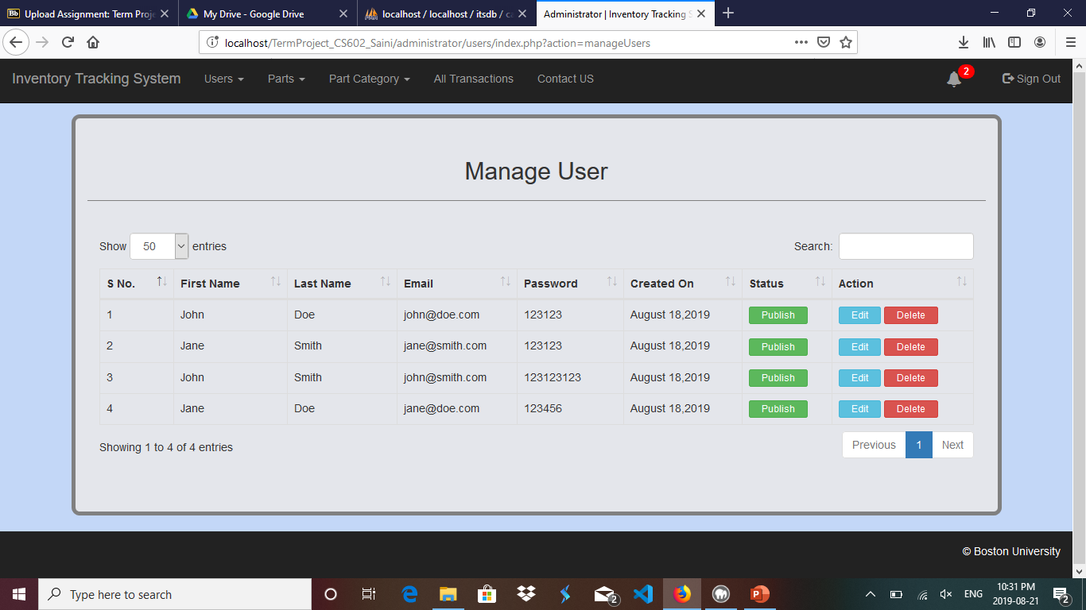
Administrator
Link :- Users >> Manage Users
Manage User

Slide 10
Manage User – Administrator
Link :- Users >> Manage Users
All the added users list is shown on this page.
Admin can search for any user, sort with any heading from the table.
If no user is there in the database, then message is shown instead of data in the table.
Publishing/Unpublishing of user (only published users are allowed to login from the front-end).
Deleting any user after clicking on confirmation message.
Edit any user from this layout.

Slide 11
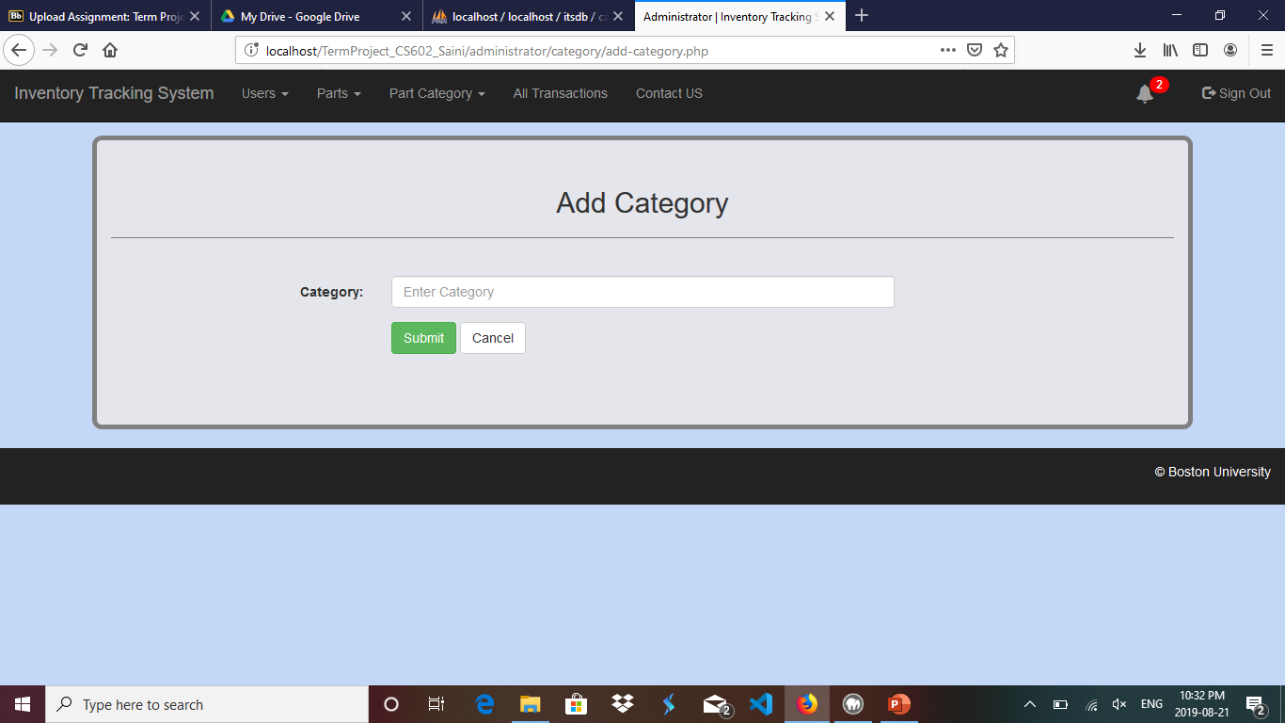
Administrator
Link :- Part Category >> Add Category
Add Category

Slide 12
Add Category – Administrator
Link :- Part Category >> Add Category
Admin can have the option to add a new category from this page. Category is going to be used further while creating a part.

Slide 13
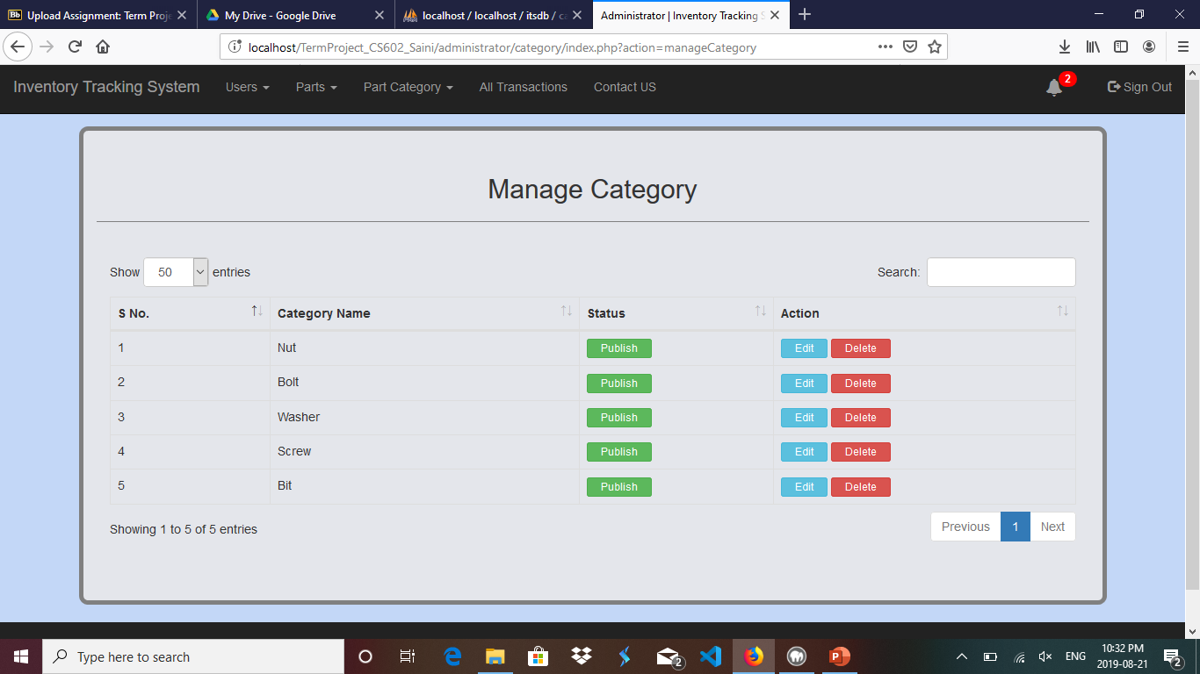
Administrator
Link :- Part Category >> Manage Category
Manage Category

Slide 14
Manage Category – Administrator
Link :- Part Category >> Manage Category
Manage category page contains all the already added categories.
Admin can search for any category, sort with any heading from the table.
If no category is there in the database, then message is shown instead of data in the table.
Publishing/Unpublishing of category.
Deleting any category after clicking on confirmation message.
Edit any category from this layout.

Slide 15
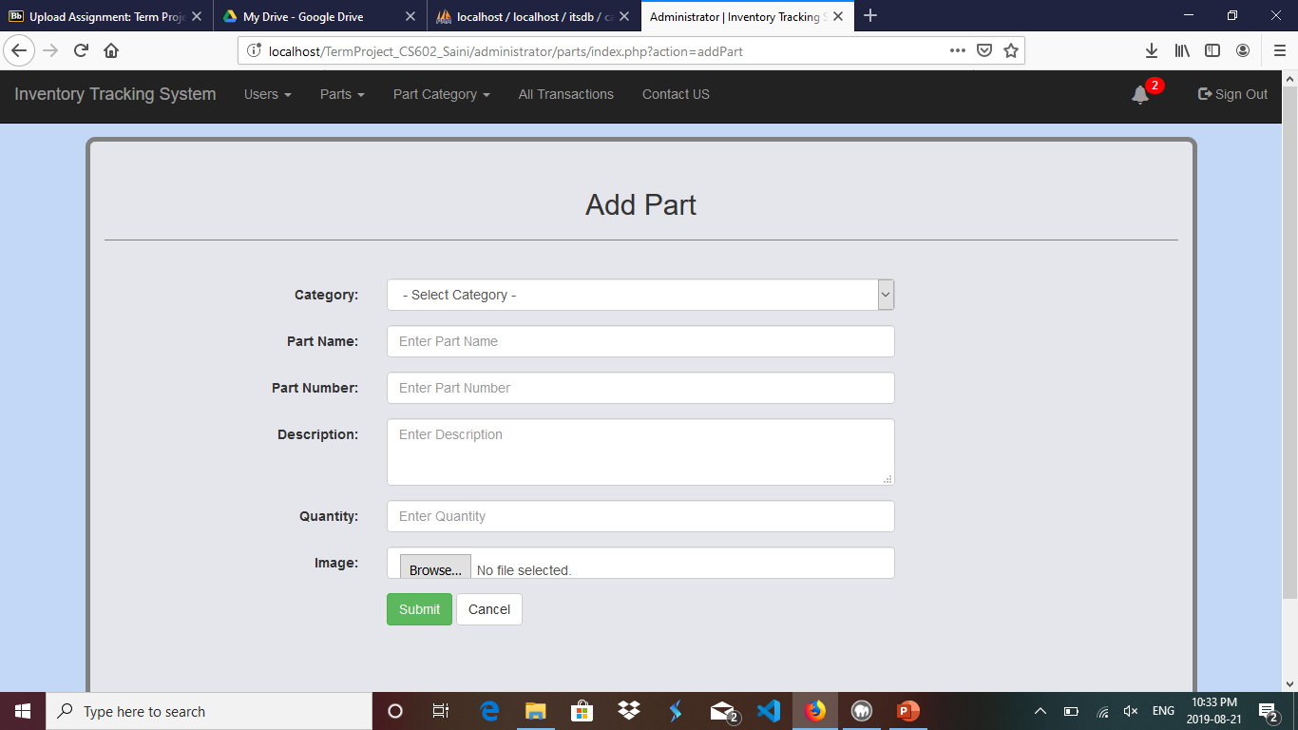
Administrator
Link :- Parts >> Add Part
Add Part

Slide 16
Add Part – Administrator
Link :- Parts >> Add Part
Admin can have the option to add a new part from this page.
The form checks for already existing part number i.e. same part number must not be present in the database.
Part Image is also uploaded from this page.
All the fields except image fields are required.

Slide 17
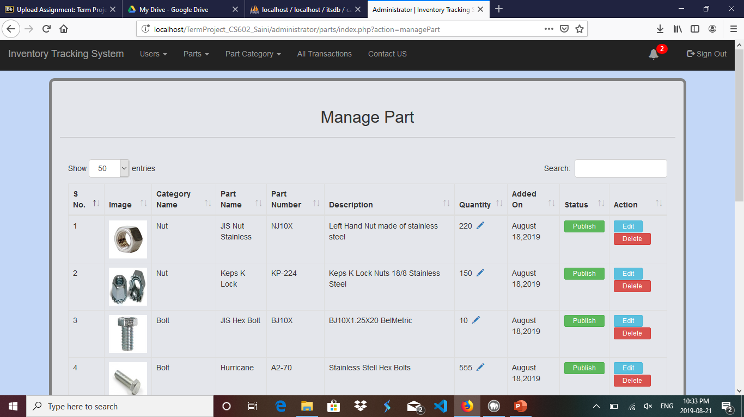
Administrator
Link :- Parts >> Manage Parts
Manage Part

Slide 18
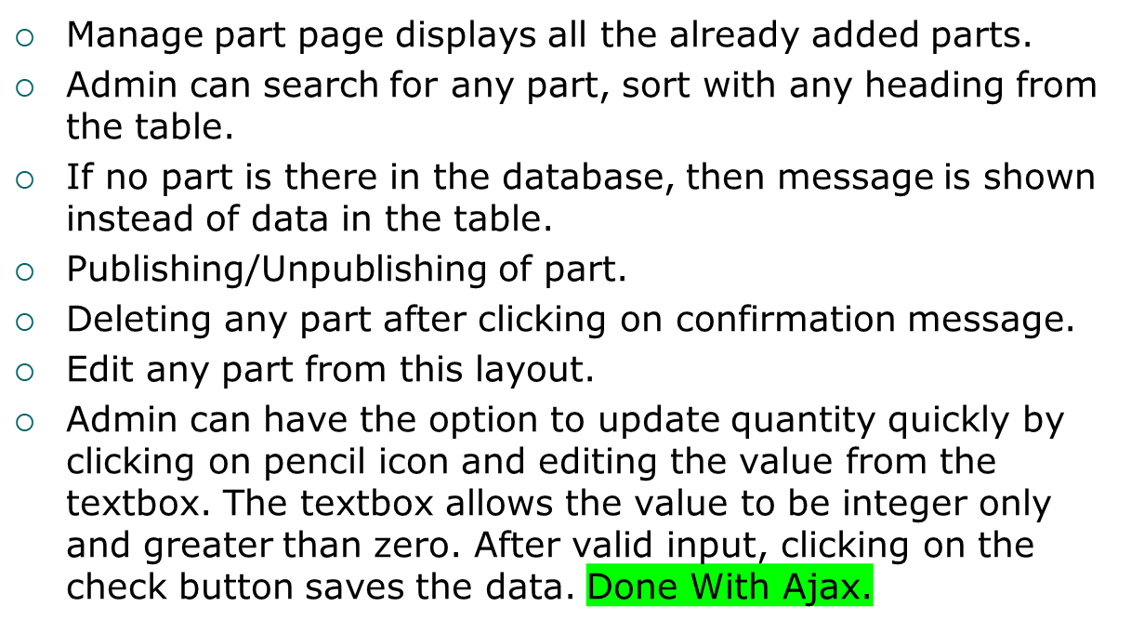
Manage Part – Administrator
Link :- Parts >> Manage Part

Slide 19
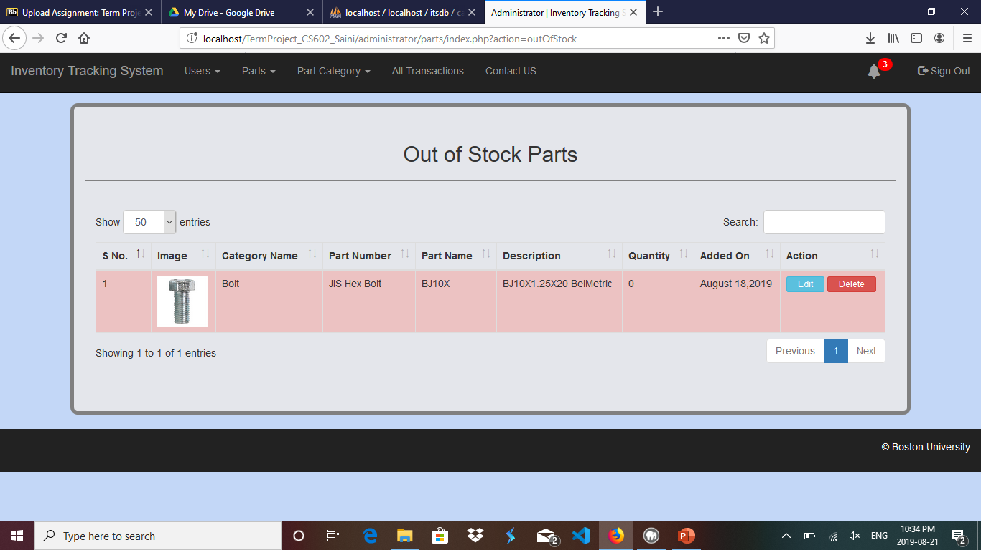
Administrator
Link :- Parts >> Out of Stock
Out of Stock Parts

Slide 20
Out of Stock Parts – Administrator
Link :- Parts >> Out of Stock Parts
Out of stock items i.e. items with quantity zero are shown on this page. Background colour becomes red for this case.
Admin can search for any part, sort with any heading from the table.
If no part is there in the database, then message is shown instead of data in the table.
Deleting any part after clicking on confirmation message.
Edit any part from this layout.

Slide 21
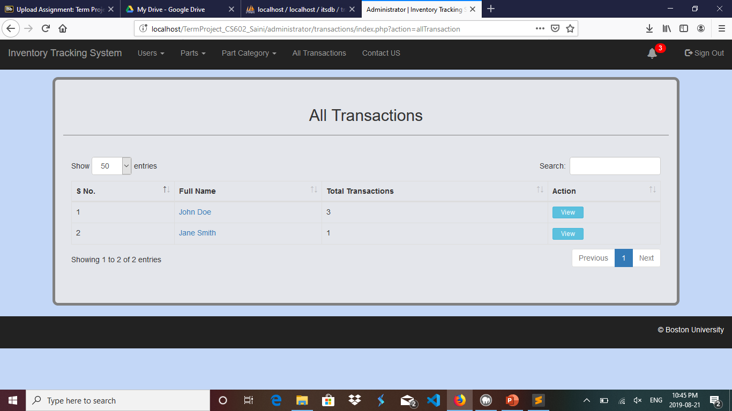
Administrator
Link :- All Transactions
All Transactions

Slide 22
All Transactions – Administrator
Link :- All Transactions
Transactions are shown according to the users. Number of transactions are mentioned against the name of the user.
Clicking on name of the user, redirects the admin to the user detail page. Clicking on back button from the view user page redirects the admin to the previous page.
Clicking on view button, redirects the admin to the transaction record page where all the transactions of that user is shown. Unread transactions are highlighted in green colour.
Mark as read button, marks that transaction as read and hides mark as read button.
Delete button deletes that particular transaction.
Clicking on part name directs the administrator to the parts info page. Clicking on back button from the part information page redirects the admin to the previous page.

Slide 23
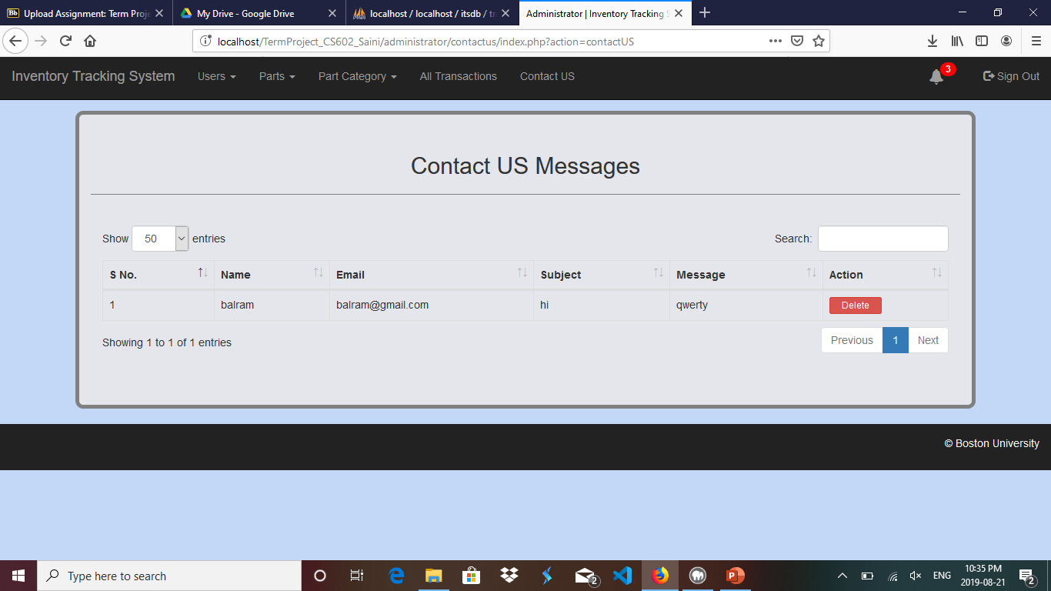
Administrator
Link :- Contact US
Contact US Messages

Slide 24
Contact US Messages – Administrator
Link :- Contact US
Contact us messages that are sent by the user to the administrator are listed on this page.
Admin can search for any message, sort with any heading from the table.
If no message is there in the database, then message is shown instead of data in the table.
Deleting any message after clicking on confirmation message.

Slide 25
Sign Out– Administrator
Link :- Sign Out
Sign out simply ends the administrator session and log it off from the admin console.

Slide 26
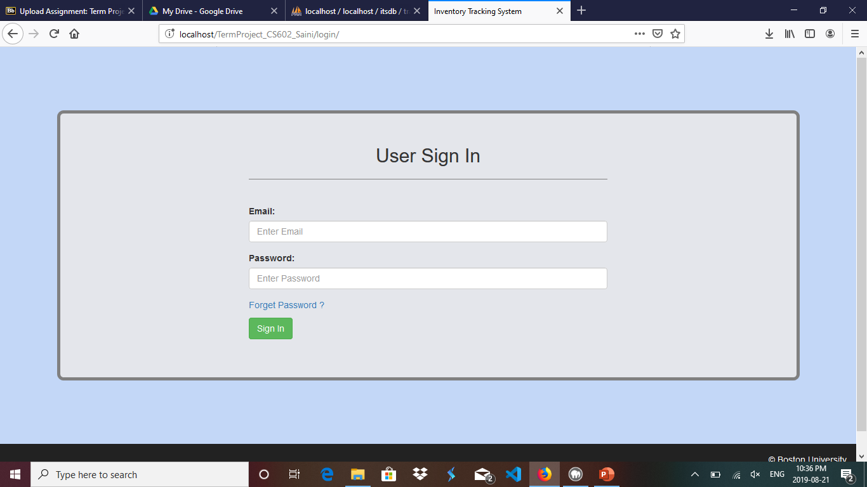
User
Link :- http://localhost/TermProject_CS602_Saini/
Login

Slide 27
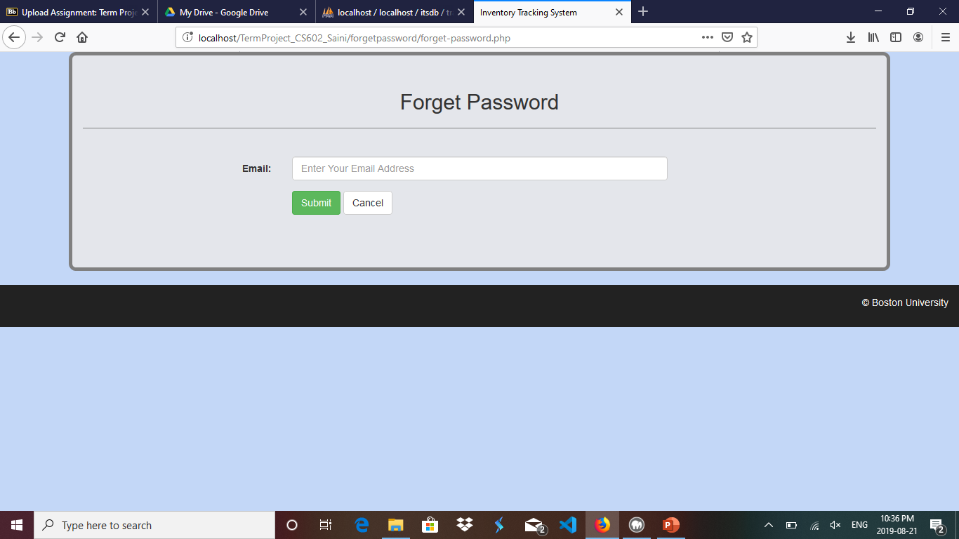
User
Link :- Forget Password
Forget Password

Slide 28
Forget Password – Administrator
Link :- Forget Password
In case if user forgot his/her password then clicking on forget password link redirects the user to this page from where user gains his/her password after filling email address assigned to that account.
Email entered should matched with the one assigned by the administrator to that user.
Incase no email match, error message display on the screen.
Password is displayed in the alert after submitting data.

Slide 29
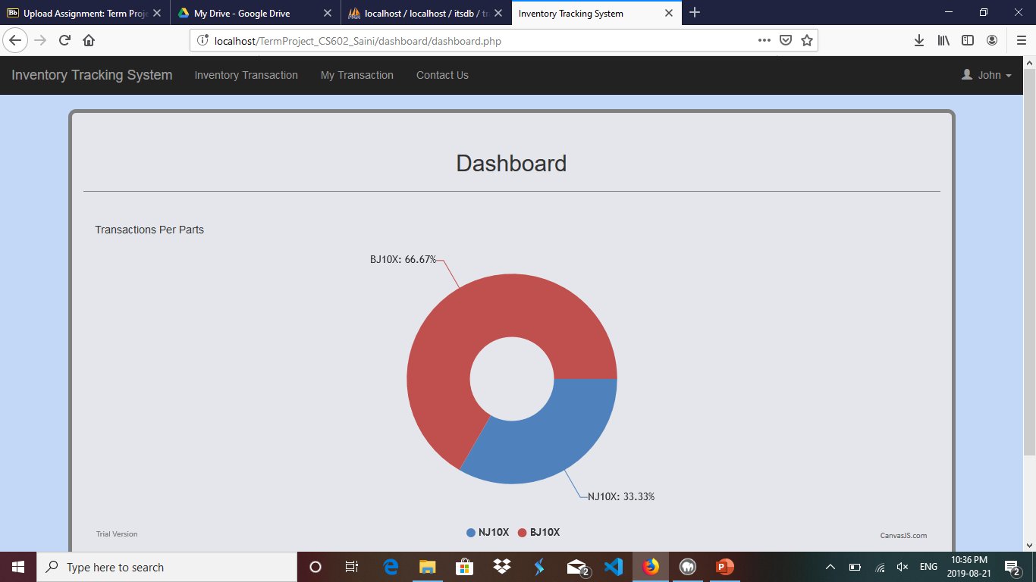
User
Dashboard

Slide 30
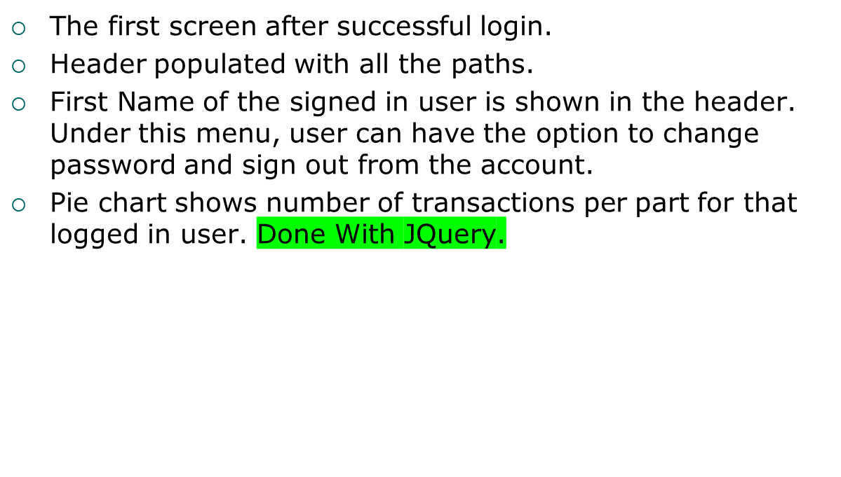
Dashboard - User

Slide 31
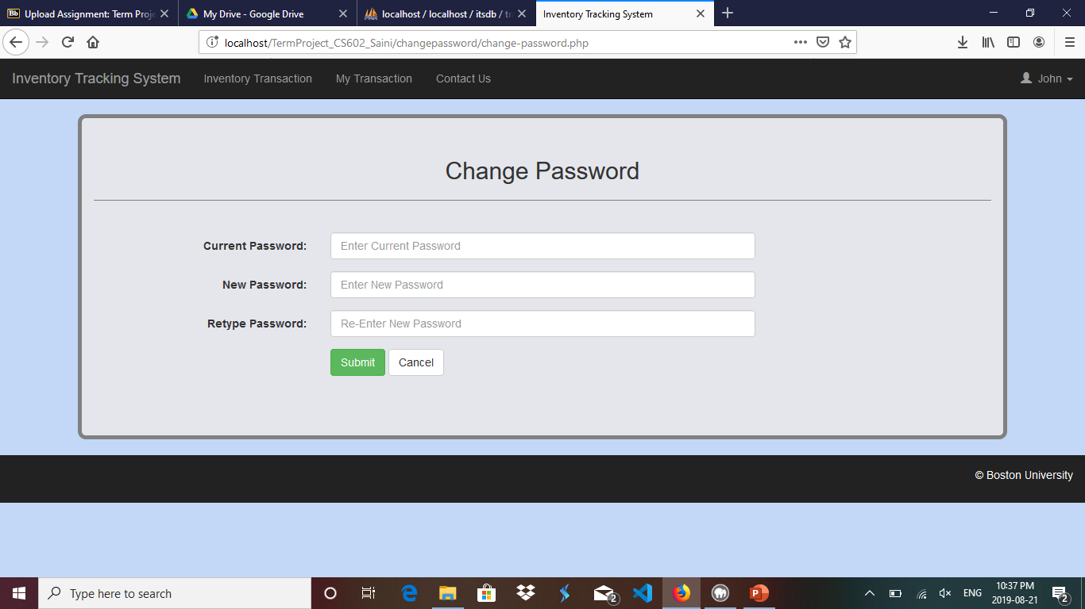
User
Link :- Change Password
Change Password

Slide 32
Change Password- User
User can have the option to change his/her login password from this page.
All the fields are required on this page.
Validation for current password to be matched with the one saved in database is applied.
New password and retype password must match with each other.
If any of the validation is not true, then an error message is displayed to the user.

Slide 33
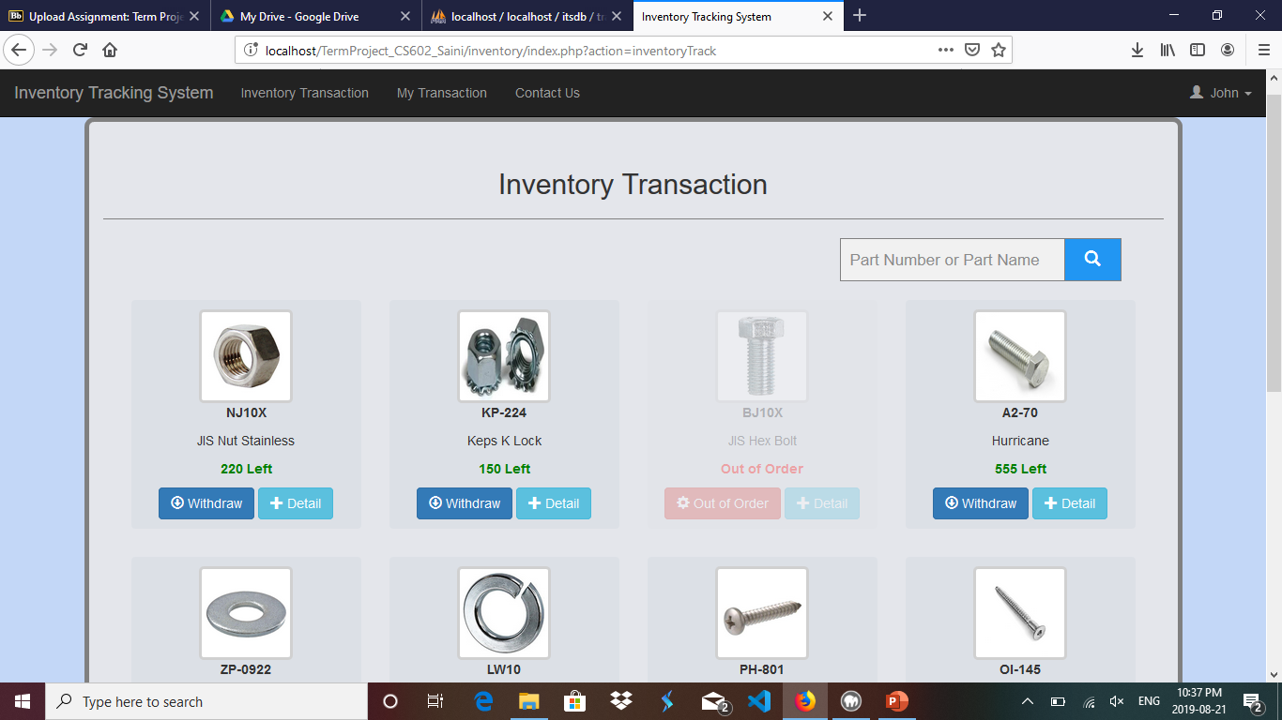
User
Link :- Inventory Transaction
Inventory Transaction

Slide 34
Inventory Transaction - User
All the parts that are added by administrator are shown on this page. Part image, part number, quantity, etc are shown on this page.
Clicking on detail button, shows a popup modal box with all the details of the part.
Clicking on withdraw button, shows another popup modal box, that displays the information about the quantity of the part to be entered to withdraw. The quantity textbox only takes up to that value that has been entered by the administrator for that part in quantity field. Only integers and value greater than zero are validated for quantity.
After entering the quantity to be withdrawn, same number of quantity is subtracted from the total part quantity.
User can also have the option to search part by entering either part number or part name.
If any item quantity becomes zero, that part become out of order item and shows as blurry.

Slide 35
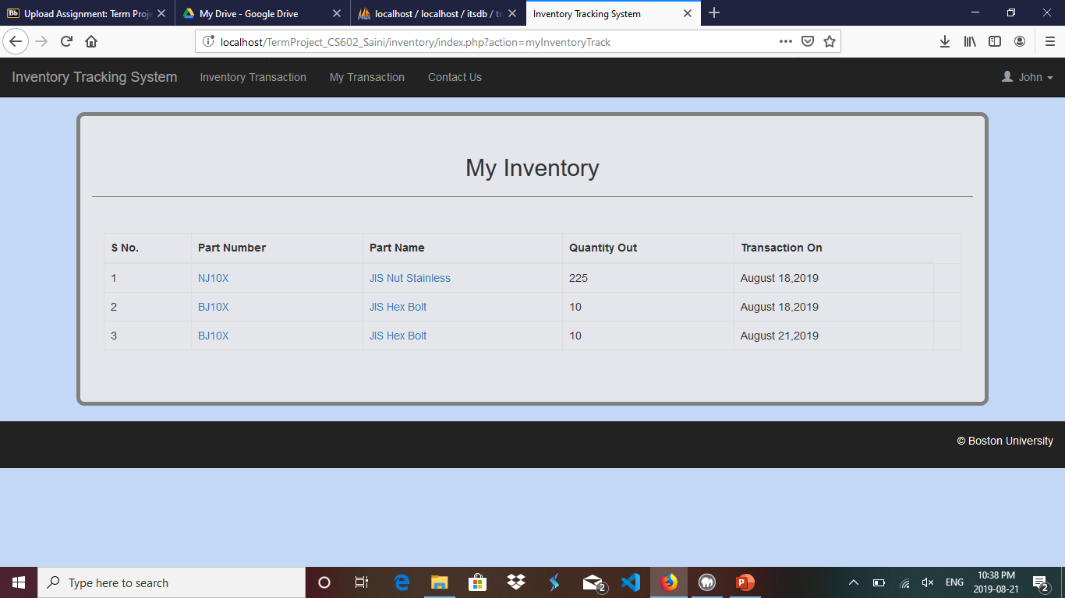
User
Link :- My Transaction
My Inventory

Slide 36
My Transaction - User
All the transactions that are done by the user are listed on this page. User can click on part number or part name page to view the respective detail of the part.

Slide 37
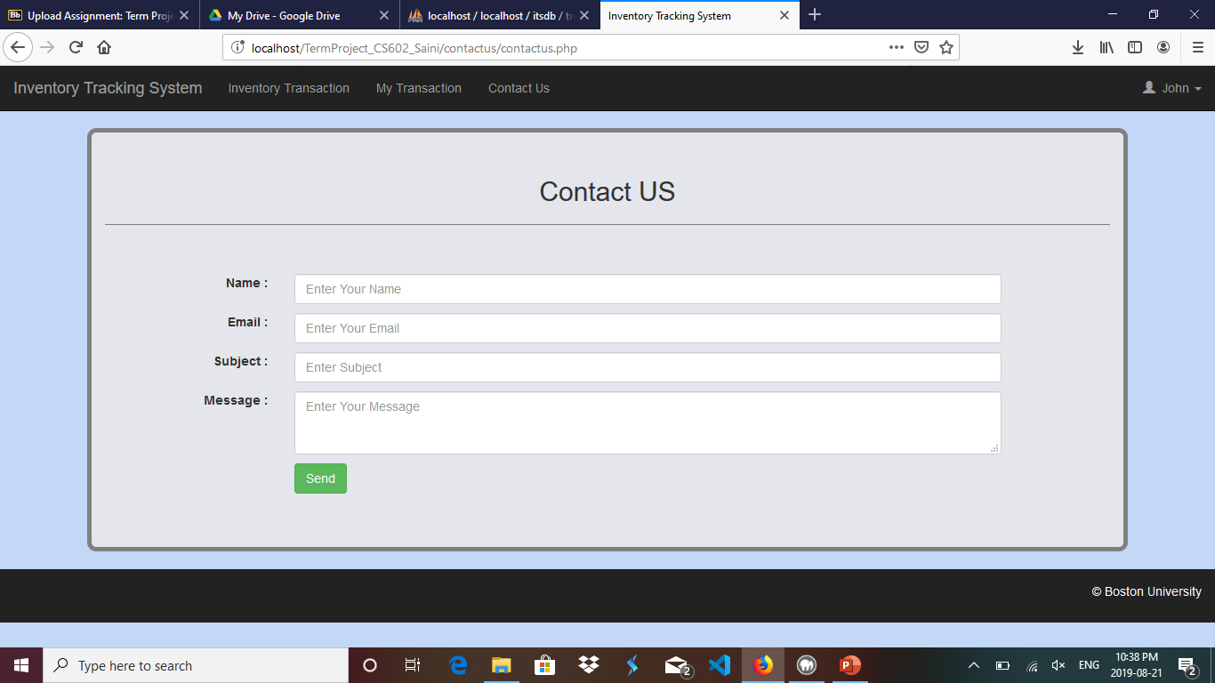
User
Link :- Contact Us
Contact US

Slide 38
Contact US - User
User can have the option to send message to the administrator anytime from contact us form. The send message is viewed under contact us section at the admin- end.

Slide 39
Sign Out- User
By clicking on sign out button, user can successfully log out from his/her session.

Slide 40
REST API
REST API for user login, user inventory, all parts and search parts are developed in both xml and json format.
Validations where ever necessary are also implemented in API’s such as variables in GET method must not be empty, email and password check while log in, etc.

Slide 41
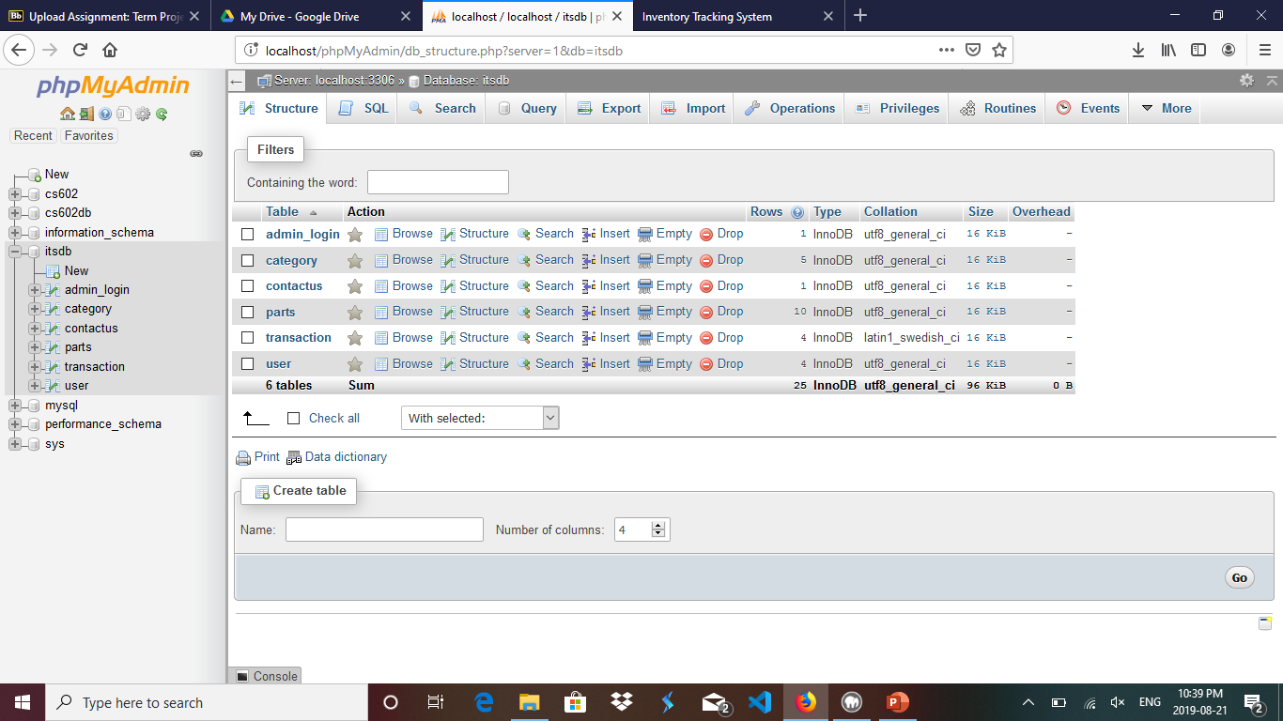
Database
Screen shot

Slide 42
References
https://stackoverflow.com/
https://www.w3schools.com/
https://www.php.net/manual/en/intro-whatis.php
https://www.google.com/
https://www.php.net/manual/en/intro-whatis.php

Slide 43
Thank You
Suresh Kalathur
Fazil Harroon

