Slide 1
MET CS-701 Rich Internet Application Development
Resume Builder
Term Project
Submission Date :- May 02, 2019
Submitted On :-?????????????
Developed By
Balramjot Saini

Slide 2
Technologies Used
  AngularJS
  HTML5
  JavaScript
  CSS
  AngularJS Server Interaction
  JQuery
  Geolocation

Slide 3
Project Overview
Build resume with built in templates.
Just add the required information and you are good to go.
Apply different types of jobs.

Slide 4
Who is our audience?
People of the professional world looking for a job.
Students from colleges.

Slide 5
Need of Resume Builder
Developing a resume is time consuming.
People want efficient and easiest way.
Innovative way required to reflect entire resume information.
Design and presentation of resume can make difference.

Slide 6
Facts about the recruitment process
On average, each professional job offer attracts 250 resumes. Of those candidates, 4 to 6 will get called for an interview, and only one will get the job.
Recruiters take an average of 6 seconds to scan a resume.

Slide 7
How resume builder be helpful ?
No need for the user to think about the design of their resume.
Easy to understand user interface.
Resume can be built in no time.
Full representation of the effective information.
Attractive design catch the attention of the recruiter.
Increases job offer chances.

Slide 8
The Architecture of the Project
What are the major parts of the system?
What does each part do?

Slide 9
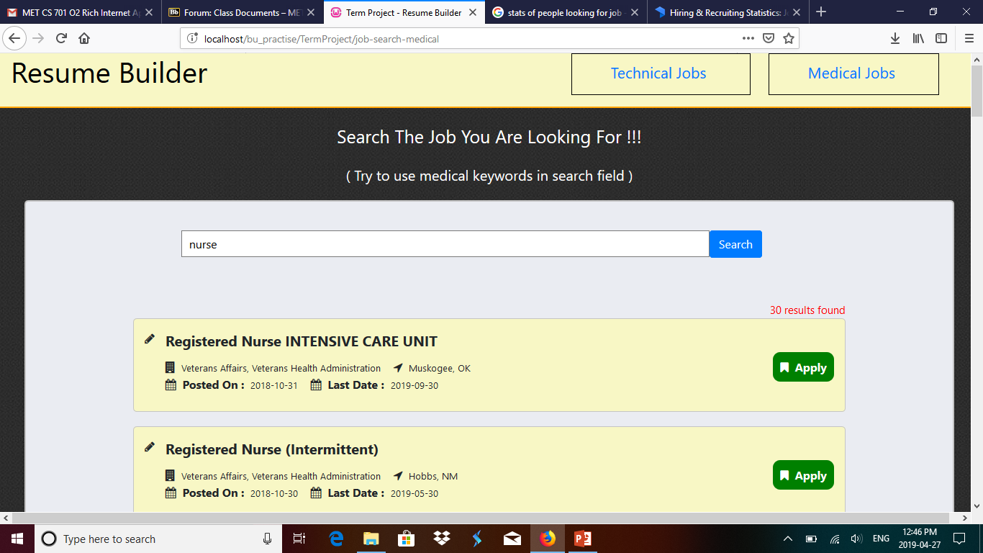
Resume Builder– Working
  Layout 1 – Homepage
  Layout 2 – Info fill up form
  Layout 3 – Info display section
  Layout 4 – Search for jobs

Slide 10
Layout 1 – Homepage
Navigation Page for the Project.
Way to other layouts.

Slide 11
Layout 2 – Information fill up form
Fill all the required information.
Add multiple records such as education, experience with just one click.
Click on save to save your changes and to load your form from the same place where left.
Any time click on new button will open up fresh form.

Slide 12
Layout 3 – Information display section
View your work done in this section.
Graphical representation of data.
Address shown on map.
Option to save your work as image.
Will try to implement save as pdf also if get enough time.

Slide 13
Layout 4 – Search for jobs
Search for jobs and apply for jobs from this layout.
Search with any keyword in the text field and then press search button to get result.
Option to search depending upon location also.

Slide 14
Future additional enhancements
  Different built in templates designs to create resume.
  Option to customize any template.
  Importing template from internet.
  Share resume on recruiting websites within this project.
  Future version as mobile application with ionic framework.

Slide 15
References
https://stackoverflow.com/
https://www.w3schools.com/
https://angularjs.org/
https://www.google.com/
https://zety.com/blog/hr-statistics

Slide 16
Thank You
Suresh Kalathur
Christian Carducci

