Slide 1
MET CS-701 Rich Internet Application Development
Resume Builder
Term Project
Submission Date :- May 02, 2019
Submitted On :-May 02, 2019
Developed By
Balramjot Saini

Slide 2
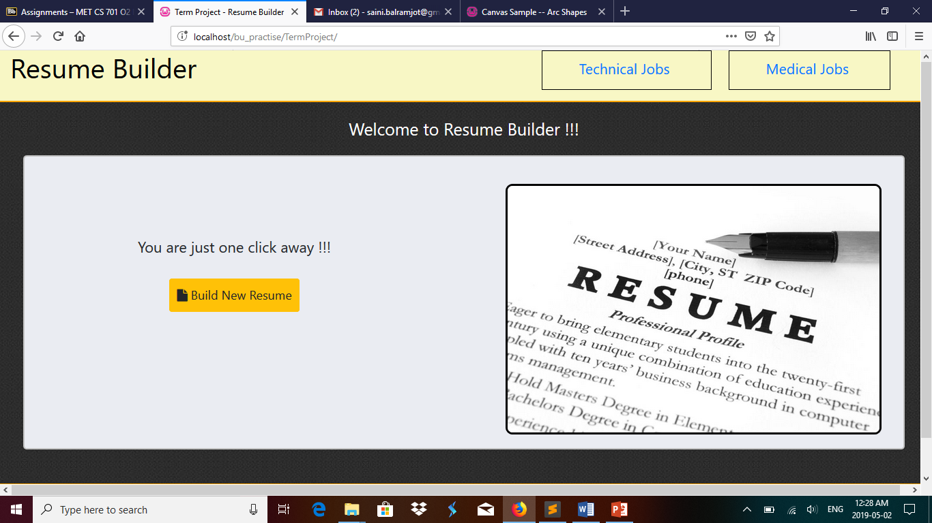
Working Demo
Home Screen

Slide 3
Home Page
For new user i.e. nothing is stored in local storage then ‘Build New Resume’ button is there.
For already existing user i.e. saved data in local storage ‘Continue with existing resume’ button is there.
Technical jobs linked to web page for showing and searching technical jobs.
Medical jobs linked to web page for showing and searching medical jobs.

Slide 4
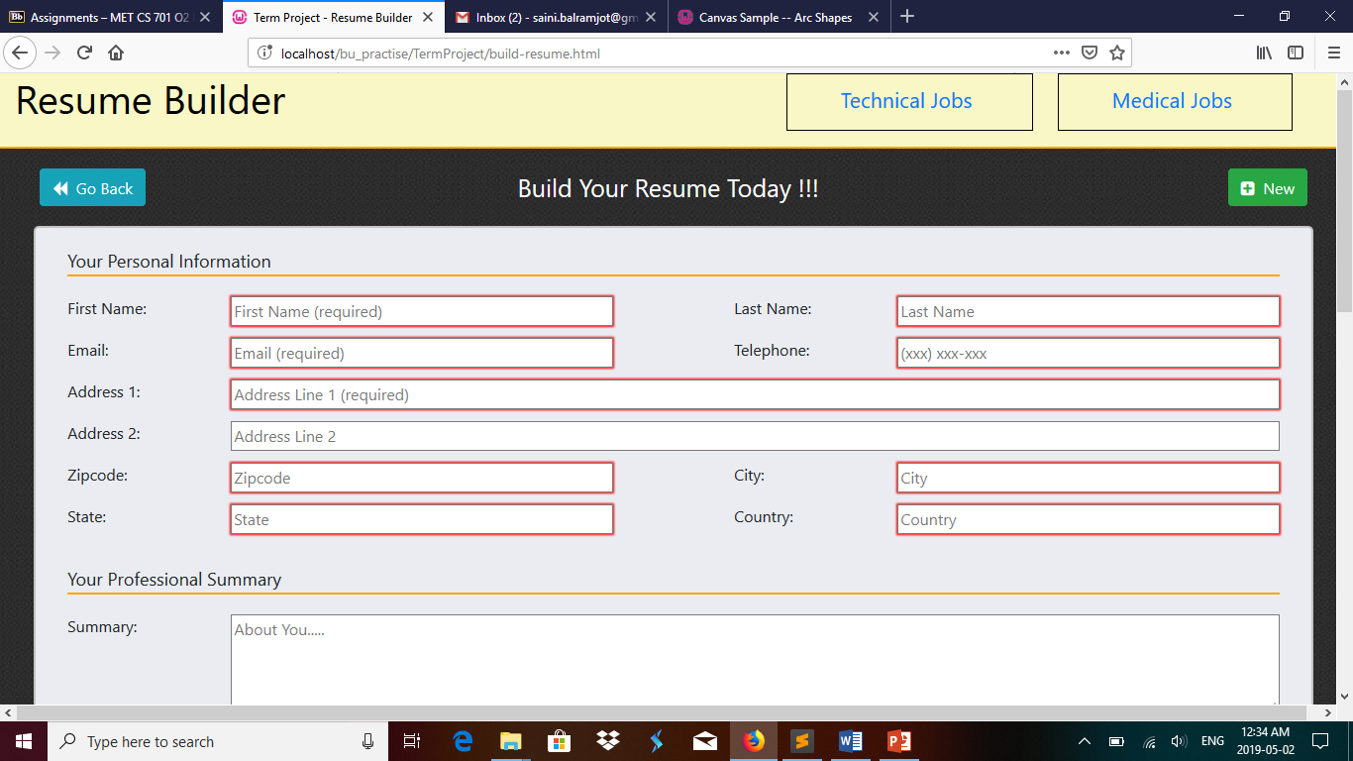
Working Demo
Build Resume

Slide 5
Build Resume
This page allows the user to build a resume from scratch or to continue with already existing resume in the local storage.
‘Go Back’ button navigate the user to the previous page.
‘New’ button shows a confirmation message and after confirming that message local storage is cleared and fresh empty fields are shown.
A simple form with ‘add column’ buttons is there.
After finishing up his/her work, user need to click on ‘Save’ button before leaving the page.
Clicking on ‘Discard’ button any time will redirect the user to the homepage after clearing local storage values.

Slide 6
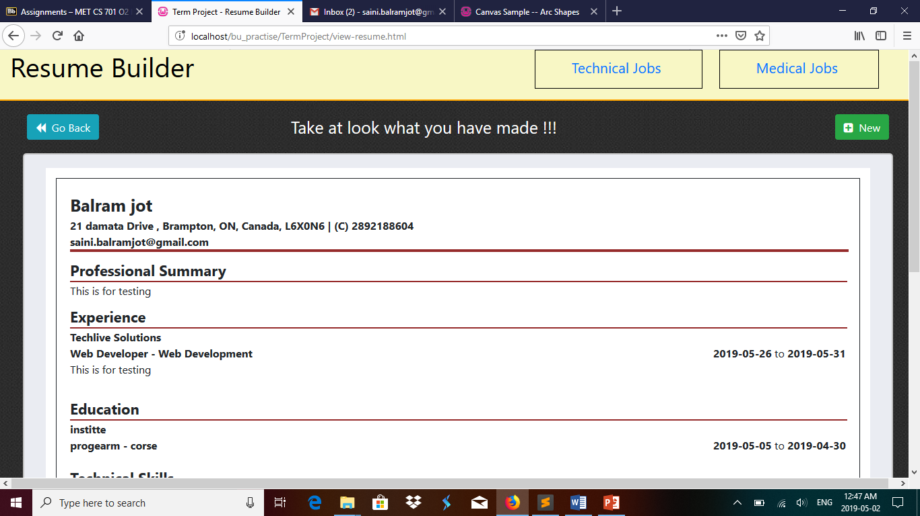
Working Demo
View Resume

Slide 7
View Resume
User can have the option to view his/her work on this page.
‘New’ and ‘Go Back’ buttons possess the same functionality as discussed earlier in build resume.
All the information filled out from the previous screen are shown on this page along with donut chart representation of the individual skills.
‘Discard’ also have the same function here as in build resume.
Clicking on ‘Save as Pdf’ button allows the user to save his/her work as a pdf file for any type of future use.

Slide 8
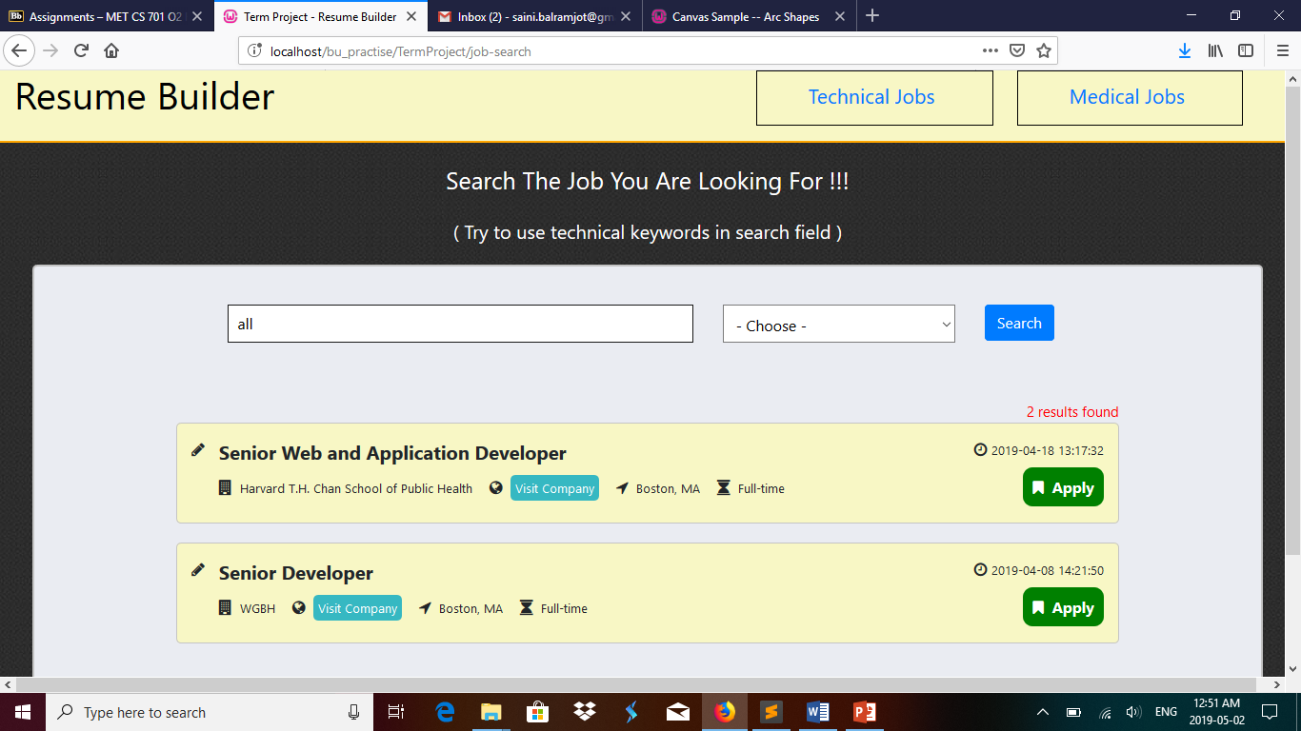
Working Demo
Technical Jobs

Slide 9
Technical Jobs
User can search for technical jobs after typing some keywords or after selecting location from the fields.
All the searched jobs are displayed in list.
Apply button will redirect the user to the job.
List includes name of the job, company location, company name, job type, posted date.
Two different api’s are used that’s why two pages i.e. technical jobs and medical jobs are there.

Slide 10
References
https://stackoverflow.com/
https://www.w3schools.com/
https://angularjs.org/
https://www.google.com/
https://zety.com/blog/hr-statistics

Slide 11
Thank You
Suresh Kalathur
Christian Carducci

