Slide 1

Telecom Customer Churn Prediction
By Balram Shah
Advanced Data Science Project | Predictive Analytics & Business Intelligence
Notes:
Introduce project & value

Slide 2
Project Overview
- Business Problem: Customer churn impacts revenue
- Goal: Identify customers at risk of leaving
- Solution: Machine Learning classification model
Notes:
Explain intent & business need

Slide 3
Dataset Summary
- Telecom customer usage & billing data
- Target: Churn (Yes/No)
- Records include: tenure, charges, services, contract type
Notes:
Describe dataset

Slide 4
EDA Key Findings
- Short-tenure clients churn more
- Month-to-month contracts show highest churn
- Higher monthly charges linked to churn
- Lack of tech support increases churn
Notes:
Share top insights

Slide 5
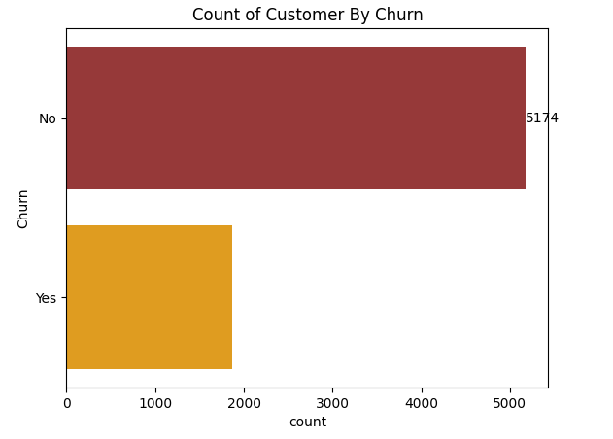
Churn by Contract Type
Notes:
Monthly contract users churn most

Slide 6
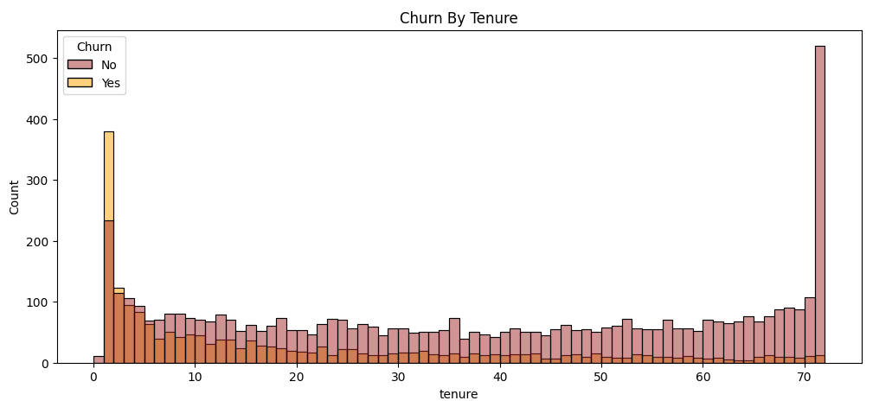
Churn vs Tenure
Notes:
Churn drops as tenure increases

Slide 7
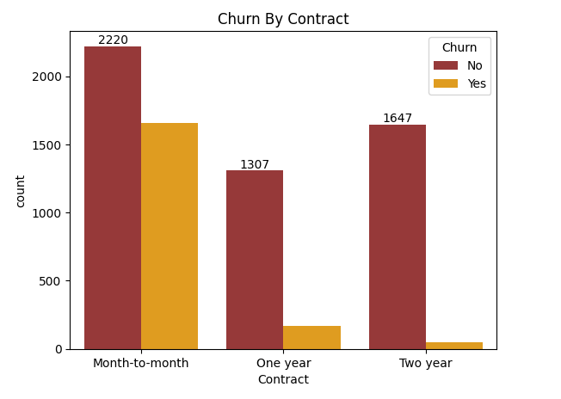
Churn by Contract Type

Slide 8
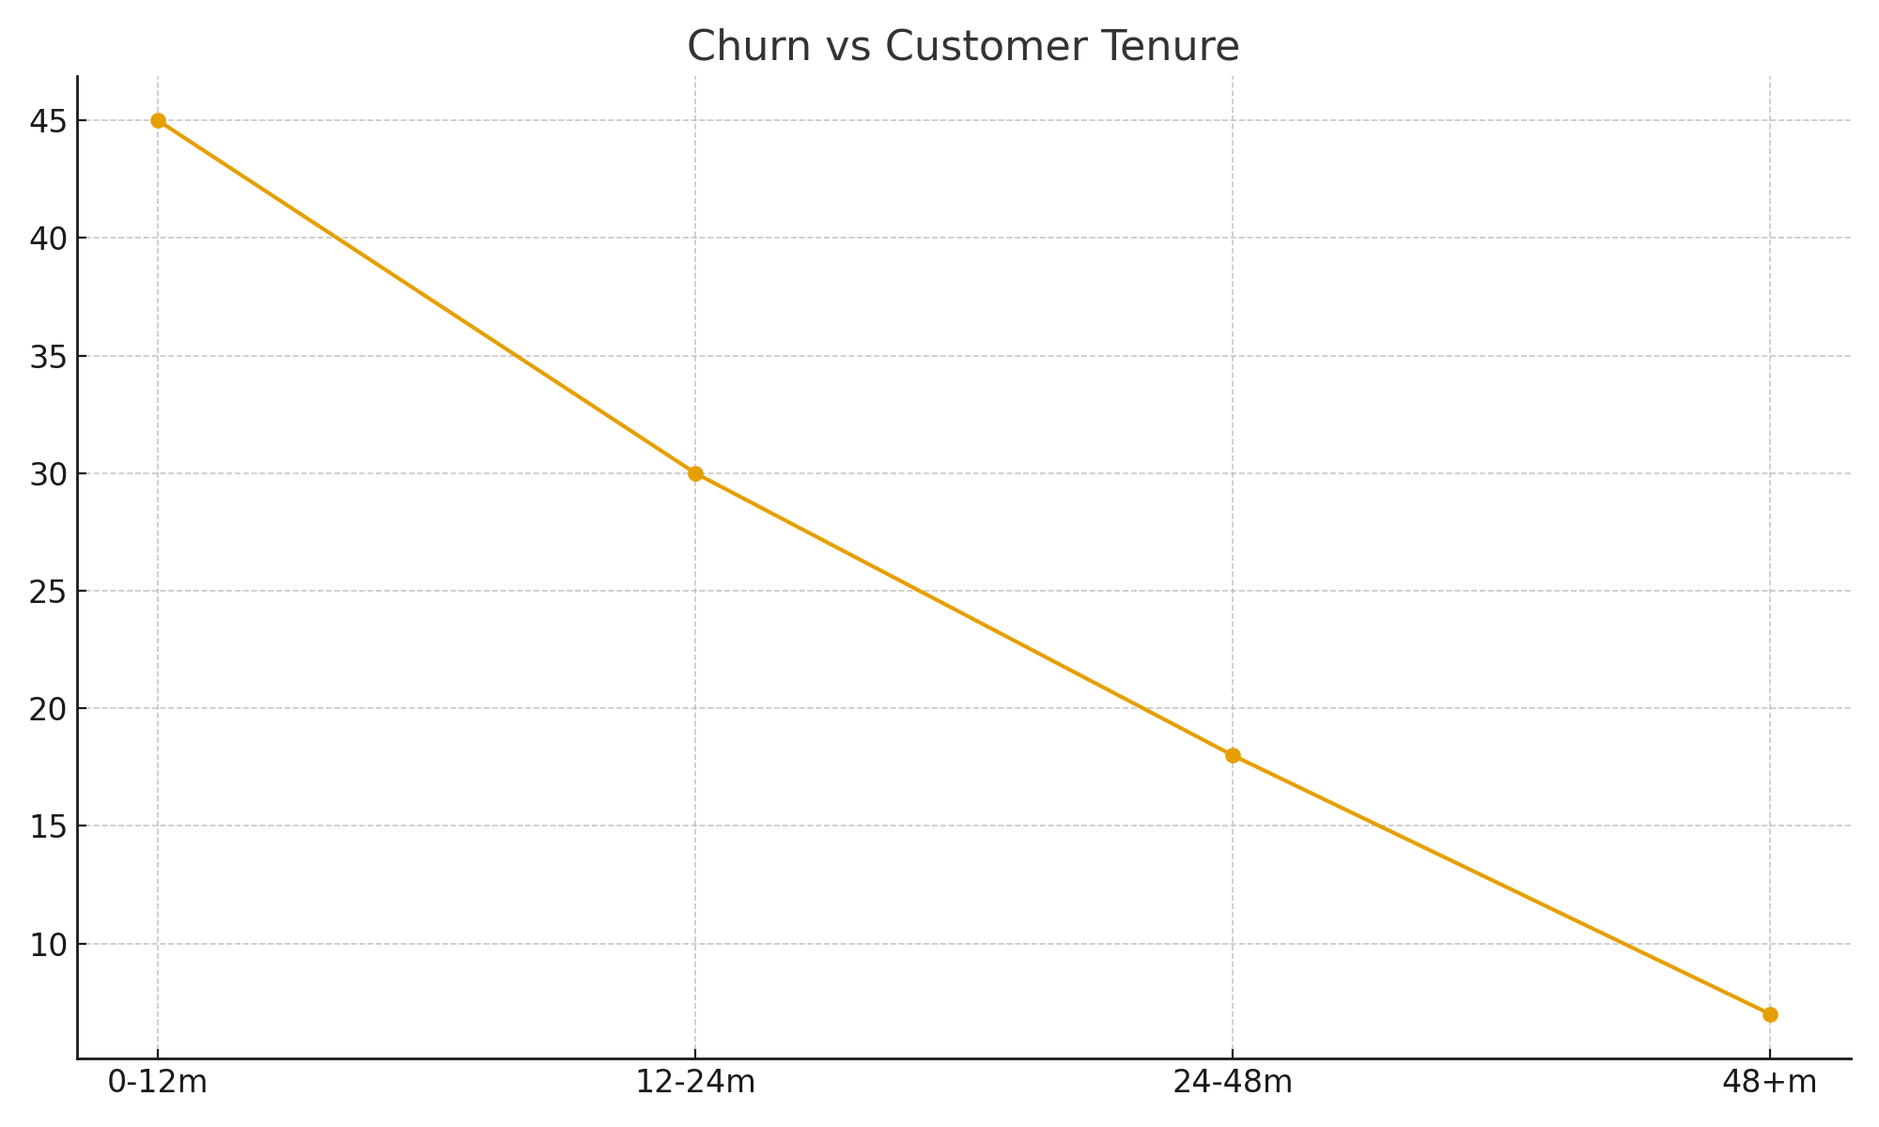
Churn vs Tenure

Slide 9
ML Model & Evaluation
- Models tested: Logistic Regression, Random Forest
- Selected: Random Forest (best accuracy)
- Accuracy: ~80-85% | ROC-AUC: ~0.85
Notes:
Explain model selection

Slide 10
Business Impact
- Identify at‑risk customers early
- Personalized retention offers
- Better customer experience = lower churn
Notes:
Impact benefits

Slide 11
Conclusion
- Robust ML pipeline
- Strong predictive performance
- Future: Live dashboard, deployment, CRM integration
Notes:
End & call to engage

Slide 12
Balram Shah
Data Science and Data Analyst Enthusiast
GitHub Link : balramshah01 (Balram Shah)
Linkedin Link : www.linkedin.com/in/balram-shah-7453b2346

