Slide 1
Back-End-Engineering Project
Job Portal
Team Details:
Asmita Sharma(2310990307)
Balreet Singh (2310990310)
Bhavisha Ahuja (2310990312)
Dhruv Kumar (2310990325)
Trainer’s Name : Mr. Rahul.
:
Chitkara University Institute of Engineering and Technology,
Chitkara University, Punjab

Slide 2
Table of Contents
Introduction
Problem Statement
Technical Details
Key Features
Project Highlights
Thank You

Slide 3
Introduction
Developed a Job-Portal application using React for frontend, Node.js &Express for backend, and MongoDB as the database.
Provides role-based access, allowing users to log in either as a Job Seeker or an Employer.
Landing page offers simple navigation to choose the appropriate role.
Employers can manage job postings and track applicants through a
dedicated dashboard.
Users can explore job listings, build resumes, practice assessments,
and apply for positions.
All user and job-related data is securely stored in MongoDB.
Designed with a user-friendly and responsive interface for seamless navigation.

Slide 4
Problem Statement
Job seekers often face difficulty finding relevant job opportunities in one centralized platform.
Employers struggle to reach the right candidates efficiently and manage applications.
Lack of structured resume-building tools and interview preparation resources for users.
Role-based interaction between job seekers and employers is often unclear or inefficient. Difficulty in tracking applications and managing applicant data for employers.
Existing platforms may have complex or non-intuitive interfaces, making navigation harder.
Need for a scalable, secure, and user-friendly system that connects job seekers with employers effectively.

Slide 5
Technical Details
Frontend:
Built using React.js for a responsive and dynamic user interface.
Implements role-based dashboards for Users and Employers.
Uses React Router for smooth navigation between pages.
Backend:
Developed with Node.js and Express.js for handling server-side logic.
Provides APIs for user authentication, job management, and application tracking.
Implements middleware for request validation and security.
Database:
MongoDB used to store user profiles, job postings, applications, and notifications.
Ensures secure and efficient data retrieval and storage.
Development Tools & Environment:
VS Code for coding, Postman for API testing, Node Package Manager (npm) for dependency management.

Slide 6
Key Features
Role-Based Access: Separate dashboards for Users and Employers.
Job Management: Employers can post jobs, manage applicants, and track applications.
Job Applications: Users can view jobs, apply, and get notifications on application status.
Resume Builder: Users can create standard-format resumes within the platform.
Interview Preparation: Users can practice assessments in subjects like DSA, aptitude, etc.
Secure Data Storage: All profiles, jobs, and applications are stored in MongoDB.
User-Friendly Interface: Clean, responsive, and intuitive navigation for both roles.
Scalable Architecture: Designed to handle multiple users and employers simultaneously.
Interactive Dashboard: Quick access to key actions and updates for both roles.

Slide 7
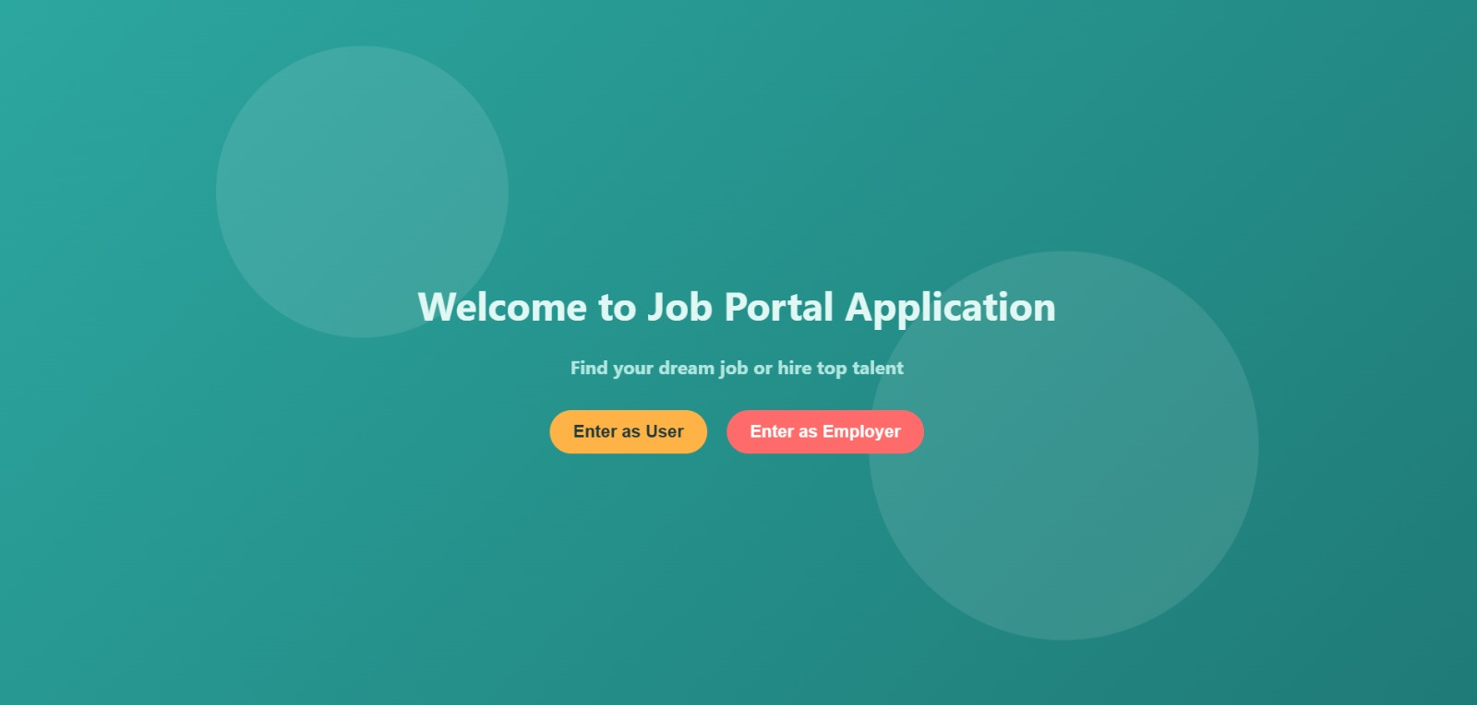
Project Highlights
The Landing Page greets with a welcome statement and offers 2 options for proceeding as user or employer and takes to respective dashboards

Slide 8
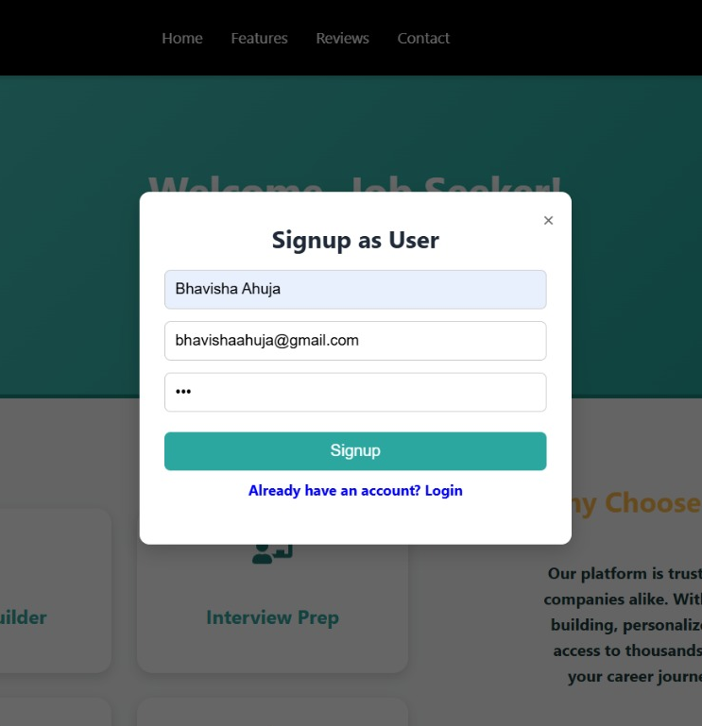
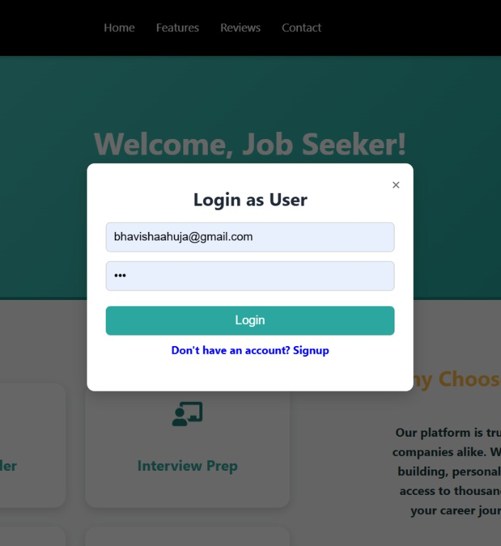
Project Highlights
Registering and Logging in as User, the same functionality is for employer

Slide 9
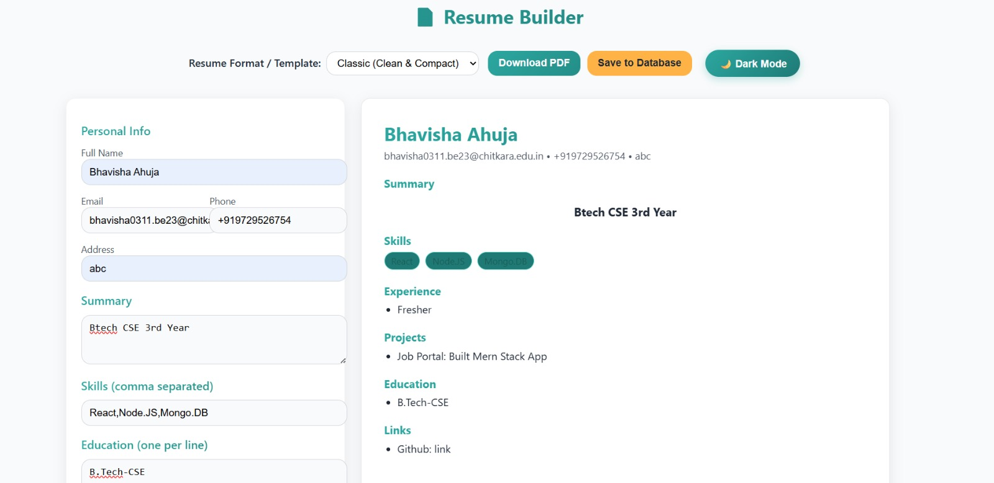
Project Highlights
The Resume Builder Functionality offers a user to enter his/her details and in returns provides a standard template resume

Slide 10
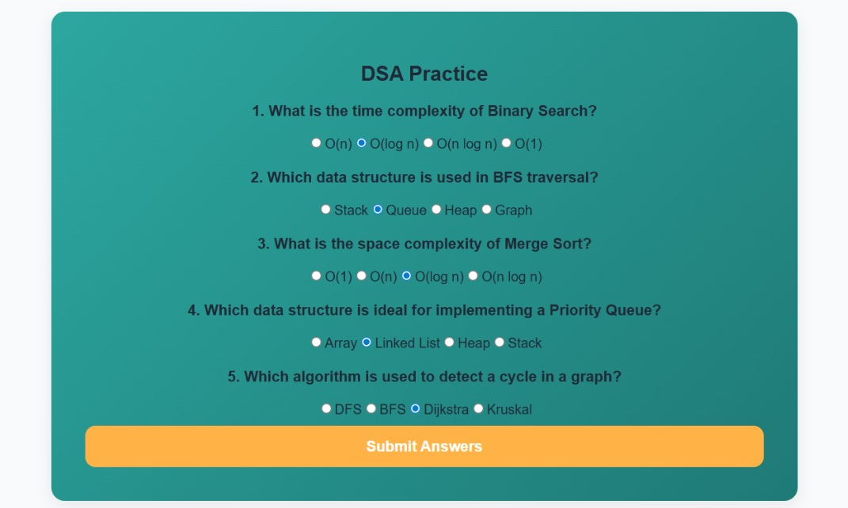
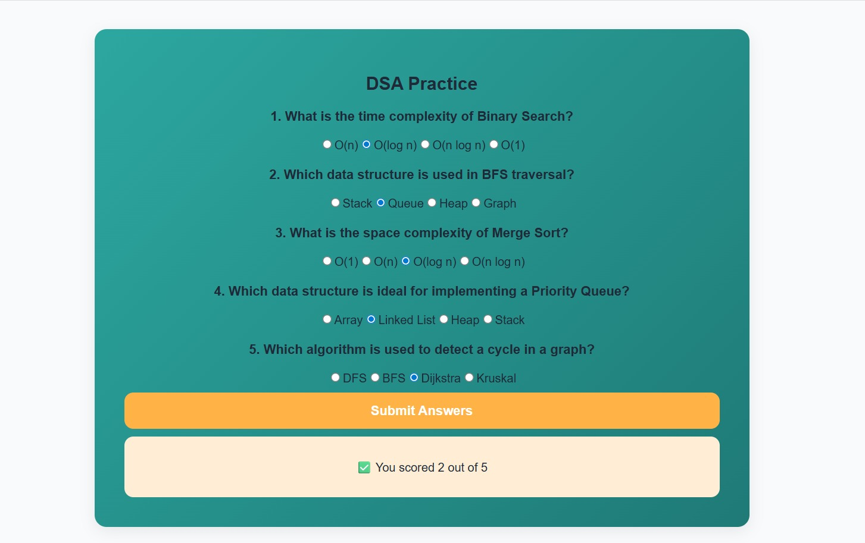
Project Highlights
Users can practice and give mocks by selecting the subject and can see their results of their respective performance

Slide 11
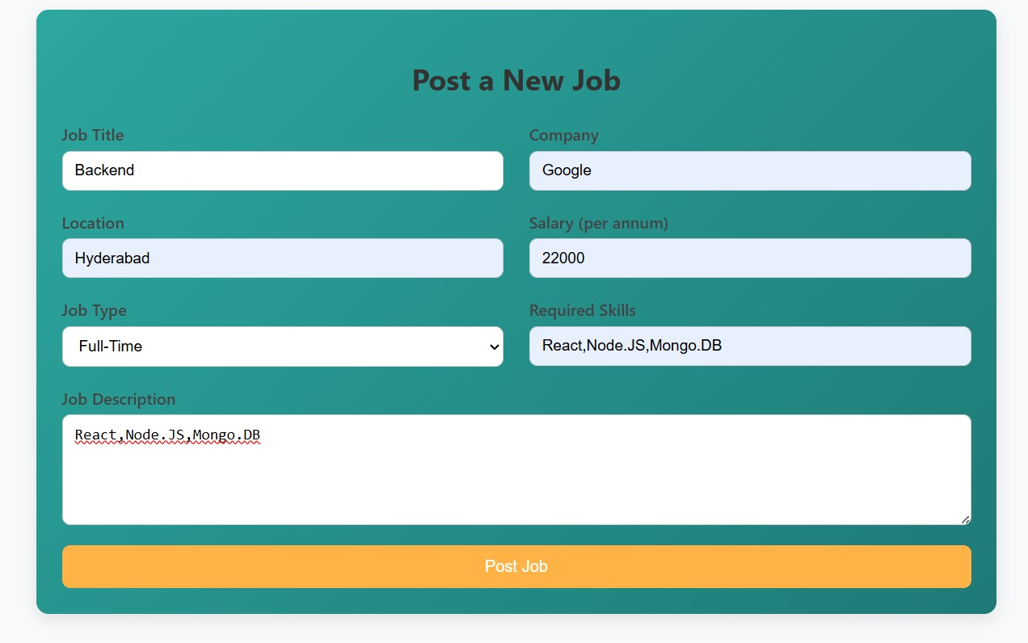
Project Highlights
Employer can post a job and it then can be viewed from user’s interface

Slide 12
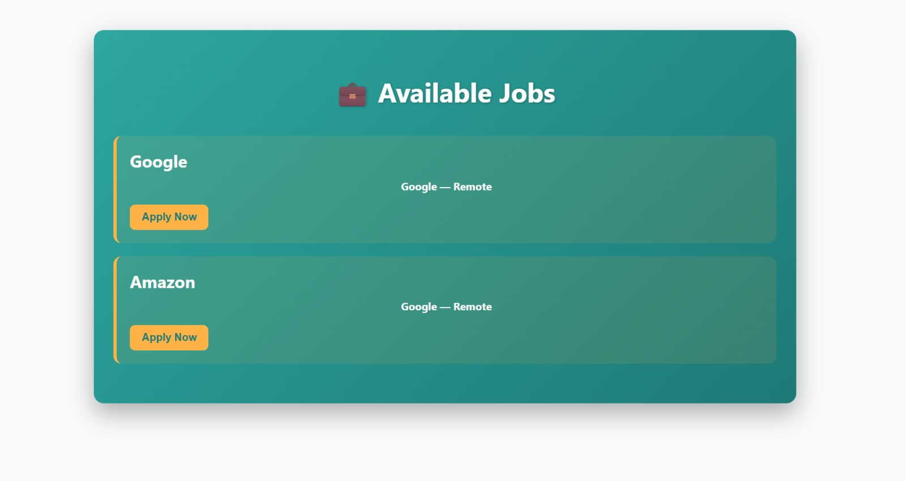
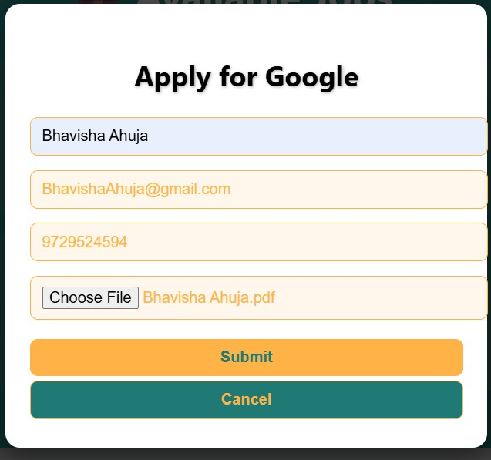
Project Hightlights
Users can access and view the listed jobs that are posted by employer and can apply for the job by filling the required details

Slide 13
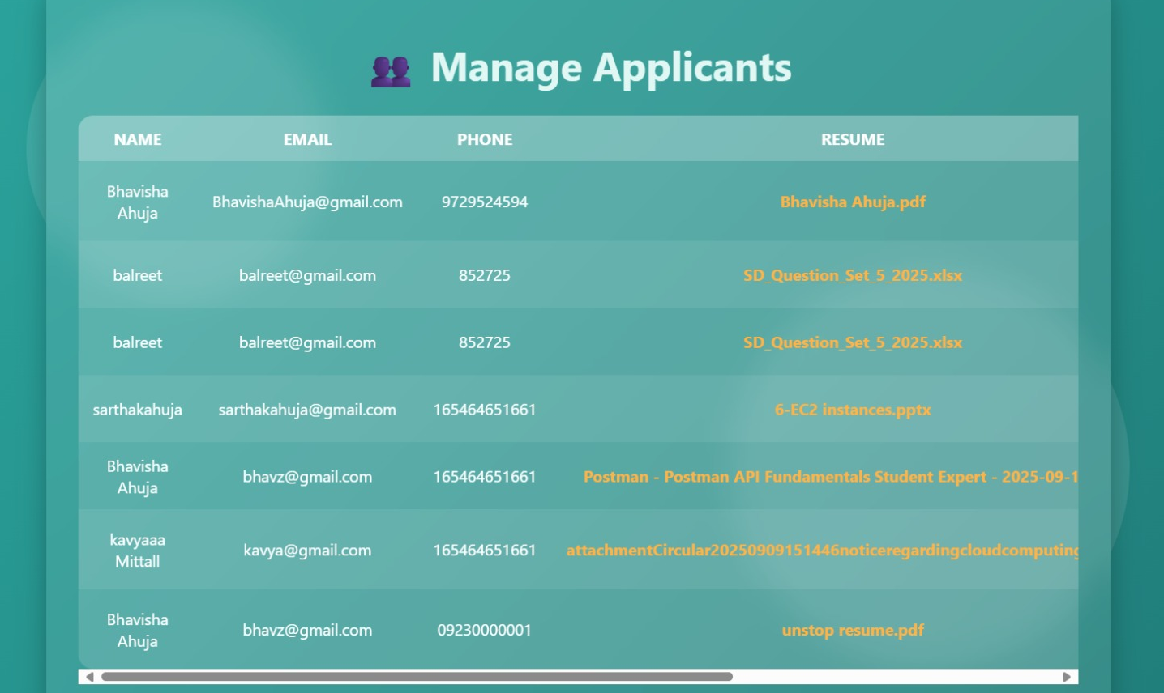
Project Highlights
Employer can manage all the applicants those requested for the job and accept or reject their requests accordingly

Slide 14
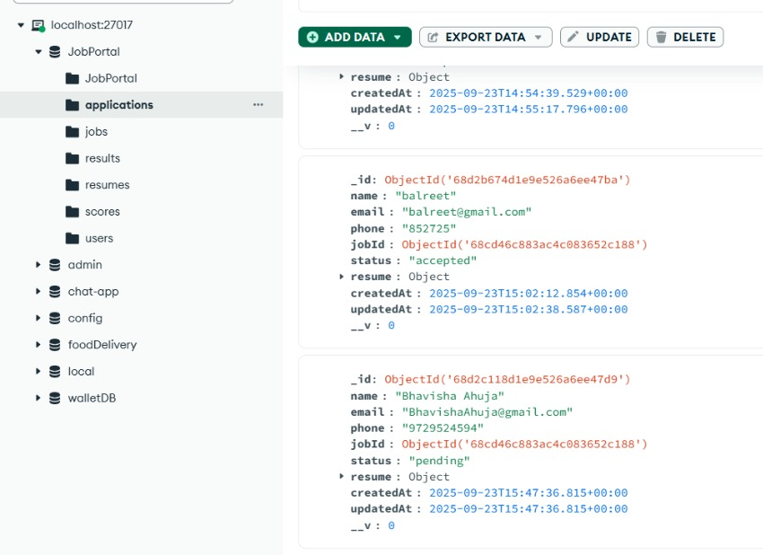
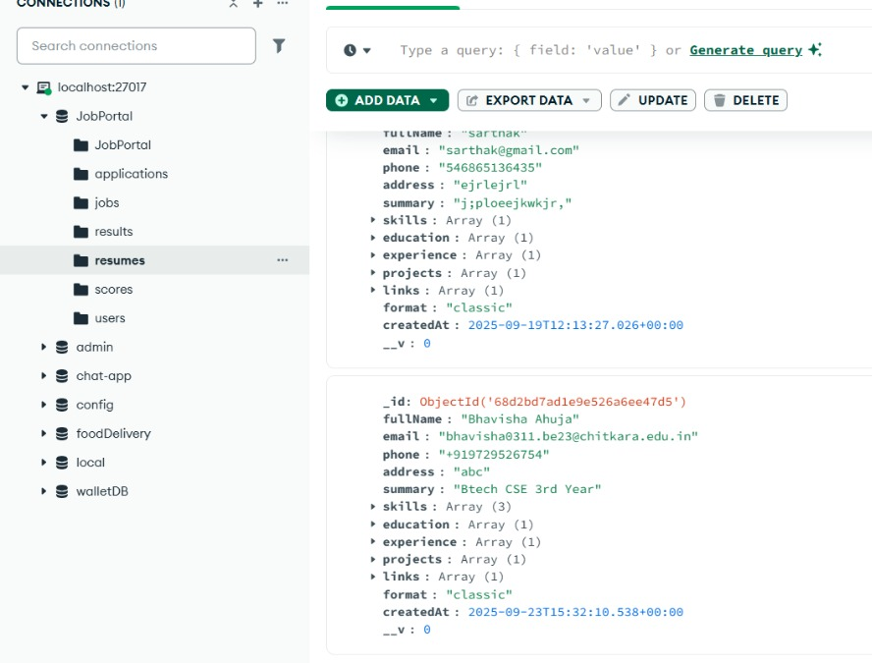
Project Highlights
Mongo Data Base snippets from both user and employer interface signifying the storage of the user/employer details, jobs, applications and resumes

Slide 15


