Slide 1

FullStack-Engineering Project
Job Portal
Team Details:
Asmita Sharma(2310990307)
Balreet Singh (2310990310)
Bharat Choudhary (2310990311)
Dhruv Kumar (2310990325)
Trainer’s Name : Mr. Shubham.
Chitkara University Institute of Engineering and Technology, Punjab

Slide 2
Table of Contents
Introduction
Problem Statement
Technical Details
Key Features
Project Highlights
Thank You

Slide 3
Introduction
Developed a full-stack Job-Portal using React, Node.js, Express, and MongoDB.
Implemented secure role-based access for Job Seekers and Employers.
Designed an intuitive landing page for seamless role selection.
Enabled Employers to manage job postings and track applicants through a dedicated dashboard.
Added resume building, job applications, assessments, real-time notifications, and analytics for enhanced user experience.

Slide 4
Problem Statement
Employers find it difficult to reach the right candidates efficiently and manage incoming applications.
Users lack structured tools for resume building, assessments, and interview preparation.
Role-based interaction between job seekers and employers is often unclear, making application tracking and applicant management challenging.
Many existing platforms have complex interfaces, limited notifications, and no analytics, creating the need for a scalable, secure, and user-friendly system with improved insights.
Job seekers struggle to find relevant job opportunities in one centralized and organized platform.

Slide 5
Technical Details
Frontend:
Built using React.js for a responsive and dynamic user interface.
Implements role-based dashboards for Users and Employers.
Uses React Router for smooth navigation between pages.
Backend:
Developed with Node.js and Express.js for handling server-side logic.
Provides APIs for user authentication, job management, and application tracking.
Implements middleware for request validation and security.
Database:
MongoDB used to store user profiles, job postings, applications, and notifications.
Ensures secure and efficient data retrieval and storage.
Development Tools & Environment:
VS Code for coding, Postman for API testing, Node Package Manager (npm) for dependency management.

Slide 6
Key Features
Job Management: Employers can post jobs, manage applicants, and track application progress.
Job Applications: Users can view job listings, apply easily, and receive real-time notifications on application status.
Resume Builder: Users can create and download standard-format resumes within the platform.
Interview Preparation: Built-in assessments like DSA, aptitude, and coding practice.
Secure Data Storage: All profiles, job posts, and applications are securely stored in MongoDB.
User-Friendly Interface: Clean, responsive, and intuitive design for smooth navigation.
Scalable Architecture: Capable of supporting multiple employers and job seekers simultaneously.
Interactive Dashboard: Provides quick access to all key actions, updates, and role-specific features.
Notifications System: Sends alerts for job status changes, new postings, employer responses, and important updates.
Role-Based Access: Separate dashboards for Users and Employers.
Analytics Module: Offers insights on job performance, application trends, user engagement, and dashboard metrics.

Slide 7
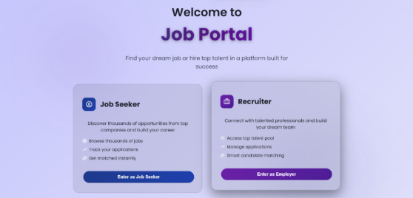
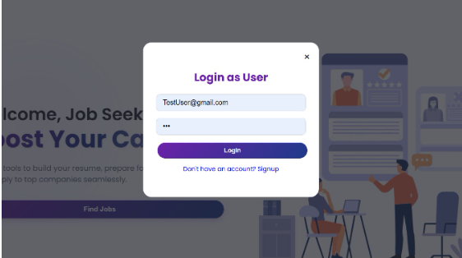
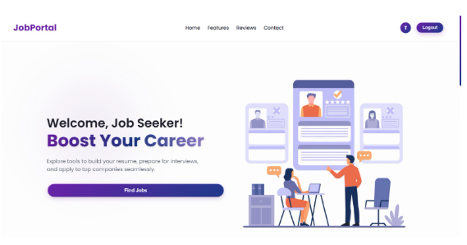
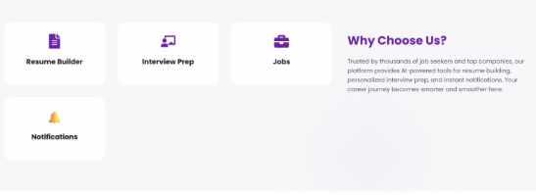
Job – Seeker Side Dashboard

Slide 8
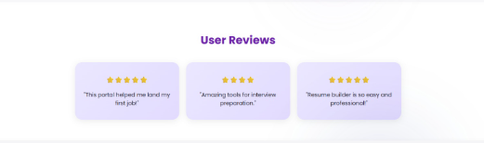
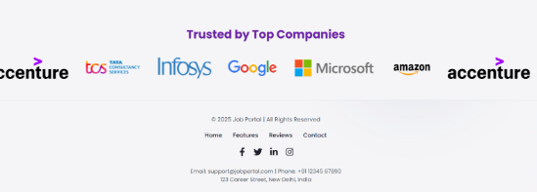
Reviews and Footer Section

Slide 9
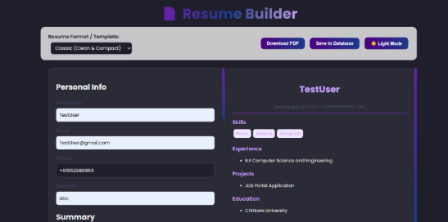
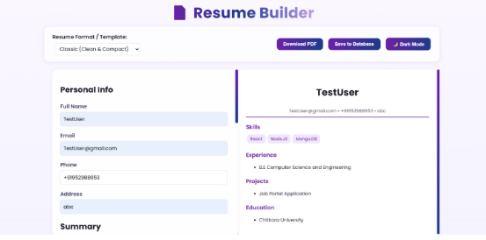
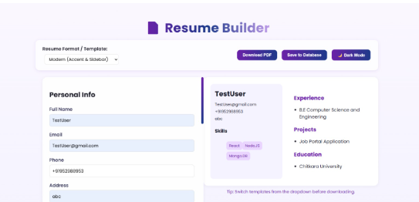
Resume Builder

Slide 10
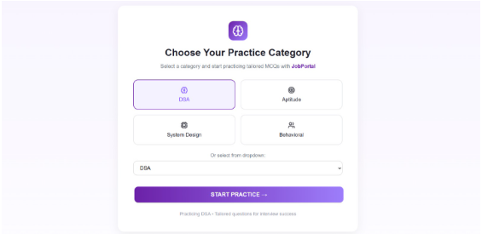
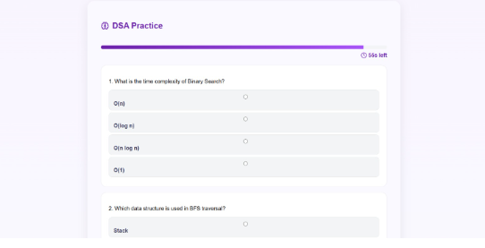
Interview Practice

Slide 11
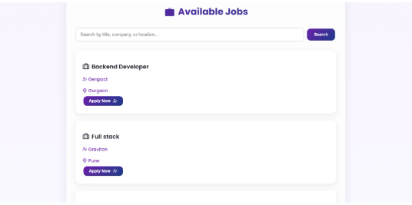
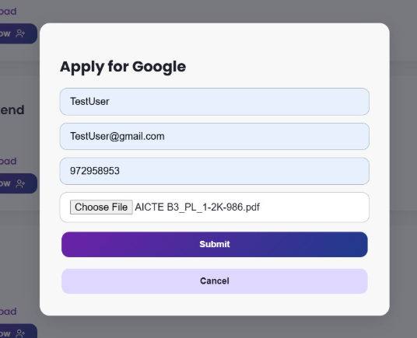
Apply for Job

Slide 12
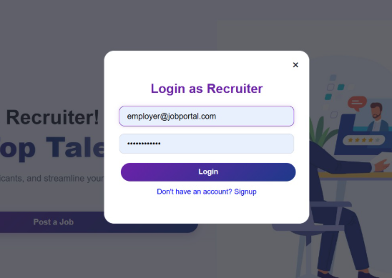
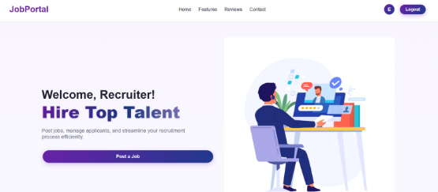
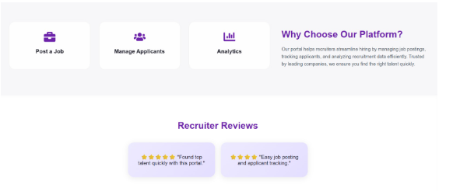
Employer Dashboard

Slide 13
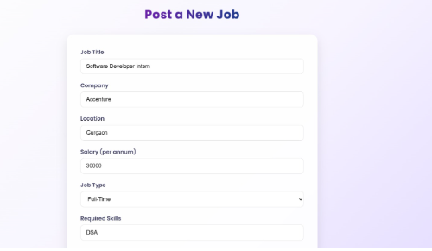
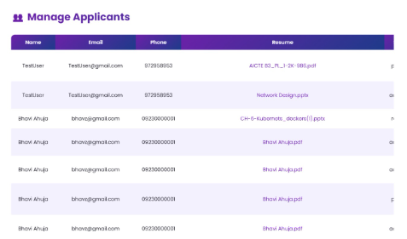
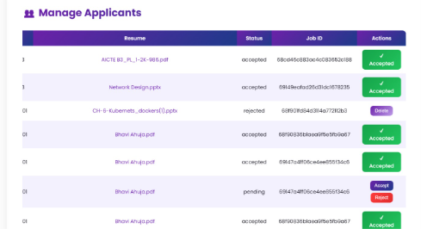
Post Job & Manage Applicants

Slide 14
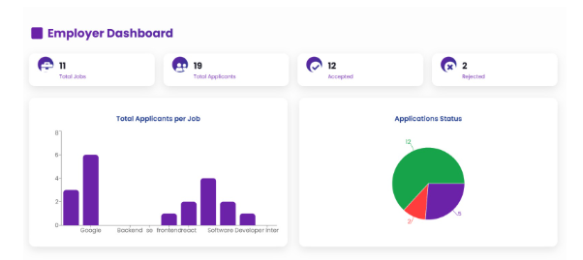
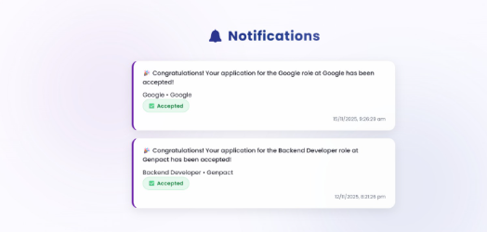
Analytics & Notifications

Slide 15
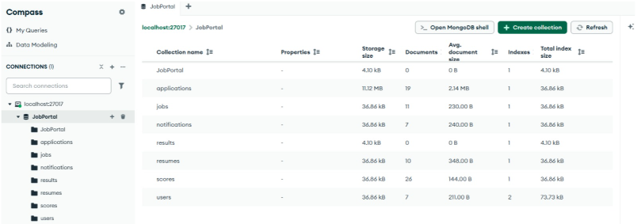
MongoDB Storage Collection

Slide 16

Thank You

